Slide 1
WineRy
An App for the Wine Enthusiast Stephanie, Margherita,
Anders, Johnathan

Slide 2
What is WineRy?
An app that allows you to select the best wine for your party!
Decide what’s more important for you: Ratings?, Price?, APK?
Are you interested in purchasing your bottle based on the Country of origin?
Are you looking for a particular Variety of wine?
WineRy will help you with that and much more!

Slide 3
Dataset - Our sources
Wine ratings and descriptions were extracted from tidytuesday repo
Details on prices and availibility were available at System Bolaget and Vinmonopolet APIs.
str(vino[,4:8])
## Classes 'tbl_df', 'tbl' and 'data.frame': 1000 obs. of 5 variables: ## $ country : chr "Italy" "Argentina" "USA" "Spain" ... ## $ points : num 87 84 86 97 87 88 87 85 89 86 ... ## $ price : num 14 11 12 180 17 15 27 12 40 38 ...

Slide 4
Cleaning and merging data
Bullet
Bullet

Slide 5
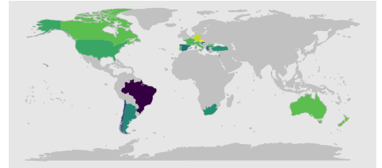
Plotting on map
The map plot will inform you on
The number, average price of wines produced per country,
The of wine produced in each country
The average score assigned for wines from each country
The plot was realised using:
library(ggplot2), library(ggmap), library(maps)

Slide 6
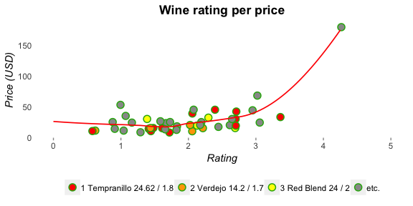
Wine Overview
WineRy plots different variables in the interactive scatterplot to aid selection of wines that meet your requirements.
Select for:
Rating
Price
APK

Slide 7
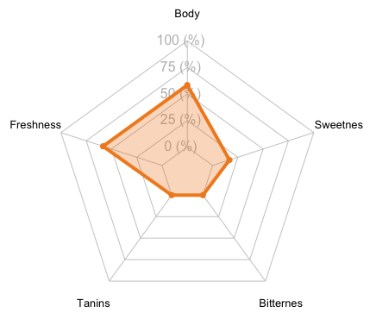
Details for your favourite wine
Select and learn more about your favourite wine
Your Favorite Wine
Title | Dom. du Chardonnay Petit Chablis 2017
Year | Chablis
Region | 2017
NOK (NAPK) | 169.9 (0.053)
SEK (SAPK) | 159 (0.059)
Description | This shows more texture than fruit, but it has weight and richness that will come forward in the next two years. Its clean apple fruit is likely to be the dominant factor.

Slide 8
Cheers!

