Slide 1
Portable Grocery Shop
Web Based Application
COURSE CODE : CSE 482
SUBMITTED TO : Shamim Al Mamun

Slide 2
GROUP MEMBERS
Name: ID :
1.Md.Marjan 1621396042
2.Shadman Rohan 1632535642
3.Sadaaf Chowdhury 1631415642
4.Jahidul Alam 1621558042
5.Md.Sayem Mahmud 1611231042

Slide 3
INTRODUCTION
Portable Grocery Shop (Web based Application) is based on a concept of making grocery orders . In this application the customer can login, select products, quantity and proceed towards confirm order. After confirming the order grocery provider will get a notification of order and he will start going to customers location with the grocery container(vehicle) . Payment method will be cash on delivery . This mini project contains limited features, but the essential ones.

Slide 4
PROBLEMS
-For buying grocery products we have to go to the shop .
-Kills time while ordering grocery products.
-Possibilities of faults when we ordering grocery products by phone call.
-Sometimes it takes too much time to serving grocery products.
- In this case Runa has two babies , she has no servant in her house.All of a sudden some of her close relatives called and said that they are coming at her place,she could not refuse them but she can not go the market to buy grocery products neither her watchman can go. She knows ,if she asks her cousin’s servant he will not do the job properly.

Slide 5
SOLUTION
We will develop an web based application for ordering grocery products.
Customer can choose grocery products from the provided list.
With grocery container salesman will come to customers location and it will provide the ordered products to the customer.
Payment method – cash on delivery.
Reduce paper work.
Improves Efficiency (This system will make things easier for staff as whole ordering process is done by the customer only)

Slide 6
USER JUSTIFICATION
The system will be designed to be user friendly and
interactive interfaces design help to achieve this by enabling customers to
easily browse through the menu and place orders with just a few clicks.
The system will be simple to use.

Slide 7
Features Details
User Registration : Both buyers and sellers can have the access after registration. For registration user must requires a unique valid mail and a password for individual segment both for buying and selling. A seller can also be a buyer.
Authentication :There will be few admins which can see the user’s personal information for verification . As firstly at initial stage system will allow them to be registered by a verified mail. Then After verification admin will allow them to be user permanently.
Customer Order :. Customer can see the available given products of all the nearest groceries before order. And customer can order all the ingredients once at a time only from a grocery.

Slide 8
Features Details
MapView of Seller’s Location : Customer can see the nearest grocery of him and with the timings of how much it will take to arrive to the buyers. Buyers can easily locate the seller’s location through Google map.
Admin Panel : Admins which can see the user’s personal information for verification . . Then After verification admin will allow them to be the user permanently.
MapView of Buyer’s Location : After finishing one order sellers can get another one’s request and can see the distance and location of the client through Google map and can accept request or not according to their wish .
Seller’s Inventory: Sellers can easily add or remove products from their inventory.

Slide 9
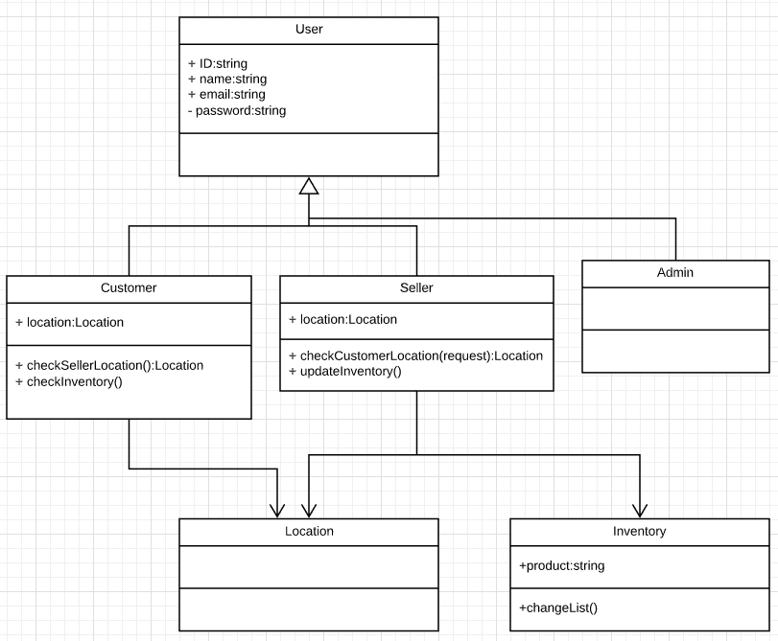
Class Diagram :

Slide 10
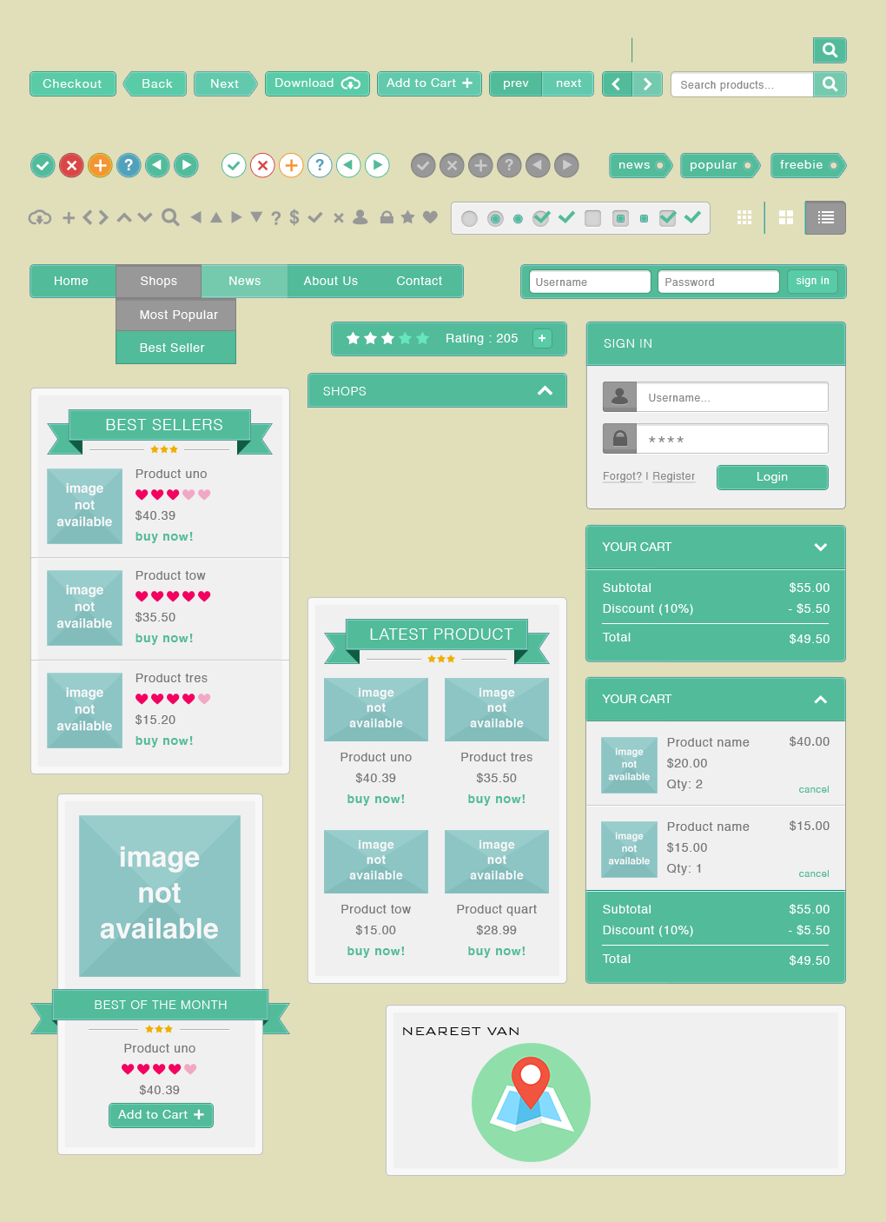
User Interface :

Slide 11
CONCLUSION
This was all about online grocery products ordering system. Everyone may know the
importance of this system in our day-to-day lives as we all prefer online
ordering over ordering on phone.

Slide 12

END OF PRESENTATION
THANK YOU

