Slide 1


Deep Dive Group 27: Visas
Alex Marzban, Bo Wang, Fang Li, Michal Juscinski

Slide 2

Slide 1: Introduction: Alex Marzban
Objective
Develop a deep learning model to predict U.S. work visa approval outcomes.
Can we use the PERM Disclosure Data for 2022 Q4 to predict visa outcomes?
Key Motivations
Streamline visa processing.
Inform policymakers, employers, and applicants about influential factors.
Features Used
Temporal: RECEIVED_DATE, DECISION_DATE, CASE_APPROVAL_LENGTH.
Geographic: EMPLOYER_STATE_PROVINCE, EMPLOYER_CITY, WORKSITE_STATE, WORKSITE_CITY.
Organizational: EMPLOYER_NUM_EMPLOYEES. Applicant: COUNTRY_OF_CITIZENSHIP.
Labels
Binary classification: 1 for "Certified" (approved), 0 for "Denied" (all other statuses).
COMPUTER SCIENCE
GRAINGER ENGINEERING

Slide 3
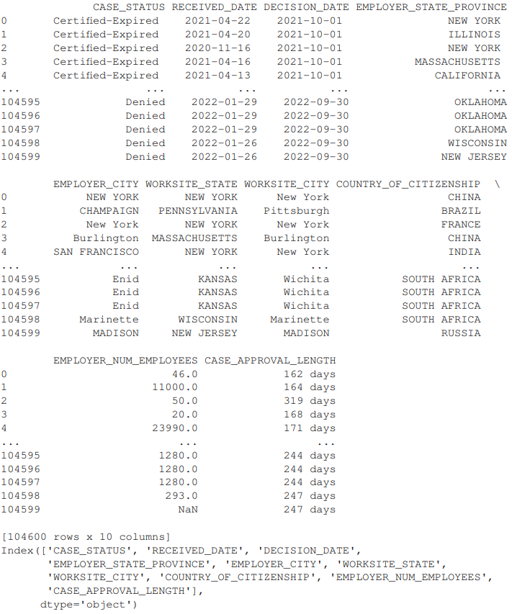
Slide 2: Feature Extraction: Fang Li
Feature Engineering
Converted dates to pandas timestamps for time delta calculations.
Standardized and encoded geographic locations.
Calculated CASE_APPROVAL_LENGTH as the number of days between RECEIVED_DATE and DECISION_DATE.
Data Processing
Handled missing values through dropping features with high levels of missing data.
Reduced dataset from 100+ features to 8 key predictors.
Sample Data
COMPUTER SCIENCE
GRAINGER ENGINEERING

Slide 4
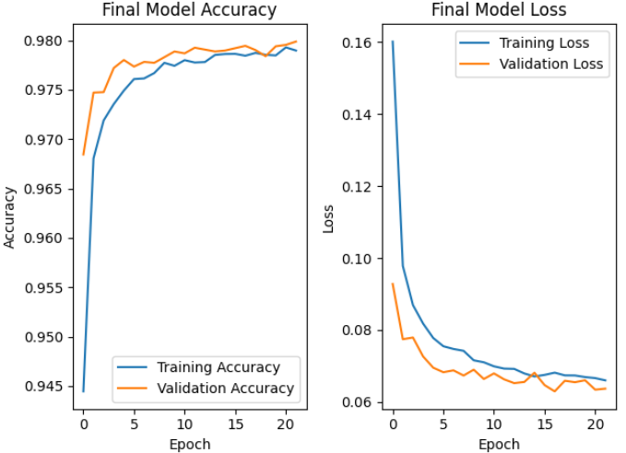
Slide 3: Deep Learning Model Results: Bo Wang
Model Performance
Achieved about 98% accuracy on validation and test sets.
Utilized Adam optimizer for training.
Architecture
Network with 5 layers and 128 hidden units in each.
Tuned hyperparameters for optimal performance.
Performance Indicators
Training and validation accuracy closely aligned.
Stable loss curves indicating good generalization.
Visualization
COMPUTER SCIENCE
GRAINGER ENGINEERING

Slide 5
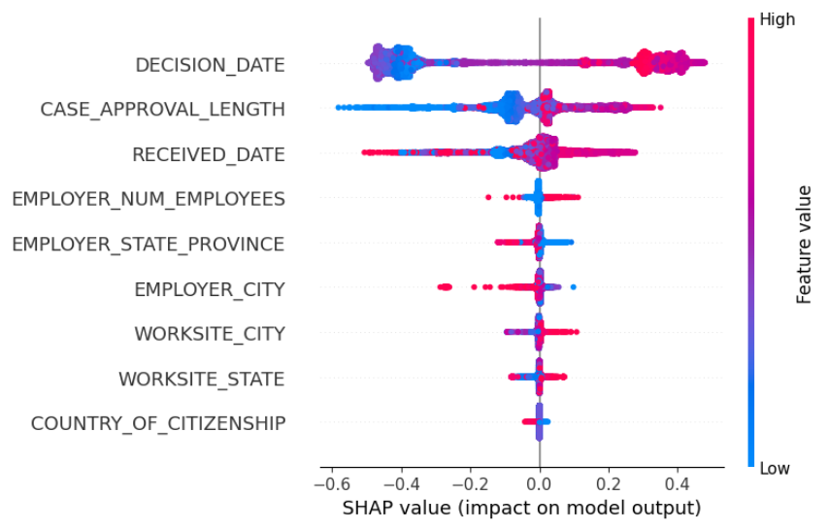
Slide 4: Feature Importance: Michal Juscinski
Top Influential Features
DECISION_DATE: Most critical predictor; recent dates correlate with approvals.
CASE_APPROVAL_LENGTH: Longer processing times often lead to certifications.
EMPLOYER_NUM_EMPLOYEES: Larger employers tend to secure more approvals.
Secondary Features
Geographic Locations: Employer and worksite locations have moderate impact.
COUNTRY_OF_CITIZENSHIP: Minimal influence compared to other features.
Visualization
COMPUTER SCIENCE
GRAINGER ENGINEERING

Slide 6
Slide 5: Lessons Learned: Alex Marzban
Data Challenges
High volume of missing values and inconsistent location data.
Reduced dataset from 100+ features to 8 key predictors.
Preprocessing Insights
Rigorous data cleaning and feature engineering are essential for model accuracy.
Modeling Insights
Hyperparameter tuning and optimizer selection significantly impact performance.
Baseline models provided valuable benchmarks for feature selection.
Project Takeaways
Emphasized the importance of data preparation over modeling alone.
Highlighted the need for strategic feature selection in predictive modeling.
COMPUTER SCIENCE
GRAINGER ENGINEERING

Slide 7
Slide 6: Conclusion: Fang Li
Conclusions
Time-related factors (DECISION_DATE, CASE_APPROVAL_LENGTH) are dominant in predicting visa approvals.
The deep learning model generalizes well with high accuracy and minimal overfitting.
Real-World Impact
Inform policymakers to refine visa processing guidelines.
Assist employers in optimizing application strategies to increase approval rates.
Guide applicants on factors that can enhance their chances of approval.
Future Work
Incorporate additional features like industry-specific trends and applicant education.
Explore advanced architectures (LSTMS, transformer models) for capturing complex relationships.
Enhance model interpretability for better stakeholder understanding.
Deploy the model as a scalable tool integrated into decision-support systems.
COMPUTER SCIENCE
GRAINGER ENGINEERING

Slide 8
Thank you!
COMPUTER SCIENCE
GRAINGER ENGINEERING

