Slide 1
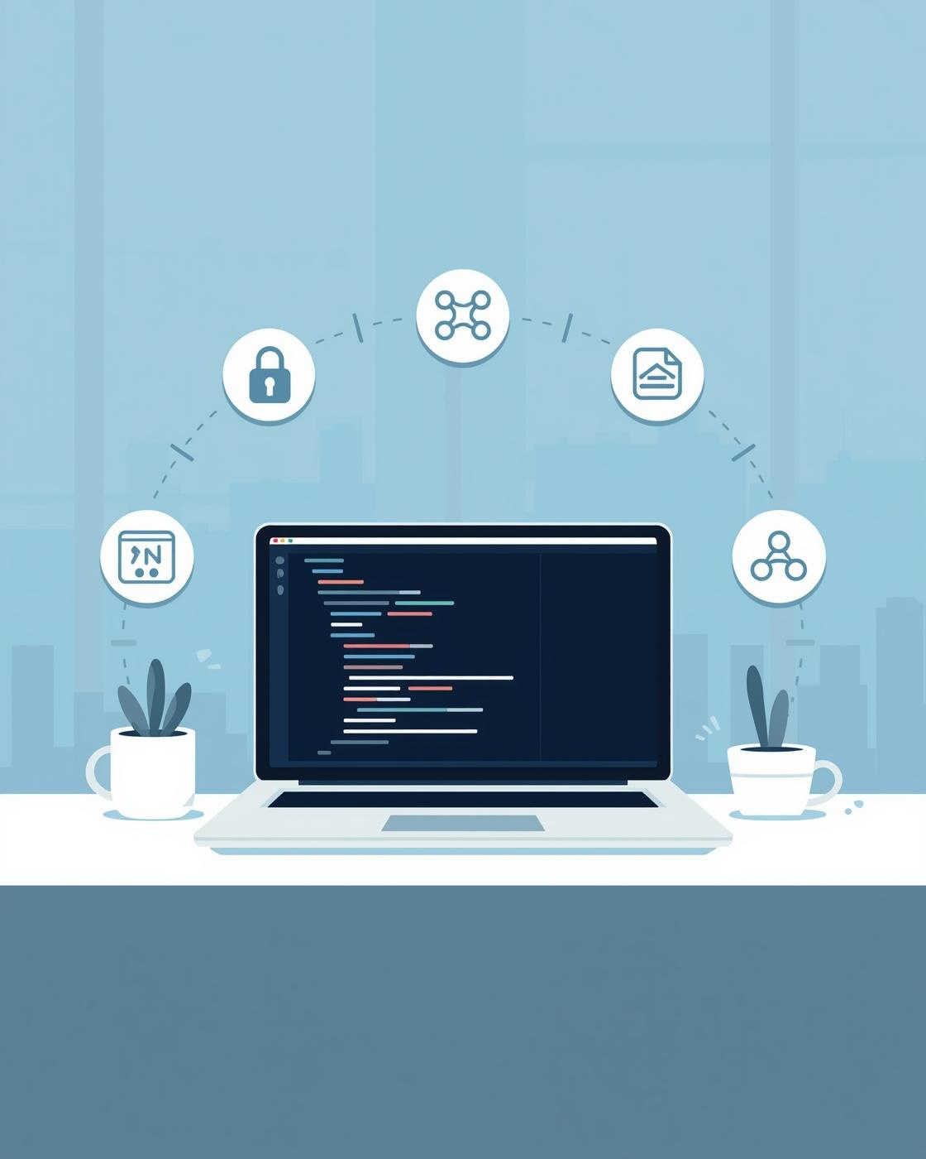

OVERVIEW
Enhanced Python Billing System
PRESENTED BY MARZOOQ C

Slide 2
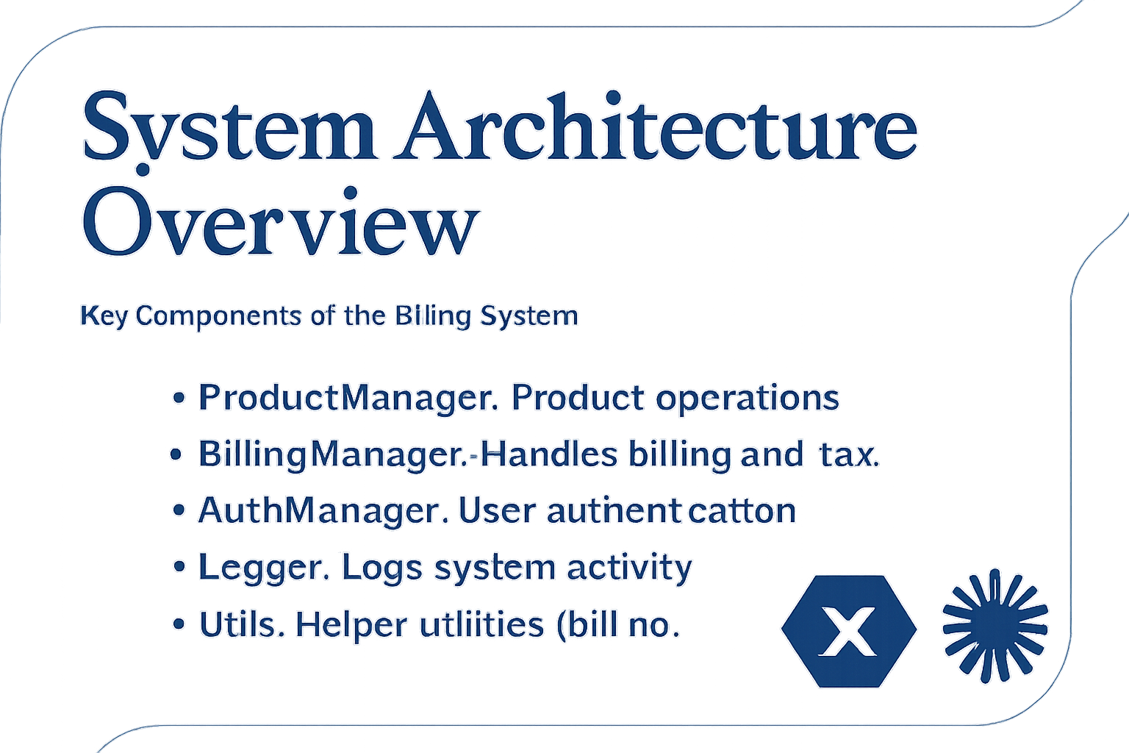

Slide 3

Authentication Module
Secure login and registration process overview
Enables secure user access (Login & Registration).
Credentials stored in users.csv.
Restricts system usage to verified users.
Adds professionalism and accountability.

Slide 4


Billing Workflow
Overview of automated billing processes
Generates auto-numbered bills (BILL-YYYYMMDD).
Applies discounts and tax dynamically.
Saves bills as CSV in /data/bills/.
Ensures accuracy and traceability in every transaction.

Slide 5
Testing & Validation
Ensuring reliability and user satisfaction
Covered product and billing modules.
Checked boundary, valid, and invalid inputs.
All tests passed — system is stable and reliable.
Results documented in tests/test_cases.xlsx.

Slide 6
Future Enhancements
Proposed features for improved functionality
Add database (SQLite/MySQL) support.
Implement password hashing for security.
Build GUI for better user experience.
Generate advanced analytics & sales reports.

Slide 7
Thank You! Contact Information
Email
marzooqmarzooq18@gmail.com

