Slide 1

Ansible Variables
Variables
Because their values vary

Slide 2
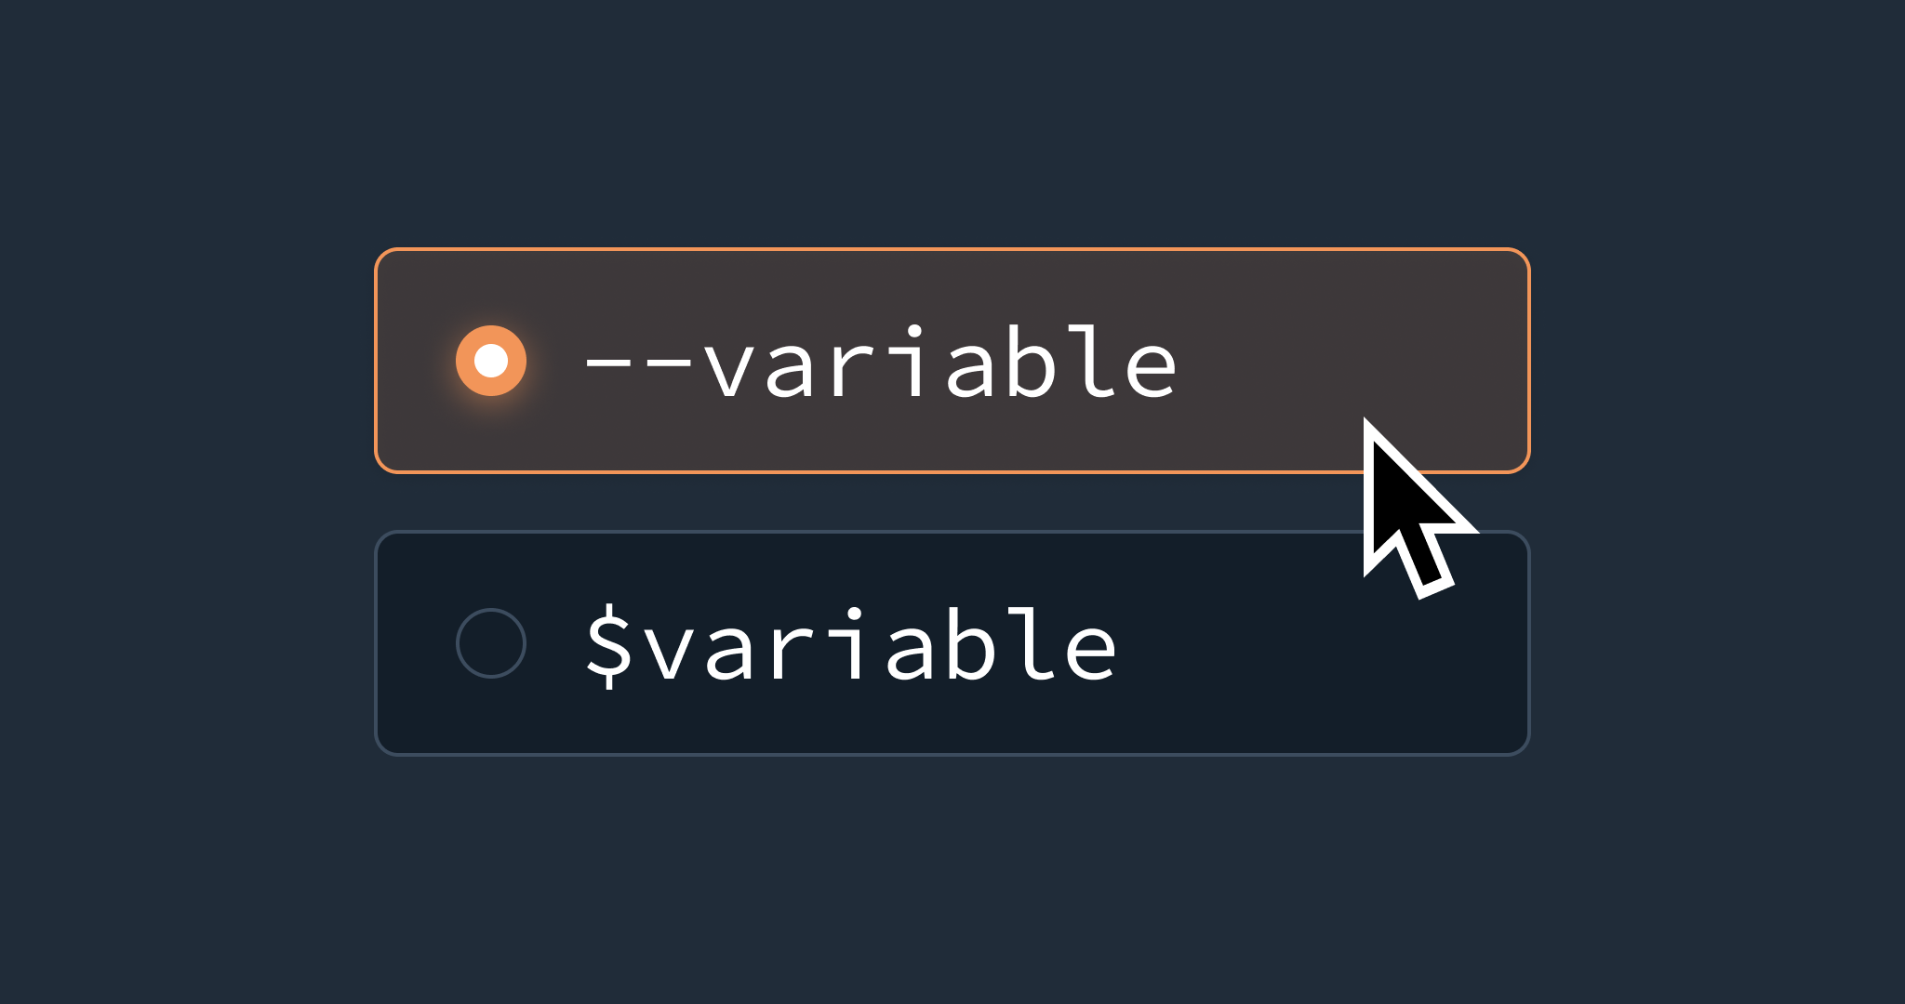
Ansible Variables
01. Store Values
Just like in programming languages, variables in Ansible are used to store a value
02. Flexibility
Variables provide flexibility in Playbooks, templates and inventories
03. Location
Variables can be defined in various places such playbooks and inventories
04. Format
Variable names should only contain letters, numbers or underscores, any combination of these is fine

Slide 3
Defining Variables
Group Vars
Host Vars
Play Vars
Task Vars
Extra Vars
01
02
03
04
05
Defined in the inventory or the group_vars directory
Defined in the inventory or host_vars directory
Defined in a playbook
Defined within tasks
Defined using the command line with “-e” option

Slide 4
Variables section
Each variable with their associated value
Using a variable syntax within modules
Variable files to be used
List of variable file paths
#Playbook variables
---
- name: Myplaybook
hosts: all
vars:
variable1: value1
variable_2: value2
tasks:
- name: Using a variable
service:
name: “{{ variable1 }}”
state: started
---
- name: Myplaybook
hosts: all
vars_files:
- variables.yml

Slide 5
Host variable defined in the inventory
Group variable defined in the inventory
Variables defined in YML format in variable files
Create arrays of information
team.andrew.name=andrew
team.andrew.uid=2001
#Inventory variables
[my_hosts]
servera service=httpd
serverb
[my_hosts:vars]
user=test
#Variable files in YML format
user_name: andrew
uid: 2001
comment: test
#Arrays
team:
andrew:
name: andrew
uid: 2001
alexander:

Slide 6
Magic Variables
groups
All hosts and groups within the inventory
group_names
All groups the managed host is a part of
hostvars
Variables for the managed host
Inventory_hostname
Hostname as configured within the inventory

Slide 7
Ansible Facts
Specific
Information
Relationships
Variables automatically discovered when Ansible connects to a managed host
They contain information on the managed host such as hostname, IP Address, Memory etc…
The have parents and children which can be clearly seen

Slide 8
Print all facts for servera
FQDN of the managed host
IPV4 address
States if the playbook will gather facts on the managed hosts or not
#Ansible facts
ansible servera –m setup
ansible_facts[‘fqdn’]
ansible_facts[‘default_ipv4’] [‘addresses’]
---
- name: playbook
gather_facts: yes/no

Slide 9
Ansible Loops
Loops
They loop

Slide 10

Ansible Loops
Purpose
Data Sets
Hashes
Used to perform the same task on a set of data without writing it multiple times
Ansible supports loops over datasets
Ansible also supports loops over hashes

Slide 11
The “item” takes the value of both httpd and crond while running the task
Declare the “services” variable values
The “item” takes the value of the “services” variable while running the task
#Simple loops
- name: Restart httpd and crond
service:
name: “{{ item }}”
state: restarted
loop:
- httpd
- crond
#Loop using variables
vars:
services:
- httpd
- crond
tasks:
- name: Restart httpd and crond
service:
name: “{{ item }}”
state: restarted
loop: “{{ services }}”

Slide 12
Each item has a name and a group
The values that the “item” loops through
#Hash loops
- name: Create users part of group
user:
name: “{{ item.name }}”
groups: “{{ item.groups }}”
state: present
loop:
- name: andrew
groups: automation
- name: alexander
groups: automation

Slide 13
Ansible Conditionals
Conditionals
Sorta like air conditioning but with Ansible

Slide 14

Ansible Conditionals
Purpose
True
Not True
Ansible supports conditional evaluations before executing a specific task on the target hosts.
If the set condition is true, Ansible will go ahead and perform the task.
If the condition is not true Ansible will skip the specified task

Slide 15
Install the service if the variable was defined
Create the user only if condition1 is equal with 1 and condition 2 is less or equal than 1
Ansible also support the “or” operator
The “in” operator is also supported by Ansible
All numerical operators are also supported by Ansible
#Simple Conditional
vars:
service: firewalld
tasks:
- name: Install service
yum:
name: “{{ service }}”
state: latest
when: service is defined
vars:
condition1: 1
condition2: 0
tasks:
- name: test conditions
user:
name: test_user
state: present
when: condition1==1 and condition2<=1

Slide 16
Handlers
01. Purpose
Handlers are tasks which are executed only if they have been notified by another task
02. Location
They are written in a separate section of the playbook and are notified by name
03. Notify
Notification only happens when a change is reported by the task charged with notifying the handler
04. No Change
If the task does not report the change then the handler will not be notified

Slide 17
Add a new rule to firewalld
Restart the firewalld service if a new rule was added
#Using Handlers
tasks:
- name: Add a new rule to firewalld
firewalld:
service: httpd
state: enabled
permanent: true
notify: restart_firewalld
handlers:
- name: restart_firewalld
service:
name: firewalld
state: restarted

Slide 18
Blocks are clauses which group tasks
Block in combination with “rescue” helps with error handling. If the tasks within the block section fail then the “rescue” section will execute.
The “always” section executes no matter the circumstances
Blocks can also be used in conjunction with “when” conditionals
#Blockers
tasks:
block:
- name: start httpd
service:
name: httpd
state: restarted
rescue:
- name: install httpd
yum:
name: httpd
state: latest
always:
- name: restart httpd
service:
name: httpd
state: restarted

Slide 19
Ansible Templates
Templates
Very standard

Slide 20

Ansible Templates
Purpose
Purpose
Syntax
Templates make managing files easier
Templates make customization of files for the managed host easier
They are written in Jinja2 syntax

Slide 21
Ansible Templates
Deployed
Tools
Support
Templates are deployed using the template module
Templates can use both Ansible facts and variables
They support loops and conditionals

Slide 22
Applies the template to the destination specified on the managed host
Specifies the owner, group owner and permission of the file once applied
#Template module
tasks:
- name: Apply a template
template:
src: <source>
dest: <managed_host_destination>
owner: <owner>
group: <group_owner>
mode: <permissions>

Slide 23
The output will be: “My FQDN is <FQDN of the managed host>
The output will: The variable has the value of <the value of myvariable>
The variable service loops through the values of the services variable
The variable service loops through the values of the services variable except the value of “httpd”
Places the value of the variable “var” within the file only if the “bool” variable is 1
#Simple template file
My FQDN is {{ ansible_facts[‘fqdn’] }}’
This variable has the value of {{ myvariable }}
{% for service in services %}
{{ service }}
{% endfor %}
{% for service in services if not service == “httpd %}
{{ service }}
{% endfor %}
{% if bool == 1 %}
{{ var }}
{% endif %}

Slide 24
Including and importing playbooks and tasks

