Slide 1

Modern Architecture
Ahmed Marzouk

Slide 2

Ahmed Marzouk Senior Software Engineer
Linkedin|Medium|GitHub|SO|IntegrantProfile

Slide 3
Agenda
What is modern architecture?
Introduction
Programming paradigms and architecture
SOLID Design Principles and Architecture
Components
Modern Architecture attributes and patterns
Demo

Slide 4
Modern Architecture?
Notes:
- What is modern architecture?

Slide 5
Architecture changed due to?
Notes:
- What is modern architecture?

Slide 6
Introduction

Slide 7
Architecture (What & Why)?
High level decisions (The decisions that are hard to change).
Including non functional decisions.
Aims to reduces cost of changes and resources.
Notes:
So, it’s a journey not a destination you can take it with a lot of observations and wrong decisions, so don’t reinvent the wheel and follow the best practice.

Slide 8
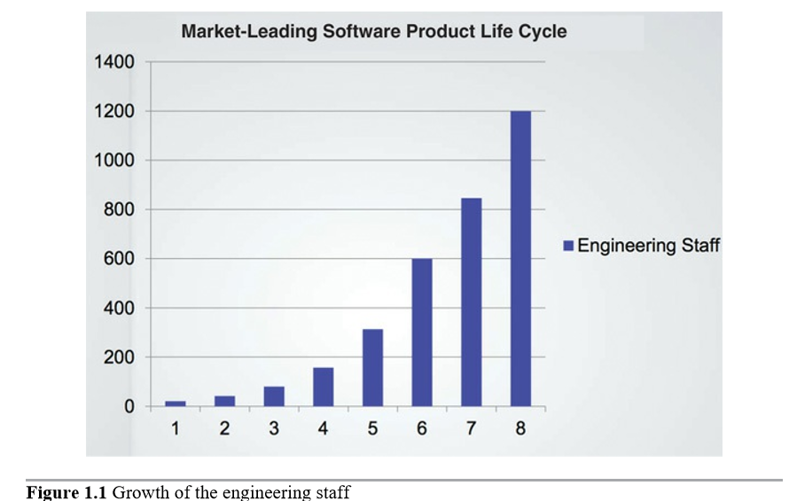
Case Study

Slide 9
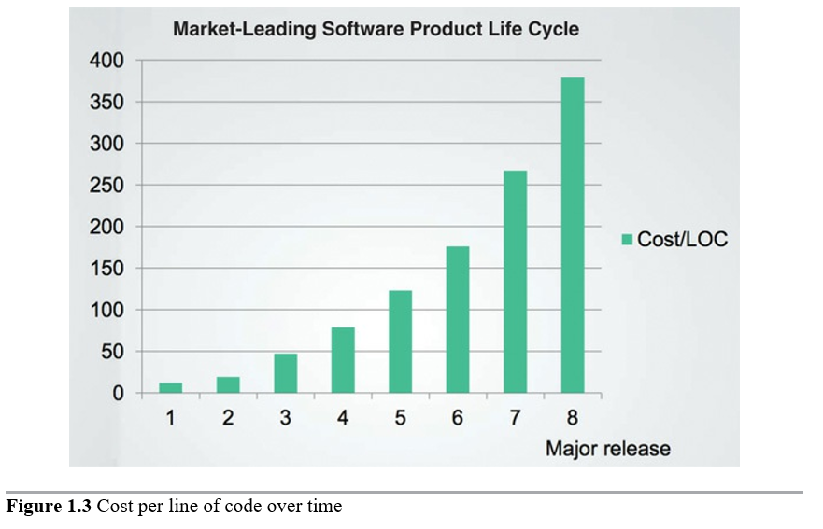
Case Study

Slide 10
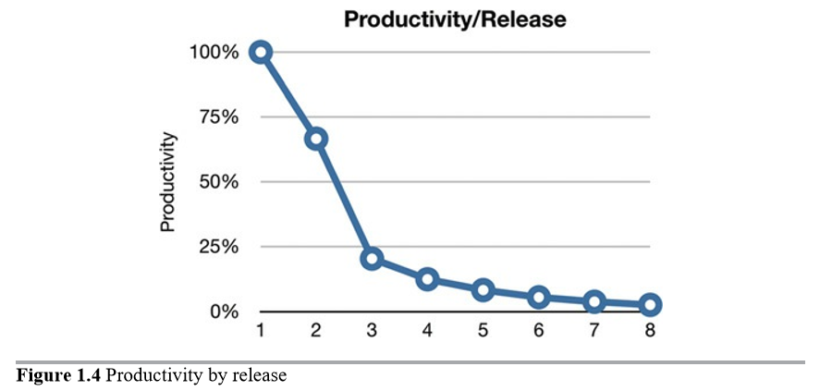
Case Study

Slide 11
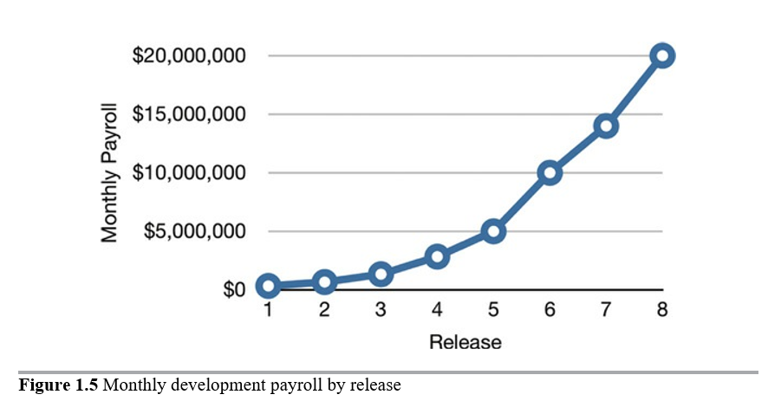
Case Study

Slide 12
So, What Went Wrong?
We can clean it up later; we just have to get to market first!

Slide 13
The Solution
Redesign the whole system?
The only way to go fast, is to go well.

Slide 14
A TALE OF TWO VALUES
Every software system provides two different values to the stakeholders:
Behavior
Architecture

Slide 15
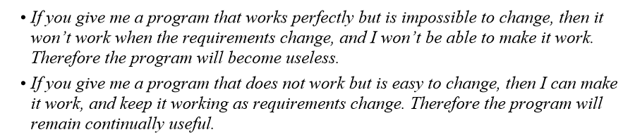
A TALE OF TWO VALUES

Slide 16

Why A Good Architecture?
It’s so easy to build a software, but not every software built right!

Slide 17
How to measure A Good Architecture?
The measure of design quality is simply the measure of the effort required to meet the needs of the customer. If that effort is low, and stays low throughout the lifetime of the system, the design is good. If that effort grows with each new release, the design is bad. It’s as simple as that.

Slide 18
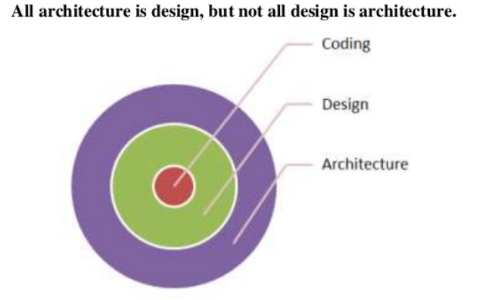
Architecture Vs. Design
Notes:
Confusion between design and architecture because there is no separate line between low and high-level decisions but always a continuous line from the highest to the lowest:
There has been a lot of confusion about design and architecture over the years. What is design? What is architecture? What are the differences between the two?
The word “architecture” is often used in the context of something at a high level that is divorced from the lower-level details, whereas “design” more often seems to imply structures and decisions at a lower level. But this usage is nonsensical when you look at what a real architect does.
For example: Building a house. In short, I see all the little details that support all the high-level decisions. I also see that those low-level details and high-level decisions are part of the whole design of the house. And so, it is with software design. The low-level details and the high-level structure are all part of the same whole. They form a continuous fabric that defines the shape of the system. You can’t have one without the other; indeed, no clear dividing line separates them. There is simply a continuum of decisions from the highest to the lowest levels.

Slide 19
Modern Architecture And PROGRAMMING PARADIGMS

Slide 20
STARTING WITH THE BRICKS: PROGRAMMING PARADIGMS
What is the relation between programming paradigms and architecture?
Notes:
Each of the paradigms removes capabilities from the programmer. None of them adds new capabilities. Each imposes some kind of extra discipline that is negative in its intent. The paradigms tell us what not to do, more than they tell us what to do.

Slide 21
STARTING WITH THE BRICKS: PROGRAMMING PARADIGMS
Structure
OOP
Functional

Slide 22
Structure Programming
goto to Control/Iteration
FUNCTIONAL DECOMPOSITION
How that is important for architecture?
Notes:
Functional Decomposition is the process of taking a complex process and breaking it down into its smaller, simpler parts.
Structured programming allows modules to be recursively decomposed into provable units, which in turn means that modules can be functionally decomposed. That is, you can take a large-scale problem statement and decompose it into high-level functions. Each of those functions can then be decomposed into lower-level functions, ad infinitum. Moreover, each of those decomposed functions can be represented using the restricted control structures of structured programming.
How that is important for architecture?
It is this ability to create falsifiable units of programming that makes structured programming valuable today. This is the reason that modern languages do not typically support unrestrained goto statements. Moreover, at the architectural level, this is why we still consider functional decomposition to be one of our best practices.

Slide 23
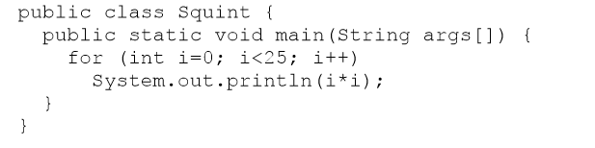

Functional Programming
C#
Clojure
C# Functional
Notes:
Instead, my goal here is to point out something very dramatic about the difference between the Clojure and Java programs. The Java program uses a mutable variable —a variable that changes state during the execution of the program. That variable is i—the loop control variable. No such mutable variable exists in the Clojure program. In the Clojure program, variables like x are initialized, but they are never modified. This leads us to a surprising statement: Variables in functional languages do not vary.

Slide 24
Functional Programming
IMMUTABILITY AND ARCHITECTURE
CQRS
EVENT SOURCING
Notes:
1 - Why is this point important as an architectural consideration? Why would an architect be concerned with the mutability of variables? The answer is absurdly simple: All race conditions, deadlock conditions, and concurrent update problems are due to mutable variables. You cannot have a race condition or a concurrent update problem if no variable is ever updated. You cannot have deadlocks without mutable locks.
2-

Slide 25
Object Oriented Programming
Power of OOP?
Notes:
Some folks fall back on three magic words to explain the nature of OO: encapsulation, inheritance, and polymorphism. The implication is that OO is the proper admixture of these three things, or at least that an OO language must support these three things.

Slide 26
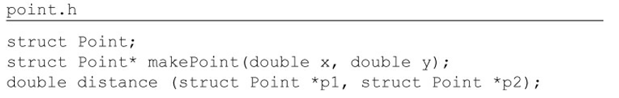
OOP - Encapsulation
Encapsulation in C
Notes:
The reason encapsulation is cited as part of the definition of OO is that OO languages provide easy and effective encapsulation of data and function. As a result, a line can be drawn around a cohesive set of data and functions. Outside of that line, the data is hidden and only some of the functions are known. We see this concept in action as the private data members and the public member functions of a class.

Slide 27
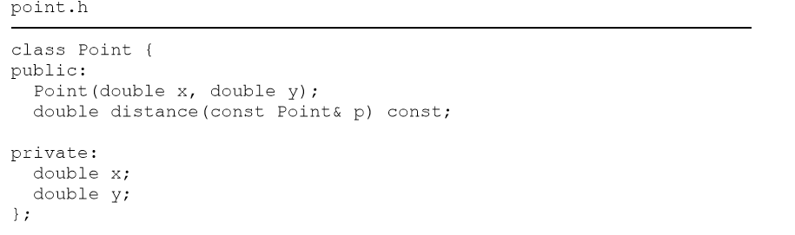
OOP - Encapsulation
Encapsulation in C++
Notes:
Clients of the header file point.h know about the member variables x and y! The compiler will prevent access to them, but the client still knows they exist. For example, if those member names are changed, the point.cc file must be recompiled! Encapsulation has been broken. Indeed, the way encapsulation is partially repaired is by introducing the public, private, and protected keywords into the language. This, however, was a hack necessitated by the technical need for the compiler to see those variables in the header file. Java and C# simply abolished the header/implementation split altogether, thereby weakening encapsulation even more. In these languages, it is impossible to separate the declaration and definition of a class. For these reasons, it is difficult to accept that OO depends on strong encapsulation. Indeed, many OO languages2 have little or no enforced encapsulation.

Slide 28
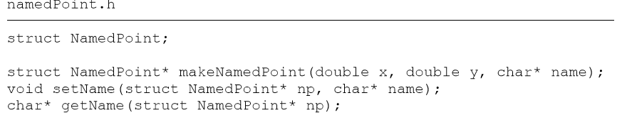
OOP - Inheritance
Inheritance in C

Slide 29
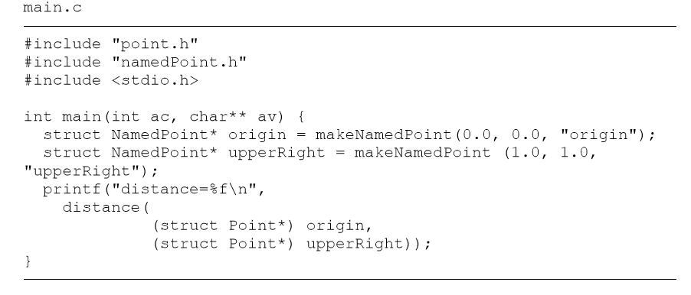
OOP - Inheritance
Inheritance in C
Notes:
This kind of trickery was a common practice4 of programmers prior to the advent of OO. In fact, such trickery is how C++ implements single inheritance. Thus we might say that we had a kind of inheritance long before OO languages were invented. That statement wouldn’t quite be true, though. We had a trick, but it’s not nearly as convenient as true inheritance. Moreover, multiple inheritance is a considerably more difficult to achieve by such trickery. Note also that in main.c, I was forced to cast the NamedPoint arguments to Point. In a real OO language, such upcasting would be implicit. It’s fair to say that while OO languages did not give us something completely brand new, it did make the masquerading of data structures significantly more convenient. To recap: We can award no point to OO for encapsulation, and perhaps a half-point for inheritance. So far, that’s not such a great score. But there’s one more attribute to consider.

Slide 30
OOP - Polymorphism
Polymorphism was exists before OOP
OOP gives us much safer and much more convenient polymorphism.
Notes:
Polymorphism was exists before OOP in form of not safe pointer to functions and developers used to do those tricks a lot.
OO languages may not have given us polymorphism, but they have made it much safer and much more convenient. The problem with explicitly using pointers to functions to create polymorphic
behavior is that pointers to functions are dangerous. Such use is driven by a set of manual conventions. You have to remember to follow the convention to initialize those pointers. You have to remember to follow the convention to call all your functions through those pointers. If any programmer fails to remember these conventions, the resulting bug can be devilishly hard to track down and eliminate. OO languages eliminate these conventions and, therefore, these dangers. Using an OO language makes polymorphism trivial. That fact provides an enormous power that old C programmers could only dream of. On this basis, we can conclude that OO imposes discipline on indirect transfer of control.

Slide 31
OOP – The Power Of Polymorphism
The power of Polymorphism > plugin architecture without any change in the core.
OO allows the plugin architecture to be used anywhere, for anything.

Slide 32
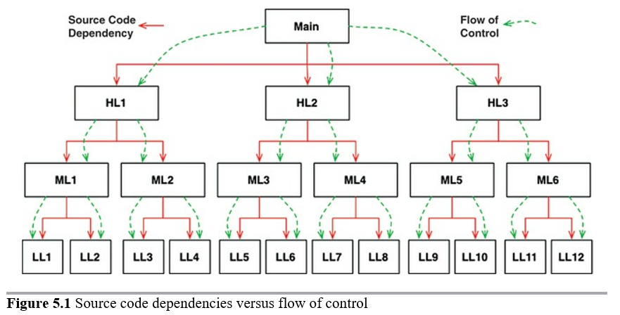
OOP – Dependency Inversion
Notes:
It’s the most important result of polymorphism.
For main to call one of the high-level functions, it had to mention the name of the module that contained that function In C, this was a #include. In Java, it was an import statement. In C#, it was a using statement. Indeed, every caller was forced to mention the name of the module that contained the callee. This requirement presented the software architect with few, if any, options. The flow of control was dictated by the behavior of the system, and the source code dependencies were dictated by that flow of control.

Slide 33
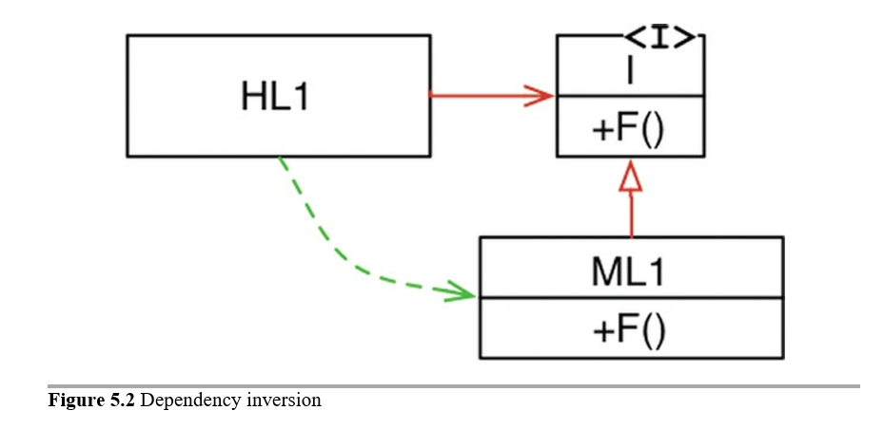
OOP – Dependency Inversion
Notes:
When polymorphism is brought into play, however, something very different can happen.
In Figure 5.2, module HL1 calls the F() function in module ML1. The fact that it calls this function through an interface is a source code contrivance. At runtime, the interface doesn’t exist. HL1 simply calls F() within ML1.7 Note, however, that the source code dependency (the inheritance relationship) between ML1 and the interface I points in the opposite direction compared to the flow of control. This is called dependency inversion, and its implications for the software architect are profound. The fact that OO languages provide safe and convenient polymorphism means that any source code dependency, no matter where it is, can be inverted. Now look back at that calling tree in Figure 5.1, and its many source code dependencies. Any of those source code dependencies can be turned around by inserting an interface between them.

Slide 34
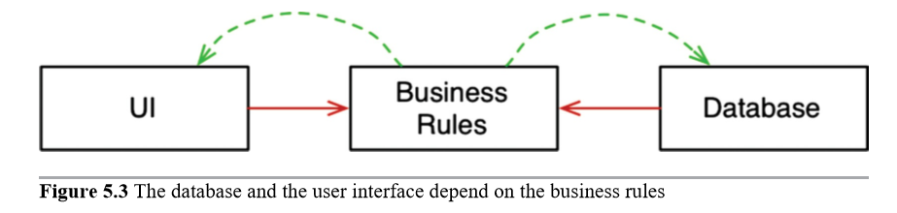
OOP – Dependency Inversion
Notes:
With this approach, software architects working in systems written in OO languages have absolute control over the direction of all source code dependencies in the system. They are not constrained to align those dependencies with the flow of control. No matter which module does the calling and which module is called, the software architect can point the source code dependency in either direction. That is power! That is the power that OO provides. That’s what OO is really all about—at least from the architect’s point of view.
What can you do with that power? As an example, you can rearrange the source code dependencies of your system so that the database and the user interface (UI) depend on the business rules (Figure 5.3), rather than the other way around.
This means that the UI and the database can be plugins to the business rules. It means that the source code of the business rules never mentions the UI or the database. As a consequence, the business rules, the UI, and the database can be compiled into three separate components or deployment units (e.g., jar files, DLLs, or Gem files) that have the same dependencies as the source code. The component containing the business rules will not depend on the components containing the UI and database. In turn, the business rules can be deployed independently of the UI and the database. Changes to the UI or the database need not have any effect on the business rules. Those components can be deployed separately and independently. In short, when the source code in a component changes, only that component needs to be redeployed. This is independent deployability. If the modules in your system can be deployed independently, then they can be developed independently by different teams. That’s independent developability.

Slide 35
OOP And Architecture
What is OO? There are many opinions and many answers to this question. To the software architect, however, the answer is clear: OO is the ability, through the use of polymorphism, to gain absolute control over every source code dependency in the system. It allows the architect to create a plugin architecture, in which modules that contain high-level policies are independent of modules that contain low-level details. The low-level details are relegated to plugin modules that can be deployed and developed independently from the modules that contain high-level policies.

Slide 36
Paradigms And Modern Architecture
Each of these three paradigms has taken something away from us. Each restricts some aspect of the way we write code. None of them has added to our power or our capabilities.
What we have learned over the last half-century is what not to do.
The rules of software are the same today as they were in 1946, when Alan Turing wrote the very first code that would execute in an electronic computer. The tools have changed, and the hardware has changed, but the essence of software remains the same.
It’s not enough.

Slide 37
Modern Architecture And DESIGN PRINCIPLES

Slide 38
Modern Architecture And Design Principles
SOLID Principles tell us how to arrange our functions and data structures into classes, and how those classes should be interconnected.
The goal of the principles is the creation of mid-level software structures.
Notes:
The SOLID principles tell us how to arrange our functions and data structures into classes, and how those classes should be interconnected. The use of the word “class” does not imply that these principles are applicable only to object-oriented software. A class is simply a coupled grouping of functions and data. Every software system has such groupings, whether they are called classes or not. The SOLID principles apply to those groupings.
The goal of the principles is the creation of mid-level software structures that:
• Tolerate change, • Are easy to understand, and • Are the basis of components that can be used in many software systems.
The term “mid-level” refers to the fact that these principles are applied by programmers working at the module level. They are applied just above the level of the code and help to define the kinds of software structures used within modules and components.
Just as it is possible to create a substantial mess with well-made bricks, so it is also possible to create a system-wide mess with well-designed mid-level components. For this reason, once we have covered the SOLID principles, we will move on to their counterparts in the component world, and then to the principles of high-level architecture.

Slide 39
SOLID - SRP
Only one reason to change - Conway’s law
The most miss understood principle.
A module should have one, and only one, reason to change == A module should be responsible to one, and only one, actor
Notes:
1- An active corollary to Conway’s law: The best structure for a software system is heavily influenced by the social structure of the organization that uses it so that each software module has one, and only one, reason to change.
2- Of all the SOLID principles, the Single Responsibility Principle (SRP) might be the least well understood. That’s likely because it has a particularly inappropriate name. It is too easy for programmers to hear the name and then assume that it means that every module should do just one thing. Make no mistake, there is a principle like that. A function should do one, and only one, thing. We use that principle when we are refactoring large functions into smaller functions; we use it at the lowest levels. But it is not one of the SOLID principles—it is not the SRP.

Slide 40
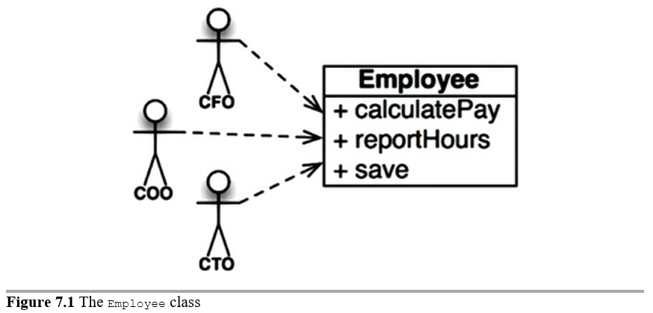
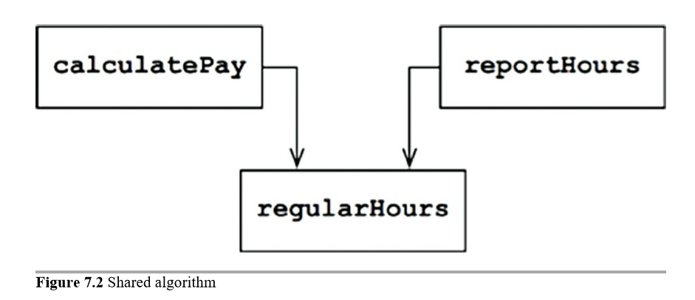
SOLID – SRP - Violation
Notes:
This class violates the SRP because those three methods are responsible to three very different actors. • The calculatePay() method is specified by the accounting department, which reports to the CFO. • The reportHours() method is specified and used by the human resources department, which reports to the COO. • The save() method is specified by the database administrators (DBAs), who report to the CTO. By putting the source code for these three methods into a single Employee class, the developers have coupled each of these actors to the others. This coupling can cause the actions of the CFO’s team to affect something that the COO’s team depends on. For example, suppose that the calculatePay() function and the reportHours() function share a common algorithm for calculating non-overtime hours. Suppose also that the developers, who are careful not to duplicate code, put that algorithm into a function named regularHours()
Now suppose that the CFO’s team decides that the way non-overtime hours are calculated needs to be tweaked. In contrast, the COO’s team in HR does not want that particular tweak because they use non-overtime hours for a different purpose. A developer is tasked to make the change, and sees the convenient regularHours() function called by the calculatePay() method. Unfortunately, that developer does not notice that the function is also called by the reportHours() function. The developer makes the required change and carefully tests it. The CFO’s team validates that the new function works as desired, and the system is deployed. Of course, the COO’s team doesn’t know that this is happening. The HR personnel continue to use the reports generated by the reportHours() function—but now they contain incorrect numbers. Eventually the problem is discovered, and the COO is livid because the bad data has cost his budget millions of dollars. We’ve all seen things like this happen. These problems occur because we put code that different actors depend on into close proximity. The SRP says to separate the code that different actors depend on.

Slide 41
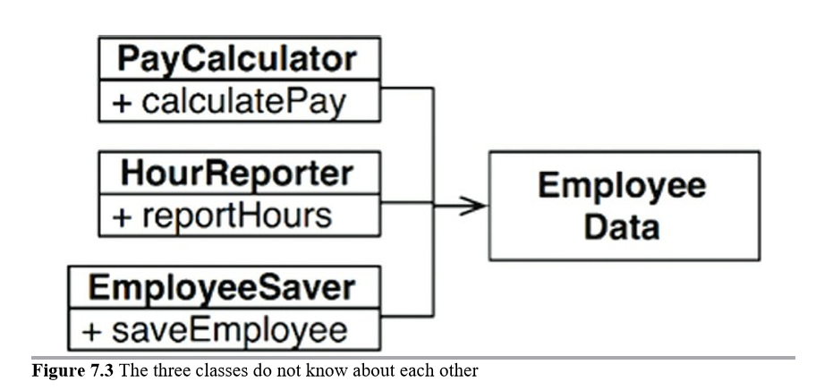
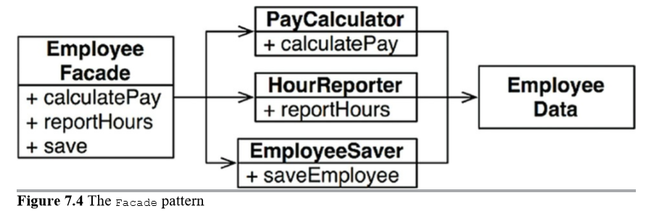
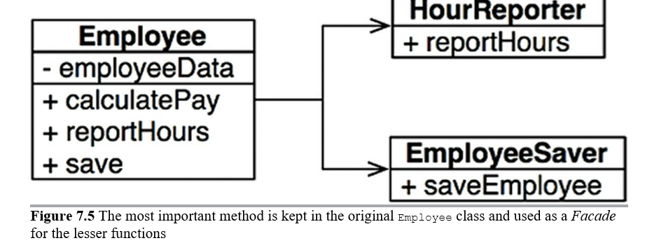
SOLID – SRP - MERGES
The problem
The solution
Notes:
The Single Responsibility Principle is about functions and classes—but it reappears in a different form at two more levels. At the level of components, it becomes the Common Closure Principle. At the architectural level, it becomes the Axis of Change responsible for the creation of Architectural Boundaries. We’ll be studying all of these ideas in the chapters to come.

Slide 42
SOLID - OCP
A software artifact should be open for extension but closed for modification.
The most fundamental reason that we study software architecture.
Notes:
This, of course, is the most fundamental reason that we study software architecture. Clearly, if simple extensions to the requirements force massive changes to the software, then the architects of that software system have engaged in a spectacular failure. Most students of software design recognize the OCP as a principle that guides them
in the design of classes and modules. But the principle takes on even greater significance when we consider the level of architectural components.
The OCP is one of the driving forces behind the architecture of systems. The goal is to make the system easy to extend without incurring a high impact of change. This goal is accomplished by partitioning the system into components, and arranging those components into a dependency hierarchy that protects higher-level components from changes in lower-level components.

Slide 43
SOLID - LSP
Square is not a rectangle in behavior.
The best way to understand the LSP from an architectural viewpoint is to look at what happens to the architecture of a system when the principle is violated.
Taxi Restful example.
Notes:
Square is not a rectangle in behavior so if I made a square : rectangle so every time I use square I should use rectangle which is not the same in behavior.
In mathematics, a Square is a Rectangle. Indeed it is a specialization of a rectangle. The "is a" makes you want to model this with inheritance. However if in code you made Square derive from Rectangle, then a Square should be usable anywhere you expect a Rectangle. This makes for some strange behavior.
Taxi Restful example: And so our architect has had to add a significant and complex mechanism to deal with the fact that the interfaces of the restful services are not all substitutable.

Slide 44
SOLID - ISP
ISP and Architecture
Notes:
The lesson here is that depending on something that carries baggage that you don’t need can cause you troubles that you didn’t expect.

Slide 45
SOLID - DIP
Standard abstraction
DIP and Architecture
Notes:
The Dependency Inversion Principle (DIP) tells us that the most flexible systems are those in which source code dependencies refer only to abstractions, not to concretions.
2- Every change to an abstract interface corresponds to a change to its concrete implementations. Conversely, changes to concrete implementations do not always, or even usually, require changes to the interfaces that they implement. Therefore interfaces are less volatile than implementations. Indeed, good software designers and architects work hard to reduce the volatility of interfaces. They try to find ways to add functionality to implementations without making changes to the interfaces. This is Software Design 101.

Slide 46
SOLID
It’s not enough.

Slide 47
Modern Architecture And COMPONENT PRINCIPLES
Notes:
If the SOLID principles tell us how to arrange the bricks into walls and rooms, then the component principles tell us how to arrange the rooms into buildings. Large software systems, like large buildings, are built out of smaller components.

Slide 48
Components
What is component?
COMPONENT COHESION
• REP: The Reuse/Release Equivalence Principle
• CCP: The Common Closure Principle
• CRP: The Common Reuse Principle
Notes:
1- Components are the units of deployment. They are the smallest entities that can be deployed as part of a system. In Java, they are jar files. In Ruby, they are gem files. In .Net, they are DLLs. In compiled languages, they are aggregations of binary files. In interpreted languages, they are aggregations of source files. In all languages, they are the granule of deployment. Components can be linked together into a single executable. Or they can be aggregated together into a single archive, such as a .war file. Or they can be independently deployed as separate dynamically loaded plugins, such as.jar or .dll or .exe files. Regardless of how they are eventually deployed, well-designed components always retain the ability to be independently deployable and, therefore, independently developable.
These dynamically linked files, which can be plugged together at runtime, are the software components of our architectures. It has taken 50 years, but we have arrived at a place where component plugin architecture can be the casual default as opposed
to the herculean effort it once was.
2- Which classes belong in which components? This is an important decision, and requires guidance from good software engineering principles. Unfortunately, over the years, this decision has been made in an ad hoc manner based almost entirely on context.

Slide 49
Component COHESION - Reuse/Release Equivalence Principle
The granule of reuse is the granule of release.
From a software design and architecture point of view, this principle means that the classes and modules that are formed into a component must belong to a cohesive group.
Classes and modules that are grouped together into a component should be releasable together.
Notes:
The last decade has seen the rise of a menagerie of module management tools, such as Maven, Leiningen, and RVM. These tools have grown in importance because, during that time, a vast number of reusable components and component libraries have been created. We are now living in the age of software reuse—a fulfillment of one of the oldest promises of the object-oriented model. The Reuse/Release Equivalence Principle (REP) is a principle that seems obvious, at least in hindsight. People who want to reuse software components cannot, and will not, do so unless those components are tracked through a release process and are given release numbers. This is not simply because, without release numbers, there would be no way to ensure that all the reused components are compatible with each other. Rather, it also reflects the fact that software developers need to know when new releases are coming, and which changes those new releases will bring. It is not uncommon for developers to be alerted about a new release and decide, based on the changes made in that release, to continue to use the old release instead. Therefore the release process must produce the appropriate notifications and release documentation so that users can make informed decisions about when and whether to integrate the new release. From a software design and architecture point of view, this principle means that the classes and modules that are formed into a component must belong to a cohesive group. The component cannot simply consist of a random hodgepodge of classes and modules; instead, there must be some overarching theme or purpose that those modules all share. Of course, this should be obvious. However, there is another way to look at this issue that is perhaps not quite so obvious. Classes and modules that are grouped together into a component should be releasable together. The fact that they share the same version number and the same release tracking, and are included under the same release documentation, should make sense both to the author and to the users.

Slide 50
Component COHESION - The Common Closure Principle
Gather into components those classes that change for the same reasons and at the same times. Separate into different components those classes that change at different times and for different reasons.
This is the Single Responsibility Principle restated for components.
This principle is closely associated with the Open Closed Principle (OCP).
Notes:
1- is the Single Responsibility Principle restated for components. Just as the SRP says that a class should not contain multiples reasons to change, so the Common Closure Principle (CCP) says that a component should not have multiple reasons to change.
2 - For most applications, maintainability is more important than reusability. If the code in an application must change, you would rather that all of the changes occur in one component, rather than being distributed across many components.1 If changes are confined to a single component, then we need to redeploy only the one changed component. Other components that don’t depend on the changed component do not need to be revalidated or redeployed. The CCP prompts us to gather together in one place all the classes that are likely to change for the same reasons. If two classes are so tightly bound, either physically or conceptually, that they always change together, then they belong in the same component. This minimizes the workload related to releasing, revalidating, and redeploying the software.
3- This principle is closely associated with the Open Closed Principle (OCP). Indeed, it is “closure” in the OCP sense of the word that the CCP addresses. The OCP states that classes should be closed for modification but open for extension. Because 100% closure is not attainable, closure must be strategic. We design our classes such that they are closed to the most common kinds of changes that we expect or have
experienced. The CCP amplifies this lesson by gathering together into the same component those classes that are closed to the same types of changes. Thus, when a change in requirements comes along, that change has a good chance of being restricted to a minimal number of components.

Slide 51
Component COHESION - The Common Reuse Principle
Don’t force users of a component to depend on things they don’t need.
RELATION TO ISP
Notes:
1 - The Common Reuse Principle (CRP) is yet another principle that helps us to decide which classes and modules should be placed into a component. It states that classes and modules that tend to be reused together belong in the same component. Classes are seldom reused in isolation. More typically, reusable classes collaborate with other classes that are part of the reusable abstraction. The CRP states that these classes belong together in the same component. In such a component we would expect to see classes that have lots of dependencies on each other. A simple example might be a container class and its associated iterators. These classes are reused together because they are tightly coupled to each other. Thus they ought to be in the same component. But the CRP tells us more than just which classes to put together into a component: It also tells us which classes not to keep together in a component. When one component uses another, a dependency is created between the components. Perhaps the using component uses only one class within the used component—but that still doesn’t weaken the dependency. The using component still depends on the used component.
2- The CRP is the generic version of the ISP. The ISP advises us not to depend on classes that have methods we don’t use. The CRP advises us not to depend on components that have classes we don’t use. All of this advice can be reduced to a single sound bite:
Don’t depend on things you don’t need.
3- In the past, our view of cohesion was much simpler than the REP, CCP, and CRP implied. We once thought that cohesion was simply the attribute that a module performs one, and only one, function. However, the three principles of component cohesion describe a much more complex variety of cohesion. In choosing the classes to group together into components, we must consider the opposing forces involved in reusability and develop-ability. Balancing these forces with the needs of the
application is nontrivial. Moreover, the balance is almost always dynamic. That is, the partitioning that is appropriate today might not be appropriate next year. As a consequence, the composition of the components will likely jitter and evolve with time as the focus of the project changes from develop-ability to reusability.

Slide 52
Modern Architecture
Notes:
If the SOLID principles tell us how to arrange the bricks into walls and rooms, then the component principles tell us how to arrange the rooms into buildings. Large software systems, like large buildings, are built out of smaller components.

Slide 53
Modern Architecture
Keeping Options Open
High Cohesion
Autonomous (Independent in dev, deploy, team, versioning)
Domain Centric
Testability
Automation

Slide 54
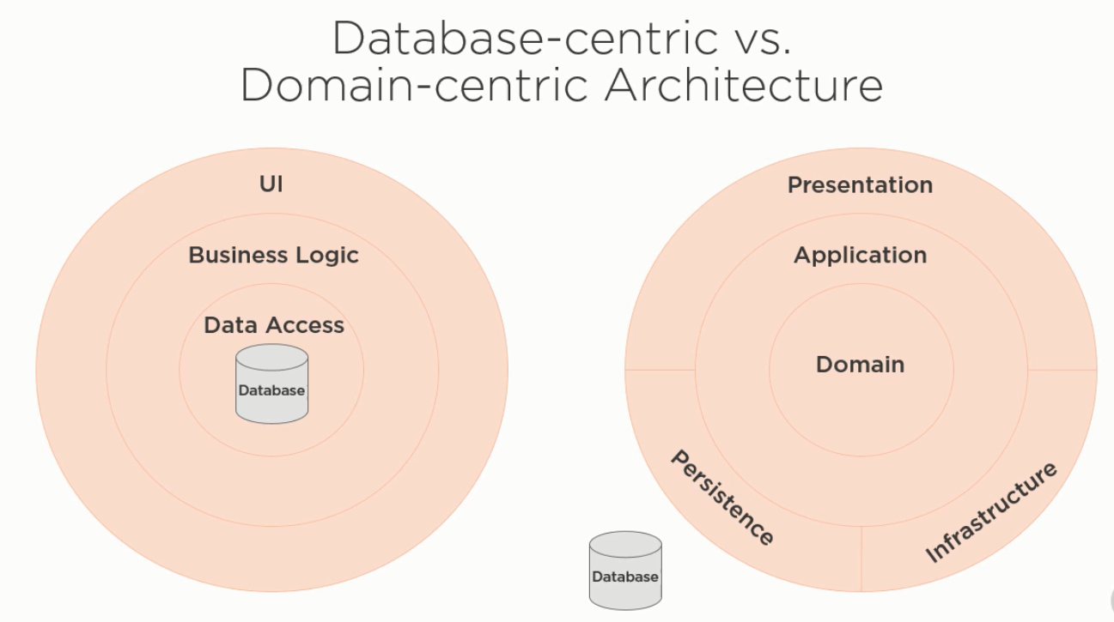
Domain Centric Architectures

Slide 55
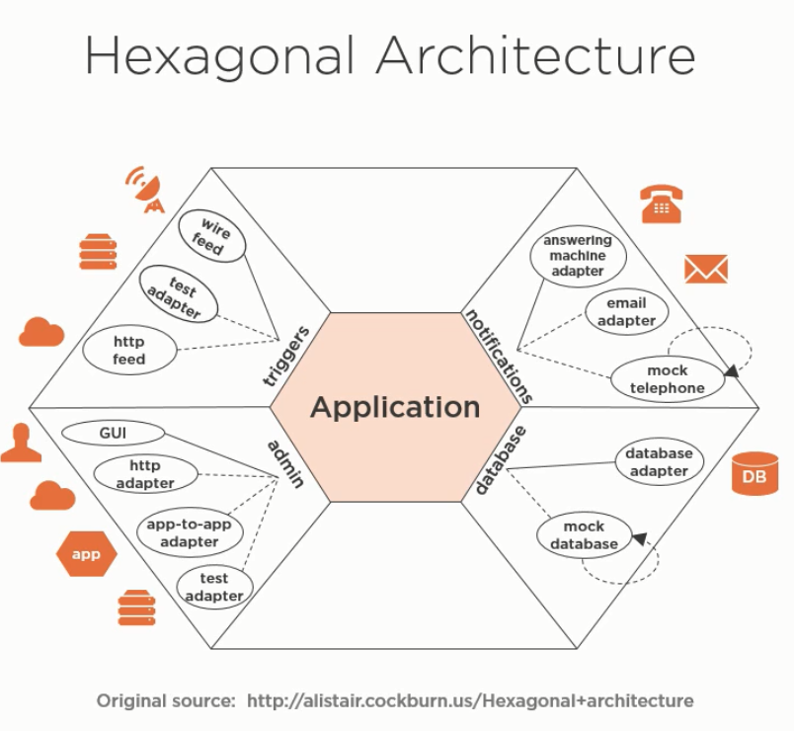
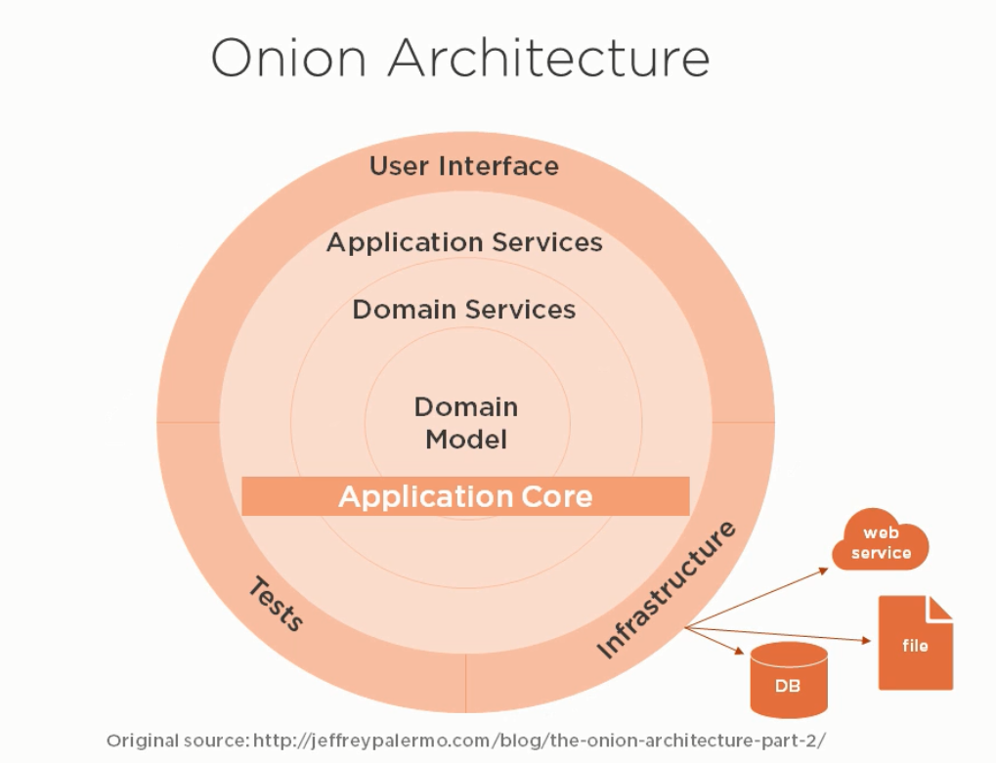
Domain Centric Architectures

Slide 56
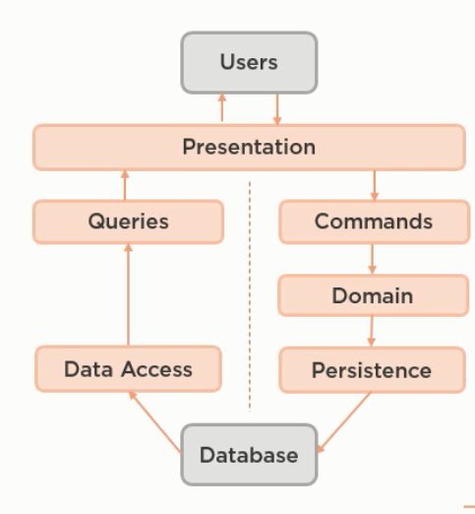
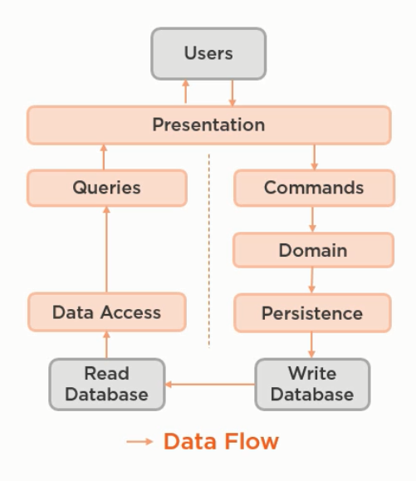
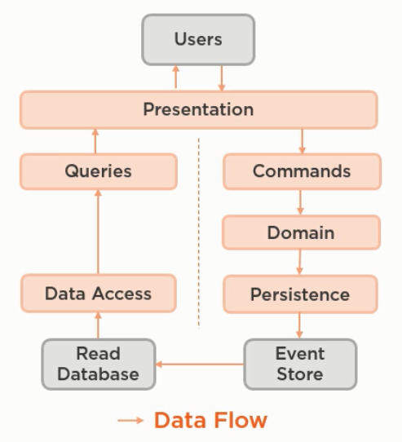
CQRS AND Event Sourcing

Slide 57
Domain Driven
Analytical Vs. Strategical
Sub Domain – Bounded Context
Ubiquitous Language

Slide 58
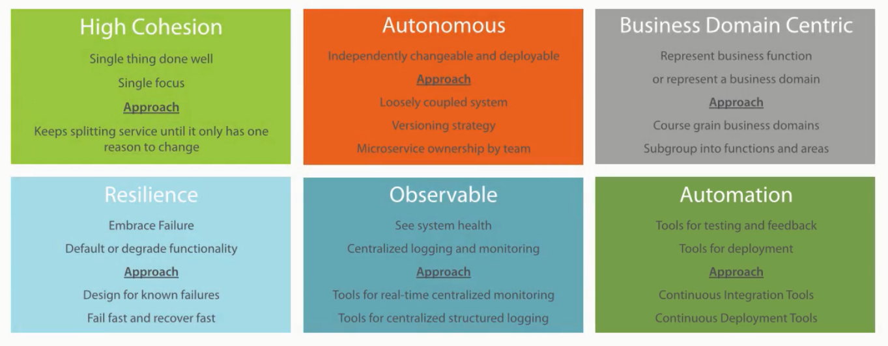
Microservices

Slide 59
Modern Architecture Ecosystem
Agile Vs. Waterfall
CICD
Cloud
Dockarization and Orchestration
DevOps
Multi-architecture paradigms.

Slide 60
Case studies
Skype
Amazon
Uber

Slide 61
Demo

Slide 62


Slide 63
References
Clean Architecture: A Craftsman's Guide to Software Structure and Design (Robert C. Martin Series) 1st Edition
Modern Software Architecture: Domain Models, CQRS, and Event Sourcing – Pluralsight
Clean Architecture: Patterns, Practices, and Principles – Pluralsight
Microservices Architecture Pluralsight

