Slide 1

POST-TEST QUIZ
Have you learned anything?
ENTER

Slide 2
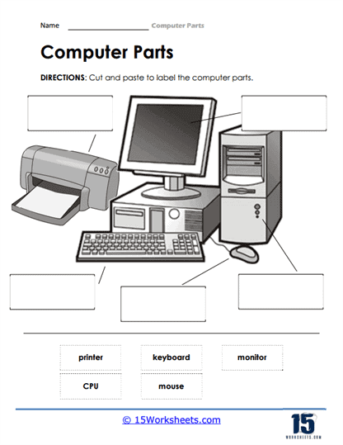
1.
2.
3.
5.
4.

Slide 3



01
7. What input device allows you to enter letters, numbers and symbols into your computer?
8. Which finger is used to press down on the caps lock? 9. What are the small symbols that represent a program?
10. What key do you press to copy?
11. What does this acronym mean (CPU)?
02
03
04

Slide 4
TRUE OR FALSE
12. Respect other people's time and bandwidth.
13. You shouldn’t always respect other people's privacy.
14. Help keep flame wars under control.
15. Do not use computer to harm other people.

