Slide 1
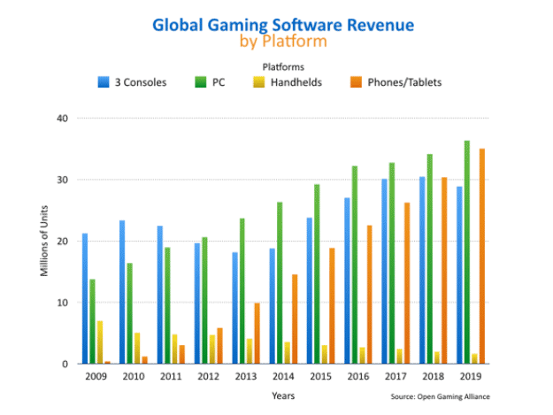

Motivation
Market for video games is growing quickly
High QoE is critical to attract many customers
Services with low QoE are not viable → Cloud gaming
QoE impact factors depend on the game since games differ strongly
Research questions
On what does the importance of QoS imapact factors depend?
How to categorize / classify games?
What are classification criterias for games?

Slide 2
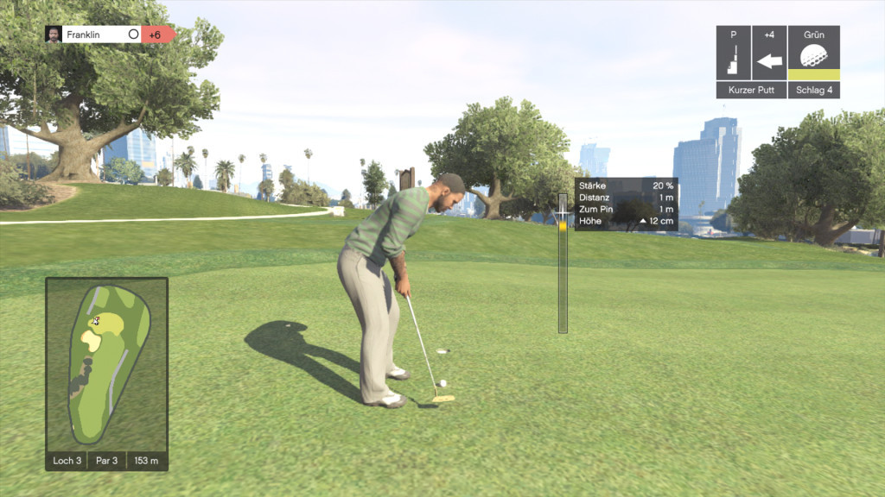
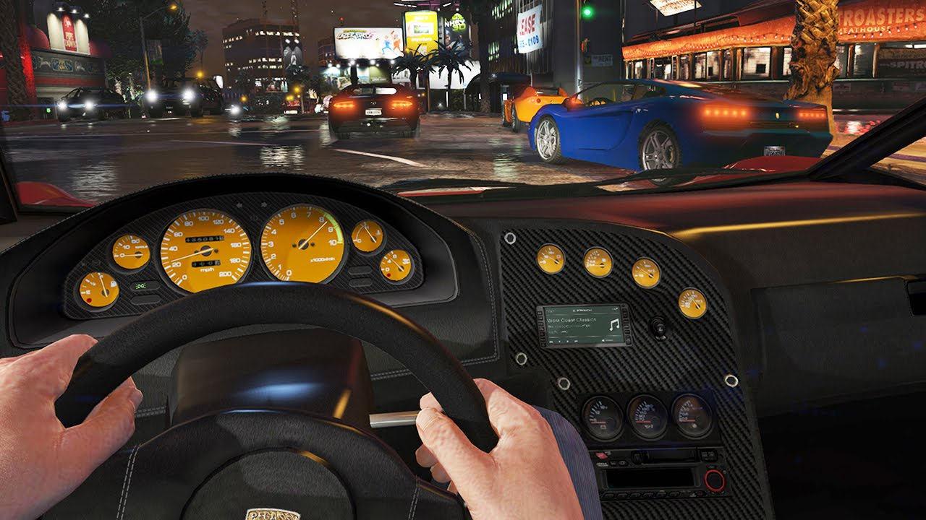
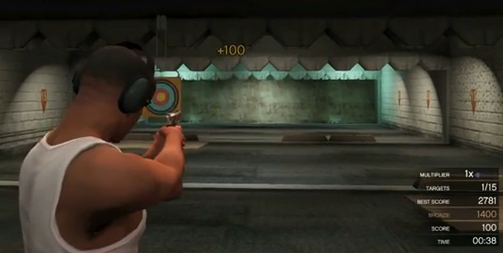
Scenario-based QoE
Same game (GTA 5)
Different scenarios
Golf, third person
Driving, first person
Shooting, third person
Different QoS requirements?

Slide 3
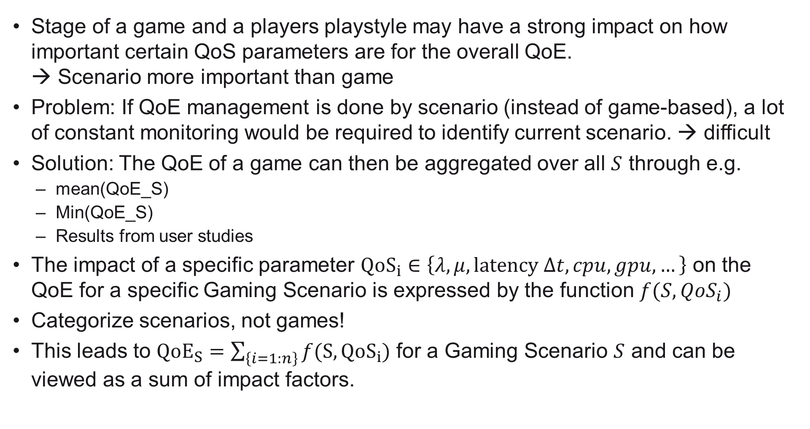
How to categorize?
Stage of a game and a players playstyle may have a strong impact on how important certain QoS parameters are for the overall QoE. → Scenario more important than game
Problem: If QoE management is done by scenario (instead of game-based), a lot of constant monitoring would be required to identify current scenario. → difficult
Solution: The QoE of a game can then be aggregated over all $S$ through e.g.
mean(QoE_S)
Min(QoE_S)
Results from user studies
The impact of a specific parameter $QoS_{i}∈\left\{λ,μ,latency Δt,cpu,gpu,…\right\}$ on the QoE for a specific Gaming Scenario is expressed by the function $f(S,QoS_{i})$
Categorize scenarios, not games!
This leads to ${QoE}_{S}=\sum_{\left\{i=1:n\right\}}{f(S,QoS_{i})}$ for a Gaming Scenario $S$ and can be viewed as a sum of impact factors.

Slide 4
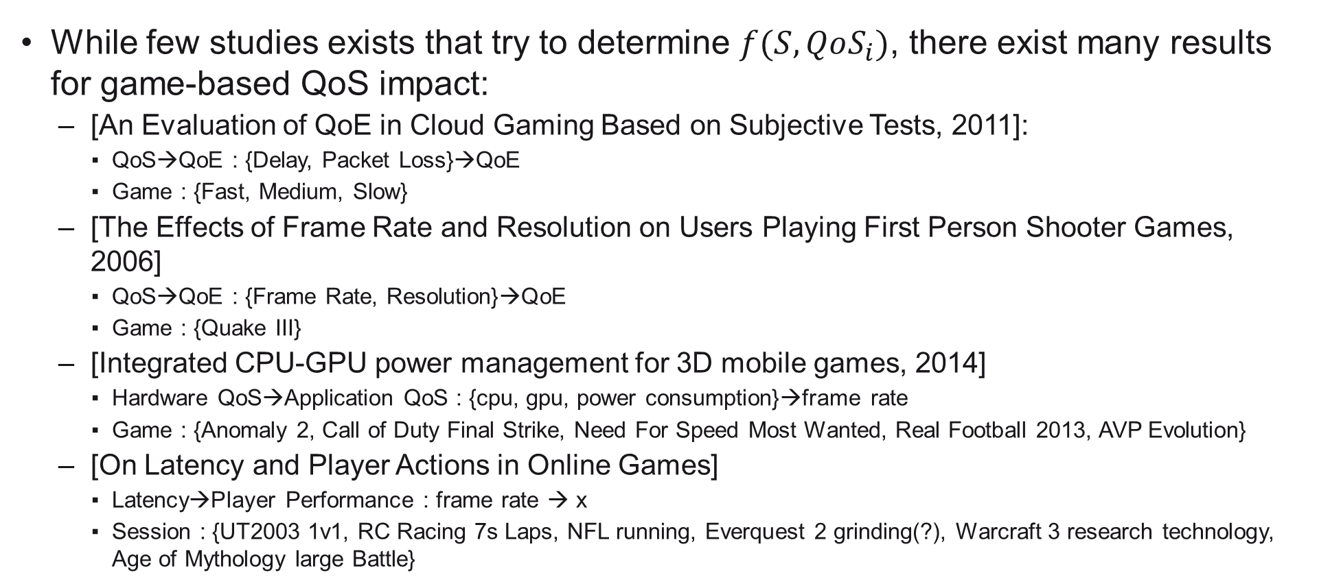
What is done in related work?
While few studies exists that try to determine $f(S,QoS_{i})$, there exist many results for game-based QoS impact:
[An Evaluation of QoE in Cloud Gaming Based on Subjective Tests, 2011]:
QoS→QoE : {Delay, Packet Loss}→QoE
Game : {Fast, Medium, Slow}
[The Effects of Frame Rate and Resolution on Users Playing First Person Shooter Games, 2006]
QoS→QoE : {Frame Rate, Resolution}→QoE
Game : {Quake III}
[Integrated CPU-GPU power management for 3D mobile games, 2014]
Hardware QoS→Application QoS : {cpu, gpu, power consumption}→frame rate
Game : {Anomaly 2, Call of Duty Final Strike, Need For Speed Most Wanted, Real Football 2013, AVP Evolution}
[On Latency and Player Actions in Online Games]
Latency→Player Performance : frame rate → x
Session : {UT2003 1v1, RC Racing 7s Laps, NFL running, Everquest 2 grinding(?), Warcraft 3 research technology, Age of Mythology large Battle}

Slide 5









$g(S_{1},QoS_{Net})$
$f(S_{1},QoS_{App})$
$g(S_{2},QoS_{Net})$
$f(S_{2},QoS_{App})$
$g(S_{3},QoS_{Net})$
Network Layer,
Hardware Layer
Application Layer
QoE,
User Engagement

