Slide 1
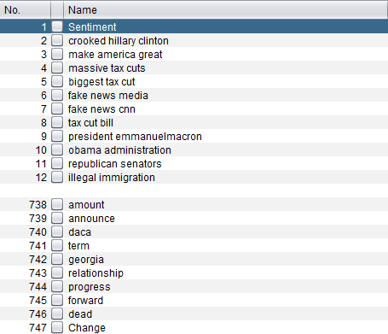
Trump Tweets vs The markets
The aim of the project is to find association between Trump tweets and U.S. Dollar.
Each tweet will have extracted
features(words and phrases),
predicted a sentiment and given a
dollar value change

Slide 2
Twitter data scrapping
Selecting tweets to do sentiment analysis
Features extraction from tweets
Building a model to do sentiment analysis
Selecting tweets to find assosiation with markets
Building a dataset with tweets and USD changes
Feature selection on the dataset
Choosing a treshold for USD value changes
Building a model predicting USD changes
Creating an interface using Flask and integration with a model
Adding other currencies
Writing a raport

Slide 3
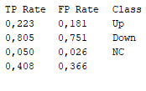
Results so far:
ZeroR: 39%
Naive Bayes: 46% on test (52% on train),
Logistic Reg: 47% on test (53% on train),
J48: 45% on test (54% on train)

