Slide 1
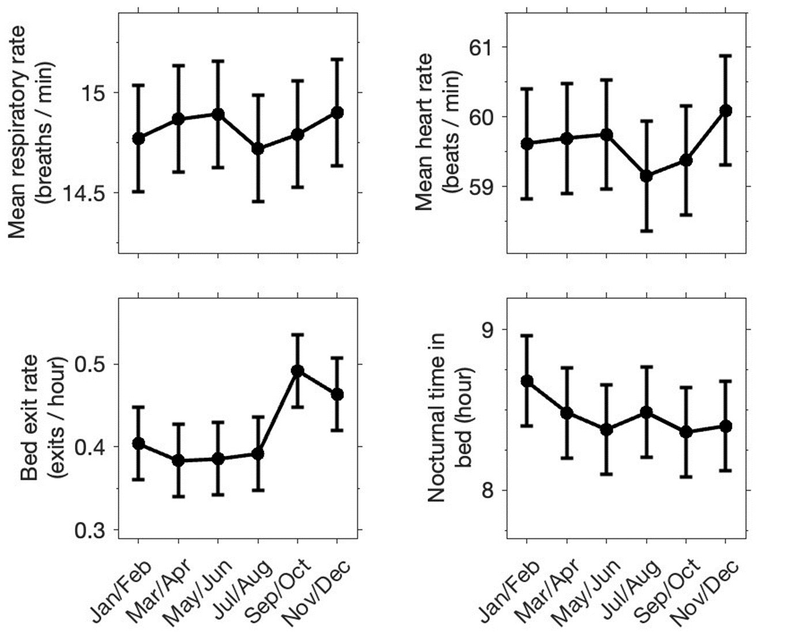
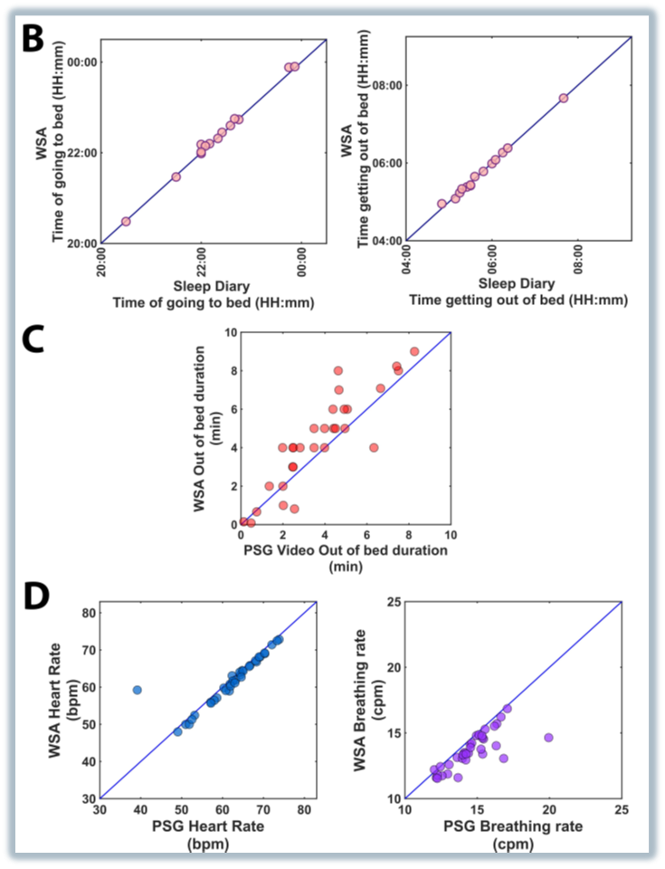
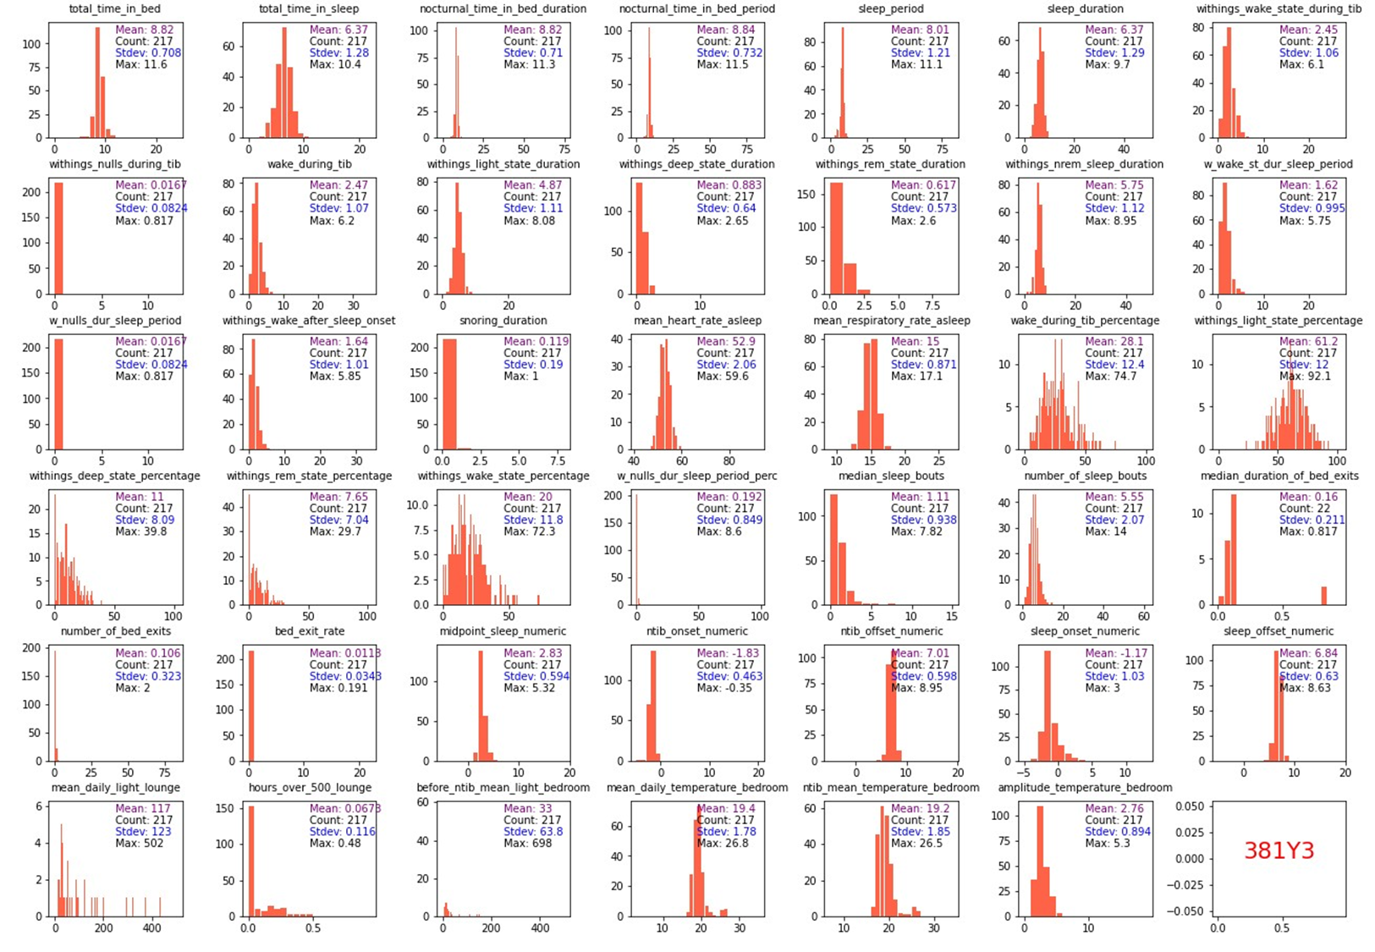
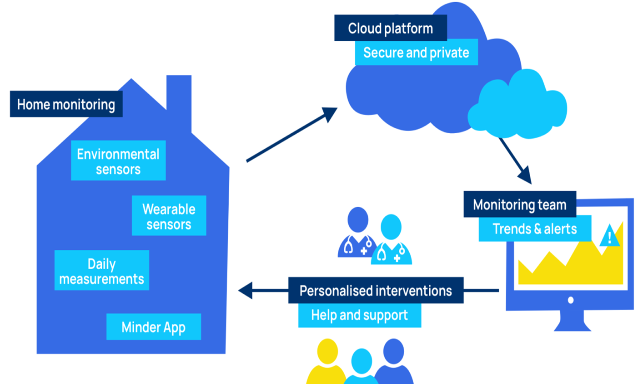
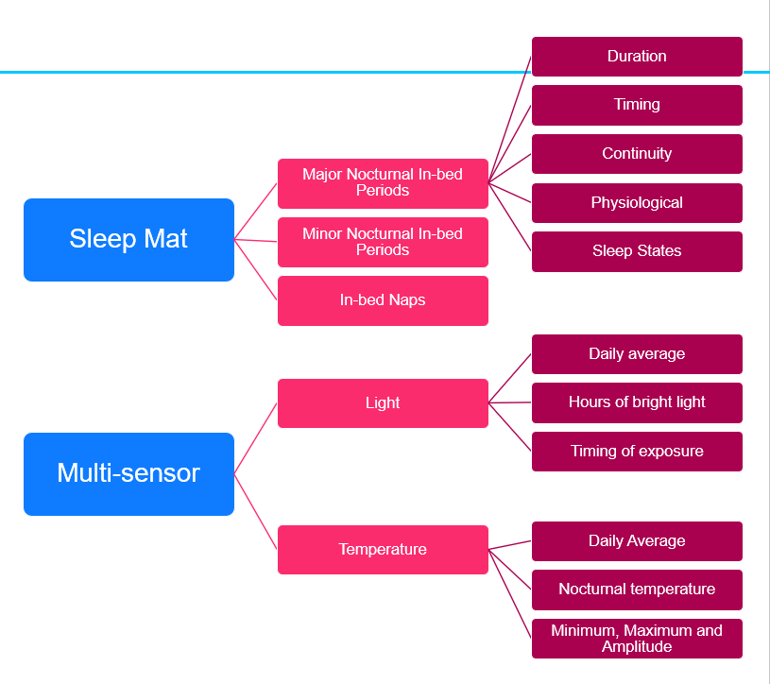
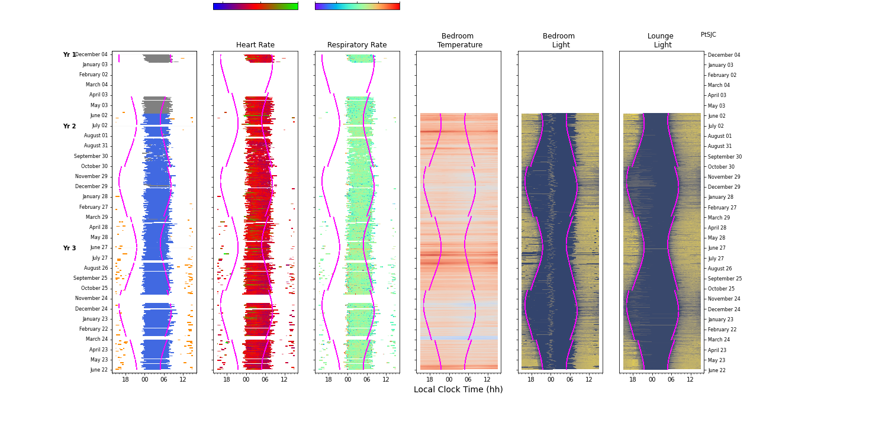
Approach, data selection and analysis pipeline
Requirements:
Sleep, light and temperature data that span all seasons
MODELING
DEVICE VALIDATION
DESCRIPTIVE STATISTICS
DATA CLEANING
METRICS
VISUAL INSPECTION

Slide 2
Process of defining and selecting metrics
WSA
Major nocturnal In-bed periods
Duration (1 metric)
Minor nocturnal In-bed periods
In-bed naps
Timing (2 metrics)
Continuity (3 metrics)
Physiology (2 metrics)
Sleep states
Multi-sensor
Light
Temperature
Daily average
Hours of bright light
Timing of exposure
Daily average
Nocturnal temperature
Minimum, maximum and amplitude

Slide 3
Merged all the different data streams to one large table
DCARTE
REDCAP DATA
Major NTIB, Minor NTIB, and nap metrics
WSA data
MMSE DATA
NPI DATA
In-bed / sleep bouts and in-bed / sleep periods
DEMOGRAPHICS DATA
Temperature Metrics
Temperature data
MASTER TABLE
Participants and dates selection
ANALYSIS TABLE
Light data
Light Metrics

