Slide 1


Slide 2
Business Case
Bugs as part of the Software Development Lifecycle
Repeat Issues can go unnoticed
Multiple teams and projects
Can be used in other areas

Slide 3




Project Requirements
Source Control
C#
SQL
MVC
ASP.NET

Slide 4
Model-View-Controller

Slide 5
Model
Code First
Entity Framework

Slide 6
Model - Classes
Represent real world entities
Need to have a relation between a Bug and the person working on it
Relates to how the data will be captured and stored within the website
Will be used to generate SQL

Slide 7
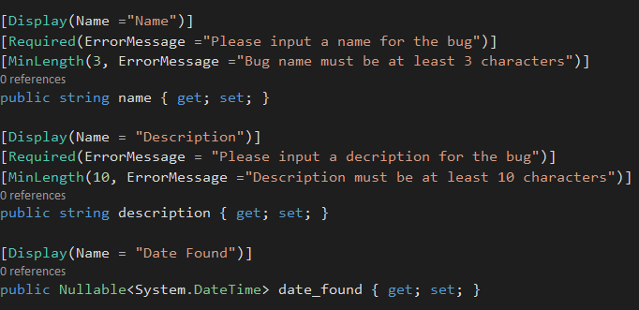
Model – Bug Class

Slide 8
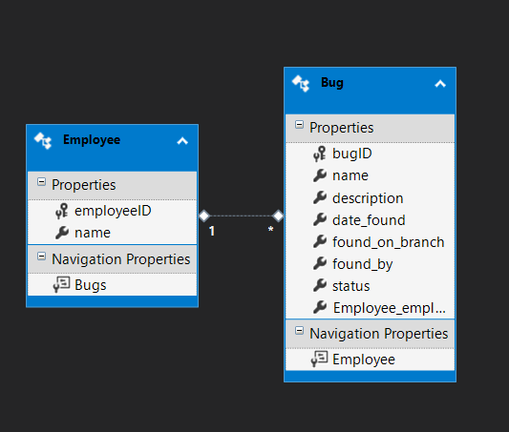
Model Entity-Relationship
Private Key
Foreign Key

Slide 9

Model Foreign Key Relationship

Slide 10
Model
Transact Structured Query Language

Slide 11
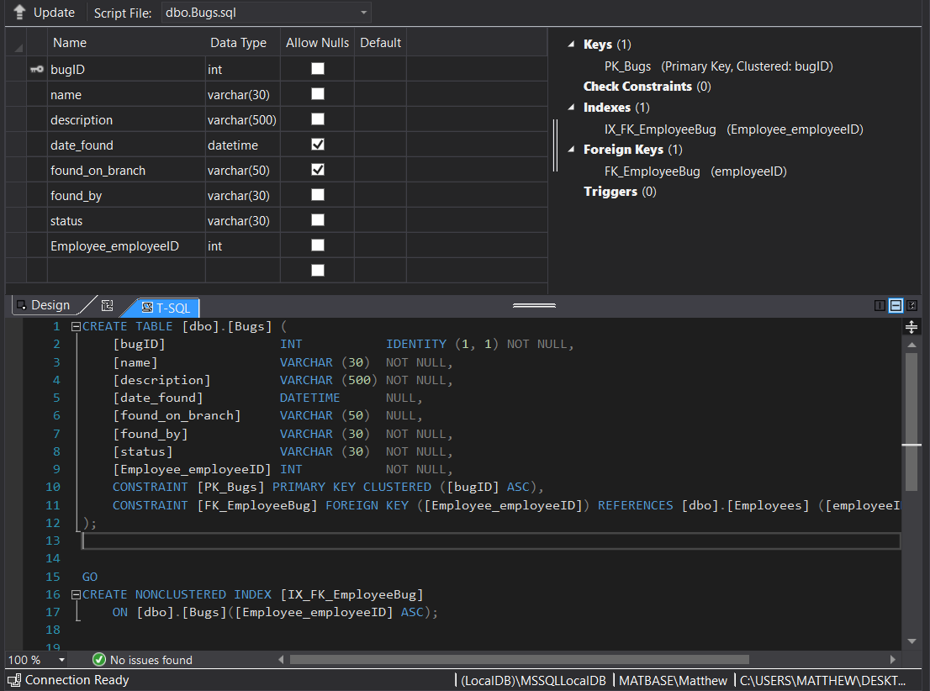
Structured Query Language

Slide 12
View
Form Entry
Navigation
Validation
Create, Read, Update, Delete

Slide 13
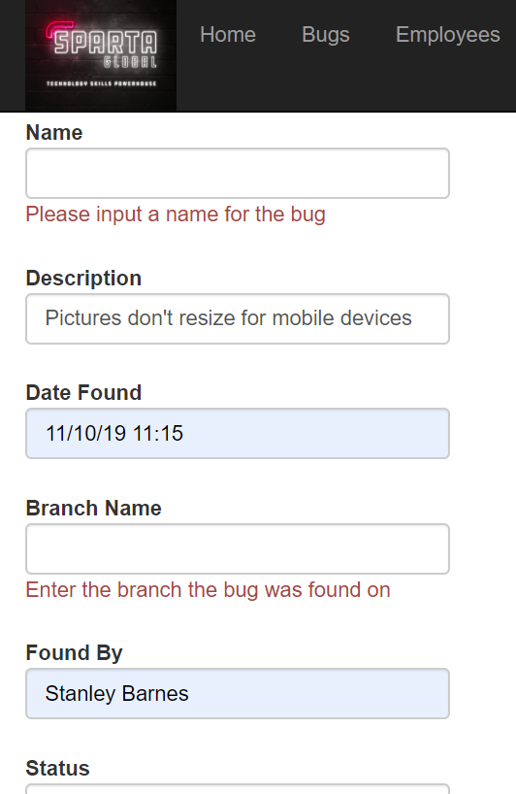
View - Create

Slide 14
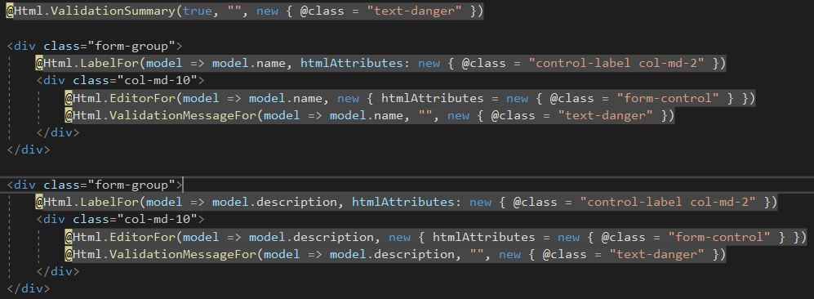
View Create code

Slide 15
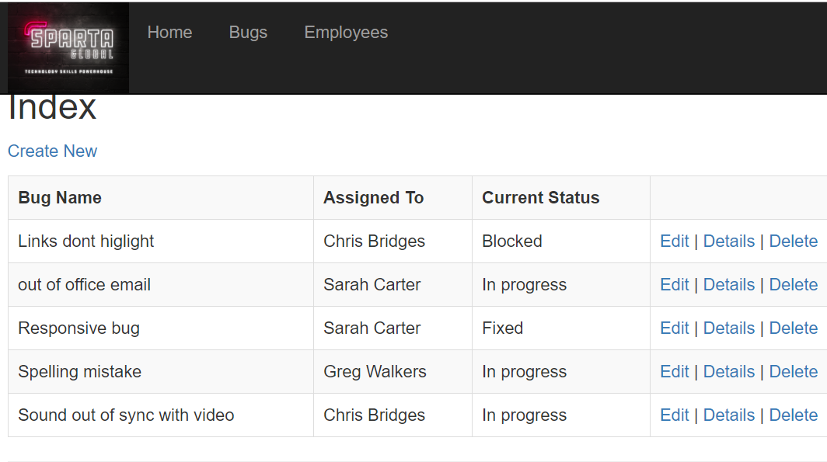
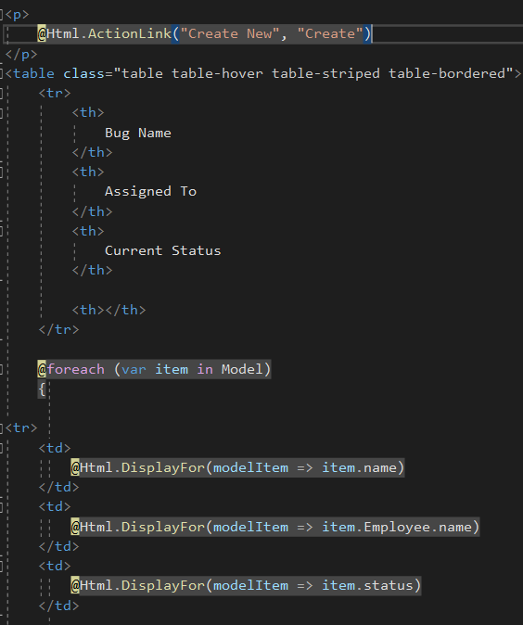
View - Read

Slide 16
Controller
Navigate Around pages
Communicate between browser and database

Slide 17
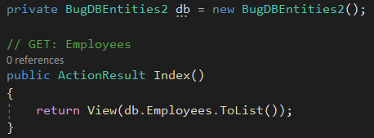
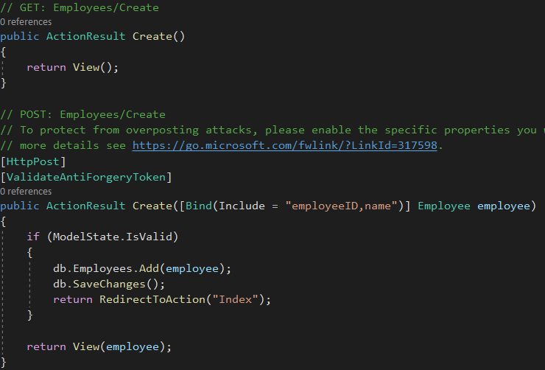
Controller Action
Model Validation

Slide 18
Conclusion

