Slide 1
Dataset
Replaced 60.667 with 60 for age
Changed all binary 0s to False, 1s to True
For sex, 0 for F, 1 for M

Slide 2
COLUMN NAME | UNIQUE VALUE COUNT | VALUES (IF NOT TOO MANY)
Age | 47 | Min: 40 Max: 95
Anaemia | 2 | False: 52.56% True: 47.44%
Creatinine Phosphokinase | 290 | Min: 23 Max: 7861
Diabetes | 2 | False: 56.06% True: 43.94%
Ejection Fraction | 17 | 35: 15.42% 40: 14.18% 38: 12.56% 30: 11.98% 25: 11.82% 60: 9.70% 45: 7.06% 50: 6.90% 20: 6.50% 55: 0.96% 15: 0.88% 17: 0.66% 62: 0.52% 65: 0.30% 70: 0.22% 14: 0.18% 80: 0.16%
High Blood Pressure | 2 | False: 63.52% True: 36.48%

Slide 3
COLUMN NAME | UNIQUE VALUE COUNT | VALUES (IF NOT TOO MANY)
Platelets | 203 | Min: 25100.0 Max: 850000.0
Serum Creatinine | 43 | Min: 0.5 Max: 9.4
Serum Sodium | 27 | Min: 113 Max: 148
Sex | 2 | M: 64.56% F: 35.44%
Smoking | 2 | False: 68.82% True: 31.18%
Time follow-up period (days) | 155 | Min: 4 Max: 285
DEATH EVENT | 2 | False: 68.64% True: 31.36%

Slide 4
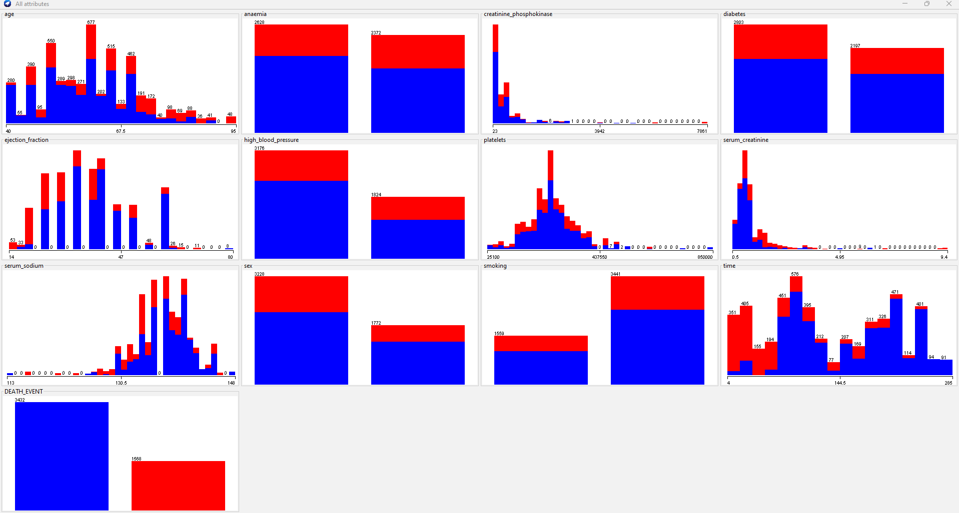

Slide 5
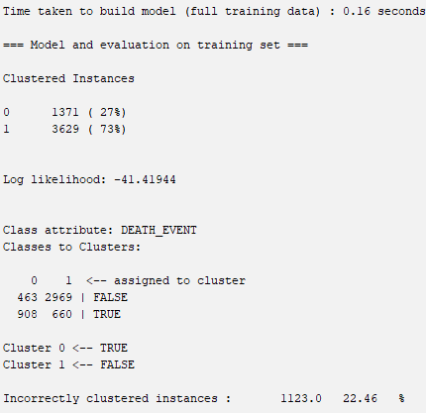
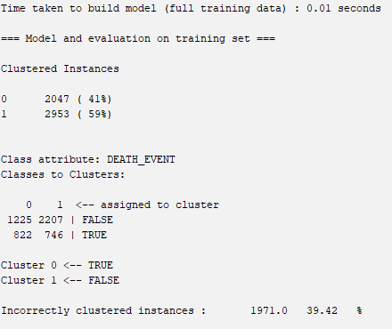
Clustering
EM
Simple K Means

Slide 6
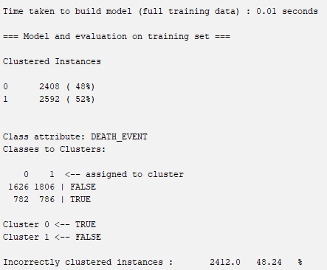
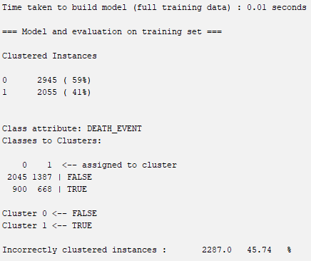
Clustering
Canopy
Farthest First

Slide 7
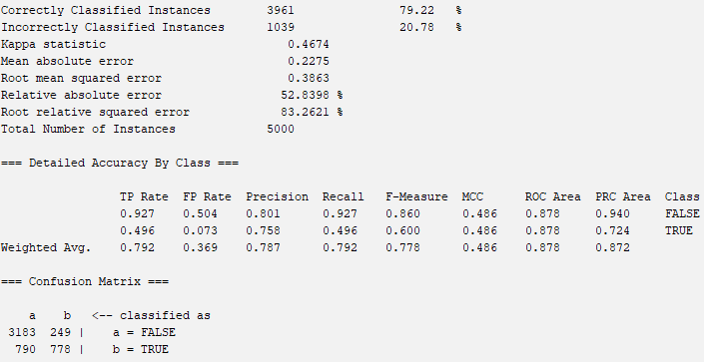
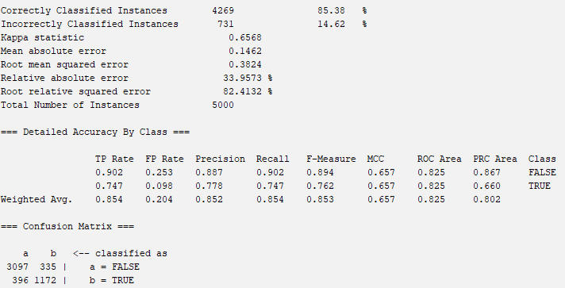
Classification
Naive Bayes
SGD

Slide 8
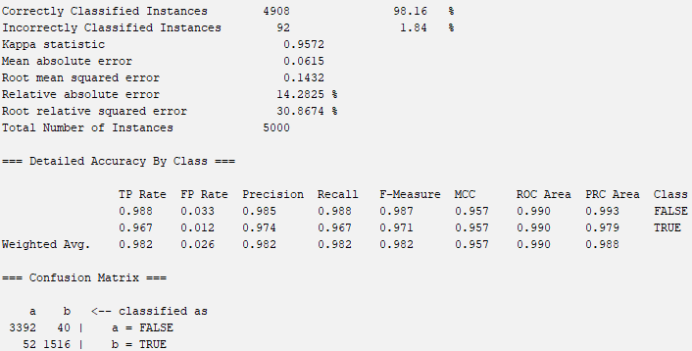
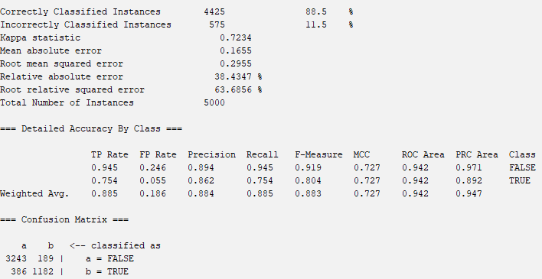
Classification
Classification via Regression
Ada Boost M1

Slide 9
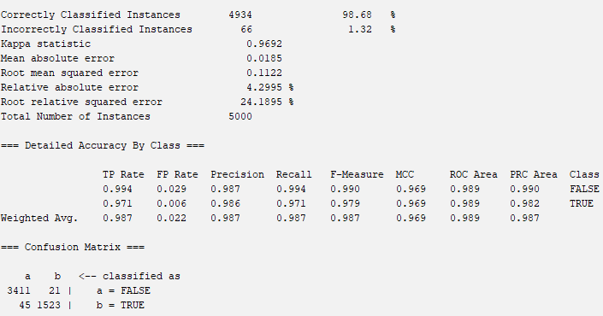
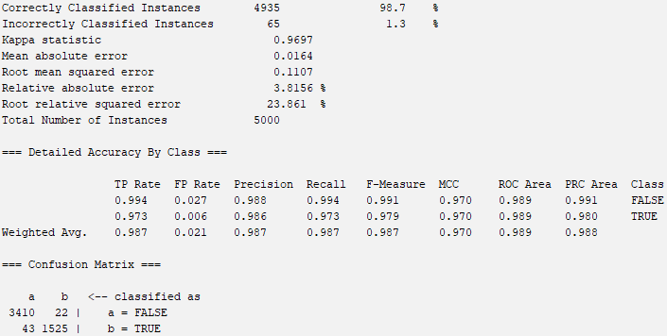
Classification
J48 Tree - pruned
J48 Tree - unpruned

Slide 10
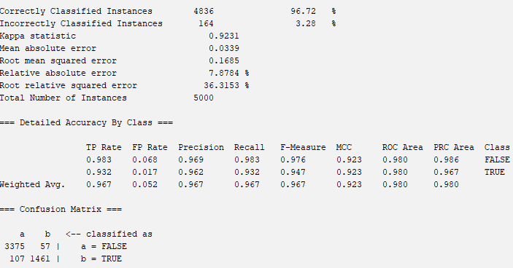
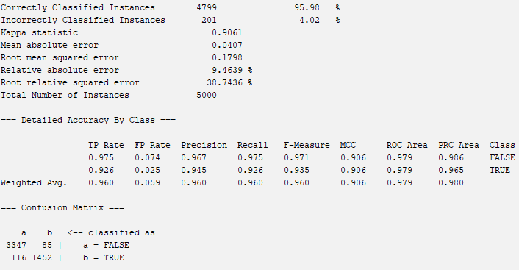
Classification
KNN - 5
KNN - 7

Slide 11
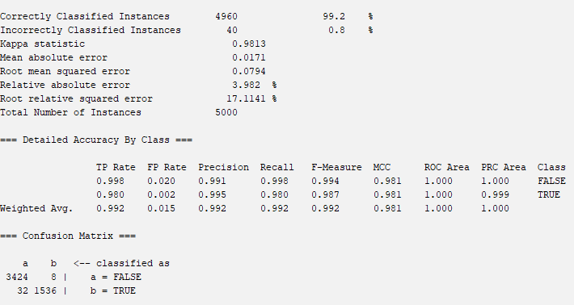
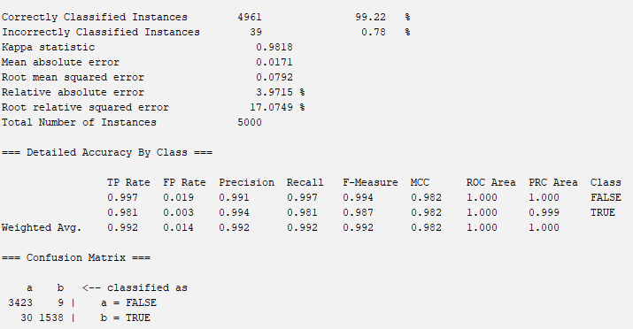
Classification
Random Forest
Random forest - normalization

Slide 12

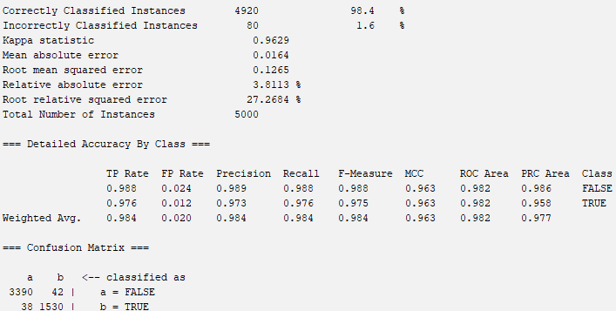
Classification
Random Tree
Random tree - normalization

Slide 13
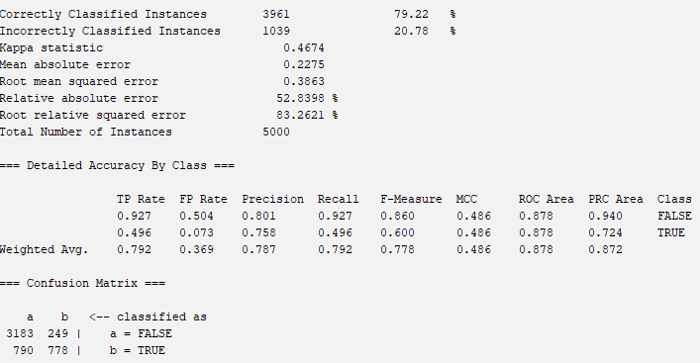
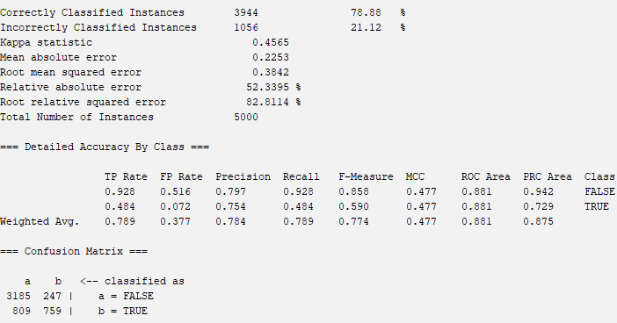
Classification
Naive Bayes
Naive Bayes with normalization

