Slide 1

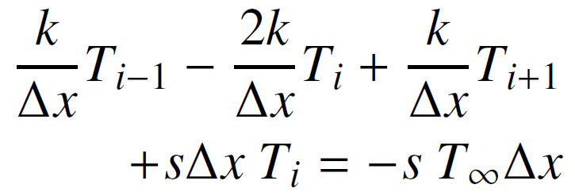
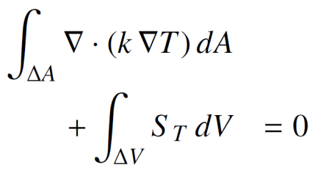

Plain-C-like style
Expression Templates
EDSL for Poisson eq. solver
Semantic model
+
Performance of executable
OOP limit
OOP style
Expressiveness of source code in C++

Slide 2
EDSL for Poisson eq. solver
Manual parallelization
Scalability
+
Parallel skeleton
Reordering of control volumes
+
Semantic model
Plain-C-like style
Expression Templates
Automatic parallelization by C++ compiler
1
Expressiveness of source code in C++

