Slide 1

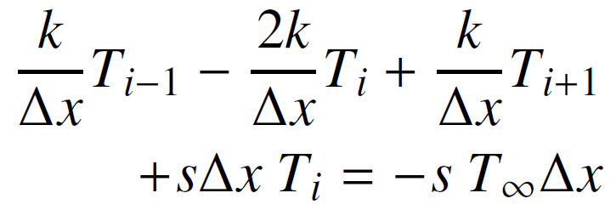
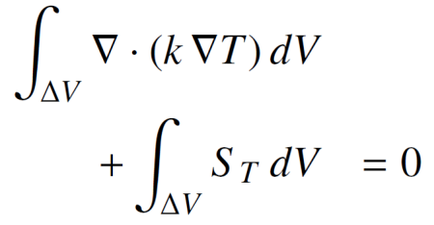

EDSL for Poisson eq. solver
Expression Templates
Performance of executable
Plain-C-like arrays
+
Semantic model
Matrix & vector
objects
Expressiveness limit of OOP
Expressiveness of C++ code in mathematical modeling

Slide 2
Scalability
Parallelization
by hand
Parallelization
by semantic model
Semantic model
EDSL for Poisson eq. solver
+
Plain-C-like arrays
Matrix & vector
objects
Parallelization
by C++ compiler
1
Expressiveness of C++ code in mathematical modeling

