Slide 1
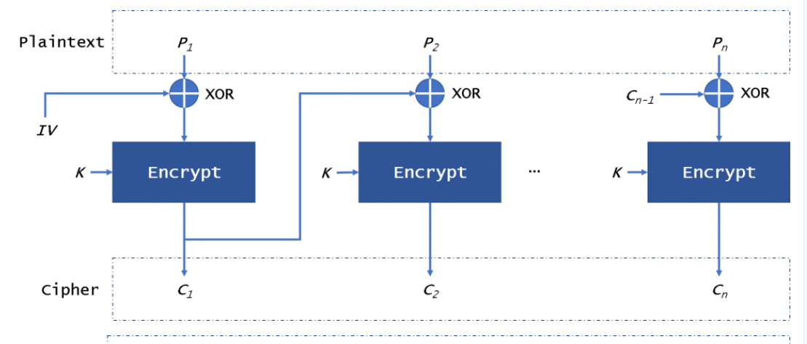
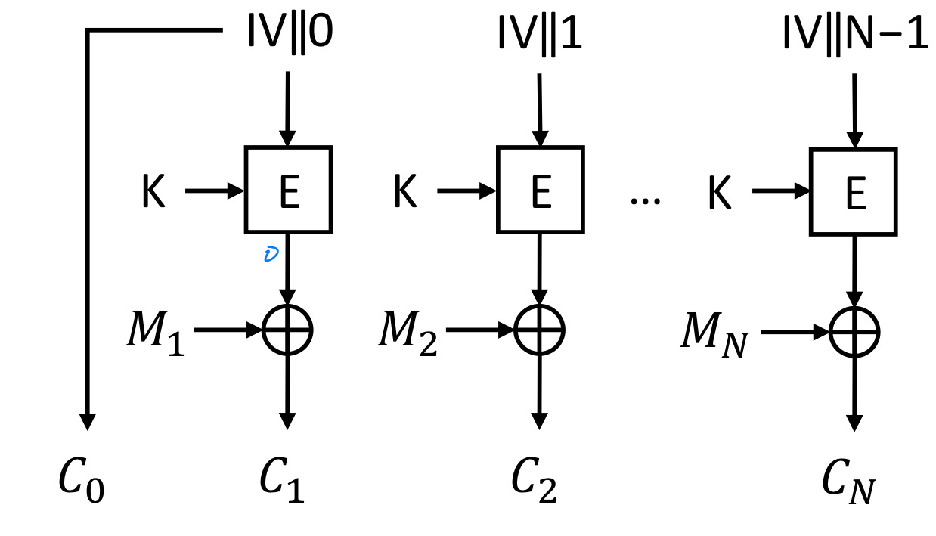
Low quality of random number affects to Crypto and then TLS
A1: how extent quality of random number
A2: how extent and how affect to Key stream from the random numbers
B1: how affect to Ciphertext from the key stream
How measures A2, B1 in AES-CTR??
A1: NIST SP-800
TLS has vulnerability by AES-CBC
Called Beast attack
AES-CBC
AES-CTR

Slide 2
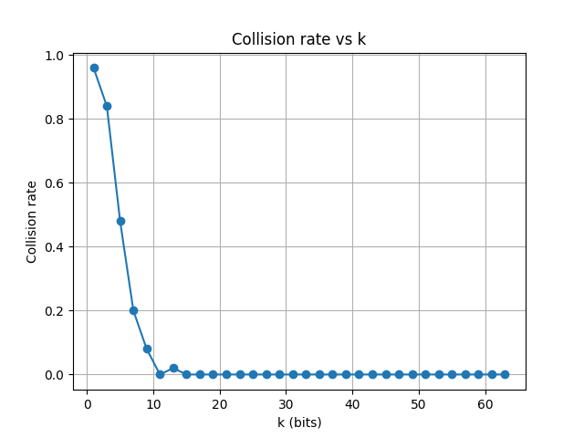
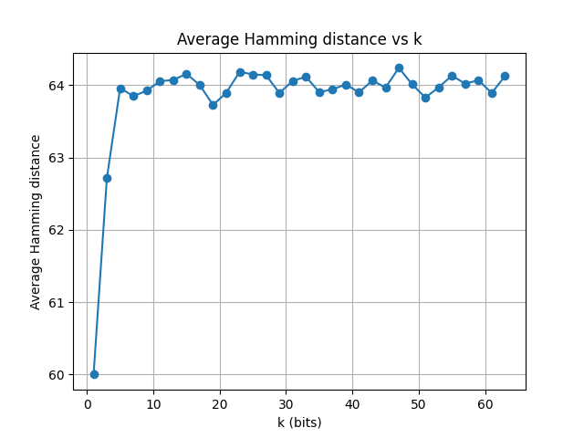
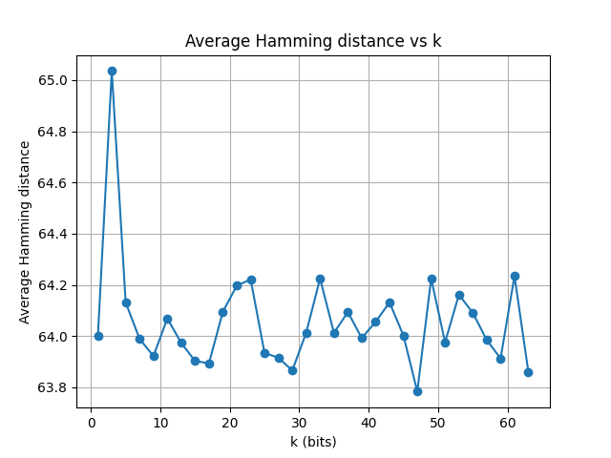
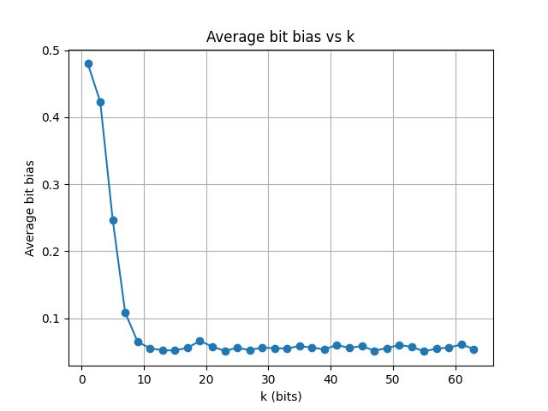
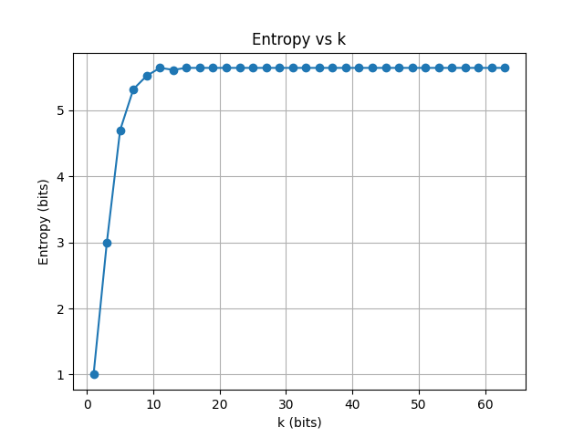
0208 measure of key stream on low random quality
support_shrink_hash_expand
2

Slide 3
Researcher review

Slide 4
GCM-SIV: Full Nonce Misuse-Resistant Authenticated Encryption at Under One C/B
Background- CAESAR competition is considering new model for authentication encryption
Even if nonce or IV repeating, this can keep secure.
RQ- : How to make new authenticated encryption scheme using GCM building block.
Measure : A full nonce misuse-resistant authenticated encryption scheme can do that if the same nonce is used encrypt the same message twice, then the same ciphertext is obtain.
How :

