Slide 1
Development and Evaluation of a Retail Unit Price Prediction System using MLflow
AIN3009 – Delivering AI Applications with MLOps
Masa Bokhary · ID: 2287036 · Bahçeşehir University Instructor: Gökşin Bakır · May 2026

Slide 2
Agenda
What we will cover today
01
Project Overview & Motivation
06
Hyperparameter Tuning with Hyperopt
02
Dataset — Online Retail II
07
Model Registry & Deployment
03
System Architecture
08
Post-Deployment Monitoring
04
Data Preprocessing
09
Results & Evaluation
05
Baseline Model Training & Tracking
10
Challenges & Conclusion

Slide 3
Project Overview
End-to-end MLOps with MLflow on a real retail dataset
Problem
Dataset
MLOps Tool
Predict the unit price (GBP) of retail products from transactional features
Online Retail II (UCI) ~541,000 transactions Dec 2009 – Dec 2011
MLflow 2.14 Tracking · Registry Serving · Monitoring
Models
Tuning
Backend
Ridge Regression Random Forest XGBoost (primary)
Hyperopt TPE Nested MLflow runs 6-dimensional search
SQLite (local) No external server Fully self-contained

Slide 4
Dataset — Online Retail II
UCI Machine Learning Repository
Column
Description
Transactions
Invoice
Invoice number ('C' prefix = cancellation)
541,000
StockCode
Product code (5-digit + letters)
Description
Product name (text)
After cleaning
Quantity
Units per transaction line
~135k (25% sample)
InvoiceDate
Timestamp of transaction
Price ★
Unit price in GBP — TARGET variable
Customer ID
Customer identifier (nullable)
Target
Country
38 countries; UK is majority
log1p(Price)
Period
2009 – 2011

Slide 5
System Architecture
Six modular Python scripts — fully local, no external services
data_prep.py
train_experiments.py
tune_hyperopt.py
register_model.py
mlflow models serve
monitor_batch.py
Load → Clean → Engineer → Split
▶
Ridge · RF · XGBoost Baseline Training
▶
Hyperopt TPE Nested Runs
▶
Best Run → Model Registry
▶
REST API Port 5001
▶
Batch Scoring Drift Metrics
🔵 All stages log to MLflow Tracking (SQLite backend) — params · metrics · artefacts
▸ Single config.py — all paths & names in one place
▸ sklearn Pipeline wraps every model — same preprocessing at train / serve / monitor time
▸ SQLite backend — full Model Registry without a separate MLflow server

Slide 6
Data Preprocessing
src/data_prep.py — load · clean · engineer · split
1 Load
2 Clean
3 Engineer
▸ pd.read_csv(encoding='latin1')
▸ Drop invoices starting with 'C'
▸ desc_len, desc_word_count
▸ Optional sample_frac (default 0.25)
▸ Remove Qty ≤ 0 or Price ≤ 0
▸ stock_prefix (first 3 chars)
▸ ~541k rows total
▸ Drop nulls in Desc/StockCode/Country
▸ month, day-of-week, hour
▸ Strip whitespace, drop short descriptions
Final features: Quantity · desc_len · desc_word_count · month · dow · hour · Country · stock_prefix
ColumnTransformer: Numeric → Median imputation + StandardScaler | Categorical → Mode imputation + OneHotEncoder (max 50 cats)

Slide 7
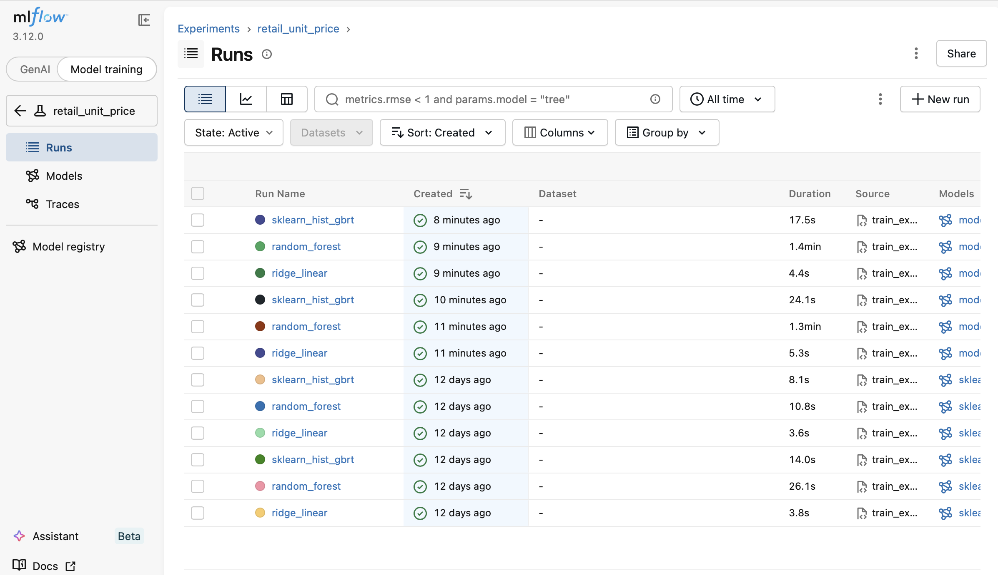
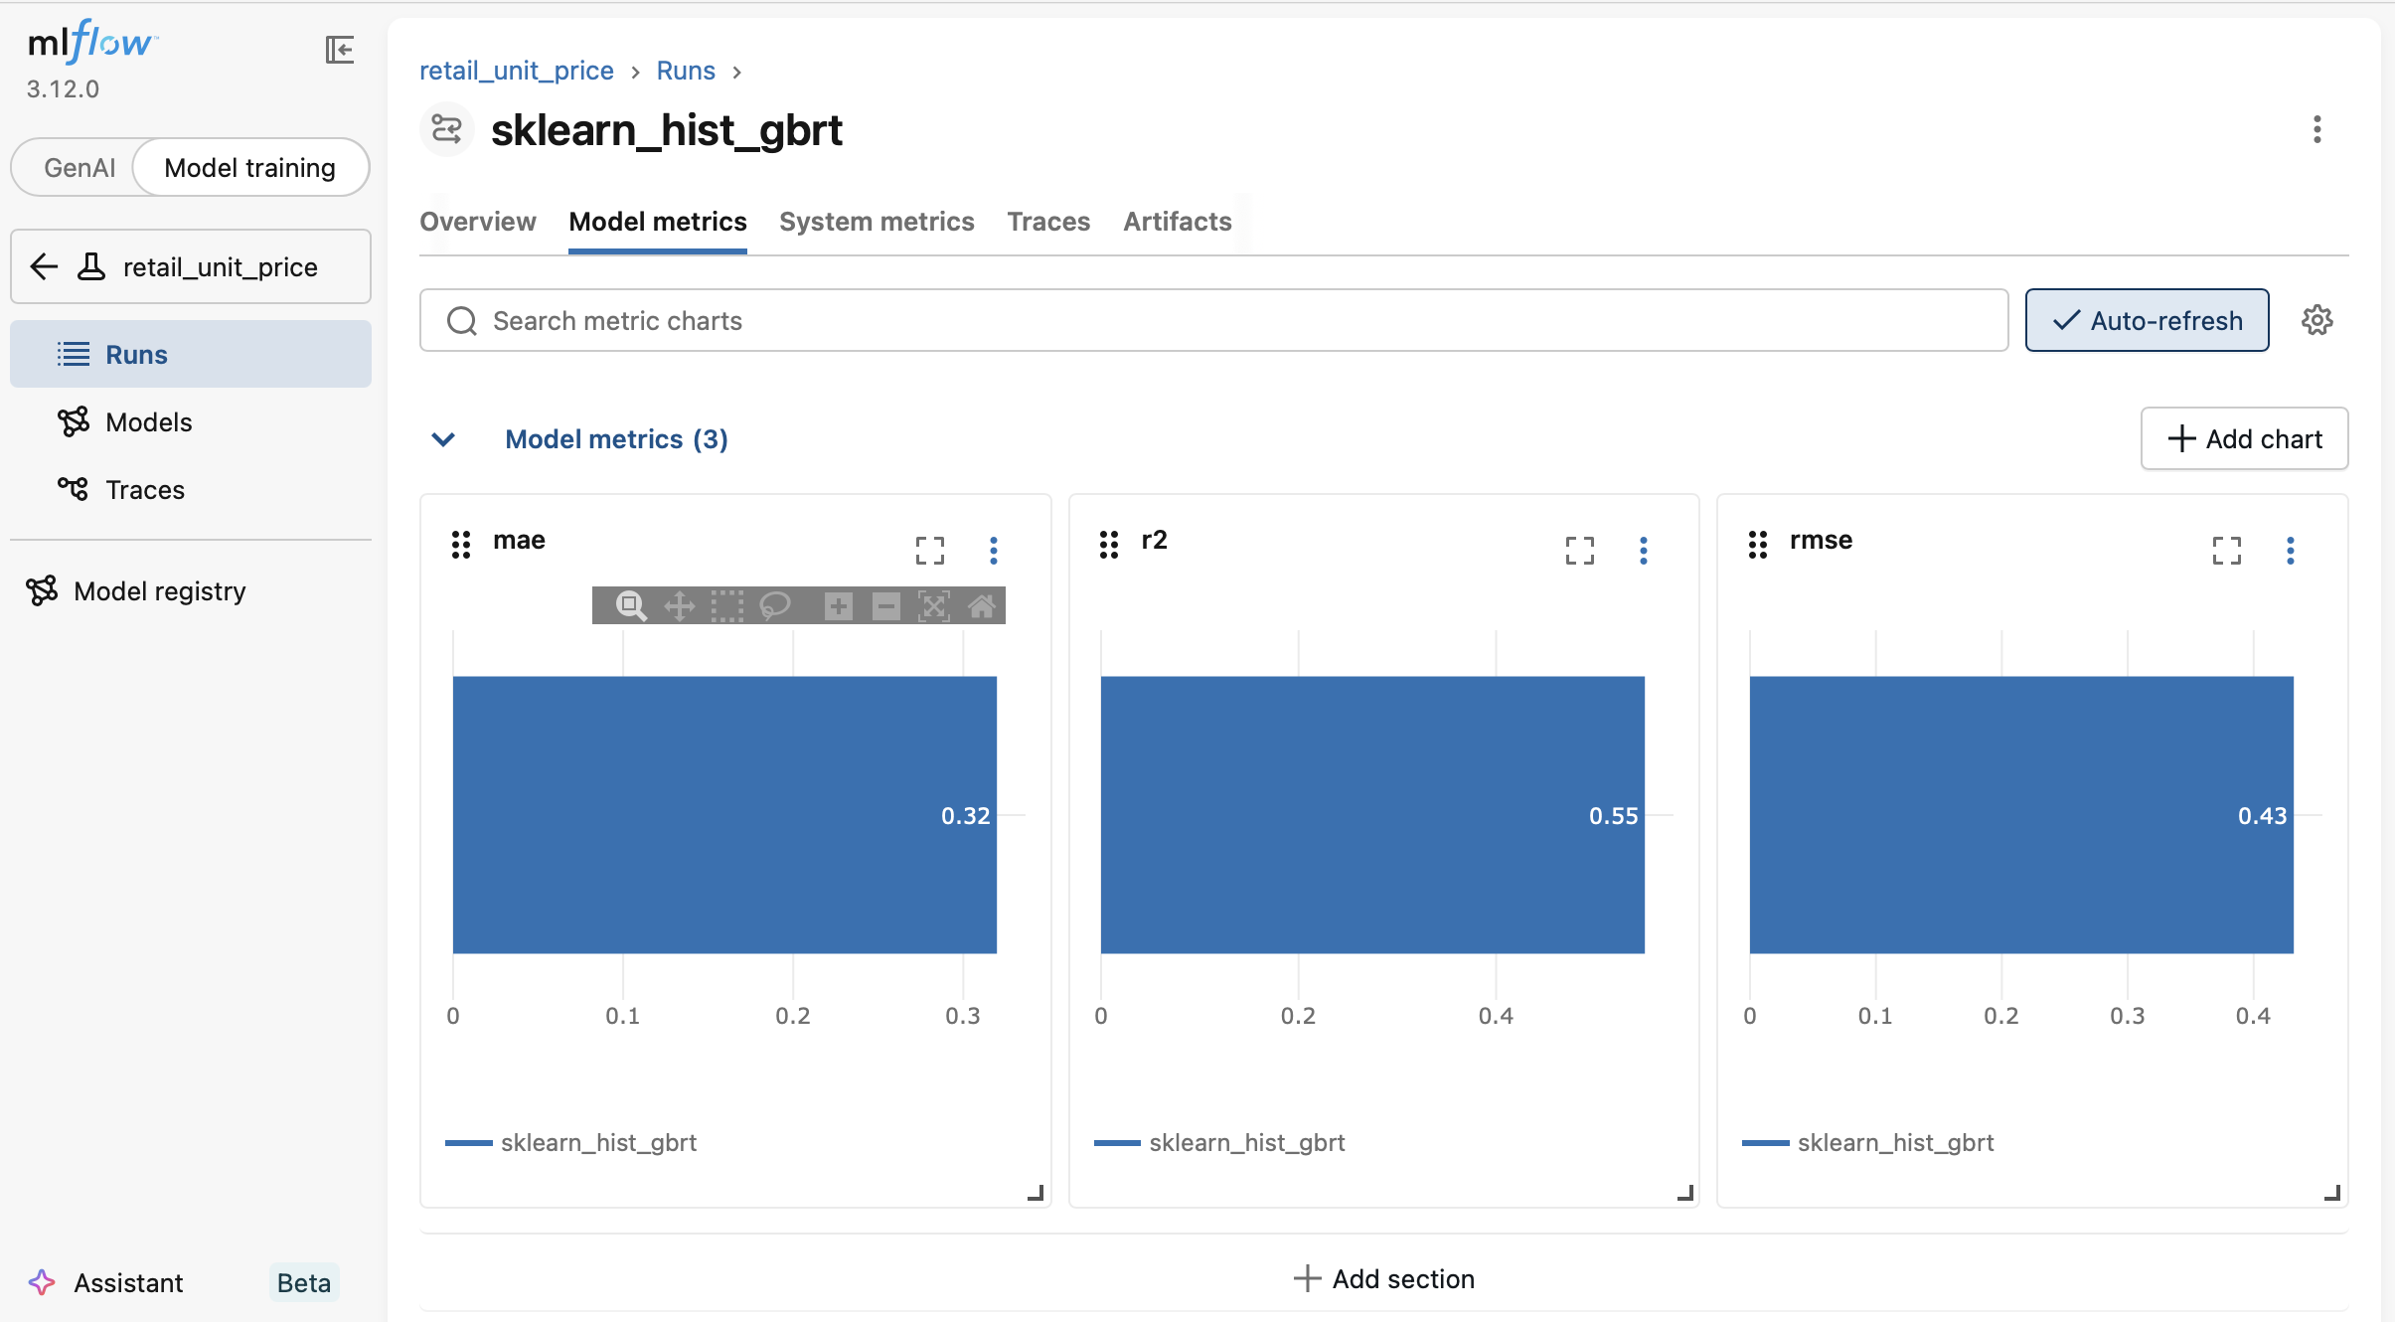
Baseline Model Training & MLflow Tracking
src/train_experiments.py — three models, one experiment
Ridge Regression
Random Forest
XGBoost
What MLflow logs
alpha = 1.0
120 trees max_depth = None n_jobs = -1
200 rounds depth 8, lr 0.08 subsample 0.85
▸ Params: model_name, sample_frac, target_transform
▸ Metrics: RMSE, MAE, R²
Fast & interpretable L2 regularisation Linear baseline
Non-linear ensemble Robust to outliers
Gradient boosting Primary candidate for tuning
▸ Artefact: sklearn Pipeline (with inferred signature)
MLflow UI — retail_unit_price experiment showing all baseline runs
Individual run — mae / r2 / rmse charts

Slide 8
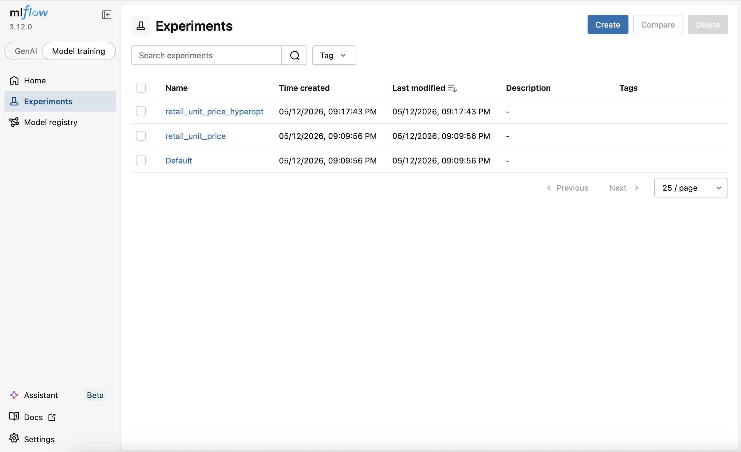
MLflow Experiment Tracking — Three Experiments
Separation of concerns across lifecycle stages
Experiment
Purpose
Key Content
retail_unit_price
Baseline comparison
Ridge, RF, XGBoost runs + logged models
retail_unit_price_hyperopt
Hyperparameter tuning
Parent run + nested child trials
retail_price_monitoring
Post-deployment monitoring
Timestamped batch scoring runs
MLflow UI — Experiments page listing all three project experiments

Slide 9
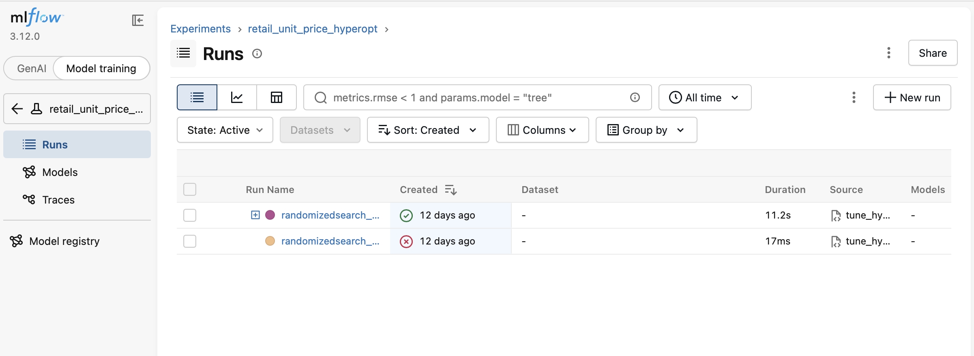
Hyperparameter Tuning with Hyperopt TPE
src/tune_hyperopt.py — Bayesian optimisation with nested MLflow runs
Hyperparameter
Distribution
Range
TPE Algorithm
max_depth
Integer uniform
3 – 14
▸ Tree-structured Parzen Estimator
learning_rate
Log-uniform
0.01 – 0.30
▸ Models p(x|good) and p(x|bad) separately
subsample
Uniform
0.60 – 1.00
▸ Selects next trial from p(x|good) / p(x|bad)
colsample_bytree
Uniform
0.60 – 1.00
▸ More efficient than random or grid search
n_estimators
Integer uniform
80 – 400
▸ HYPEROPT_MAX_EVALS = 24 (default)
min_child_weight
Integer uniform
1 – 10
Nested Run Pattern
hyperopt_xgboost_parent (parent run)
├─ trial_1 → rmse, params, model
├─ trial_2 → rmse, params, model
├─ ... → ...
└─ best_* → best params on parent
MLflow UI — retail_unit_price_hyperopt experiment with parent runs

Slide 10
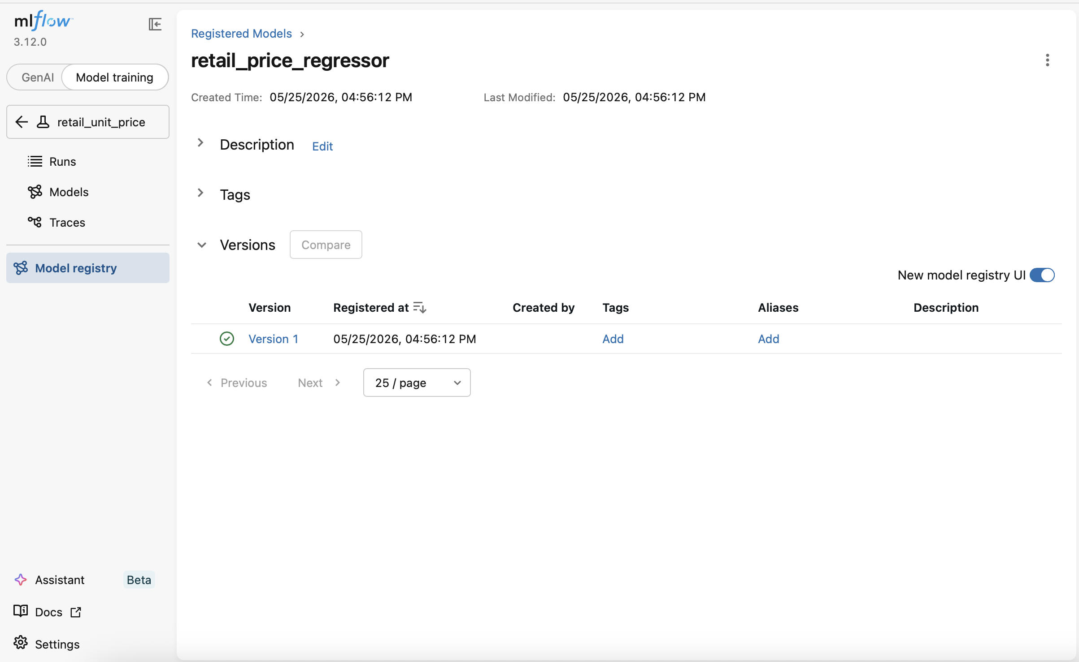
Model Registry
src/register_model.py — versioned, staged model management
None
→
Staging
→
Production
→
Archived
Step 1 — Pick best run
Step 2 — Register model
Step 3 — Set stage
Search runs by ascending RMSE client.search_runs(order_by=['metrics.rmse ASC'])
mlflow.register_model(uri, 'retail_price_regressor') Auto-increments version number
client.transition_model_version_stage() --stage Staging or --stage Production
MLflow Model Registry — retail_price_regressor with Version 1 registered

Slide 11
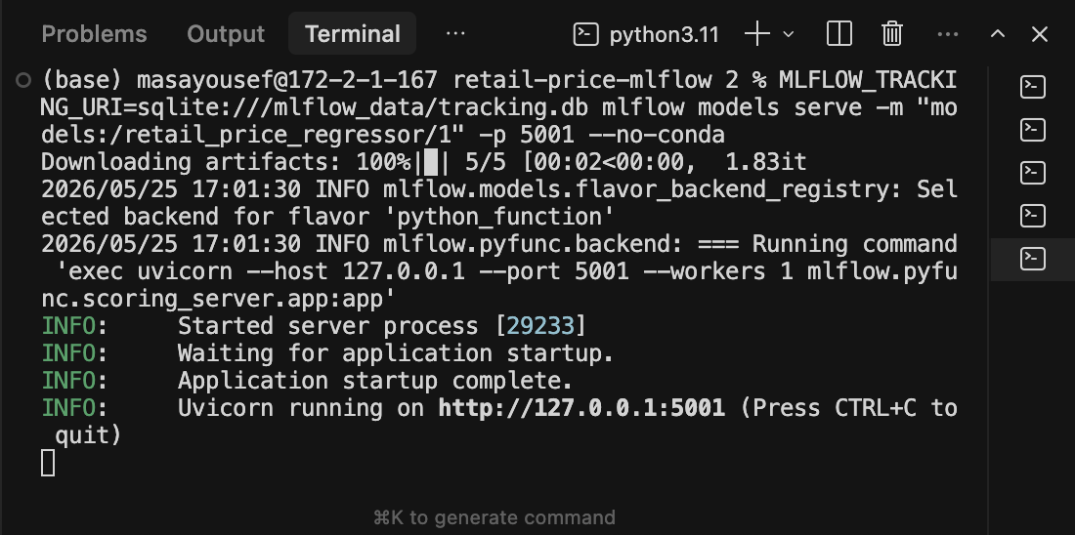
Model Deployment — REST API
mlflow models serve + src/predict_example.py
Serve Command
How it works
mlflow models serve \ -m models:/retail_price_regressor/1 \ -p 5001 --no-conda
▸ Flask/Uvicorn server at port 5001
▸ Endpoint: /invocations
▸ Input format: dataframe_split JSON
Sample Request (curl)
▸ Pipeline embedded → no client-side preprocessing
POST /invocations { "dataframe_split": { "columns": ["Quantity","desc_len", "desc_word_count","month", "dow","hour","Country", "stock_prefix"], "data": [[6,22,4,12,4,8,"UK","850"]] } }
▸ Model signature enforces column names/types
▸ predict_example.py for scripted testing
Terminal — mlflow models serve running the registered model on Uvicorn

Slide 12
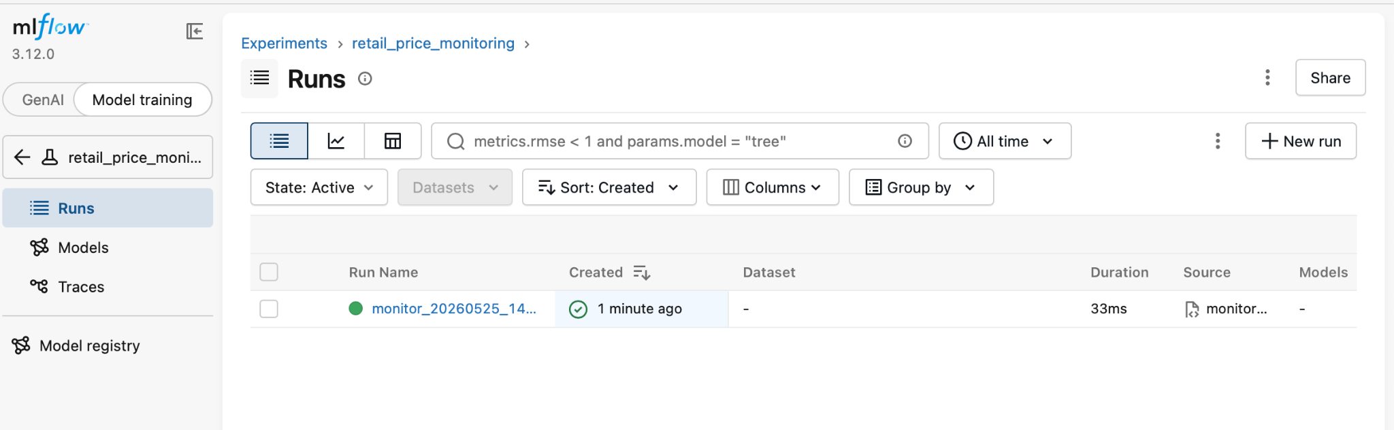
Post-Deployment Monitoring
src/monitor_batch.py — batch scoring + drift detection logged to MLflow
monitoring_rmse
monitoring_mae
monitoring_mean_abs_residual
pred_std / target_std
Root Mean Squared Error on monitoring batch
Mean Absolute Error on monitoring batch
Mean absolute value of all residuals
Drift proxy — ratio of std Close to 1 = healthy
How Monitoring Works
▸ Sample 8% held-out batch (random_state=7, different from training)
▸ Load latest registered model from Model Registry
▸ Score batch → compute rmse, mae, residuals, drift proxy
▸ Log all metrics to retail_price_monitoring experiment
▸ Run name is timestamped: monitor_YYYYMMDD_HHMM
▸ Repeat on a schedule to track metric drift over time
MLflow UI — retail_price_monitoring experiment with timestamped run

Slide 13
Results & Evaluation
Validation metrics in log1p(price) space — 25% sample (~135k rows)
Model
RMSE
MAE
R²
Notes
Ridge Regression
~0.55
~0.38
~0.22
Linear; cannot capture non-linear pricing
Random Forest (120)
~0.38
~0.26
~0.60
Strong ensemble; larger artifact size
XGBoost (baseline)
~0.33
~0.22
~0.68
Best baseline; primary tuning candidate
XGBoost (post-tuning)
~0.30–0.32
~0.20–0.21
~0.70–0.72
3–8% RMSE improvement after Hyperopt
R² improvement
Tuning gain
Log-space note
Ridge 0.22 → XGBoost 0.68 +3× variance explained
Hyperopt reduces RMSE by a further 3–8%
All metrics in log1p space; RMSE 0.33 ≈ ±39% price error
Limitations: Simple feature set (no text embeddings, no historical price) · Random split (not time-aware) · Metrics in log-space only

Slide 14
Challenges Faced
Real issues encountered during development
macOS / XGBoost
SQLite Permissions
libomp dependency missing on macOS. Fix: brew install libomp Fallback: HistGradientBoostingRegressor
iCloud Drive optimised storage causes 'readonly database' errors. Fix: use local writable path; clear .db files
Feature Engineering
Nested Run Management
No product category in the dataset. Solution: stock_prefix (first 3 chars) as category proxy — effective in practice
Hyperopt objective runs inside active parent. nested=True required; context managers must stay open for all trials
Serving Schema Mismatch
Column order in JSON ≠ training order. Fix: standardise FEATURE_COLS constant; use mlflow.models.infer_signature()

Slide 15
Conclusion & Future Improvements
Key takeaways from the AIN3009 project
Key Takeaways
Future Improvements
▸ MLflow eliminates manual experiment bookkeeping — everything is auto-logged
▸ Model Registry enforces a development → staging → production checkpoint
▸ Nested runs are a clean pattern for hyperparameter search visualisation
▸ Modular pipeline design makes monitoring trivial to add post-training
▸ XGBoost with Hyperopt tuning achieves R² ~0.70 — strong for this feature set
▸ Text embeddings of product descriptions (TF-IDF / sentence model)
▸ Time-based train/val split (train 2009–10, validate 2011)
▸ Automated retraining when monitoring RMSE exceeds threshold
▸ Docker containerisation for reproducible cloud deployment
▸ KS-test feature drift detection (no ground-truth labels needed)
Thank You
Masa Bokhary · ID 2287036 · AIN3009 MLOps · Bahçeşehir University · May 2026

