Slide 1


Case Study 1
How does a Bike-Share Navigate Speedy Success?

Slide 2


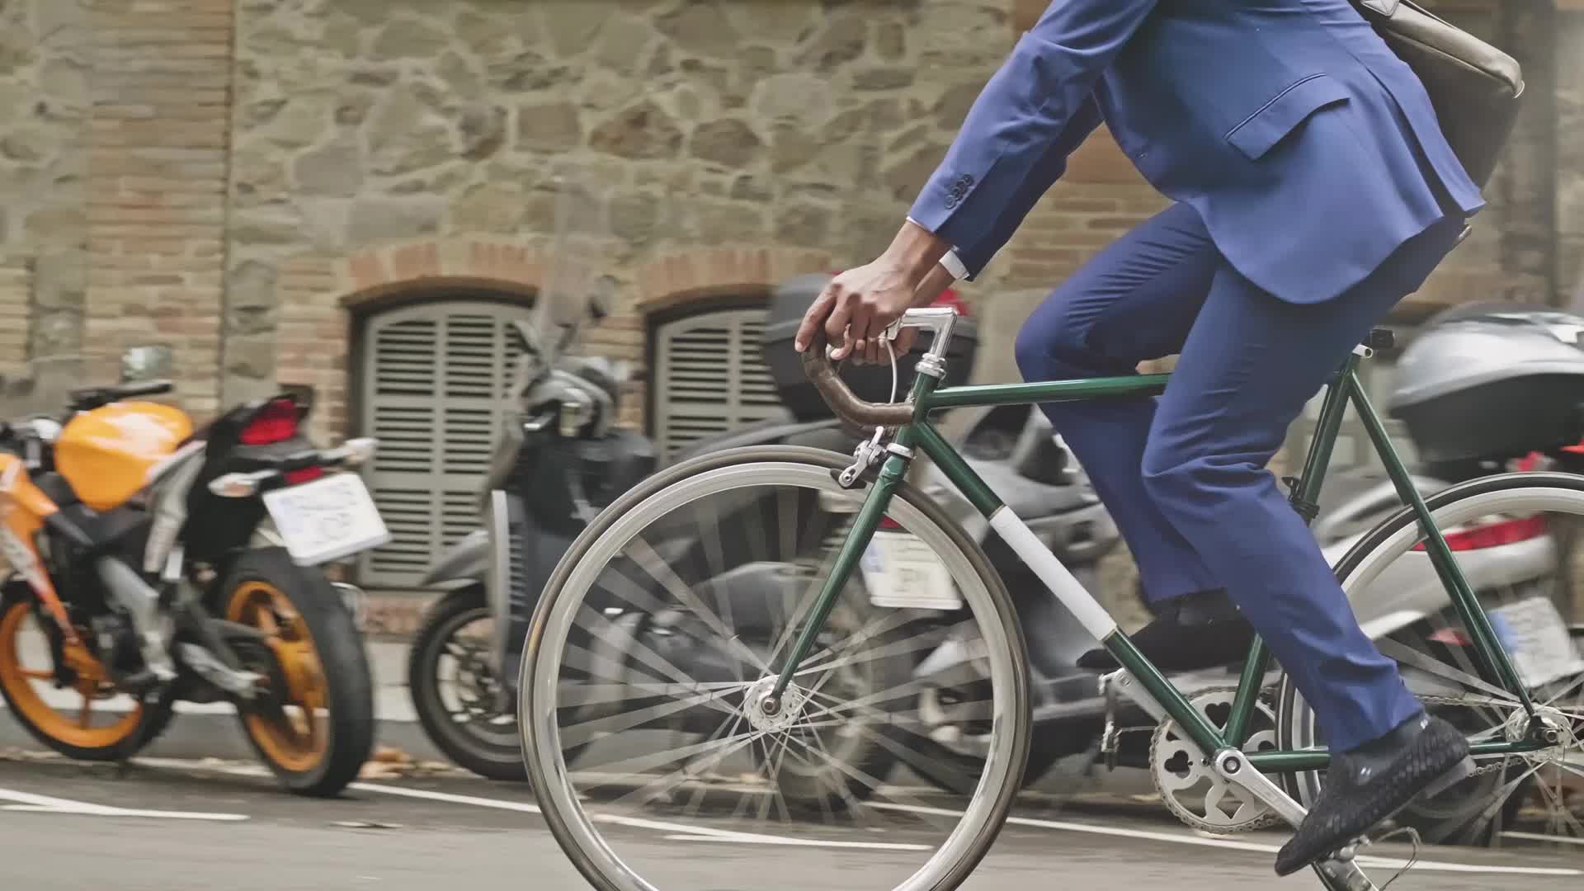


Goals: To maximize the number of annual members because finance analysts have concluded that annual members are more profitable. Target: Convert casual riders into members; the stakeholder notes that casual riders have already aware of the Cyclistic program and have chosen Cyclistic for their mobility needs.

Slide 3
Task: To answer the first question.
How do annual members and casual riders use Cyclistic bikes differently?

Slide 4
Data Source:
Cyclistic last 12 months of all the transactions;
https://divvy-tripdata.s3.amazonaws.com/index.html
Data Integrity:
Check the datatype of each column
Check if any missing values
Check duplication
Data Processing:
Convert start time and end time to datetime from strings
Create new column ‘ride_length’ by subtracting end time from start time
Create the column week of the day

Slide 5
Analyze data:
First to check ride_length:
I found the data error, so I need to clean the data. It was negative ride time values on the dataset. I checked the number of rows and decided to drop the data.
Also, I found the data that ride length to be zero. I drop those rows as well.

Slide 6
Findings 1:
I checked the ride length to be longer than one day. Then I found this result.
Casual riders; 4644
Annual member; 716

Slide 7
Findings 2:
I went a little farther; I checked the ride length to be longer than two days. Then I found this result.
Casual riders; 1168
Annual members; 0
The maximum ride length in the entire dataset is 28 days and 17 hours, and 47 minutes. This data shows different behaviour between casual riders and annual members. It needs farther investigation of why casual riders keep their bike longer.

Slide 8
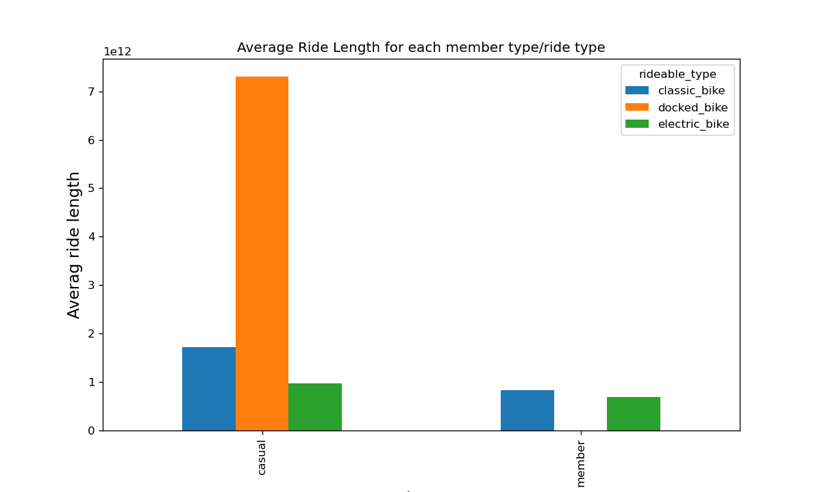
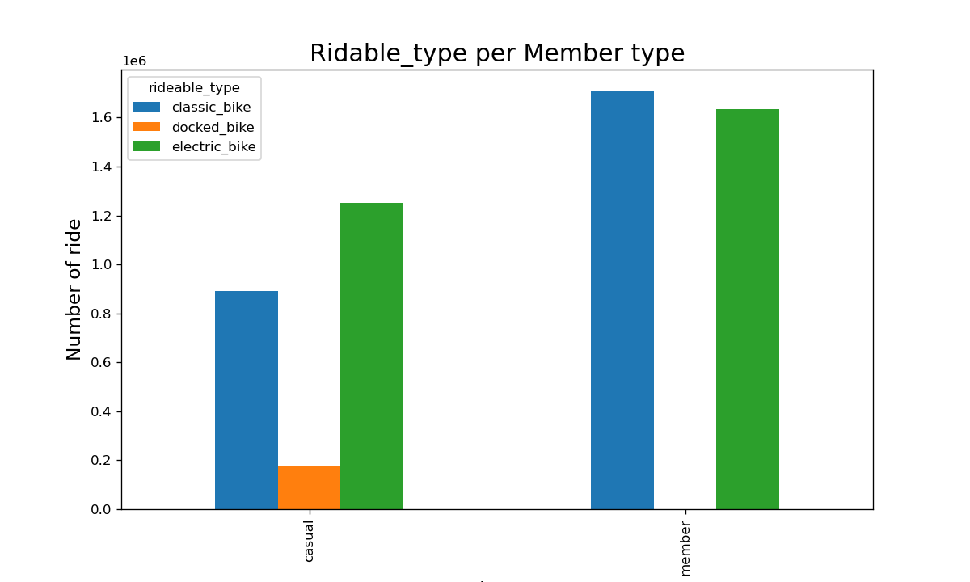
Left graph is the average ride length by casual riders and Annual members by the type of bike. And right graph is the number of usages by casual riders and annual members. It shows that the casual riders have longer ride length as I showed you on last slide.

Slide 9
Conclusion:
Docked bike is for casual riders
Casual riders use the electric bike more, but annual members use the classic bike more.
Casual riders use a docked bike for an extended period.
Both casual riders and annual members use the electric bike and classic bike similarly.
From those findings, the difference is the ride length. If we focus on this part, we should be able to find the benefit for the casual riders to become annual members.

Slide 10
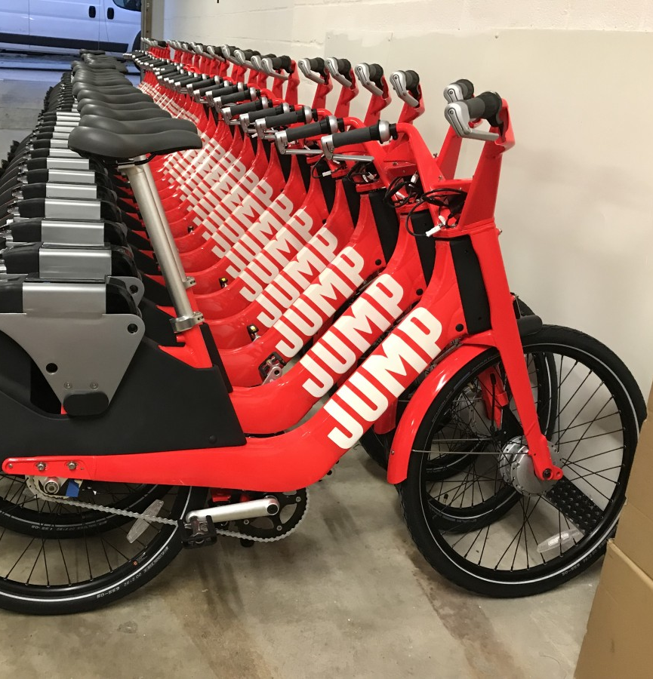
Next step:
Use this analysis to answer the next question;
Why do casual riders buy Cyclistic annual membership?
This Photo by Unknown Author is licensed under CC BY-NC

