Slide 1
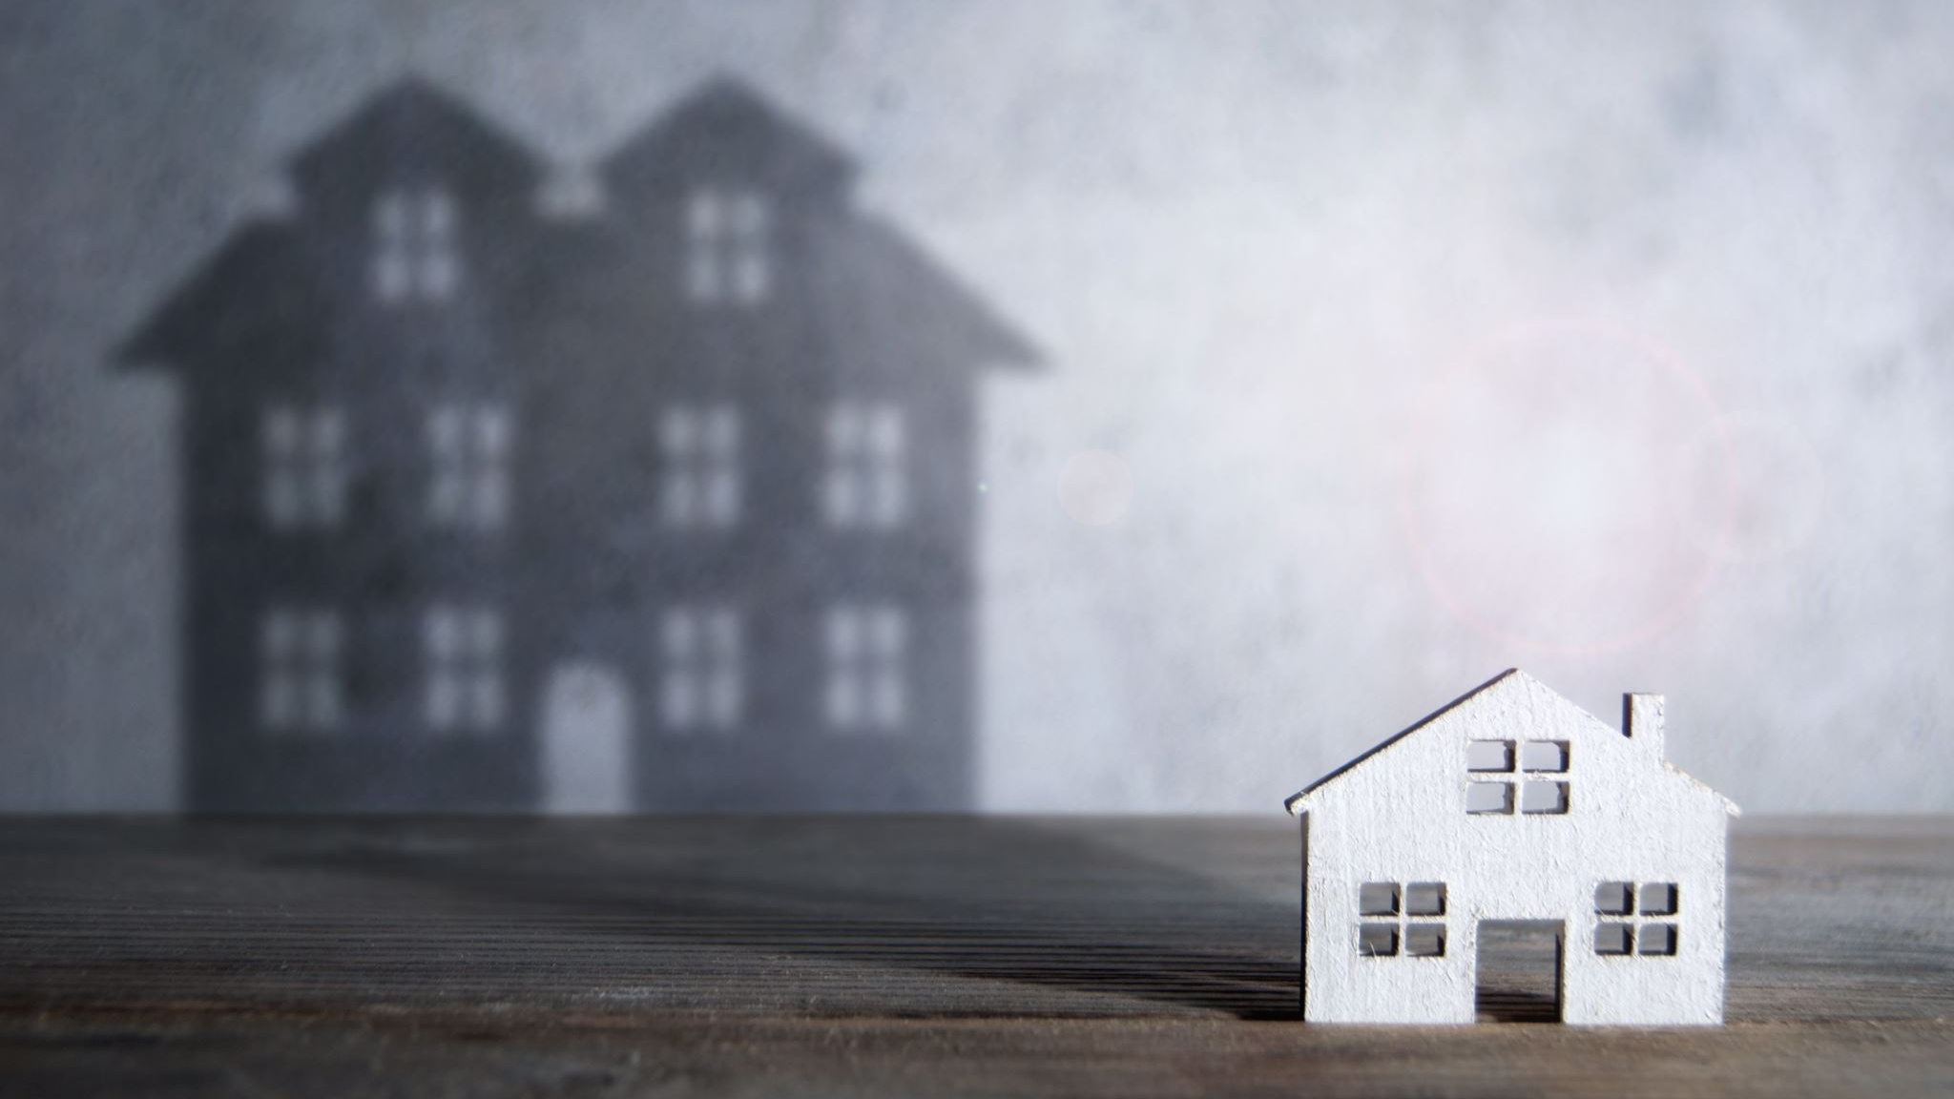
50% ROI in 3 Months Mobile Home Flipping Project

Slide 2
Why Mobile Home?
Right property for the location:
I locate Chilliwack, BC, part of the lower mainland about 200km from Vancouver.
Unlike the bigger city, a mobile home is famous in a smaller cities like here
Inexpensive and significant to people who are looking to downgrade or for a young family.
Download the file for more information here.

Slide 3
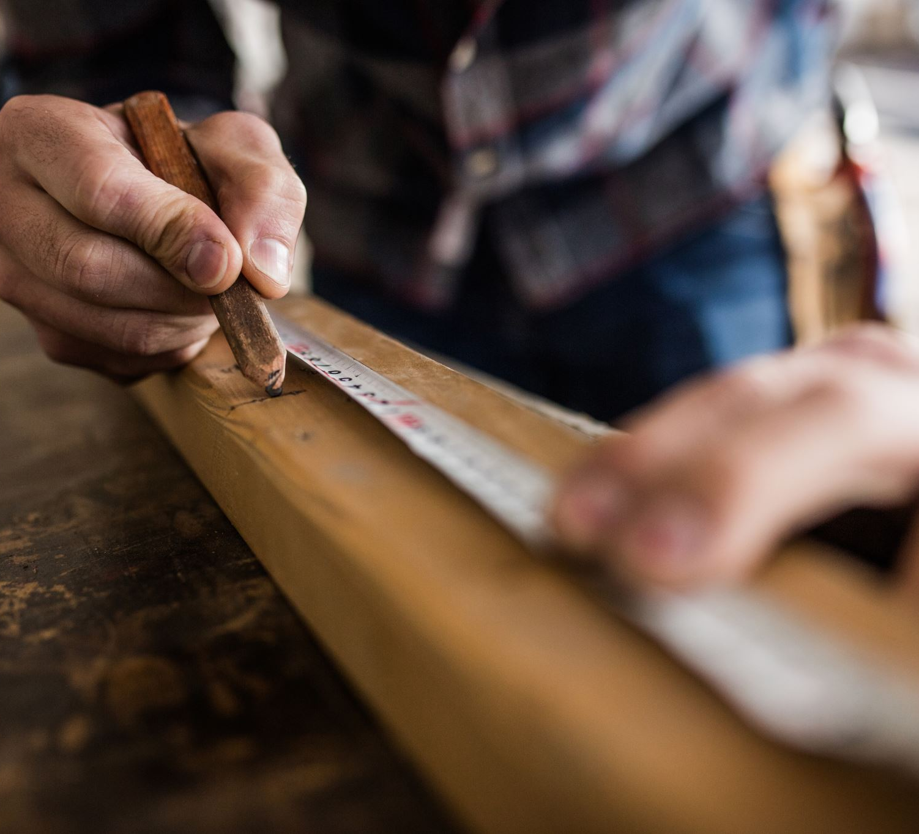
About Me:
My name is Masa. I have been working in residential construction as a journeyman carpenter for over 10 years.
- Instagram
- Website
- Download the file for more information

Slide 4

Research & Analysis:

Slide 5
Example last 3 Years: Research & Analysis
Purchase Date:
2020-02-06
Purchase Price:
$76,500
Sold Date:
2020-08-16
Sold Price:
$192,000
Purchase Date:
2020-06-25
Purchase Price:
$90,000
Sold Date:
2020-12-07
Sold Price:
$230,000
Purchase Date:
2020-08-20
Purchase Price:
$75,000
Sold Date:
2021-02-16
Sold Price:
$268,900
Purchase Date:
2021-11-12
Purchase Price:
$135,000
Sold Date:
2022-03-02
Sold Price:
$299,900

Slide 6
Analyze Historical Data: Mobile home park: 45640 Watson Rd, Chilliwack, BC

Slide 7

What I see from this data:
I see a price drop after 1994 and 2008 when the number of sales dropped to near zero, but the price trend is consistently upward.
When the number of sales drops this year, we will have a chance to buy a house for lower price.

Slide 8
Another data:

Slide 9

What I see from the data:
Max price, which we know is after the renovation price significantly higher than the minimum price, which we know is before the renovation price.
This data gave me the confidence to purchase a home lower price and sell high price after renovation.

Slide 10
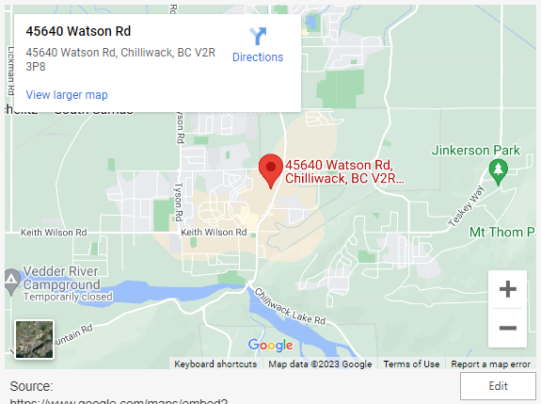
Area Research: Research & Analysis
How I feel about the area:
I live in the area called “Garrison Crossing, which is one of the best areas in town and developing townhouses, condos and housing.
Mobile home located right next to Garrison Crossing, and you can expect to get better value in future.

Slide 11

Our Target & Cost Forecast: Business Plan
Target Purchase Price: $110,000
Target Selling Price: $250,000
Anticipated Cost of Renovation: $ 65,000
Anticipated Other Costs: $ 27,800
Target Profit: $ 42,000
Capital Required: $ 83,000
Return on Investment: 50.70%
ROI Calculation tool Download:

Slide 12
Renovation Plan: Business Plan

Slide 13
Marketing Strategy & Target Audience: Business Plan

Slide 14
JV Agreement: Investment

Slide 15
More Details: Conclusion

Slide 16

Future Business Plan & Partnership:
Mobile home is the starting point. Low cost and more straightforward renovation than a regular house. I want to build up the renovation team and move on to more expensive homes or more complicated renovation projects to make a more significant profit.

