Slide 1

Perl 6 Pride and Envy
Czech Perl Workshop 2014
2014-05-20
Carl Mäsak

Slide 2
Perl 6 can be thought of as a
re-mix of Perl 5:
Keeping what works
Improving what doesn’t
Re-imagining Perl with hindsight

Slide 3
Basically,
It’s a community project,
a work of love and appreciation

Slide 4
Basically,
It’s fanfiction

Slide 5
We love canon so much that we are
writing our own fan work based on it

Slide 6
A fan work can be awesome
It can also be crap
Most of the time,
it’s a mixture of both

Slide 7
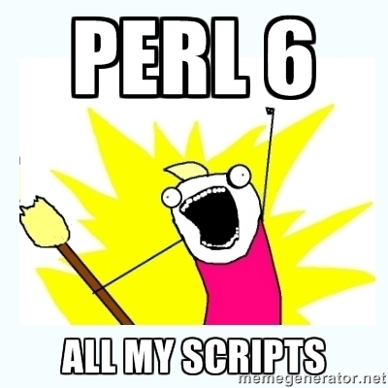
(Perl 6 is awesome)

Slide 8
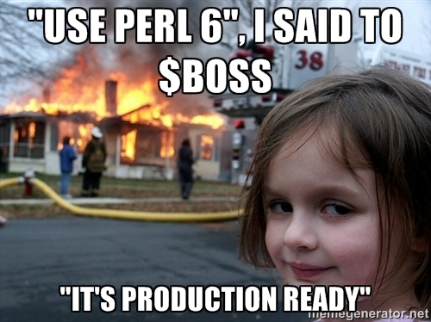
(just kidding — it’s crap)

Slide 9
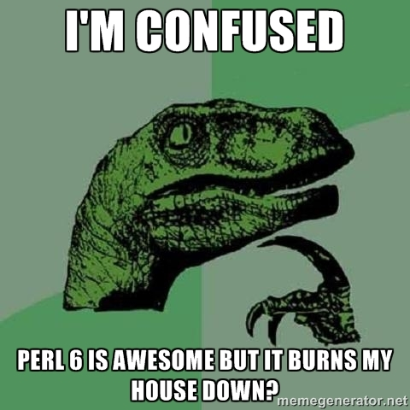
(just kidding — it’s a mixture of both)

Slide 10
In the cases where it’s awesome,
we feel a sense of Pride
and want to tell the world
how it improves on Perl 5

Slide 11
In the cases where it’s crap,
we feel a sense of Envy
and want to grow up to
be more like Perl 5

Slide 12
hi
I’m masak

Slide 13
Pride

Slide 14
Sigils that vary with use in Perl were an interesting linguistic experiment.
But the results are back: the confusion isn’t worth the benefits.
So Perl 6 makes sigils invariant:
invariant sigils
my %hash; $hash{foo}; @hash{qw<foo bar>};
my %hash; %hash<foo>; %hash<foo bar>;

Slide 15
Perl 6 is more “math-y”
Some have claimed that Perl 6 is full of math, like, all academic and stuff.
It is. I’m proud of that.
my $sum = [+] @values;
sub postfix:<!>($n) { [*] 2..$n }
say 5!;
my $dot_product = [+] @v_1 »*« @v_2;

Slide 16
Perl 6 is more “math-y”
We should treat more things like values and functions. Values parallelize well. Functions compose and refactor nicely.

Slide 17
functional programming
Where Perl 5 likes to throw itself into a for loop to do things, Perl 6 tends to treat the whole collection of things.
Think map and grep, but with lots more functions like that.
Perl 6 likes to pass functions to things.

Slide 18
smartmatching
Smartmatch is an awesome feature in Perl 6. Perl 5 stole it back early on.
It was never so awesome in Perl 5. Useful yes, but kinda awkward. People called it “psychotic-match”.
Why? The type system isn’t there.

Slide 19
letter frequency
Task: collect all the letters in a text
and print their frequencies.
Perl 5 solution:
while (<>) { $count{lc chop}++ while length }
say "$_ => ", $count{$_}//0 for 'a' .. 'z';

Slide 20
letter frequency
Let’s start by translating the script
to Perl 6:
my %count is default(0);
for lines() { %count{$_}++ for .comb }
say "$_ => %count{$_}" for 'a' .. 'z';

Slide 21
letter frequency
We don’t need a for loop,
we have hypers:
my %count is default(0);
%count{$_}++ for lines».comb;
say "$_ => %count{$_}" for 'a' .. 'z';

Slide 22
letter frequency
But why store non-letters and then
not count them?
my %count is default(0);
%count{$_}++ for lines».comb.grep('a'..'z');
say "$_ => %count{$_}" for %count.keys;

Slide 23
letter frequency
But why store non-letters and then
not count them?
my %count is default(0);
%count{$_}++ for lines».comb.grep('a'..'z');
.say for %count.pairs;

Slide 24
letter frequency
Finally, the whole notion of looping
and counting things is a bit antiquated
when we have the Bag type:
I would consider this to be an example of Concatenative Programming. Everything is strung together.
.say for lines».comb.grep('a'..'z').Bag.pairs.sort;

Slide 25
lazy lists
The default in Perl 6 tends to be lazy: elements in a sequence get computed on-demand as you require them.
The usual list functions participate in this game, and it turns into a laid-back programming style, where you stop caring if you’re generating “too much”.

Slide 26
object orientation
In Perl 5, the object-oriented parts were artfully woven into the existing design after the fact.
In Perl 6, they were integrated fully into the language, and they underpin everything in a very real sense.

Slide 27
object orientation
Here’s a typical class:
class Pair is Enum {
has $.key;
has $.value;
}
sub infix:«=>»($key, Mu $value) {
Pair.new(:$key, :$value);
}

Slide 28
grammars
Perl 5 is already good at manipulating strings and doing things with regexes. Its toolset is hard to beat.
Perl 6 beats it by elevating string parsing to language parsing. Every parse results in a parse tree. You can build grammars, and act on them.

Slide 29
grammars
Here’s a typical grammar:
grammar HashLang {
rule TOP { '{' [ <pair> [',' <pair>]* ','? ]? '}' }
rule pair { <term> '=>' <term> }
token term { ... }
}

Slide 30
grammars
Parsing separators is so common that we have the syntax % and %% for it.
% wants a separator between things.
%% additionally allows a trailing one.
grammar HashLang {
rule TOP { '{' <pair>* %% ',' '}' }
rule pair { <term> '=>' <term> }
token term { ... }
}

Slide 31
grammars
Another thing that’s common is parsing start and end tokens. ~ does that.
grammar HashLang {
rule TOP { '{' ~ '}' <pair>* %% ',' }
rule pair { <term> '=>' <term> }
token term { ... }
}

Slide 32
new methods
I find these hard to live without nowadays.
.pick($n) Like $n things out of a hat
.roll($n) Like $n dice
.uniq Keep non-repeating elems
.min/.max Get extreme values
.classify Collect into bins
.first Find first matching value

Slide 33
last Friday of each month
Task: print the last Friday of each
month of a given year. Perl 5:
use strict;
use DateTime;
use feature qw( say );
for my $month ( 1..12 ) {
my $dt = DateTime->last_day_of_month( year => $ARGV[ 0 ],
month => $month ) ;
while ( $dt->day_of_week != 5 ) {
$dt->subtract( days => 1 ) ;
}
say $dt->ymd ;
}

Slide 34
last Friday of each month
Perl 6 doesn’t have last_day_of_month. So we need to emulate it:
for 1..12 -> $month {
my $d = Date.new(@*ARGS[0], $month, 1)
.delta(1, month).delta(-1, day);
while $d.day-of-week != 5 { $d.=delta(-1, days) }
say $d;
}

Slide 35
last Friday of each month
Something else? Yes, @*ARGS[0]
doesn’t look so sixish:
sub MAIN(Int $year = Date.today.year) {
for 1..12 -> $month {
my $d = Date.new($year, $month, 1)
.delta(1, month).delta(-1, day);
while $d.day-of-week != 5 { $d.=delta(-1, days) }
say $d;
}
}

Slide 36
last Friday of each month
Myself, I would approach this tool not with for loops but with lists of things:
sub MAIN(Int $year = Date.today.year) {
my @year-days = Date.new("$year-01-01") ..
Date.new("$year-12-31");
my @months = @year-days.classify: *.month;
my @month-last-fridays = (.value.reverse.first: *.day-of-week == 5 for @months);
.say for @month-last-fridays;
}

Slide 37
last Friday of each month
But why are we messing with variables when we chain everything?
sub MAIN(Int $year = Date.today.year) {
say ~.value.reverse.first: *.day-of-week == 5
for classify *.month,
Date.new("$year-01-01") .. Date.new("$year-12-31");
}

Slide 38
last Friday of each month
Or we could write that in the forwards direction, with the help of feeds:
sub MAIN(Int $year = Date.today.year) {
.say
for Date.new("$year-01-01") .. Date.new("$year-12-31")
==> classify *.month
==> map *.value.reverse.first: *.day-of-week == 5
}

Slide 39
interactive shell
When you write perl, it just sits there:
When you write perl6 (or python, or irb), you get an interactive shell:
$ perl
^C
$ perl6
> say "OH HAI"
OH HAI
>

Slide 40
debugger
In the same vein, you can write perl6-debug and get an interactive debugger.
(It’s a module, but it’s included in Rakudo Star.)
Cool fact: it was a stealth project, made by extending Rakudo, not changing it.

Slide 41
concurrency
The ideas behind concurrency in Perl 6 are finally coming together this year.
Lazy lists are for repeatedly getting something. Supply objects are for repeatedly being given something.
They unify async and events.

Slide 42
refactorability
There’s something about Perl 6 that makes it very nice to refactor programs in small incremental steps.
Perl 5 has that too, but not to the same extent. Somehow the features of Perl 6 conspire to make refactoring an extra pleasant experience.

Slide 43
Envy

Slide 44
performance
Still not fast. Working on it, though.
Moar has been a godsend, and useful work is going on with optimization.
It’s reasonable to expect Perl 6 to be not much slower (and sometimes faster) than Perl 5... eventually.

Slide 45
third-party modules
For basically any problem you want to solve, Perl 5 has a module for that.
Perl 6 module count has... three digits. We have some ways to go.
It’s a bootstrapping thing. Popularity breeds modules, and vice versa.

Slide 46
nytprof
Devel::NYTProf is just so amazing.
Perl 6 doesn’t have anything like that.
Someone needs to write it.

Slide 47
devel-cover
We don’t have a Devel::Cover either.
In fact, we’re missing many of those tools that reach into the backend and instrument it... except for a debugger.

Slide 48
perl critic
Perl 5 has excellent Perl::Critic capabilities, thanks largely to PPI.
Perl 6... has excellent potential here, but still no real way for Perl 6 user code to parse Perl 6 code into an AST and do stuff with it. Hopefully macros will help.

Slide 49
some of the event-y things
When I look at the AnyEvent, POE, and Coro family of modules on CPAN, I also grow a little bit jealous.
We should have something like that. In fact, Perl 6 is still missing a unified event handling story. But we’re inching closer with the work on concurrency.

Slide 50
CPAN/PAUSE
The whole Perl 5 module infrastructure, with uploading and testing and smoking and reviews... is impressive.
Perl 6 is still mostly on Github.
We want CPAN and PAUSE. Work is going on in that area.

Slide 51
Conclusion

Slide 52
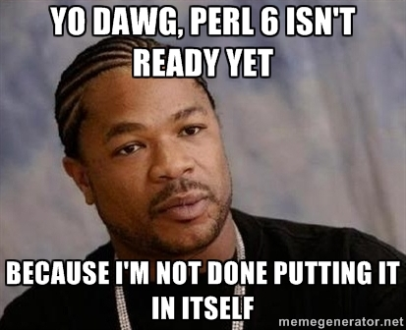
Everything that’s worth doing
is worth doing well

Slide 53
Perl 5 and Perl 6 are different
Both have strong points
and weak
Perl 5 gets the ecosystem right
Perl 6 is a syntax/semantics upgrade
Both should be proud of their strengths
and envious about the other’s strengths

Slide 54
Perl 5 and Perl 6 will probably
never converge fully back into one
single language
Neither do I think one of them will
ever “win” or obviate the other
But we can certainly remain one
community, and keep stealing from
and inspiring each other

Slide 55
Thank you.

