Slide 1
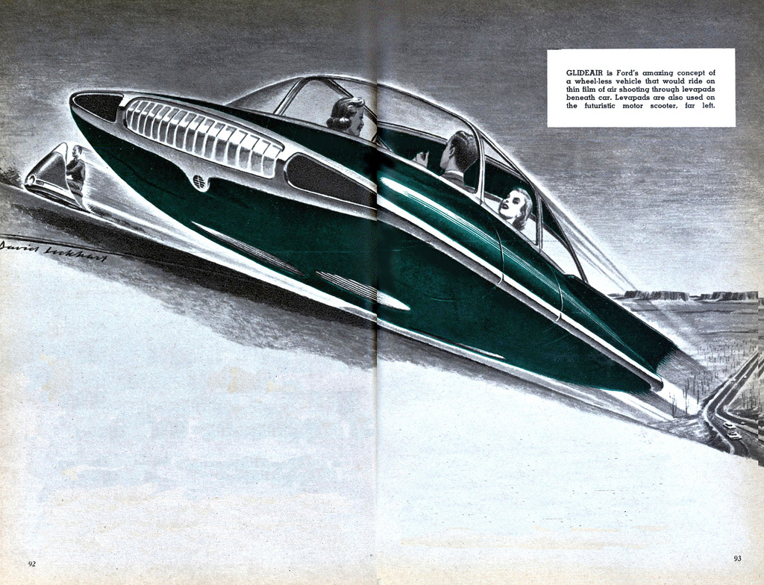
masak & jnthn
Bristol 2012-05-19
Dude,
where’s my
flying car?
A whirlwind exposition
of the Perl 6 language: its
release status, some concrete
syntactic examples, a historical
overview, a real live demo, and
current status and roadmap.

Slide 2
programming since being 8 years old
multi-paradigm programming wizard
enjoys beer, mountains, and photography
masak & jnthn
started programming at 10
learns a new language every year
enjoys cooking, writing music, and beer

Slide 3
We like Perl 6.
This talk is about why.

Slide 4
When will Perl 6 be released?
How about a production-ready Perl 6?
You know, an official release.
6.0.0?
You may have heard these things about Perl 6...
Will it ever be finished?
Perl 6 has “missed the boat”!
Perl 6 is vapourware!

Slide 5
Rakudo
2009
2010
2011
2012
Fun fact: we do make releases! ☺
Niecza
2009
2010
2011
2012
But that’s not what people mean when they say “released”. ☹

Slide 6
Perl 6 is partway done. Some things are ready for use.
First 80%
Second 80%
Third 80%
Big project
we are here
(In this talk and the next one, we’ll only talk about things
that are implemented already. You’ll see that it’s quite a lot.)

Slide 7
We’re riding the wave of the adoption curve, inviting
people as we go along:
we are here
innovators
laggards
early adopters
early majority
late majority

Slide 8
“
The future is already here —
it's just not very evenly distributed.
”
William Gibson

Slide 9
A few small language examples

Slide 10
Loops
combine together like a zipper
for @students { ... }
for @students -> $student { ... }
for @tastes Z @foods -> $taste, $food { ... }
for @tastes X @foods -> $taste, $food { ... }
while $continue { ... }
until $quit { ... }
repeat while $continue { ... }
repeat until $quit { ... }
loop { ... }
loop (;;) { ... }
combine together
in all possible ways
test condition
after
first iteration
C-style loop

Slide 11
Subroutines
sub foo { say “OH HAI” }
foo(); # OH HAI
foo; # OH HAI
sub bar($a, $b?) { say defined $b }
bar(1, 2); # True
bar(3); # False
sub baz($a, $b = 5) { say $b }
baz(1, 2); # 2
baz(3); # 5
sub greet($name, :$greeting = “Hello”) {
say “$greeting $name”;
}
greet “jnthn”; # Hello jnthn
greet “kathy”, :greeting(“你好”); # 你好 kathy

Slide 12
Classes
class Point {
has Real $.x;
has Real $.y;
method gist {
“($.x, $.y)”
}
}
my Point $p .=
new(:x(3), :y(4));
say $p; # (3, 4)
class Rectangle {
has Point $.topleft;
has Point $.bottomright;
method gist {
“$.topleft - $.bottomright”
}
}
class SmoothRectangle is Rectangle {
method gist {
callsame() ~ “ with web 2.0 corners”
}
}

Slide 13
Subtypes and enums
subset EvenInt of Int where { $^n %% 2 };
say 5 ~~ EvenInt; # False
say 8 ~~ EvenInt; # True
sub foo(EvenInt $e) { ... }
enum Day <Sun Mon Tue Wed Thu Fri Sat>;
say +Fri; # 5
say ~Fri; # Fri
say Fri.kv; # Fri 5
say 3 ~~ Day; # True
say 9 ~~ Day; # False

Slide 14
Operator overloading
sub postfix:<!>($n) { [*] 1..$n }
say 5!;

Slide 15
Build ranks and suits
Build a deck of cards
Build a table of card points
Draw a random hand of five cards
Print the hand and its total point sum

Slide 16
With Perl 5

Slide 17
my @suits = qw< ♣ ♢ ♡ ♠ >;
my @ranks = (2..10, qw< J Q K A >);
① Build ranks and suits

Slide 18
# concatenate each rank with each suit
my @deck;
for my $rank (@ranks) {
for my $suit (@suits) {
push @deck, "$rank$suit";
}
}
② Build a deck of cards

Slide 19
③ Build a table of card points
my %points;
for my $rank (@ranks) {
for my $suit (@suits) {
my $score = $rank eq 'A' ? 11
: $rank =~ /[JQK]/ ? 10
: $rank;
$points{"$rank$suit"} = $score;
}
}

Slide 20
④ Draw a random hand of five cards
# grab five cards from the deck
my @hand;
for (1..5) {
my $card = $deck[rand @deck];
redo if grep { $_ eq $card } @hand;
push @hand, $card;
}

Slide 21
⑤ Print the hand and its total point sum
# display my hand
say join ' ', @hand;
# tell me how many points it's worth
my $sum;
for $card (@hand) {
$sum += $points{$card};
}
say $sum;

Slide 22
With Perl 6

Slide 23
my @suits = < ♣ ♢ ♡ ♠ >;
my @ranks = 2..10, < J Q K A >;
① Build ranks and suits
no need for qw any more;
<> is now a list quoter

Slide 24
# concatenate each rank with each suit
my @deck = @ranks X~ @suits;
the two for loops are gone; cross operator
joins together elements in all possible ways
② Build a deck of cards

Slide 25
③ Build a table of card points
my %points = @deck Z ((2..10, 10, 10, 10, 11) xx 4);
no for loop; zip operator combines two lists

Slide 26
④ Draw a random hand of five cards
# grab five cards from the deck
my @hand = @deck.pick(5);
no for loop; built-in .pick method

Slide 27
⑤ Print the hand and its total point sum
# display my hand
say @hand;
# tell me how many points it's worth
say [+] %points{@hand};
no join; you get spaces for free
for loop folded into reduce operator

Slide 28
my @suits = < ♣ ♢ ♡ ♠ >;
my @ranks = 2..10, < J Q K A >;
# concatenate each rank with each suit
my @deck = @ranks X~ @suits;
my %points = @deck Z ((2..10, 10, 10, 10, 11) xx 4);
# grab five cards from the deck
my @hand = @deck.pick(5);
# display my hand
say @hand;
# tell me how many points it's worth
say [+] %points{@hand};

Slide 29
Overview of the history of Perl 6
Apocalypses
Synopses
Exigeses
Project
announced
Pugs
Rakudo
Niecza
today
RFC phase
Specification phase
Implementation phase
2000
2001
2002
2003
2004
2005
2006
2007
2008
2009
2010
2011
2012

Slide 30
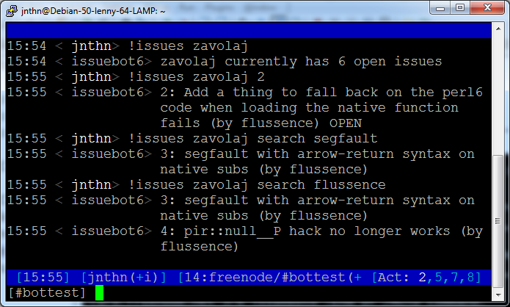
Demo of a real application
IRC bot, running on Rakudo, using Github’s REST API to list issues

Slide 31
What's there today
Basic control structures,
blocks, file IO, regexes,
control flow, variables,
constants, functions, etc
Operators
Introspection
Reduction ops
Junctions
Hyper ops
Meta-
Object
Protocol
Cross ops
Phasers
Classes
Zip ops
Roles
Lots of built-in types
Subset types
Pod documentation
Packages
Enums
Multi dispatch
Regexes
Modules
Mixins
Grammars
Advanced signature matching

Slide 32
What's we’re still working on
Macros
Performance
Native type stuff
Compile-time optimizations
Slangs
Some advanced
regex constructs
Backend
portability
Perl 5 interop

Slide 33
Perl 6 is partway done.
Some things are ready for use.
Is it finished, polished, production-hardened?
No.
But it’s worth checking out.

Slide 34
Try it out!

Slide 35
