Slide 1

Mandarin Chinese
— the good parts
Carl Mäsak Polish Perl Workshop 2014-05-17

Slide 2
hi, I’m masak
I took Chinese in 2005

Slide 3
I have two purposes here today

Slide 4
to show that Chinese is kind of cool

Slide 5
to make you think twice about learning it

Slide 6
Sounds

Slide 7
initials + finals
r + en = ren
x + iong = xiong

Slide 8
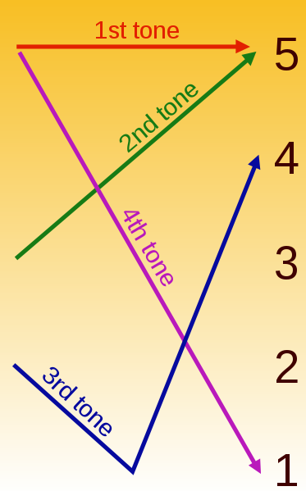




four tones
妈
(mother)
麻
(hemp)
马
(horse)
骂
(scold)

Slide 9
For example, if you wish say something like
"Hey, that's my water glass you're drinking out of!",
and you follow your intonational instincts — that is,
to put a distinct falling tone on the first character of the word
for "my" — you will have said a kind of gibberish that may or
may not be understood.
— David Moser

Slide 10
Guess The Famous People

Slide 11
莫扎特
Mò zhā tè

Slide 12
肖邦
Xiāo bāng

Slide 13
托尔斯泰
Tuō ěr sī tài

Slide 14
莎士比亚
Shā shì bǐ yà

Slide 15
梵高
Fán gāo

Slide 16
爱因斯坦
Ài yīn sī tǎn

Slide 17
If you get it ever so slightly wrong...

Slide 18
数学
shùxué
(mathematics)

Slide 19
输血
shūxiě
(blood transfusion)

Slide 20
物理
wùlǐ
(physics)

Slide 21
五里
wǔ lǐ
(2.5 km)

Slide 22
Thank heavens for Pinyin

Slide 23
Characters

Slide 24
the magic of characters

Slide 25
the art and science of characters

Slide 26
some characters are images

Slide 27
人
(person)

Slide 28
女
(woman)

Slide 29
子
(child)

Slide 30
口
(mouth)

Slide 31
家
(home)

Slide 32
头
(head)

Slide 33
猫
(cat)

Slide 34
熊
(bear)

Slide 35
日
(sun)

Slide 36
月
(moon)

Slide 37
雨
(rain)

Slide 38
many characters are sorta-kinda images

Slide 39
上
(above)

Slide 40
下
(below)

Slide 41
中
(center)

Slide 42
国
(country)

Slide 43
大
(large)

Slide 44
小
(small)

Slide 45
有
(to have)

Slide 46
看
(to see)

Slide 47
开
(to open)

Slide 48
雪
(snow)

Slide 49
电
(electricity)
電
traditional version

Slide 50
most characters are not images

Slide 51
他
(he)
radical
phonophore

Slide 52
她
(she)

Slide 53
地
(dirt)

Slide 54
到
(to)

Slide 55
这
(this)

Slide 56
道
(way)

Slide 57
Words

Slide 58
words in Chinese don’t bend
看
to see
看
sees
看
saw
看
have seen
看
had seen
看
is seeing

Slide 59
words tend to be two characters long

Slide 60
朋友
péngyǒu
(friend)

Slide 61
compound words

Slide 62
大小
dàxiǎo
(size)

Slide 63
好看
hǎokàn
(pretty)

Slide 64
好吃
hào chī
(tasty)

Slide 65
眼镜
yǎnjìng
(glasses)

Slide 66
墨镜
mòjìng
(sunglasses)

Slide 67
熊猫
xióngmāo
(panda)

Slide 68
现代化
xiàndàihuà
(modernize)

Slide 69
proper names

Slide 70
可口可乐
Kěkǒukělè
(Coca Cola)

Slide 71
爱立信
Àilìxìn
(Ericsson)

Slide 72
Here’s how you look up a word in an English dictionary:
Open the dictionary at the approximate place
Narrow it down, binary search style
Find the word

Slide 73
Here’s how you look up a word in a Chinese dictionary:
Identify the radical
Count the number of strokes in it
Look up radical by number of strokes
Count the number of remaining strokes
Look up character by remaining number of strokes
Get a page number
Go to the page number
Try to find the bloody character on that page
“Chinese is not exactly what you would call a user-friendly language,
but a Chinese dictionary is positively user-hostile.”
— David Moser

Slide 74
Grammar

Slide 75
no need for “who” or “whose” or “that” -- kind of a telescoping structure
我有一个朋友。
I have a friend.
+
+
朋友叫小张。
The friend is called Zhang.
=
=
我有一个朋友叫小张。
I have a friend who is called Zhang.

Slide 76
adjectives are really verbs
这部电影很红。
Zhè bù diànyǐng hěn hóng.
(This movie is very popular.)

Slide 77
prepositions are really verbs
他给我写了一封信。
Tā gěi wǒ xiěle yī fēng xìn.
He to me wrote a letter.
(He wrote me a letter.)

Slide 78
cool words: de的
昨天来的人是谁 。
yesterday came的 people is who.
(people who arrived yesterday.)

Slide 79
reminds me of XPath
//people[ @arrived = "yesterday" ]

Slide 80
cool words: le 了
哦，看，下雨了！
Oh look, it’s raining!

Slide 81
Conclusion

Slide 82
Chinese is awesome
Learn it!

Slide 83
Chinese is bloody difficult
Don’t learn it!

Slide 84
Thank you
谢谢

