Slide 1
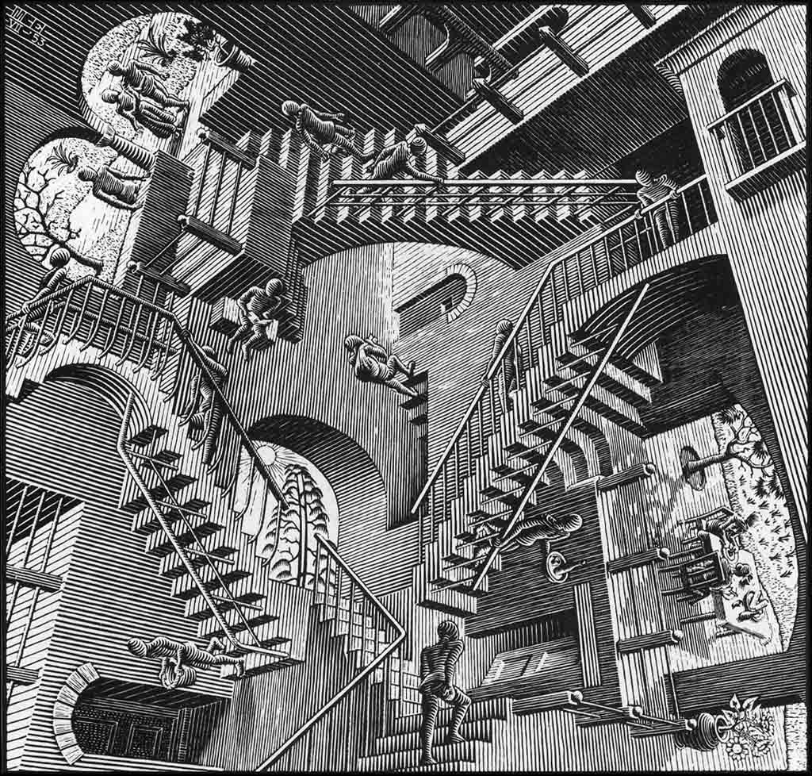
There’s more than one way to model it
Carl Mäsak
Polish Perl Workshop
2014-05-18

Slide 2
What is a model

Slide 3
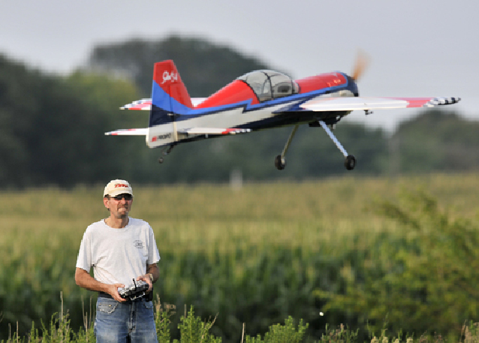
A model is a small version of something,
like a model airplane.

Slide 4
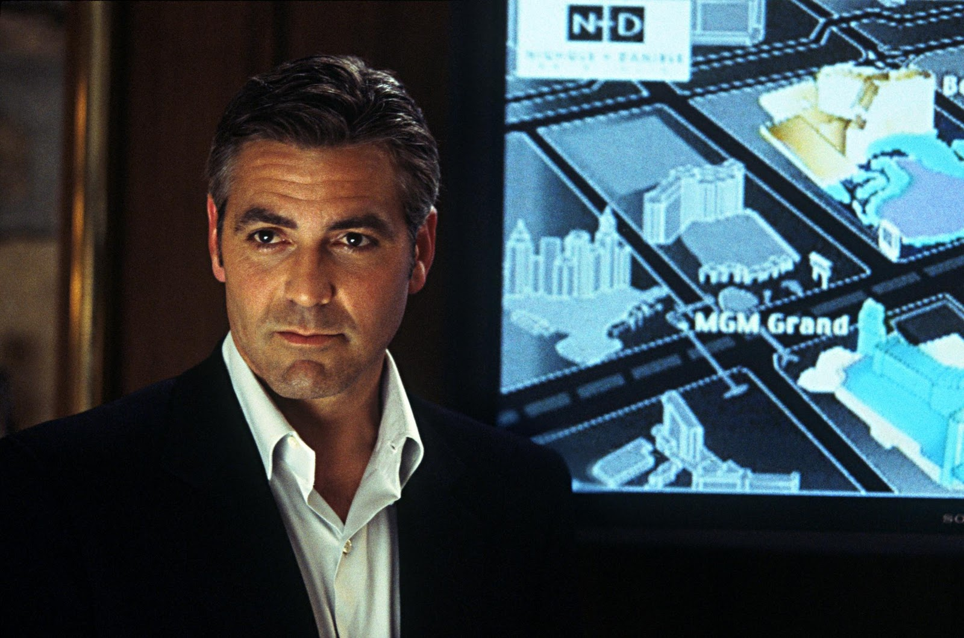
Or the model of the bank that the thieves use
to plan a break-in.

Slide 5
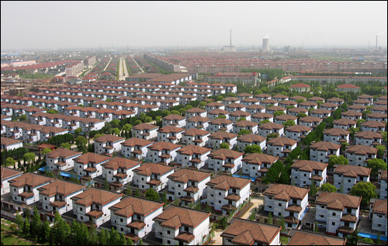
Or something we’re meant to aspire to,
like a model citizen or a model village.

Slide 6
So, um.
What is a model?

Slide 7
Let’s try this definition.
A model is an approximation of something else, good enough for some purpose.
It fits the three things we just saw.
In computing, our models tend to be made up of bits (data) and code (operations). But if we could build it with corks and strings, that would also work.
Usually, the “something else” is a thing that the business is interested in. But really, it could be anything, physical or non-physical.

Slide 8
An example

Slide 9
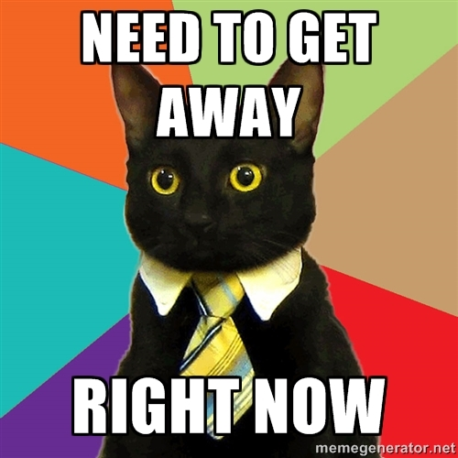
The Purr Foundation Amused Feline Hotel is a place where exhausted lolcats go to relax, away from their demanding human thralls.

Slide 10
As an overview, we’ll need the ability to check in cats, check out, and perhaps even register cats beforehand.
As we go along, let’s consider happy paths and sad paths — that is, what happens when we succeed and what happens when we fail.
Don’t forget the sad paths. It’s important to fail gracefully, and in the right way.

Slide 11
By the way, I put “cat hotel” into Google Images, and didn’t expect to find that much...
Apparently, I shouldn’t underestimate the Internet.

Slide 12
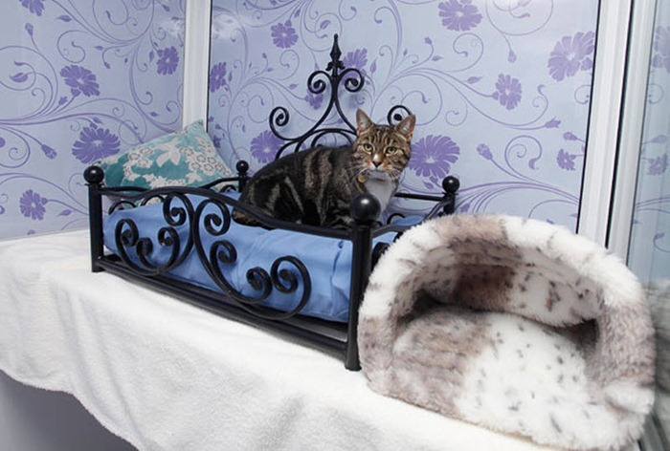
“Longcroft Luxury Hotel ... for Cats”

Slide 13
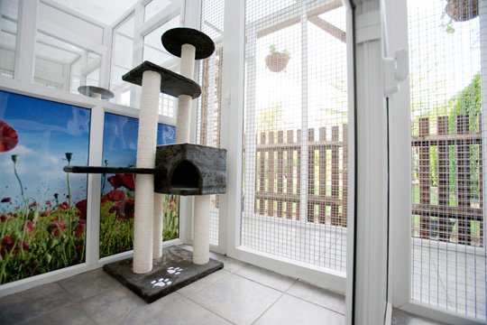
That’s the same hotel, an inside view.

Slide 14
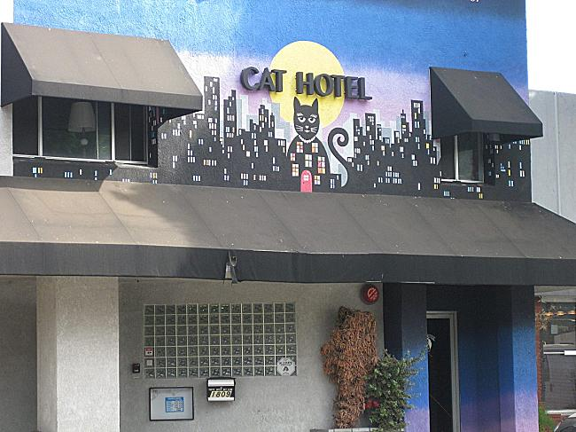
“Cat Hotel in Burbank, CA”

Slide 15
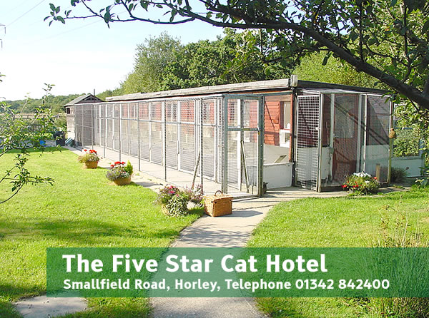
Clearly this is not an isolated occurrence.

Slide 16
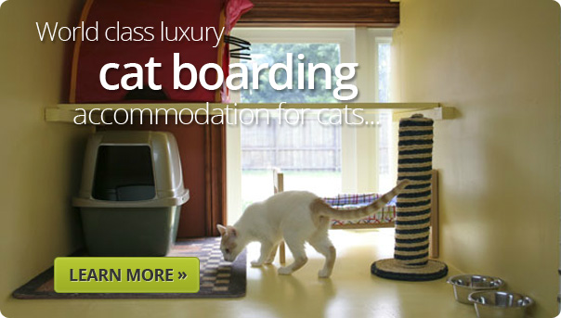
This one is better than some hotel rooms I’ve stayed in.

Slide 17
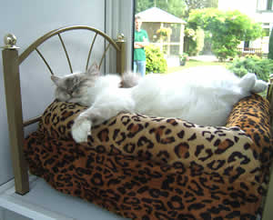
Man, that looks cozy.

Slide 18
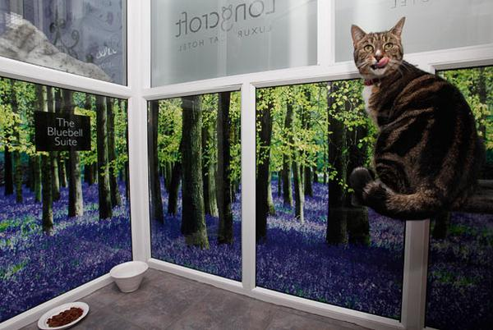
This one had the headline
“Cat Hotel in London Attract Celebrity Felines”

Slide 19
We know we are going to need a model for this.
Let’s code it up.

Slide 20
Requirement: a cat should be able to check in to a room.
Hm, maybe they shouldn’t be able to check into two rooms at once.
Also, maybe they shouldn’t be able to check into a room that doesn’t exist.

Slide 21
Requirement: a cat should be able to check out. (Duh.)
Again, consider sad paths. What are all the ways we can fail when checking out?
Are we sure the system behaves as expected?

Slide 22
Requirement: the hotel is now such a success that we introduce the ability to pre-reserve their stay.
This introduces the notion of time, because rooms are reserved for a particular duration. Tricky, but we can handle it.

Slide 23
Requirement: in order to make more profits, we want to start distinguishing between Normal rooms, Meow rooms, and Purrfect rooms.
Consider what the exact relation is between a pre-reservation and a check-in.
It’s good for the hotel if cats can upgrade when they check in, and maybe we should allow downgrades. Neither should mess with other cats’ reservations.

Slide 24
Projections

Slide 25
The MVC pattern is well-known by now. It has may uses. People don’t always go with controllers, so there’s often talk of MV* patterns instead.
We get to couple many
views to a model
if we want.
Slightly less appreciated is the fact that we can also couple the same view to many models. This allows us to simplify some models and honor the Single Responsibility Principle.
view
view
model
model
view
view

Slide 26
Just to be clear:
Models are where things happen.
Views are just there to present derived information. That’s why we can describe them as projections.

Slide 27
Requirement: hotel staff should be able to see which rooms are currently occupied and which are free.
Interestingly, this is the first time we need to think of how to represent the room information for the user. It’s late-bound, and it’s easy to modify later.

Slide 28
Requirement: hotel staff should get suggestions for which room to check a cat into.
Notice that it needs to be a suggestion, not a rule the staff has to follow. Otherwise the system will be too inflexible.

Slide 29
Cat Theory

Slide 30


Slide 31
Category theory is a branch of mathematics with a very simple language. It assumes almost nothing, so it can be used to describe almost everything.
A category is a bunch of objects bound together by a bunch of directed arrows. Arrows can be composed, in a sensible way.
Categories are used to bridge between distant fields of mathematics. First the fields are turned into categories at both ends, and then you find a way to map concepts from one to the other. It’s quite cool.
f
g
g ◦ f

Slide 32
Here, let me save you the trouble of studying category theory:
It turns out that the objects are not important at all. The arrows carry all the oomph in a model.
Translated back to programming, that means we should care a lot less about values (or structs, or attributes, or objects) and a lot more about functions (or methods, or constructors, or dependency injection).

Slide 33
There’s a cool trick where you start talking about the arrows themselves as objects. You can show that the object contains just as much information as some arrows.
That’s the idea behind first-class functions. You pass around functions (arrows) as values (objects).
Our events fill a similar role. Doing so essentially makes a category “Turing-complete”. That kind of gives a hint of why events are so general/powerful in a model.

Slide 34
Summary

Slide 35
It’s so nice to work on a model free from all outside concerns. Our two weapons: ignore it, or inject it.
TDD helps a lot too. In fact, TDD seems to lead to this approach as some kind of ultimate endpoint.
MVC teaches us that it’s nice to have a core model and then derive all view information from that.
The core model needs to be general enough to support all present and future projections.
Events do that.
Category theory explains why. Kind of.

Slide 36
Dziękuję

