Slide 1
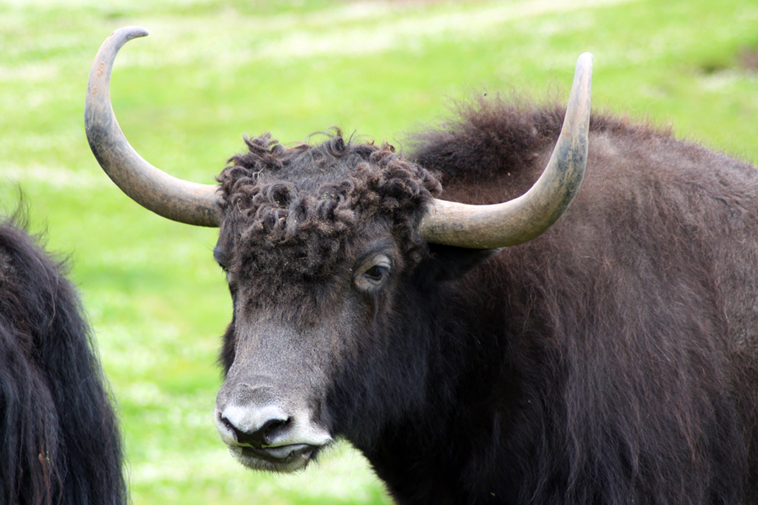
https://www.flickr.com/photos/hyshqa/4939751212/
Big
Hairy
Yaks
Carl Mäsak
GPW 2016-03-10

Slide 2
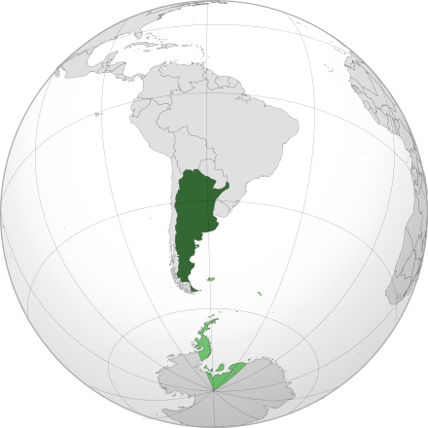
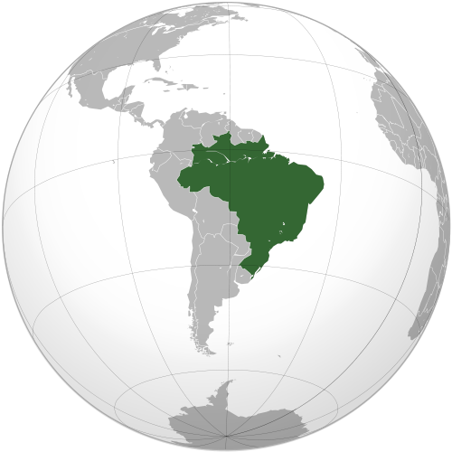
Before we begin, a correction...
Argentina
Brazil

Slide 3
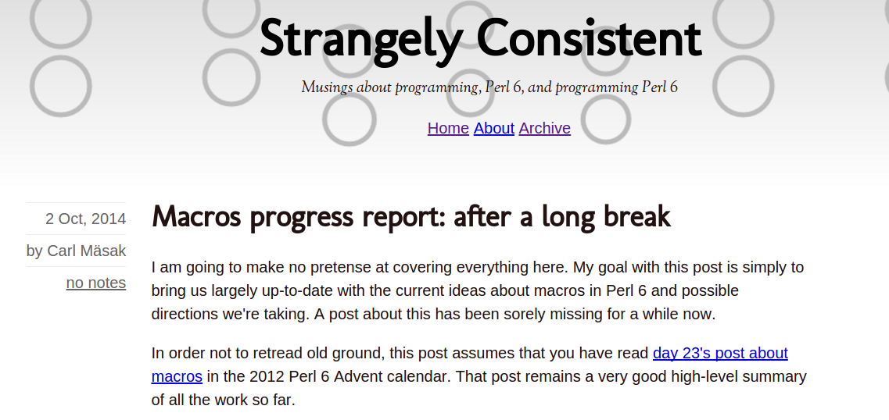
A little bit of background...

Slide 4
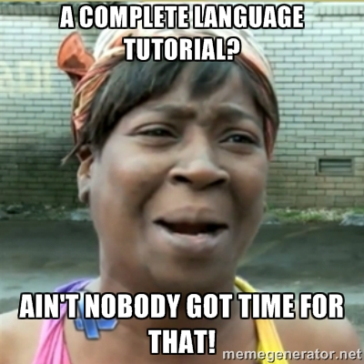

Slide 5
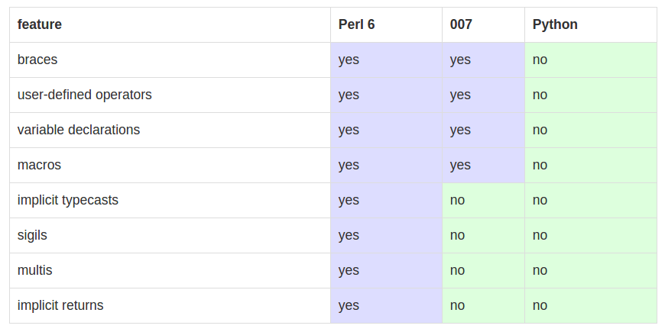
Freely borrowing features
007 looks like a mix of Perl, Python, and JavaScript.

Slide 6
(live demo)

Slide 7
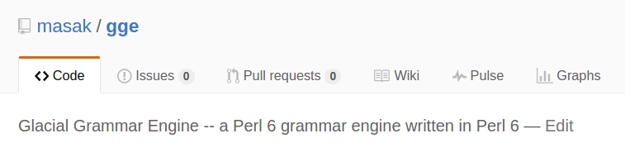
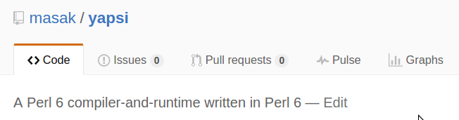
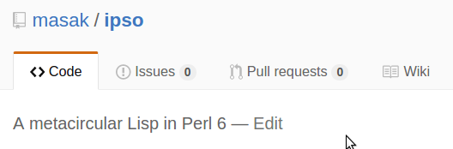
Everything I've done leads up to this

Slide 8
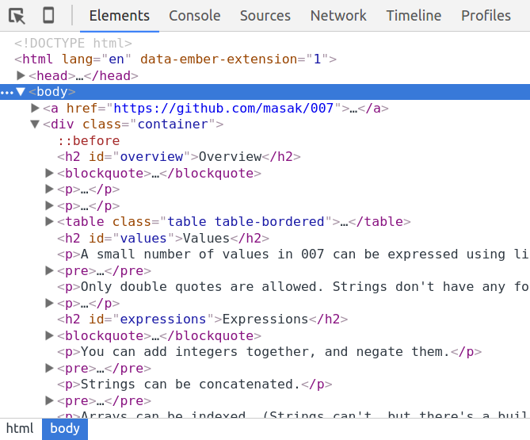

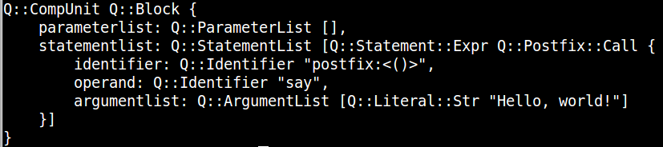
Secret sauce: the AST format
Homoiconic? I think so...

Slide 9
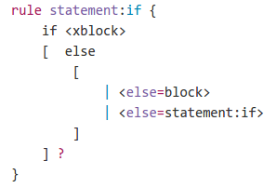
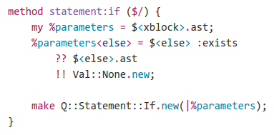
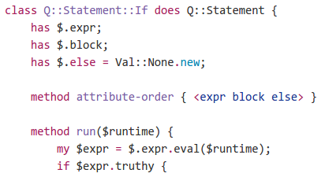
Well-kept secret: this is easy

Slide 10
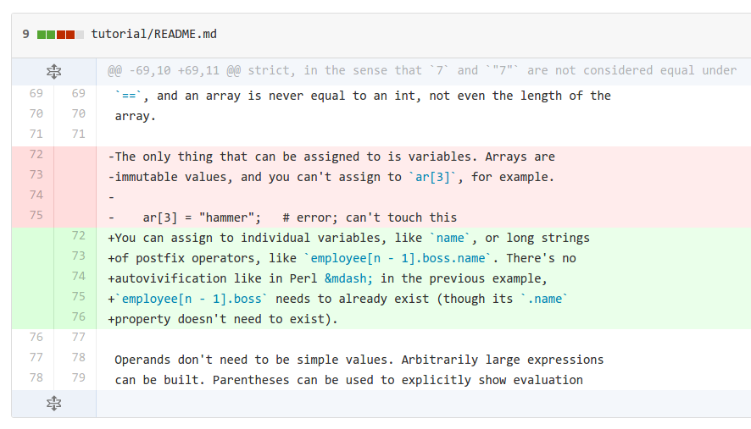
Easy: index chains and assignment

Slide 11
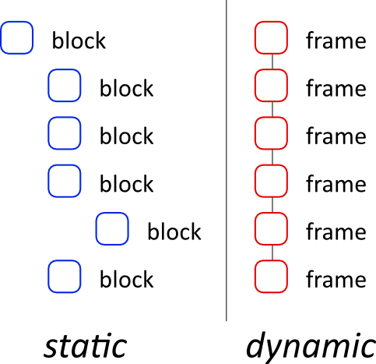
Some less easy things

Slide 12
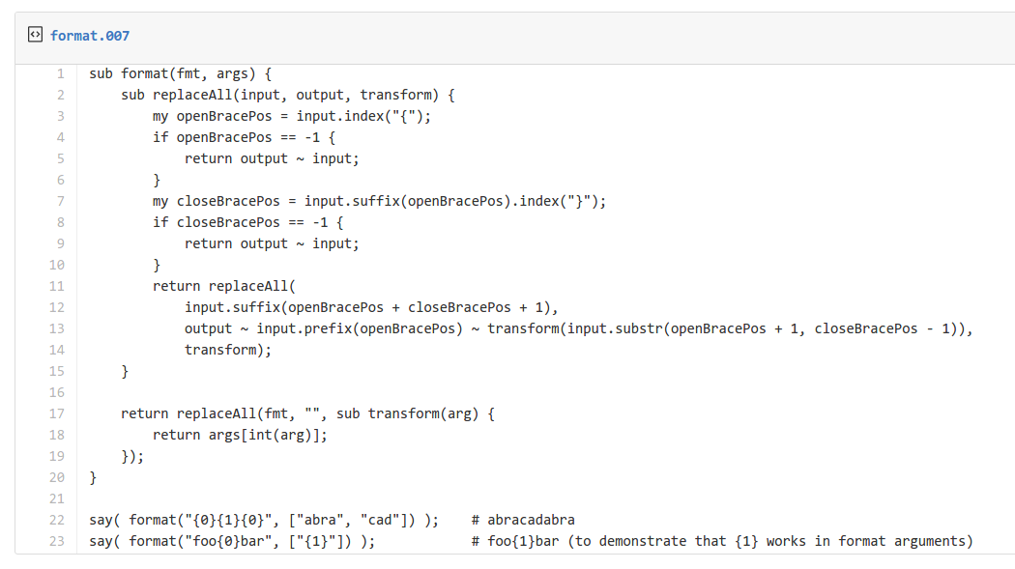
Macros: easy

Slide 13
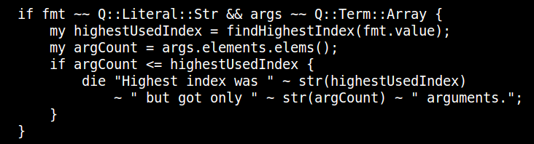
Compile-time error checking

Slide 14
Closures
(live demo)

Slide 15
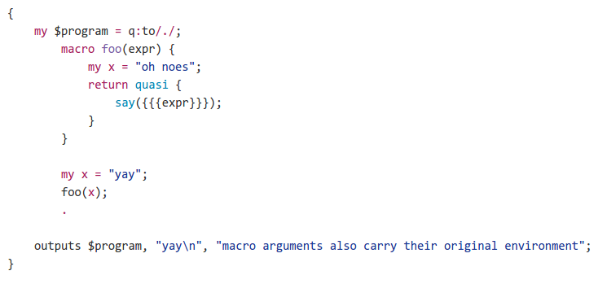
Hygiene
This is the case of a variable. Also true for subs, operators, macros...

Slide 16
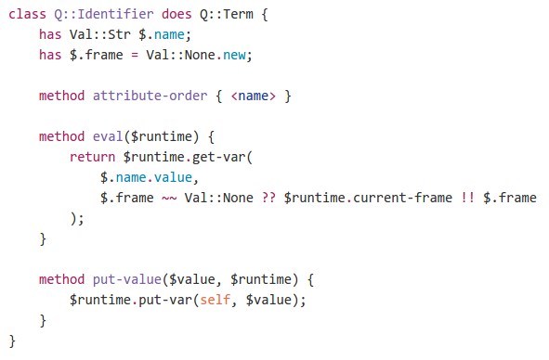
Solution: identifiers with context
A variable knows the context in which it was created.

Slide 17
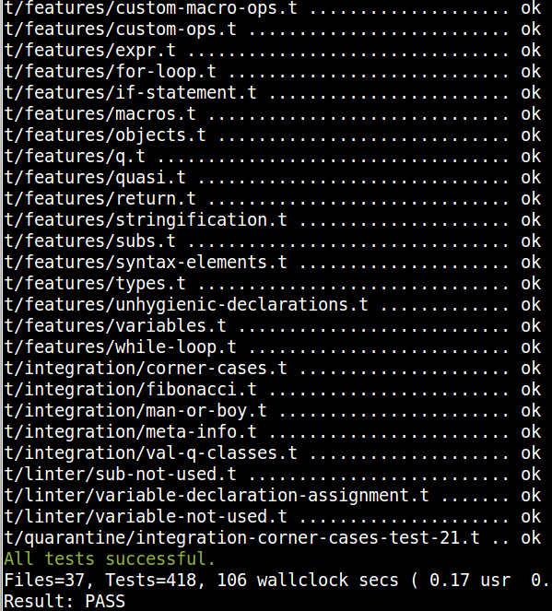
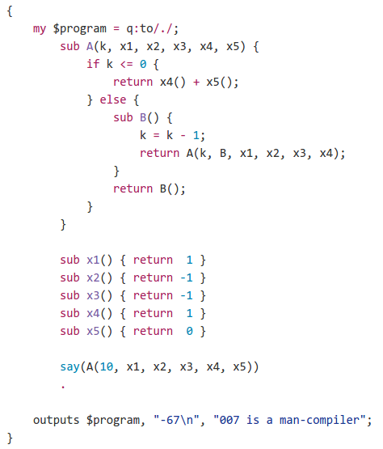
Testing

Slide 18
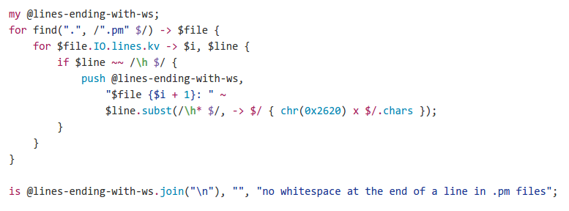
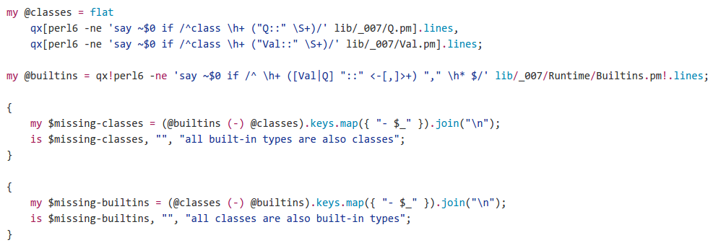
Tests I didn't expect

Slide 19
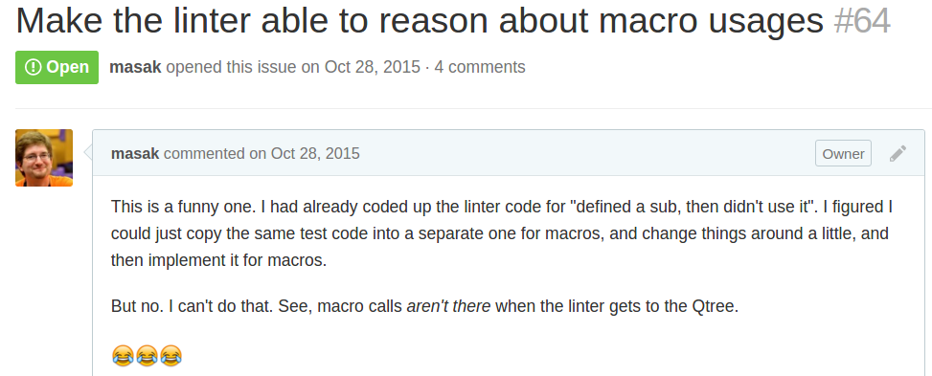
Realization: raw AST vs cooked

Slide 20
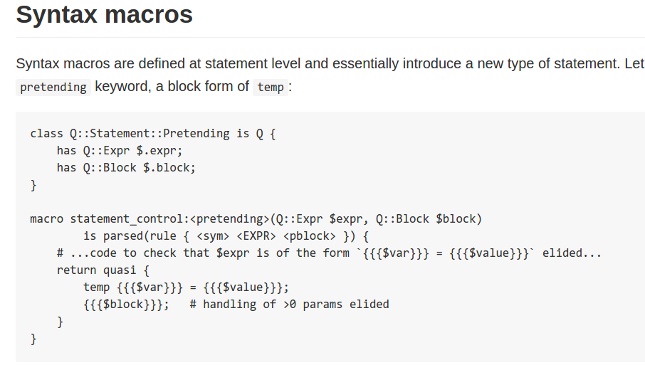
Future: syntax macros

Slide 21
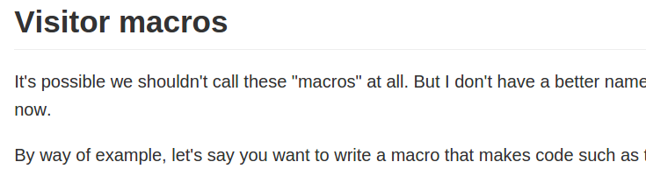
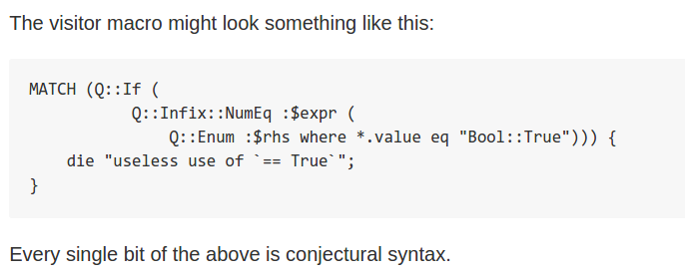
Future: visitor macros

Slide 22

Thank you!
Questions?
https://github.com/masak/007
Remember, pull requests
are love <3
https://www.flickr.com/photos/brenda-starr/3727579805

