Slide 1
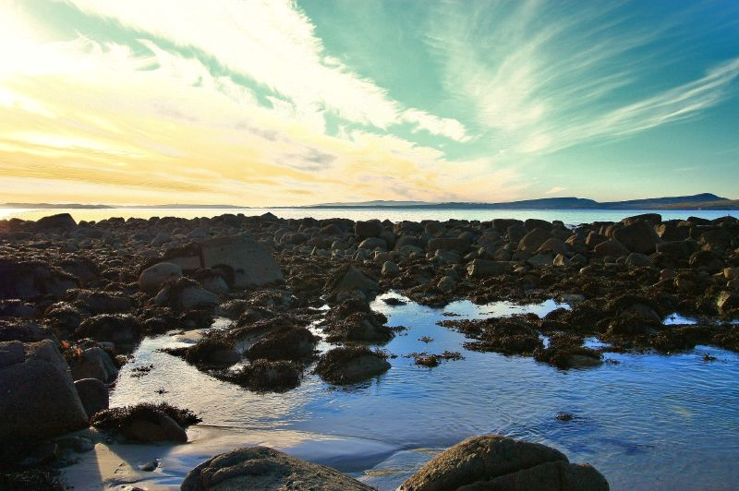
Domain modeling
&
the real world
Carl Mäsak
GPW 2016-03-09
https://www.flickr.com/photos/tir_na_nog/5346342563

Slide 2
so, I'm a father

Slide 3
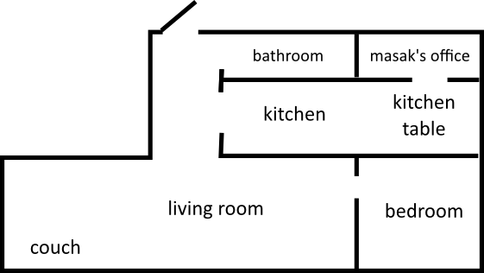

Slide 4
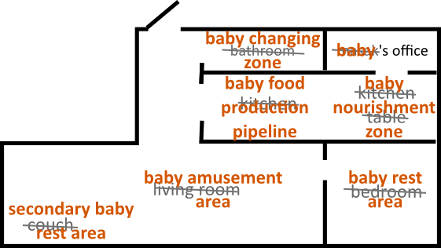

Slide 5
this makes one think

Slide 6
“what is software development?”

Slide 7
two views

Slide 8
completely at odds with each other

Slide 9
ok, that could make a decent talk

Slide 10
hi, I'm masak

Slide 11
I write Perl 6

Slide 12
professionally

Slide 13
(and on my spare time)

Slide 14
so, two views of software dev

Slide 15
first view: complete clarity

Slide 16
your core domain has no dependencies

Slide 17


Slide 18
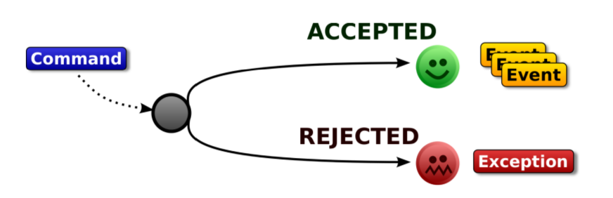
example: domain events

Slide 19
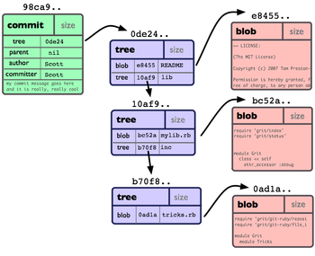
example: Git

Slide 20
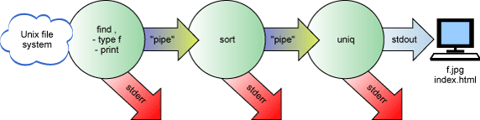
example: Unix pipes

Slide 21
second view: complete chaos

Slide 22
code as organism

Slide 23

code as organism

Slide 24
technical debt

Slide 25
we don't plan, we measure

Slide 26
less physics more biology

Slide 27
resources

Slide 28
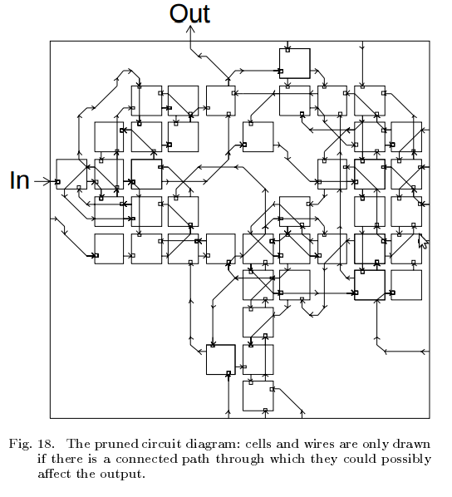
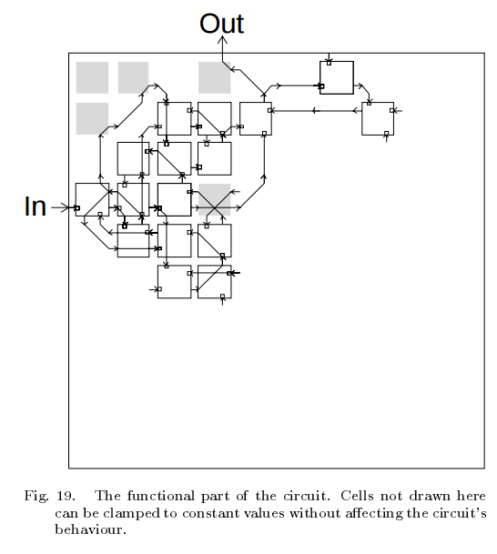
example: FPGA + evolutionary programming
http://www.idi.ntnu.no/emner/tdt22/2011/Thompsonieeeehw.pdf

Slide 29
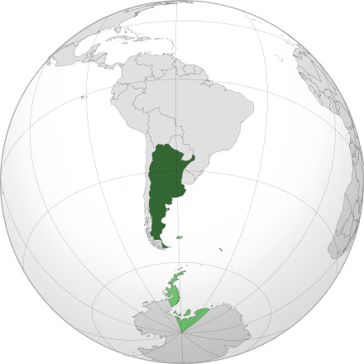
example: exceptions in Argentina

Slide 30
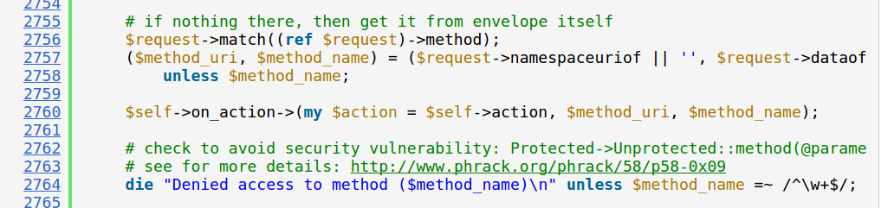
example: injection in SOAP::Lite

Slide 31
unintended consequences

Slide 32
alright, so who wins?

Slide 33
my take: we can push niceness far...

Slide 34
...but not all the way

Slide 35
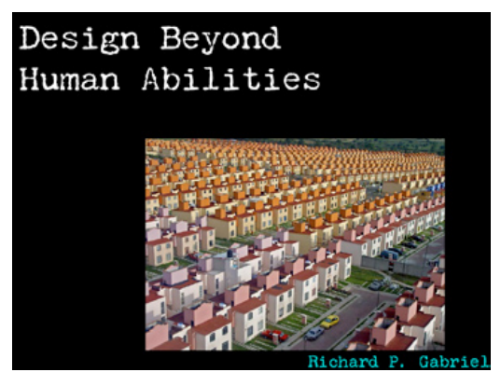

Slide 36
we need to be both physicists and biologists

Slide 37
to handle both the beauty and the chaos

Slide 38
thank you

