Slide 1
Pearls from the contest
Carl Mäsak
Olten, SPW 2015-08-28

Slide 2

So, I had this idea to arrange a contest involving Perl 6 and some curious problems.
Inspiration: someone ordered books off my Amazon wish list I wanted to “pay it forward”.
Inspiration: the X-prize competitions. The journey is more important than the goal.

Slide 3
Content warning: puzzles.

Slide 4
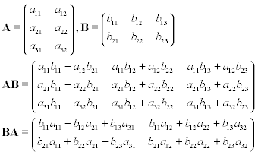
Multiply a chain of matrices
If you have matrices ABC to multiply, you can either do (AB)C or A(BC), and get the same matrix as a result.
But one might be much less work than the other.
Challenge: pre-scan dimensions and find the best way.

Slide 5
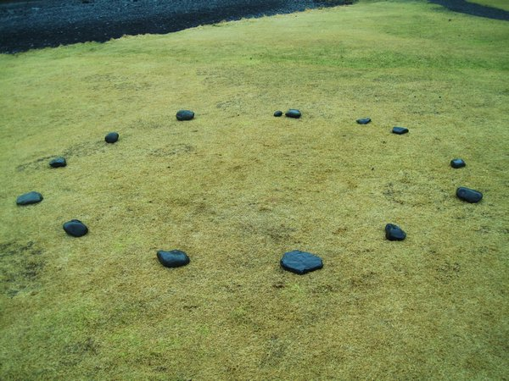
Pick the last pair of stones
A ring of stones.
Legal move: picking two stones which are next to each other. The player who makes the last legal move wins.
Write a computer strategy that wins consistently.

Slide 6
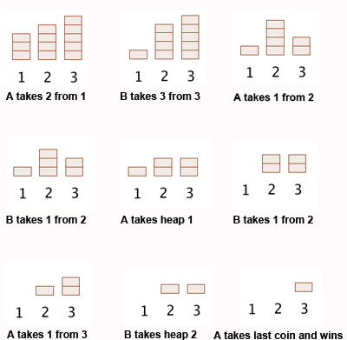
Nim

Slide 7
Expressing integers using four 9s
(9 + 9) / (9 + 9)
(9 * 9 + 9) / 9
You're given four 9s. You can combine them using + - * / %, negation, and parentheses.
Produce the given (non-negative) integer N in this way. If possible.

Slide 8

Hex puzzle
Slide the l piece to the far right.

Slide 9
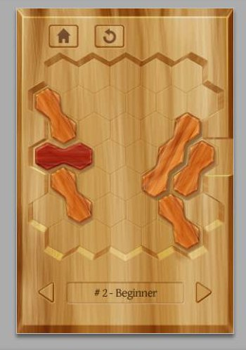

Slide 10
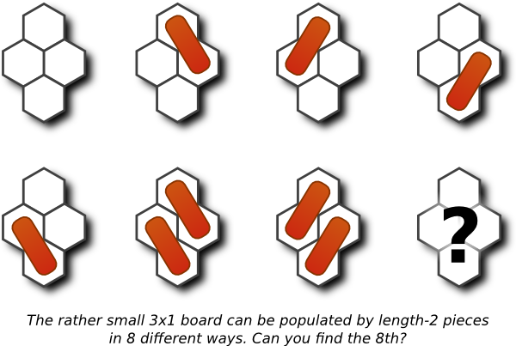

Slide 11


Slide 12
There are 4,783,154,184,978 board configurations.

Slide 13
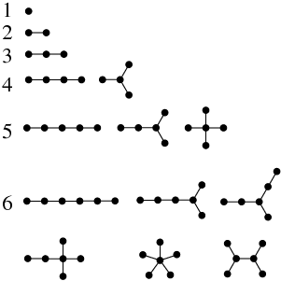
Enumerating trees
We're looking at unrooted trees, so there's no distinguished root node. All nodes are equal.
How many are there, if there are N nodes? Don't just count them, but also describe how they look.

Slide 14
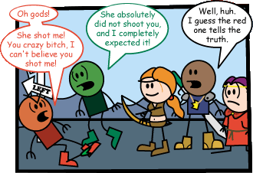
Tell knights from knaves
On the island Smul, there are only two types of people: those who know binary, and those who don't.
No, that's not it. There are knights (always truthful) and knaves (always lying). You don't know which is which. Find out, if possible.
A: A is a knight.
B: B is a knave.
C: C and D are of the same type.
D: D and C are of different types.

Slide 15
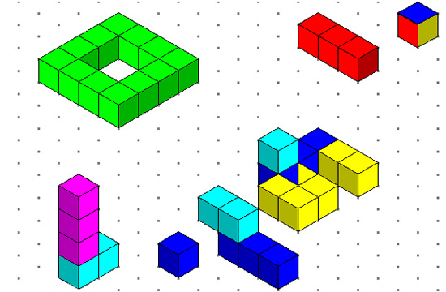

Rain in a world of cubes
Cubes are flung out in space to form “vessels” which can hold water. Rain falls from infinitely high and forms pools and waterfalls.
Find out how much water pools up in the vessels.

Slide 16


Conclusion

Slide 17
If you arrange a contest with puzzles, you will be amply rewarded. You will meet new people.
If you try to solve one of these puzzles, you might get intrigued, withdrawn, and frustrated.
When you ask ~five people to solve something separately, you will get five unique solutions.
Perl 6 is versatile. It allows you to have the appropriate amount of production, but also the appropriate amount of fun!

