Slide 1
May you live in interesting times
Carl Mäsak
Granada, YAPC::EU 2015-09-03

Slide 2

Maybe you thought I was going to talk about macros.
Nope. Not today.
If you're starving for macros, check out 007.

Slide 3

Turning points. Bootstrapping a user base.

Slide 4
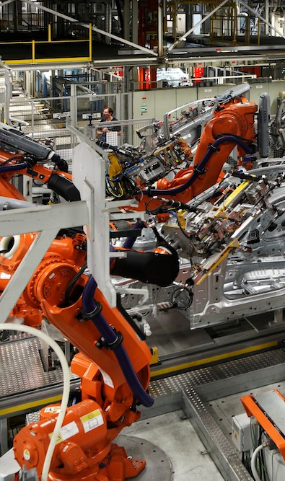
What is production?
It means different things to different people.
For some people it means something like “usable for work stuff”. For others, it means “we are actually using this for work stuff”.
For yet others it means “very bad things happen if this stops working”.

Slide 5
In this talk...
Production means...
...code I wrote...
...not for the Perl 6 tool chain itself...
...to serve me (or my employer) in some way...
...that actually gets run.

Slide 6
Thesis of this talk
Perl 6 is pretty cool, but all the features that make it cool are individually pretty mundane.
They're mundane because they're well-tested, and dependable. Things like types, lexical scoping, and good APIs.
As a corollary, the cool features that have traditionally been advertised as being the awesomest, are pretty marginal in Perl 6.

Slide 7
Challenge of this talk
I just commit to focusing only on boring features, didn't I?
Oh, shucks. ☺
…
As compensation, I promise to be very grumpy and cynical, so I sound like I have some “wisdom” and hard-earned “experience” to share.
Get off my lawn!

Slide 8
The today script
Let's start simple. This script
runs every time I open a new
terminal window or tab.
(But only once a day.)
It reminds me of important
dates, like birthdays and anniversaries.
Think of it like a modern-day digital almanac.
wed 26
thu 27
fri 28 X's birthday
sat 29 Y's birthday
sun 30
mon 31
tue 1 hours to $boss
wed 2
masak@siddharta ~ $

Slide 9
slurp and spurt
First off, I note that I use slurp and spurt a lot in smaller scripts.
For Perl 5 users, CPAN provides, as usual: File::Slurp has your back (with read_file and write_file). But I'm glad these are built in.
my $LAST_RUN_FILE = "%*ENV<HOME>/.today-last-run";
exit
if try slurp($LAST_RUN_FILE) eq $today;
spurt($LAST_RUN_FILE, ~$today);

Slide 10
qqw
I found I really liked qqw list quoting for hashes. For when you want rich strings but don't want to type any fat arrows and commas.
Perl has always been good at making this kind of list convenient to write. Perl 6 even more so.
I think post-GLR there should be a flat there.
my %year-events = «
"month 8, day 4" "Obama's birthday"
"month 7, day 14" "Trump's birthday"
»;

Slide 11
Naming your lexicals
Just like most of you, I've agonized about what to name my lexical variables. Perl 6 makes that slightly easier in some cases.
I consider it a win every time I get to do this. It's like the callee decides the name of my variable, saving me the responsibility of choice.
my $today = Date.today;
for ^7 -> $days {
my $date = $today.later(:$days);
# ...
}

Slide 12
Cautious perl6
If you have something running at every terminal startup, it turns out you need to cover the case where your Rakudo is rebuilding.
I learn shell/bash on a strictly need-to-know basis. In this case, the brief foray into the manpages meant that I could de-clutter my life a bit.
#!/bin/sh
if test $RAKUDO/src/gen/m-main.nqp -nt $RAKUDO/install/bin/perl6
then exit
fi
# otherwise, invoke perl6

Slide 13
The month script
At the turn of every month, I send a work summary to my boss.
I used to manually list all the days from the previous month in a text file, but I got tired of that. So I wrote this script which does it for me.
Each month, it saves me a minute or two of tedious, repetitive, error-prone typing.

Slide 14
Output is always fiddly
I wanted the output to come out like you see on the right. The rule is: empty lines before and after a weekend.
In code, this comes out as:
Note how a “before” viewpoint is slightly forced upon us. Ergh.
Wednesday 1 July
Thursday 2 July
Friday 3 July
Saturday 4 July
Sunday 5 July
Monday 6 July
Tuesday 7 July
Wednesday 8 July
Thursday 9 July
Friday 10 July
Saturday 11 July
Sunday 12 July
...
say "" if $weekday eq "Monday" | "Saturday"
&& $_ !== $first;
say "$weekday $monthday $monthname";

Slide 15
Junctions
Hey, you probably noticed that junction flash by.
So what about not caring much for cool features?
Well, I don't. I use junctions as syntax, not as values. I consider the other ways an anti-pattern.
YMMV.
say "" if $weekday eq "Monday" | "Saturday"
&& $_ !== $first;

Slide 16
The pinnacle of Perl 6: MAIN
Many excellent Perl 6 features (types, multi subs) meet and blend into a completed whole in MAIN.
multi MAIN() {
MAIN(LAST_MONTH.year, LAST_MONTH.month);
}
multi MAIN('current') {
MAIN(TODAY.year, TODAY.month);
}
multi MAIN($year, $month) {
# most of the code
}

Slide 17
constant
Constants look quite un-Perlish when you first see them. No sigil? What with the long keyword!?
But they are very Perlish. They allow you to clearly specify intent (“this is not going to change”).
And constant isn't so long once you realize that a BEGIN-time declaration is included in the deal.
The sigil is optional.
constant TODAY = Date.today;
constant LAST_MONTH = TODAY.earlier(:month(1));

Slide 18
Unexpected success: dates
The month script relies heavily on Perl 6's built-in date library. (As does the today script.) So do many Perl 6 scripts and programs.
We struggled to get dates and times right in Perl 6. Part of the problem is that lots of people have opinions about it, but it's actually really, really gnarly to get right. Like, horror-stories gnarly.
Let's look at an example.

Slide 19
Later
CPAN has a DateTime::Duration. It lets you specify a span of time in components: years, months, …, down to seconds.
The problem comes when you start to mix components. Do you add seconds first, or years? Does it matter? It kinda does, doesn't it? Augh!
Perl 6's solution? Forcing you to be explicit.
my $date2 = $date.later(months => 1);

Slide 20
We can loop over a range of dates
Just a small thing, but... ranges of dates work!
In fact, let's go back and improve the today script in the same way:
Not bad.
sub mday($day) { Date.new: $year, $month, $day }
my $first = mday 1;
my $last = mday $first.days-in-month;
for $first .. $last {
# ...
}
for Date.today .. Date.today.later(:7days) -> $date {
# ...
}

Slide 21
mishu
Many years ago, for an old $dayjob, I wrote an IRC bot (in Perl 5) called zarah. She was a roaring success, and is still operational.
Ever since then, I've thought “I can do better”. This is the first sign of Second System Syndrome.
Now, finally, mishu is taking shape.

Slide 22
Restarting is how you stay alive
Steve Yegge wrote a great blog post, The Pinocchio Problem, about how great systems never reboot.
That's a tall order. Sometimes a system goes down, and you need to reload all the data and get back to where you were.
So a design principle of mishu is that it runs for very short pieces of time, catches up, and shuts down. Most of the time it's off.

Slide 23
A DSL instead of language hackery
For the longest time, I wanted to implement the restarting with continuations, and cool stuff!
But no. Bad masak! Not even Perl 6 has continuations, that's how insane they are.
Instead, look at the problem from a different angle, and implement something sane. In this case, basically a small interpreter that can be paused whenever we want.

Slide 24
Building small, building big
Perl 6 has this ladder of features that you start to lean on as your program scales up and becomes more “enterprisey”.
Packages. Classes. Roles. Grammars. Test.pm.
The experience of migrating from small to big is something Perl 6 does surprisingly well.

Slide 25
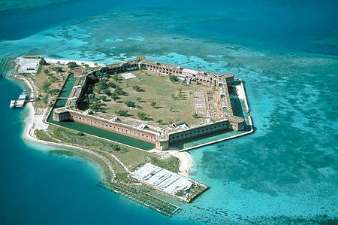
Hexagonal architecture
Speaking of testing.
There's this idea that you
can make an easy-to-test
“core” model, and then plug in all these GUI/DB/IO things.
I feel like I'm doing that more and more. Most things have such a core, especially after you discover events. Not always, but really often.
Testing gets to be really nice.

Slide 26
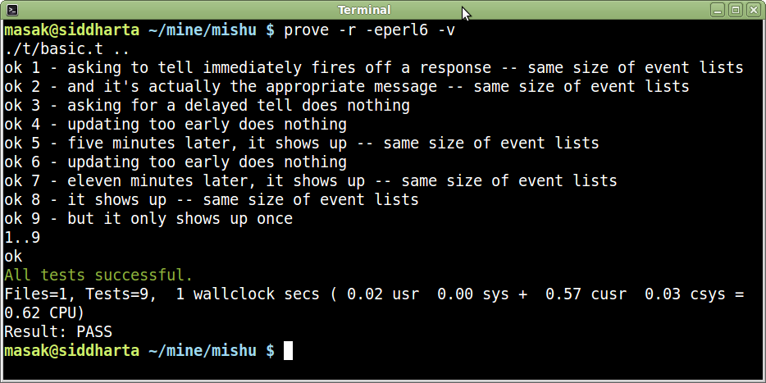
Look! Tests! And they pass!
This must mean something exists!

Slide 27
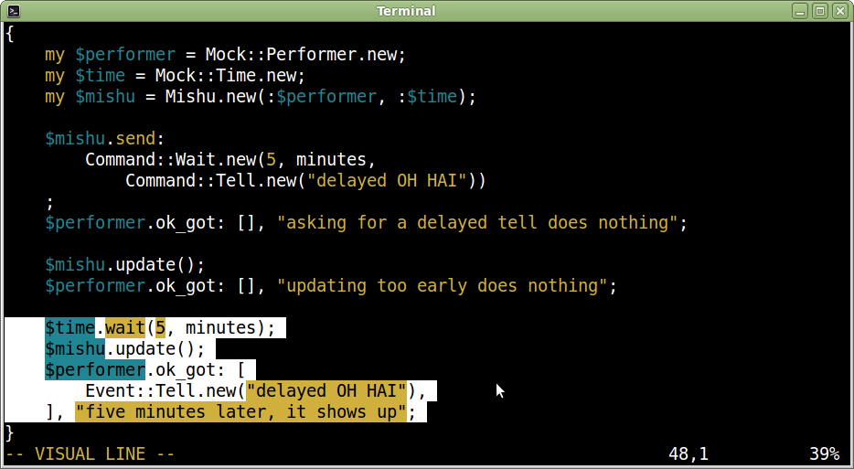
Looking at one of the tests

Slide 28
The course-abstracts repository
The “course-abstracts” repository is exactly what it says on the tin: a collection of course abstracts. They're in a Markdown-compliant data format.
But there's also a script that makes that makes a number of consistency checks against the data files. Kind of a custom linter for course abstracts.

Slide 29
Here's how the data format looks
Just so you know what we're dealing with.
# title
Rakudo Perl 6 and NQP Internals
# tweet
Take a deep dive into the Rakudo Perl 6 and NQP internals.
# blurb
Take a deep dive into the Rakudo Perl 6 and NQP internals. Build a small
compiler, complete with a simple class-based object system, to understand how
the toolchain works.
# abstract
This intensive 2-day workshop takes a deep dive into many areas of the Rakudo
Perl 6 and NQP internals...

Slide 30
What we're linting for
No Byte-Order Marks in the file, injected by people who are either evil or use Windows.
No missing required keys.
No mistyped or made-up keys.
No duplicate keys.
No field values left empty.
The “tweet” field shouldn't exceed 140 chars.
...and so on.
Many of these were installed on a “fool me once” basis.

Slide 31
What the linting code looks like
It's actually an API on top of Test.pm. The &expect_no function uses &is under the hood.
given Courses.new {
expect_no .boms, "no files set up us the BOM";
expect_no .missing_keys, "all courses have the required keys";
expect_no .unrecognized_keys, "all entries have recognized keys";
expect_no .empty_values, "all values are non-empty";
expect_no .overlong_tweets, "all tweets are within 140 chars";
expect_no .duplicate_keys, "there are no duplicate keys";
expect_no .tweets_without_dot, "no tweet keys are missing final dot";
expect_no .duplicate_codes, "there are no duplicate codes";
expect_no .en_courses_without_sv, "all en courses have sv courses";
expect_no .sv_courses_without_en, "all sv courses have en courses";
expect_no .todo_entries, "there are no TODO entries";
}

Slide 32
Roles for great good
It took a while until I realized that I could factor the different concerns into individual roles.
This is an example of roles-for-reuse, because there's another class Talks which does another combination of these roles.
class Courses
does CheckKeys[
required => <title tweet blurb abstract>,
optional => <audience prerequisites agenda material length>
]
does CheckValues
does CheckTweets
does CheckBom
does CheckDuplicates {
# much less stuff in here
}

Slide 33
Subs and methods?
To a Perl 5 person, it might seem weird that Perl 6 allows both subs and methods in a class.
But the distinction is very useful. Subs do what they always did: provide convenience functionality. Methods specify the object API. Inner language vs outer language.
sub en_courses { ... }
sub sv_courses { ... }
sub courses { ... }
sub extract_code { ... }
method en_courses_without_sv { ... }
method sv_courses_without_en { ... }

Slide 34
These things but not those things
Most of us are familiar with this pattern. Hashes are useful in the sense that they provide a solution for this use case.
But if you go “hey wait”, you might realize that this is not a hash problem in the first place.
method en_courses_without_sv {
my %courses = map { $_ => 1 }, en_course_codes();
%courses{ sv_course_codes() } :delete;
return %courses.keys.map($_
~ " has an English course but not a Swedish one");
}

Slide 35
Sets and hypers
What we really want is set difference.
Here hypers and sets work together to allow us to describe entire collections without for loops.
method en_courses_without_sv {
@( en_course_codes() (-) sv_course_codes() )
>>~>> " has an English course but not a Swedish one";
}

Slide 36
Pipes
Pipes are nice for when you want your data flow to run in the same direction as people read.
Watch out, though! You still can't end a line with a closing curly (}) without also ending the statement!
method missing_keys(@required) {
@required ==>
grep { %.entries{$_} :!exists } ==>
map { $.file_and_key($_) }
}

Slide 37
A grammar
Almost as an afterthought, there's a grammar in there that just parses the necessary bits of Markdown-ish data syntax.
my grammar MarkData {
token TOP {
^ <bom>? <entry>* $
}
token bom { \xFEFF }
token entry { <heading> <data> \n? }
# ...
}

Slide 38
psyde
Ever been to strangelyconsistent.org? The blog posts are generated by a ~240 line Perl 6 script.
The name “psyde” is a bad pun that stuck. The generator is based on Hakyll, a Haskell-based static site generator. Jekyll and Hyde, Hakyll and psyde.
Those 240 lines could be greatly generalized/de-duplicated, but over the years this script has done its job and hasn't needed improvement.

Slide 39
Overall structure
Roughly, psyde does four things:
Generate the list of all posts
Generate all individual articles (as needed)
Generate the RSS feed (with last 10)
Generate the index.html page (with last 3)
(Hakyll has a framework for doing dataflow; psyde just hardcodes the flow.)

Slide 40
The one thing to call out
I think this is the nicest function I ever wrote.
sub nonexistent-or-older($target, :than(@sources)!) {
return $target.IO !~~ :e
|| $target.IO.changed before any(@sources).IO.changed;
}

Slide 41
Text::Markdown
I keep coming back to Markdown as something I need to parse. I don't know if you noticed, but...
...psyde uses it. A presentation framework I want to write for $work could really use it. Even course-abstracts got in on the action.
What I really want is a Markdown DOM in Perl 6. That's the holy grail.

Slide 42
Data-driven TDD
Here I just want to share a very different way to do TDD, that involves writing zero tests.
I have these 369 posts. They are test input. And I have a p5 Markdown module that can process them; so I have test output.
I just go through them in a sensible order and find the first thing that blows up. When it gets through all 369, I'll know I'm done.

Slide 43
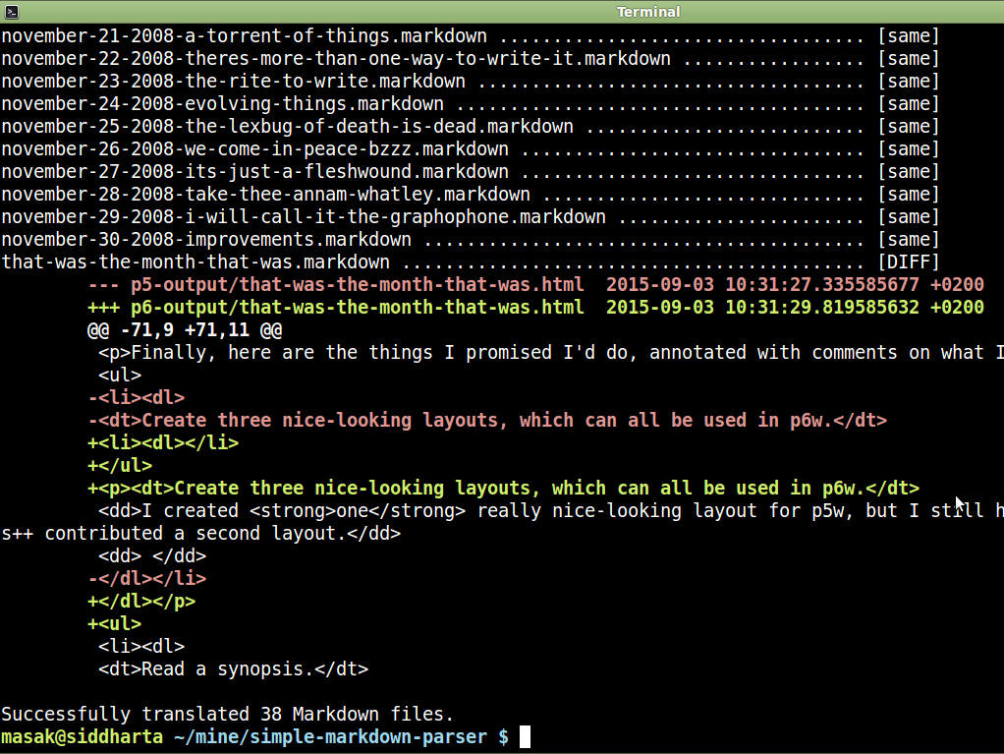

Slide 44
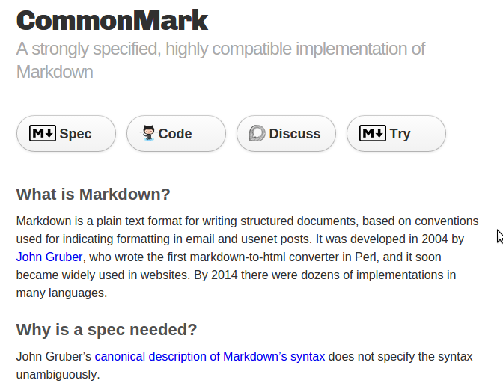
CommonMark
Once the parser can handle all my posts, I want to become compatible with CommonMark, a kind of gold standard for Markdown.
And yes, I expect fallout from my blog posts when doing this.

Slide 45
Conclusion

Slide 46
Perl 6 works well in production
I use it a lot in just that way.

Slide 47
Yay for boring features
Perl 6 has cool features. But the reason I stick with the language, and prefer to code in it, is that it provides a lot of sensible, safe, reliable, and well-designed features.
That also happen to mesh really well together.
But the interesting times should come from the problem domain, not from the language.

Slide 48
The future is stable
We've been living in the future for a while now.
Not everything in the future is flying cars and cool neon and talking animals. Sometimes it's just another day at work, snuggling up with your favorite cozy language, Perl 6.
And I like that.

