Slide 1
Agenda
09:00 - 10:30 Project update (AMBS workflow, Booser EA program, and Paper on evaluation metrics )
10:30 - 11:00 Birthday celebration for Micha, Amirpasha, and Bing
11:00 - 12:30 Project update and future plan (Future plan)
12:30 - 14:00 lunch break
14:00-16:00 AMBS group discussion of the feedback from Martin

Slide 2
Project update
Timelines (Scarlet)
Goals – ECCV paper resubmission and workflow development strategy (Bing)
New highlights of the workflow (Bing)
JUWELS Booster Early Access Program (Micha)
Evaluation paper (status, scope ...) (Scarlet and Bing)
Future plan and Milestone (Bing)

Slide 3
Project update
Timelines (Scarlet)
Goals – ECCV paper resubmission and workflow development strategy (Bing)
New highlights of the workflow (Bing)
JUWELS Booster Early Access Program (Micha)
Evaluation paper (status, scope ...) (Scarlet and Bing)
Future plan and Milestone

Slide 4
Timeline
GOAL NOVEMBER 2020: RESUBMISSION ECCV PAPER
ECCV Paper
Implementation other architectures
Implementation unit testing
Continue writing paper on evaluation
02/2020
11/2020
Need mAMBS
Booster
Urgent need: concurrency
Modularization of existing code
Concept mAMBS
Parallelization of one architecture
Draft ideas for 3 additional papers
Seite 4

Slide 5
Timeline
GOAL NOVEMBER 2020: RESUBMISSION ECCV PAPER
WHY WERE WE DOING THESE TASKS?
ECCV Paper
Implementation other architectures
Implementation unit testing
Continue writing paper on evaluation
Goal
Acceptance in ML community
Technical
Vision
02/2020
11/2020
Need mAMBS
Booster
Urgent need: concurrency
Modularization of existing code
Visibility
JSC goals
Technical
Technical
Concept mAMBS
Technical
Parallelization of one architecture
Draft ideas for 3 additional papers
Vision
Seite 5

Slide 6
Project update
Timelines (Scarlet)
Goals – ECCV paper resubmission and workflow development strategy (Bing)
New highlights of the workflow (Bing)
JUWELS Booster Early Access Program (Micha)
Evaluation paper (status, scope ...) (Scarlet and Bing)
Future plan and Milestone

Slide 7
Goal: ECCV Resubmission and workflow development strategy
Goal: ECCV paper: 2m temperature forecasting using video – video prediction
Priority for achieving the goal: Complement new vision of the current code
Workflow development strategy:
Tasks | Revision of source code (including modularization) | unitest | AMBS review
Data Preprocessing, step 1 (ERA5) | Yes | Yes | Yes
Data Preprocessing, step 2 (EAR5) | Yes | Yes | No
Data Preprocessing, step 2 (MNIST, KTH) | No | No | No
Training | Yes | Yes | No
Post Processing | No | No | No
convLSTM | Yes | - | Yes
SAVP/McNet | No | No | No
Restructure repo with cleaned up/ renamed scripts
Modularization
Comments for each function/method
Add unitest
Joint review by AMBS group

Slide 8
Project update
Timelines (Scarlet)
Goals – ECCV paper resubmission and workflow development strategy (Bing)
New highlights of the workflow (Bing)
JUWELS Booster Early Access Program (Micha)
Evaluation paper (status, scope ...) (Scarlet and Bing)
Future plan and Milestone

Slide 9
New hightlights of the workflow
Cluster systems: End-to-End ML workflow running on GPU and CPU cluster systems (HDF-ML and JUWELS; JUWELS Booster only for training)
Cross domains: Use in Weather forecasting domains and ML domains: Plug in benchmarking datasets from both Weather forecasting provider and ML communities (ERA5, moving MNIST, KTH for future)
State of the art: Plug in state-of-the-art video-video ML benchmarking models (convLSTM, VAE, McNet and SAVP)
Traceability and Reproducible: Auxilary scripts (generate_workflow_runscripts.sh and config_train.py) to allow for user-defined and backtracable experiments (e.g. an experimental identifier was added), metadata were generated for each experiment to be traceable.
Interactive and Easy-to-use: config_train.py enabling keyboard interaction with the user 1) Selection of input dataset, 2) modification of hyperparameter setting, and 3) enable run on multiple jobs simultaneously on HPC
Generic and universal: Multiple variables (Change DataExtraction and we need to test) and regions can be selected
Distributed computation across the workflow (Except for postprocessing)
More efficient cross-validation enabled : Index-based splitting of the dataset into the train-, validation, and test-data subset during runtime (no duplicated data storaging anymore)

Slide 10
New hightlights of the workflow
Cluster systems: End-to-End ML workflow running on GPU and CPU cluster systems (HDF-ML and JUWELS; JUWELS Booster only for training)
Cross domains: Use in Weather forecasting domains and ML domains: Plug in benchmarking datasets from both Weather forecasting provider and ML communities (ERA5, moving MNIST, KTH)
State of the art: Plug in state-of-the-art video-video ML benchmarking models (convLSTM, VAE, McNet and SAVP)
Traceability and Reproducible: Auxilary scripts (generate_workflow_runscripts.sh and config_train.py) to allow for user-defined and backtracable experiments (e.g. an experimental identifier was added), metadata were generated for each experiment to be traceable.
Interactive and Easy-to-use: config_train.py enabling keyboard interaction with the user 1) Selection of input dataset, 2) modification of hyperparameter setting, and 3) enable run on multiple jobs simultaneously on HPC
Generic and universal: Multiple variables (Change DataExtraction) and regions can be selected
Distributed computation across the workflow
More efficient cross-validation enabled : Index-based splitting of the dataset into the train-, validation, and test-data subset during runtime (no duplicated data storaging anymore)

Slide 11
Project update
Timelines (Scarlet)
Goals – ECCV paper resubmission and workflow development strategy (Bing)
New highlights of the workflow (Bing)
JUWELS Booster Early Access Program (Micha)
Evaluation paper (status, scope ...) (Scarlet and Bing)
Future plan and Milestone

Slide 12
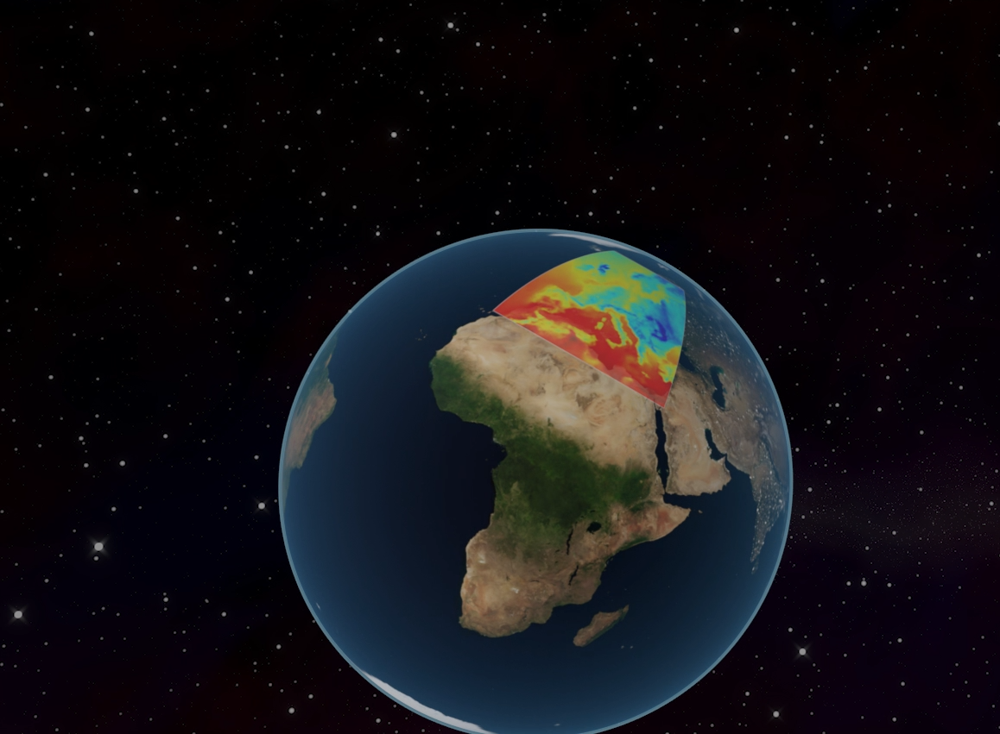
Updates on Juwels Booster EA Programme
Accomplished tasks
Submission of video clip for visualizing prediction approach with convLSTM model
Submission of application profile
Adaptions of the software environment for AMBS
Running convLSTM training on single and multiple GPUs (with Horovod)

Slide 13
Updates on Juwels Booster EA Programme
Accomplished tasks
Submission of video clip for visualizing prediction approach with convLSTM model
Submission of application profile
Adaptions of the software environment for AMBS
Usage of container equipped with CUDA-enabled TensorFlow 1.15
Trouble shooting with support from Andreas Herten and Benedikt von St.Veith
Possibility to build up virtual envs in Python (installing packages)
Set up of Modular Component Architecture parameters of OpenMPI (OMPI_MCA_btl) and transporting framework (UCX_TLS)
Running convLSTM training on single and multiple GPUs (with Horovod)

Slide 14
Updates on Juwels Booster EA Programme
Accomplished tasks
Submission of video clip for visualizing prediction approach with convLSTM model
Submission of application profile
Adaptions of the software environment for AMBS
Running convLSTM training on single and multiple GPUs (with Horovod)
Training on single GPU works technically (~1.9s per step vs. ~6.7s per step)
First successful test with 4 GPUs on Monday (reasonable reduction in loss over training iteration)

Slide 15
Updates on Juwels Booster EA Programme
Open tasks
Clean job submission on Juwels Booster (quick-and-dirty approach so far)
Check parallelization on multiple nodes (4 GPUs/node)
Check results from parallelized training (Does Horovod implementation work properly?)
Check performance w.r.t. Juwels + scaling property with varying #GPU

Slide 16
Project update
Timelines (Scarlet)
Goals – ECCV paper resubmission and workflow development strategy (Bing)
New highlights of the workflow (Bing)
JUWELS Booster Early Access Program (Micha)
Evaluation paper (status, scope ...) (Scarlet and Bing)
Future plan and Milestone

Slide 17
Evaluation paper
EVALUATION OF ENSEMBLE WEATHER FORECASTS CREATED BY MACHINE LEARNING APPROACHES
Main idea:
Contrast evaluation metrics used in computer vision and metrics used for (ensemble) weather forecasts
Main selling point: both point of views???
Current status:
Draft text already available on Overleaf (like ifftex)
Drafts for abstract, introduction, related work exists
Literature review for computer vision evaluation metrics (all done by Bing)
Open tasks:
Translate this into experiment setup to produce results
Sharpen the scope of the paper
Discuss first author/corresponding author
Seite 17

Slide 18
Evaluation paper
SCOPE
We review the evaluation metrics in computer vision and ensemble weather forecasting. What computer vision metrics? Only for video prediction or also for image prediction?
What variables do we forecast?
Do we keep the multitask learning?
What architecture(s) do we want to use? We have the luxury to pick.
What domain do we want to use?
What temporal resolution do we want to train on? Still hourly? I suggest 3 or 6 hours.
What lead time to train for? Can we train on 24 h but also try 2 weeks?
Include case studies?
Are extremes captured in the ensemble?
Seite 18

Slide 19
Project update
Timelines (Scarlet)
Goals – ECCV paper resubmission and workflow development strategy (Bing)
New highlights of the workflow (Bing)
JUWELS Booster Early Access Program (Micha)
Evaluation paper (status, scope ...) (Scarlet and Bing)
Future plan and Milestone

Slide 20
Future plan (1M-3M)
JUWELS Booster EA Program (still highest priority):
Scaling across multiple nodes and GPUs with Horovod (Done)
Provide the scalable results
Report on the 20th Jan for Jewels booster Conference.

Slide 21
Future plan (1M-3M)
AMBS Workflow
Complete the tasks in the table
Start experiments, udpate the results for ECCV paper, and used for Evaluation metric paper
Tasks | Revision of source code (including modularization) | unitest | AMBS review
Data Preprocessing, step 1 (ERA5) | Yes | Yes | Yes
Data Preprocessing, step 2 (EAR5) | Yes | Yes | No (1 week)
Data Preprocessing, step 2 (MNIST, KTH) | No (Bing: 2 -3 weeks) | No (Bing: 2 -3 weeks) | No (3 -4 weeks)
Training | Yes | Yes | No (1 week)
Post Processing | No (Bing: 1 week) | No (Bing: 1 week) | No (2 weeks)
convLSTM | Yes | - | Yes
SAVP/McNet | No (Gildas and Bing 3-4 weeks) | No (Gildas and Bing 3-4 weeks) | No (3 -4 weeks)

Slide 22
Future plan (3M~)
Target features of workflow
Multiple ML framworks support: Do not support the multiple framework which will limit the ML benchmarking algorithms
Interface design for users to integrate the customized benchmark dataset, ML algorithms and evaluation metrics
Portable: use container
TensorCore supports for accelerating the training process
….

Slide 23
Future plan (3M~)
New software engineers will be involved. Potential tasks are:
‘External’ review of current workflow and source codes with focus on more sophisticated model architectures (SAVP and McNet)
Direct conversion from ‘raw data given as grib-files to tfrecords (Gildas, 6 months) Side note by Michael: Handling of grib-files requires careful coupling with grib-table definitions/ecCodes
COSMO-ER6 integrates into the workflow and prepares for using for MAELSTROM project
Parallelization of two outstanding architectures McNet and SAVP (Gildas,6 months)
From Bing’s point of view, maybe this part is not so hard
Tfrecords1. -> tfrecords 2 (Gildas, 6 months)
Pytorch maybe needs to be considered?
This year 75% of the publish ML publications using PyTorch ( Not touch this before we submit the two publications ;
PS: HEaT use Pytorch, maybe future cooperate with them) (Gildas: long future plan)

Slide 24
Future plan
Papers submission priority:
ECCV resubmission (Science)
Evaluation metrics (Science)
AMBS workflow (Technical paper)
Extreme values in weather forecasting with video prediction models (Science)
Season weather forecasting (Science)

