Slide 1
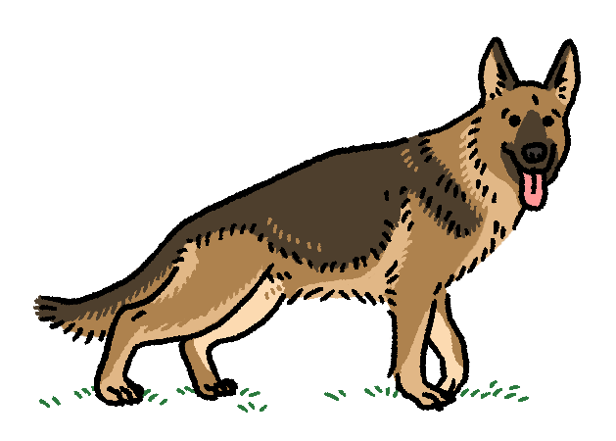
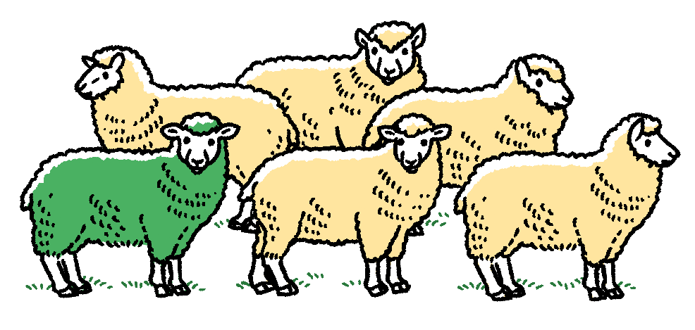
Shepherding algorithm
for heterogeneous flock
Variant sheep
Normal sheep

Slide 2
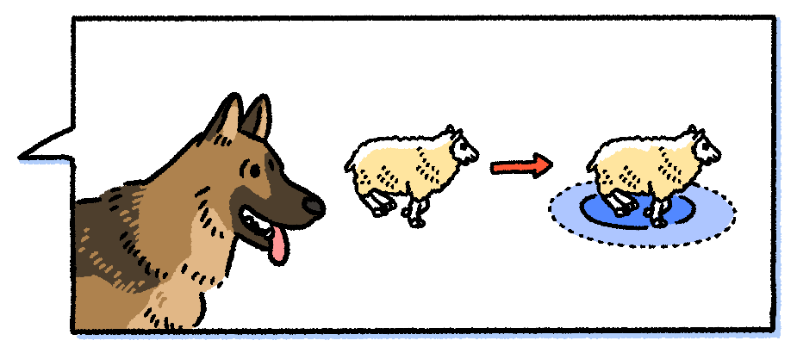
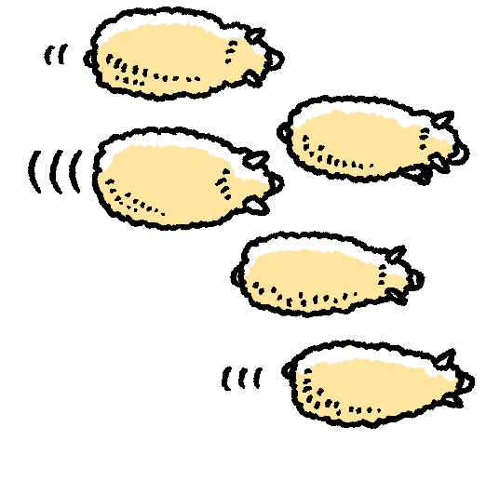
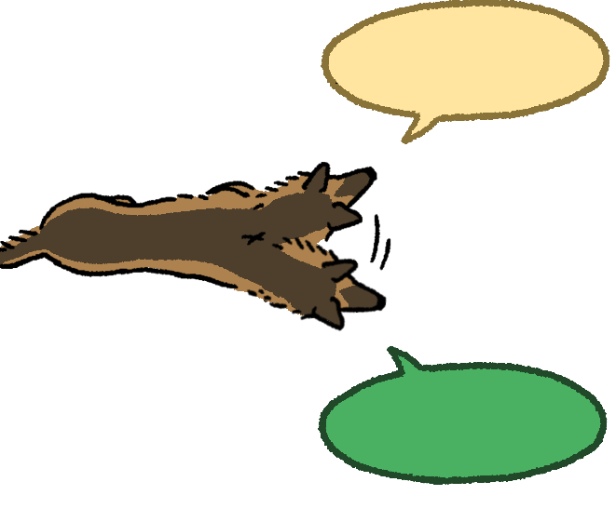
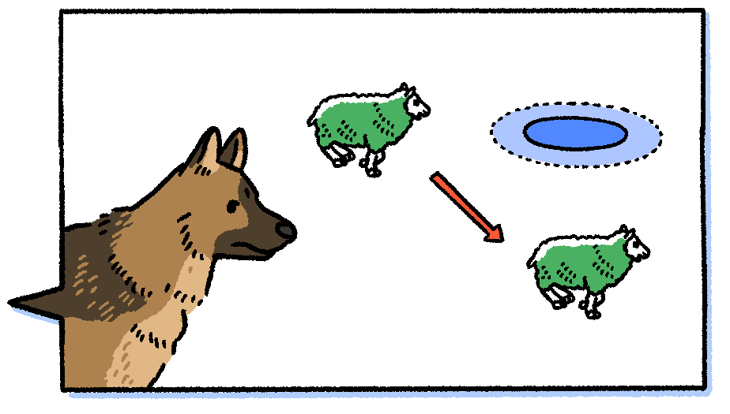
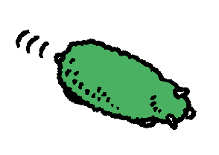
The shepherd discriminates normal and variant sheep.
Normal sheep
Estimate
Actual
Normal !
Variant sheep
Estimate
Variant…
Actual

Slide 3

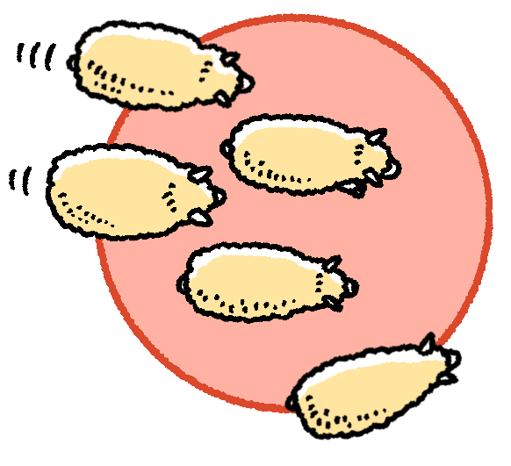
The shepherd guides only sheep which are determined to be normal.
Normal sheep
Goal area
Variant sheep

