Slide 1
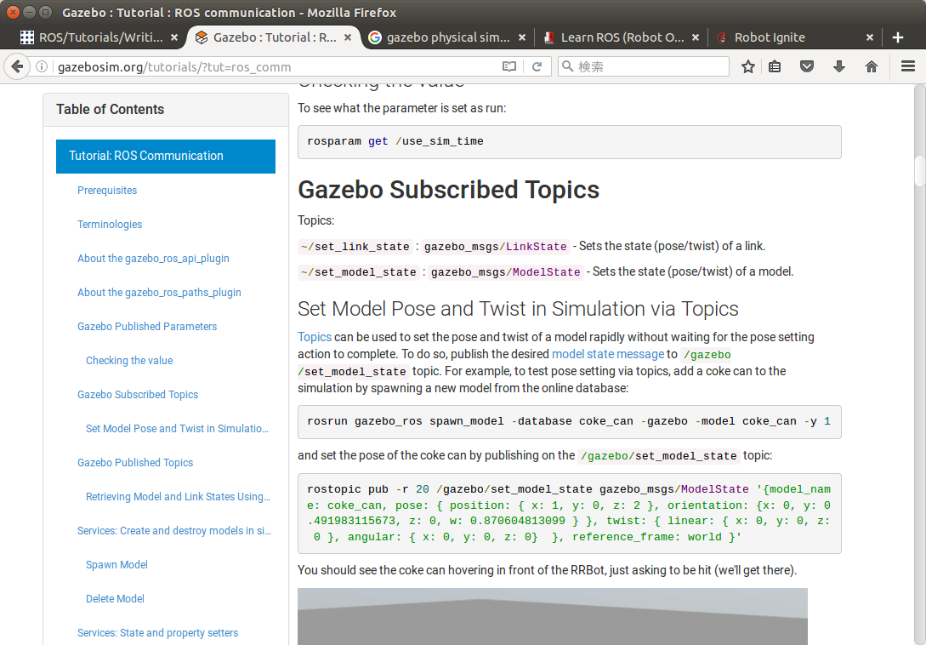
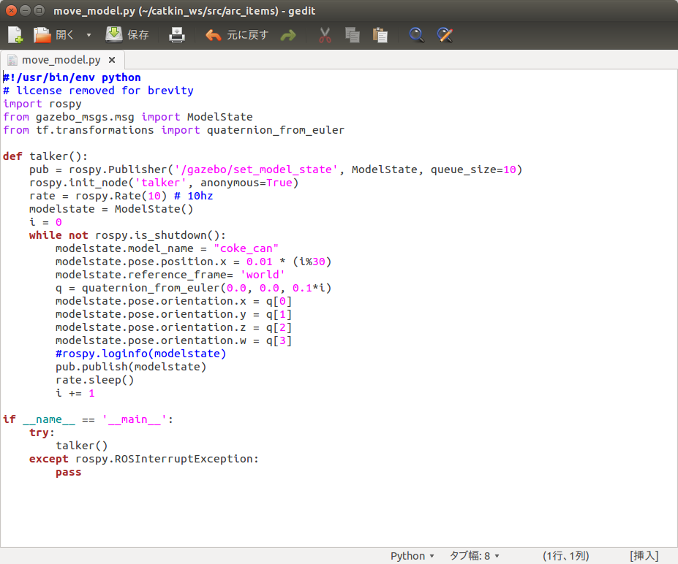
Move_model.py
Gazebo内のモデルの位置を外部から指定する
#!/usr/bin/env python
# license removed for brevity
import rospy
from gazebo_msgs.msg import ModelState
from tf.transformations import quaternion_from_euler
def talker():
pub = rospy.Publisher('/gazebo/set_model_state', ModelState, queue_size=10)
rospy.init_node('talker', anonymous=True)
rate = rospy.Rate(10) # 10hz
modelstate = ModelState()
i = 0
while not rospy.is_shutdown():
modelstate.model_name = "coke_can"
modelstate.pose.position.x = 0.01 * (i%30)
modelstate.reference_frame= 'world'
q = quaternion_from_euler(0.0, 0.0, 0.1*i)
modelstate.pose.orientation.x = q[0]
modelstate.pose.orientation.y = q[1]
modelstate.pose.orientation.z = q[2]
modelstate.pose.orientation.w = q[3]
#rospy.loginfo(modelstate)
pub.publish(modelstate)
rate.sleep()
i += 1
if __name__ == '__main__':
try:
talker()
except rospy.ROSInterruptException:
pass
http://gazebosim.org/tutorials/?tut=ros_comm

