Slide 1
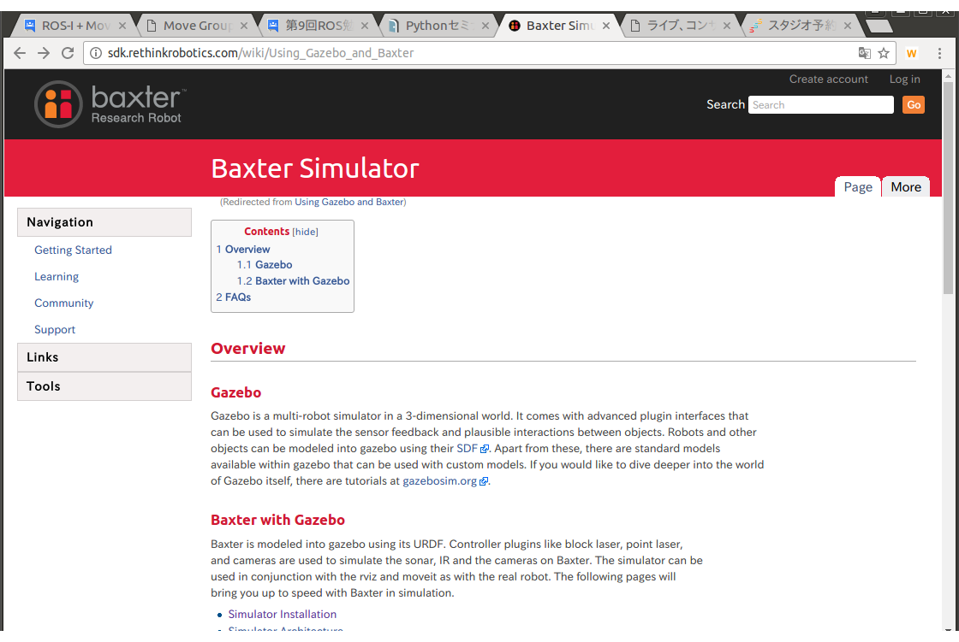
Baxter Simulator
Simulator Installation
Simulator Architecture
Simulator API
Simulator Code Examples
Gripper Customization
Gazebo Troubleshooting

Slide 2
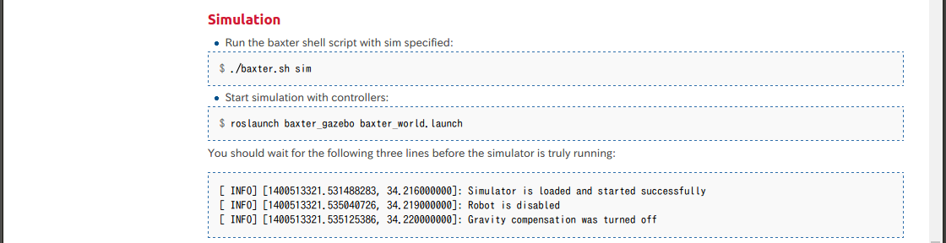
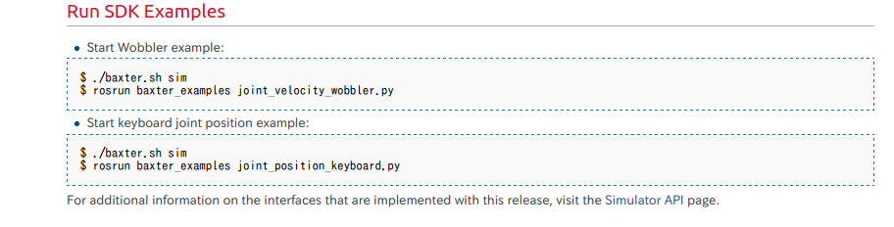
シミュレーションの起動
cd ~/ros_ws

Slide 3
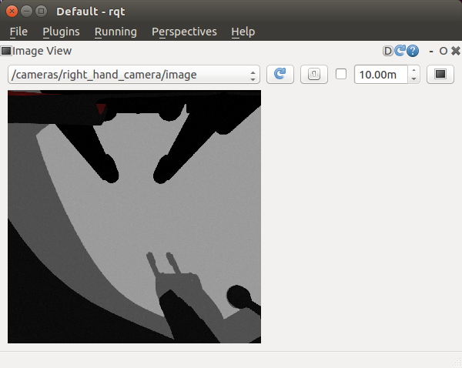
カメラ映像
ｒｑｔ
  最初はPlugins->Visualization->ImageViewを選択
    /cameras/head_camera/image
    /cameras/left_hand_camera/image
    /cameras/right_hand_camera/image

Slide 4
SDK Examples
Fundamentals
  Enable Robot Example (Start Here) - This tool is responsible for enabling (powering and state monitoring) Baxter. Enabling the robot is expected and necessary for standard Baxter usage.
Movement
  Joint Position Waypoints Example - The basic example for joint position moves. Hand-over-hand teach and recording a number of joint position waypoints. These waypoints will then be played back indefinitely upon completion.
  Joint Position Keyboard Example - This example demonstrates numerous joint position control.
  Joint Position Example - Joystick, keyboard and file record/playback examples using joint position control of Baxter's arms.
  Joint Torque Springs Example - Joint torque control example applying virtual spring torques.
  Joint Velocity Wobbler Example - Simple demo that moves the arm with sinusoidal joint velocities.
  Joint Velocity Puppet Example - Simple demo which mirrors moves of one arm on the other in Zero-G.
  Inverse Kinematics Service Example - Basic use of Inverse Kinematics solver service.
  Simple Joint Trajectory Example - Simple demo using the joint trajectory interface.
  Joint Trajectory Playback Example - Trajectory playback using the joint trajectory interface.
  Head Movement Example - Simple demo moving and nodding the head.
  Head Action Client Example - A demo to showcase the functionality of the head trajectory action server.
  Gripper Example - Joystick and Keyboard control for the grippers.
  Gripper Cuff Control Example - Simple cuff-interaction control with Zero-G mode.
Robot Configuration
  URDF Configuration Example - A simple ROS node that shows how to add segment and joint subtrees to the robot's model.
Simulator
  IK Pick and Place Demo - An intermediate example for combining Inverse Kinematics Service calls with Arm movement, gripper actuation, Gazebo Model Spawning, and simulator readiness.
Input and Output
  Camera Control Example - Demonstrates usage for listing, opening, and closing the available cameras.
  View Cameras Example - Simple tool for viewing camera feed on development machine.
  Screen Display - Example tool for displaying image files (png, jpeg) on the Head Screen.
  I/O Example - Flash the lights on the digital outputs.

Slide 5
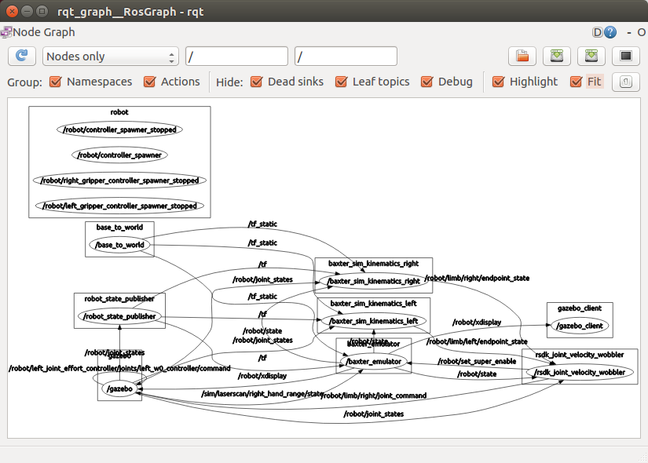
joint_velocity_wobbler.py
import
  import argparse
  import math
  import random
  import rospy
  from std_msgs.msg import UInt16
  import baxter_interface
  from baxter_interface import CHECK_VERSION
class Wobbler
  def __init__(self) # 500 Hzに制御周期を決めるとともに、＾C停止時の終了処理を設定
  def resetcontrol_modes(self) # 終了時の制御モードのリセット
  def set_neutral(self) # 終了時に初期姿勢へ戻る
  def clean_shutdown(self) # 終了時に呼び出される関数
  def wobble(self) # 実際の動作をする関数
    def _v _func() # 現在時間から、関節の角速度を決定する関数
    def make_cmd(joint_names, elapsed) # 全関節の角速度を決定する関数リストをつくる
def main()
  rsdk_joint_velocity_wobblerノードの登録
  終了時の呼び出し関数の設定（終了時に非常に安定）
  動作の開始
実行は
  rosrun baxter_examples joint_velocity_wobbler.py

Slide 6
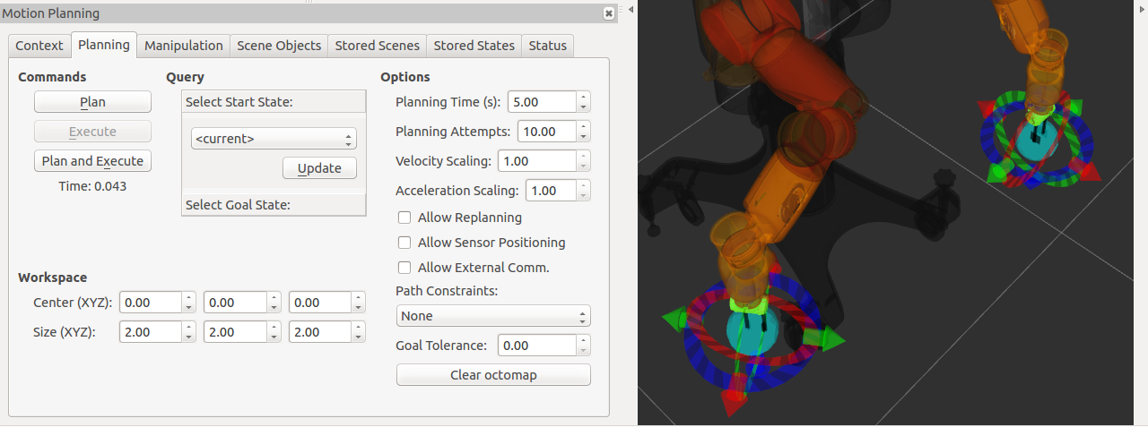
MoveIt
ターミナル立ち上げは（シミュレーション）
  cd ros_ws
  ./baxter.sh sim
  roslaunch baxter_gazebo baxter_world.launch # Gazebo立ち上げ
実行
  rosrun baxter_tools enable_robot.py -e # ロボットEnable
  rosrun baxter_interface joint_trajectory_action_server.py # 関節コントローラ立ち上げ
  roslaunch baxter_moveit_config baxter_grippers.launch # Rviz立ち上げ
RVIZ上で起動計画→Gazebo上で確認
  StartStateをCurrentｓにして、計画、実行すると順繰りに起動が作られていく

Slide 7
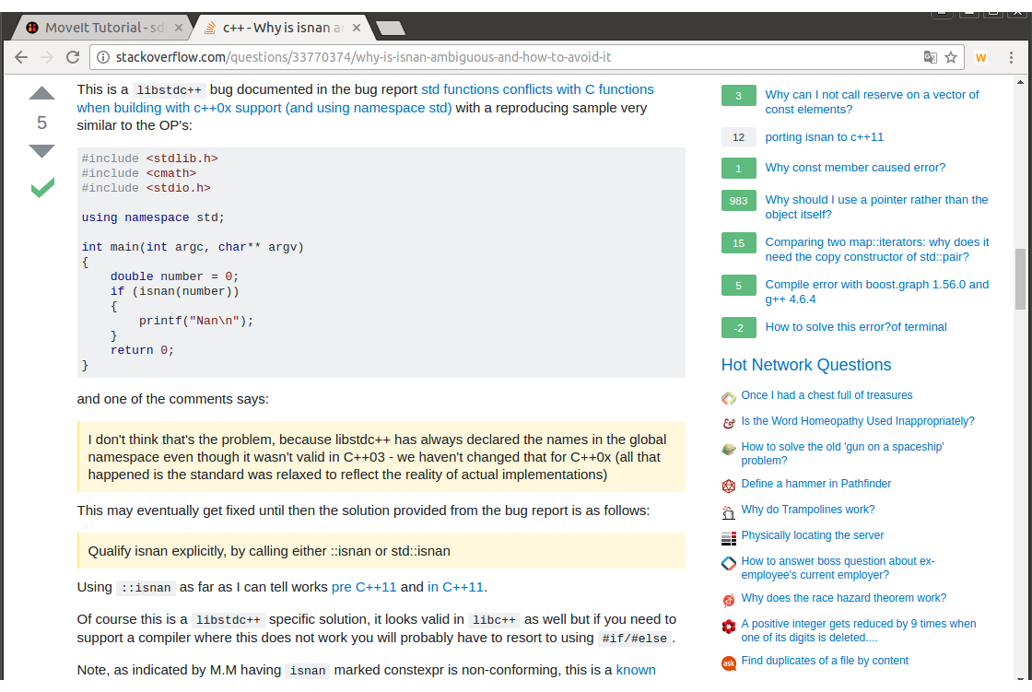
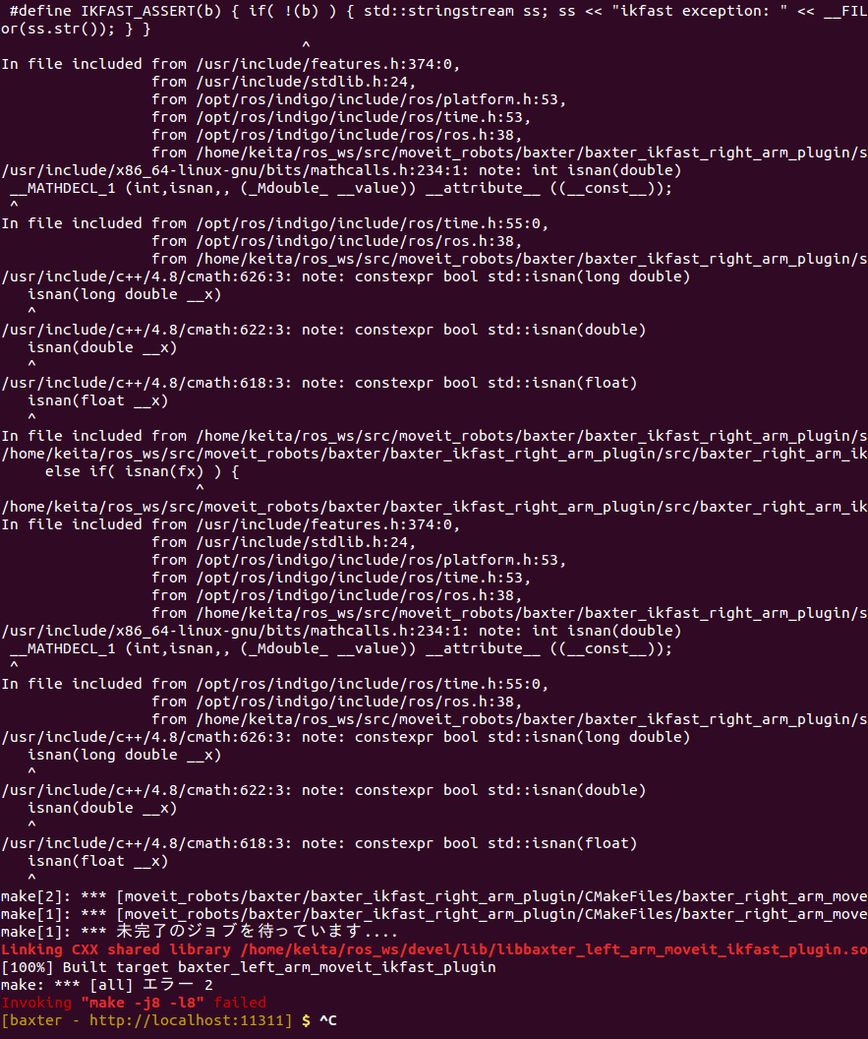
Makeエラー
catkin_makeエラー
  コンパイラのバグらしい
  ｓｔｄ：：isnanと書き換えて回避

