Slide 1
P2P Transactive Energy & Blockchain
Miguel Salinas Gancedo (masalinas.gancedo@gmail.com)

Slide 2
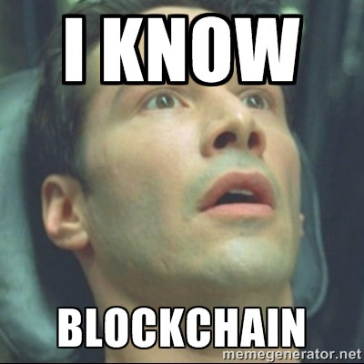
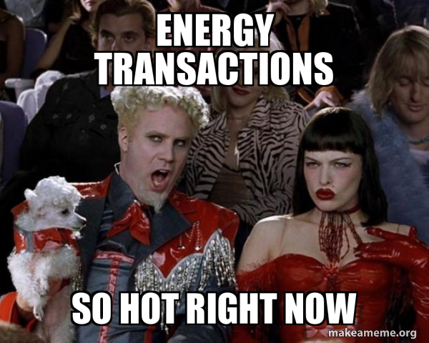


Introduction: Topics
+

Slide 3

Introduction: Topics

Slide 4
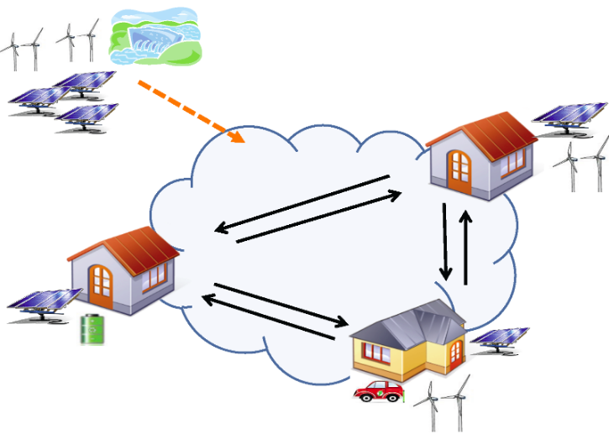
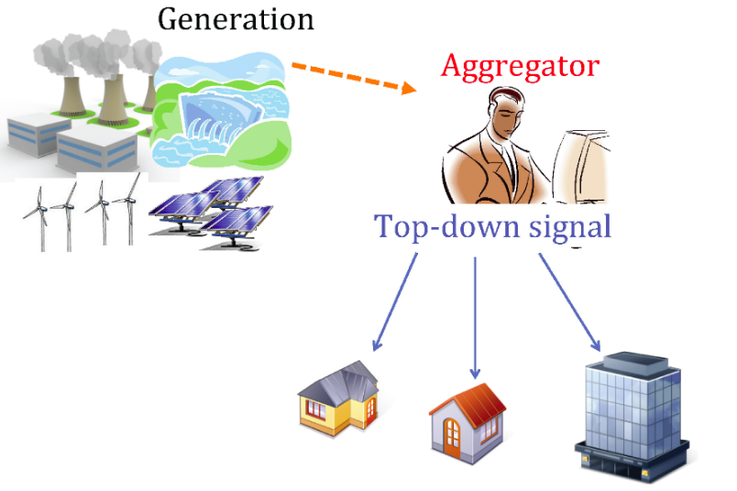
Energy Distribution
Transaction
Vs
Microgrid
Top-down
Energy Distribution
Transactive
Energy Distribution

Slide 5
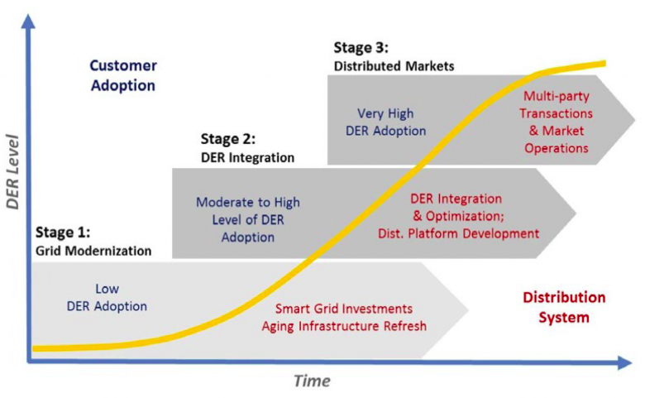
Energy Distribution Evolution

Slide 6
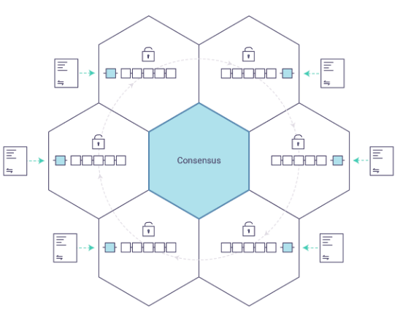
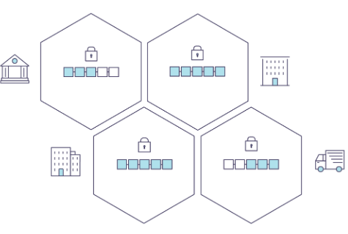
What is Blockchain
Vs
Distributed Ledger
Decentralization Ledger

Slide 7
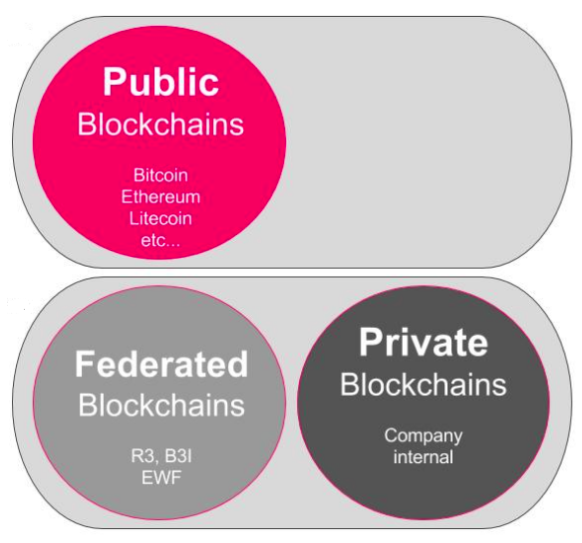
Blockchain Types

Slide 8
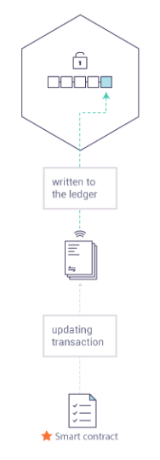
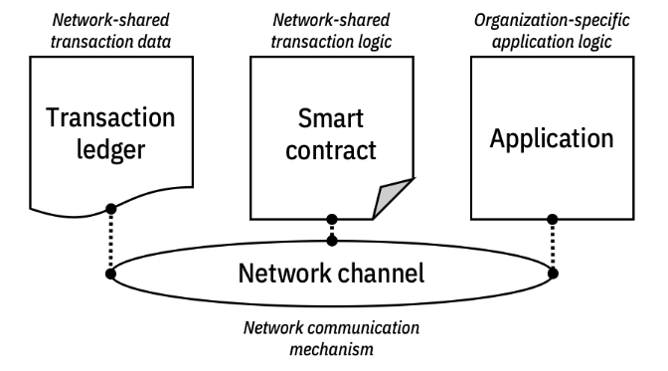
What is Smart Contract

Slide 9
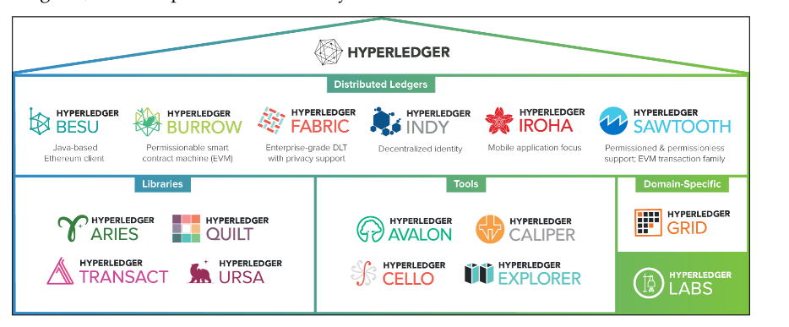
Hyperledger Ecosystem

Slide 10
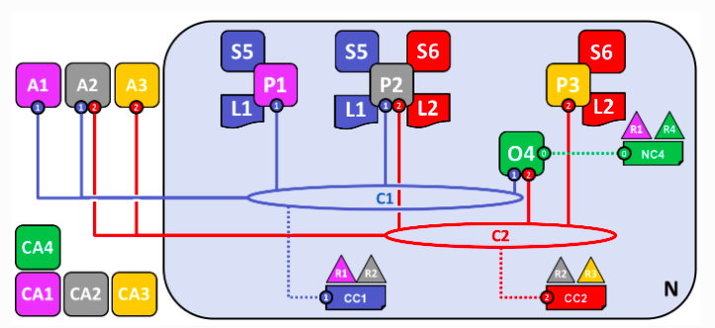
A Sample Hyperledger Network
A: Application C: Channel
CA: Certificate Authority O: Ordered Peer
P: Peer CC: Channel Configuration
S: smart Contract R: Organization
L: Ledger N: Business Network
NC: Network Configuration

Slide 11
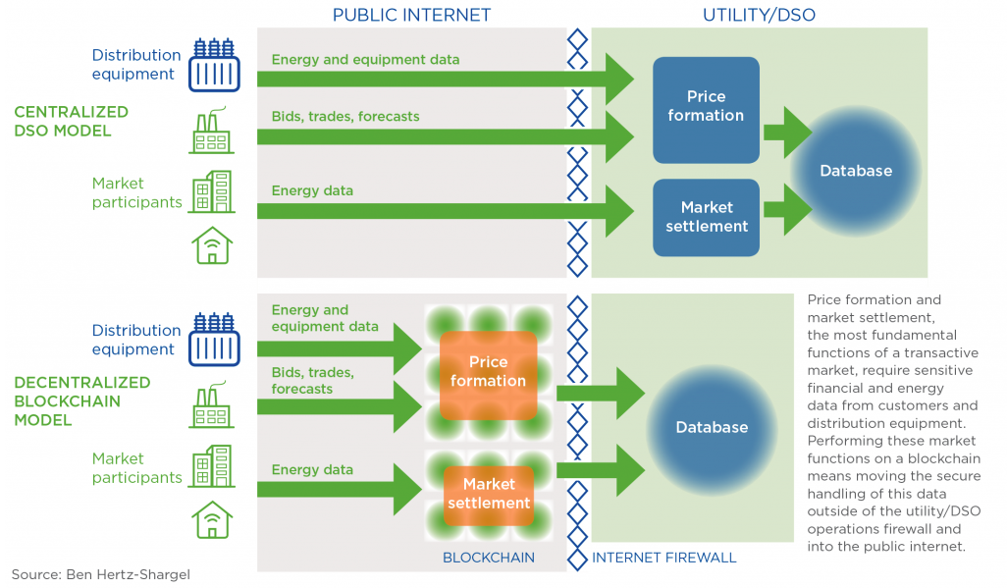
Energy Transactional + Blockchain

Slide 12
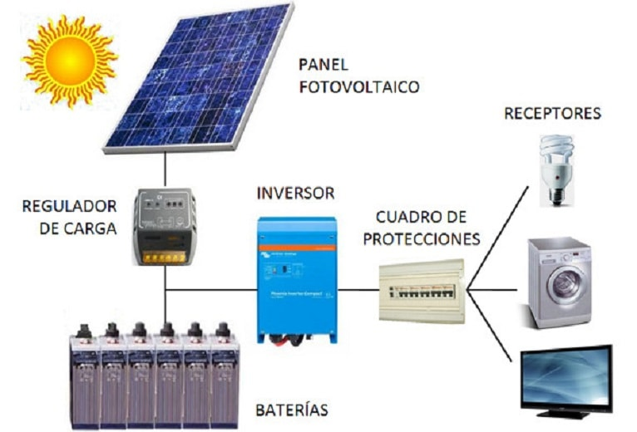
Photovoltaic Installation

Slide 13
Install Hyperledger Fabric
Download the latest hyperledger package version:
mkdir hyperledger-sample
cd hyperledger-sample
curl -sSL https://bit.ly/2ysbOFE | bash
Bring up the test network
cd fabric-samples/test-network
./network.sh up
Check docker containers running
docker ps -a
Create the default channel named: ‘mychannel’
./network.sh createChannel

Slide 14
Install Hyperledger Fabric
Download the latest hyperledger package version:
mkdir hyperledger-sample
cd hyperledger-sample
curl -sSL https://bit.ly/2ysbOFE | bash
Bring up the test network
cd fabric-samples/test-network
# without any channel and withput any ca server
./network.sh up
# create a new channel and ca servers for all services
./network.sh up createChannel -c mychannel -ca
Check docker containers running
docker ps -a
Create the default channel named: ‘mychannel’
./network.sh createChannel

Slide 15
Install Hyperledger Fabric
Deploy a chaincode on the channel
./network.sh deployCC -ccn basic -ccp ../asset-transfer-basic/chaincode-javascript -ccl javascript
Prepate environment for with the chaincode in Org1 Organization
export PATH=${PWD}/../bin:$PATH
export FABRIC_CFG_PATH=$PWD/../config/
# Environment variables for Org1
export CORE_PEER_TLS_ENABLED=true
export CORE_PEER_LOCALMSPID="Org1MSP"
export CORE_PEER_TLS_ROOTCERT_FILE=${PWD}/organizations/peerOrganizations/org1.example.com/peers/peer0.org1.example.com/tls/ca.crt
export CORE_PEER_MSPCONFIGPATH=${PWD}/organizations/peerOrganizations/org1.example.com/users/Admin@org1.example.com/msp
export CORE_PEER_ADDRESS=localhost:7051

Slide 16
Install Hyperledger Fabric
Interact with the chaincode: insert assets
peer chaincode invoke -o localhost:7050 --ordererTLSHostnameOverride orderer.example.com --tls --cafile ${PWD}/organizations/ordererOrganizations/example.com/orderers/orderer.example.com/msp/tlscacerts/tlsca.example.com-cert.pem -C mychannel -n basic --peerAddresses localhost:7051 --tlsRootCertFiles ${PWD}/organizations/peerOrganizations/org1.example.com/peers/peer0.org1.example.com/tls/ca.crt --peerAddresses localhost:9051 --tlsRootCertFiles ${PWD}/organizations/peerOrganizations/org2.example.com/peers/peer0.org2.example.com/tls/ca.crt -c '{"function":"InitLedger","Args":[]}'
Interact with the chaincode: query assets
peer chaincode query -C mychannel -n basic -c '{"Args":["GetAllAssets"]}'
Remove all resources
./network.sh down

Slide 17
Install Hyperledger Explorer
Create a working folder
mkdir hyperledger-explorer
Copy Hyperledger explorer files
wget https://raw.githubusercontent.com/hyperledger/blockchain-explorer/master/examples/net1/config.json
wget https://raw.githubusercontent.com/hyperledger/blockchain-explorer/master/examples/net1/connection-profile/test-network.json -P connection-profile
wget https://raw.githubusercontent.com/hyperledger/blockchain- explorer/master/docker-compose.yaml
Copy Hyperledger Fabrid Organizations folder
cp -r ../hyperledger-sample/fabric-samples/test-network/organizations/ ./

Slide 18
Install Hyperledger Explorer
Edit compose hyperledger yaml file for the current Hyperledger Fabric previous running installation
Update the network external name for net_test to fabric_test and
the volumens for the explorer service lije this:
networks:
mynetwork.com:
external:
name: fabric_test
...
services:
explorer.mynetwork.com:
...
volumes:
- ./config.json:/opt/explorer/app/platform/fabric/config.json
- ./connection-profile:/opt/explorer/app/platform/fabric/connection-profile
- ./organizations:/tmp/crypto
- ./wallet:/opt/explorer/wallet

Slide 19
Install Hyperledger Explorer
Start Hyperledger Explorer
docker-compose up -d
Clean up Hyperledger Explorer
docker-compose down -v

Slide 20
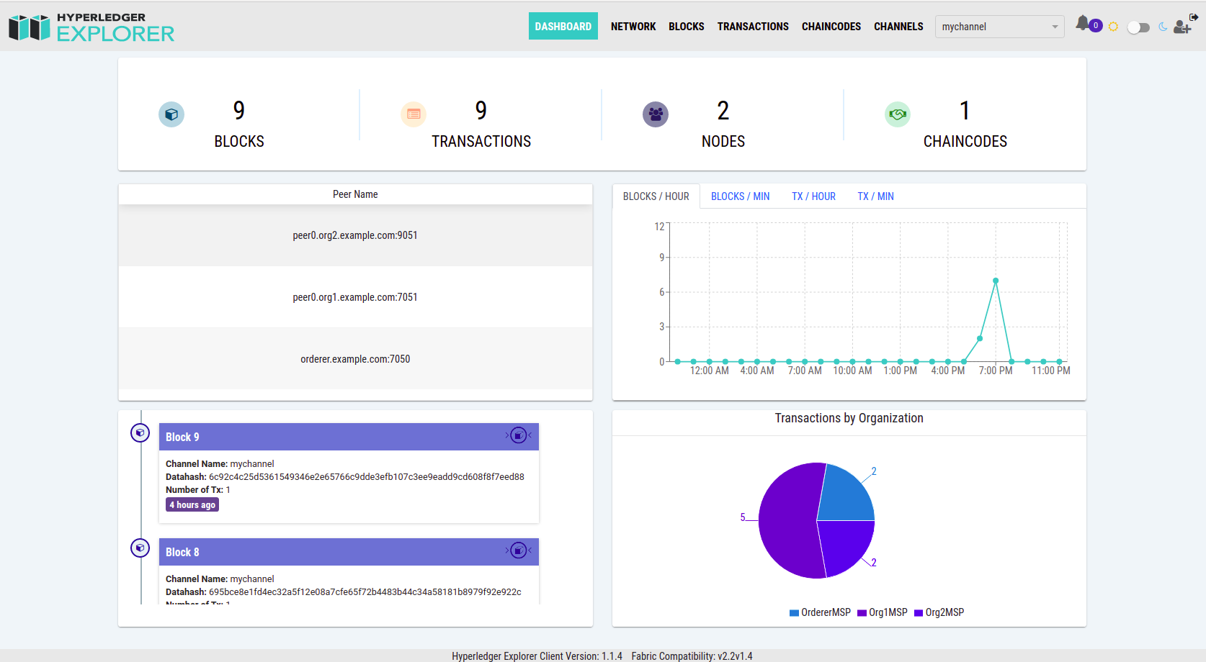
Install Hyperledger Explorer
To access Hyperledger Explorer browse to http://localhost:8080 ang login with these credentials: username:password → exploreradmin:exploreradminpw

Slide 21
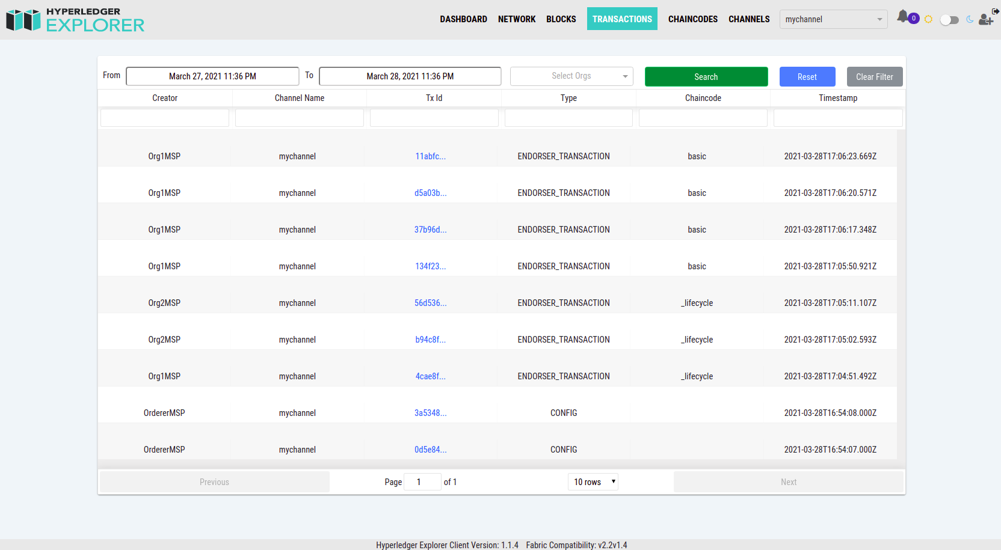
Install Hyperledger Explorer
Hyperledger Explorer Transaction views

Slide 22
Hyperledger Docker Containers
After start the Hyperledger Blockchain test business network and Hyperledger Explorer the total docker containers running are. Discover running this command
docker ps | grep hyper
Hyperledger Fabric:
peer0.org1.example.com (172.25.0.6:7051 → localhost:7051): Peer node for the Organization 1
peer0.org2.example.com (172.25.0.5:7051 → localhost:9051): Peer node for the Organization 2
orderer.example.com (172.25.0.7:7050 → localhost:7050, 172.25.0.5:7053 → localhost:7053 ): Orderer node for the channel
ca_org1 (172.25.0.2:7054 → localhost:7054): CA node for the Organization 1 Peer node
ca_org2 ((172.25.0.4:7054 → localhost:8054): CA node for the Organization 2 Peer node
ca_orderer (172.25.0.3:7054 → localhost:9054): CA node for the Orderer node
cli (172.25.0.8): hyperledger cli container with tools to manage blockchain business network
Hyperledger Explorer:
explorer.mynetwork.com (172.25.0.12:8080 → localhost:8080): hyperledger explorer ui
explorerdb.mynetwork.com (172.25.0.10:5432): hyperledger explorer postgresssql database

Slide 23
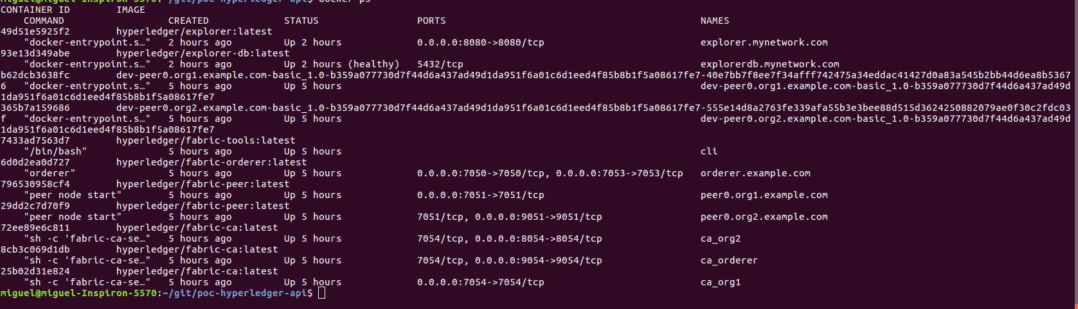
Hyperledger Docker Containers
The total docker containers are:

Slide 24
Install Hyperledger Chaincode
We are deploying the Hyperledger chaincode with one smart contract named trade
Development under javascript in Visual Code
We choosed javascript language to implement the transactions smart contract all to implemente the energy trasactive domain
Deploy start contract
From basic network business folder execute this command:
./network.sh deployCC -ccn trade -ccv 1.0 -ccp ~/git/poc-hyperledger-cc/ -ccl javascript
This command install, approve and commit the chaincode in the two organization peers. The result is two images and two containers instanciated for the new chaincode named trade like these:

Slide 25
Manage Hyperledger Chaincode
Manage smart contracts from your blockchain business network
Remove and chaincode installed
The lifecycle of hyperledger when you want to deploy and chaincode is:
    Package smart contratcs in a chaincode (zip file with metadata)
    Install chaincode in organization peers
    Approve chaincode in the channel (new in Hyperledger 2.0)
    Commit and initialize chaincode
Each peers start a container when deploy the chaincode and the chaincode with the smart contract running inside
To list the new container created we could execute this command:
docker ps | grep hyper
To login inside the peer or any chaincode container we could execute this command:
docker exec -it 796530958cf4 /bin/sh

Slide 26
Install Hyperledger Backend
We are deploying the Hyperledger API Backend with swagger integrated
Clone the project
git clone https://github.com/masalinas/poc-hyperledger-api.git
Generate the wallet with admin and appUser and cop
We could create the wallet from the javascript basic application in:
fabric-samples/asset-transfer-basic/application-javascript/wallet
This example enrolled the default admin user and create and enrolled a new user named appUser. The copy this wallet inside resources application folder.
Add blockchain connection configuration
Copy the connection-org1.yaml from hyperledger fabric test network used in:
fabric-samples/test-network/organizations/peerOrganizations/org1.example.com in resources application folder
Execute backend service from shell
./mvnw spring-boot:run
Access to Swagger API Explorer
http://localhost:8081/swagger-ui.html

Slide 27
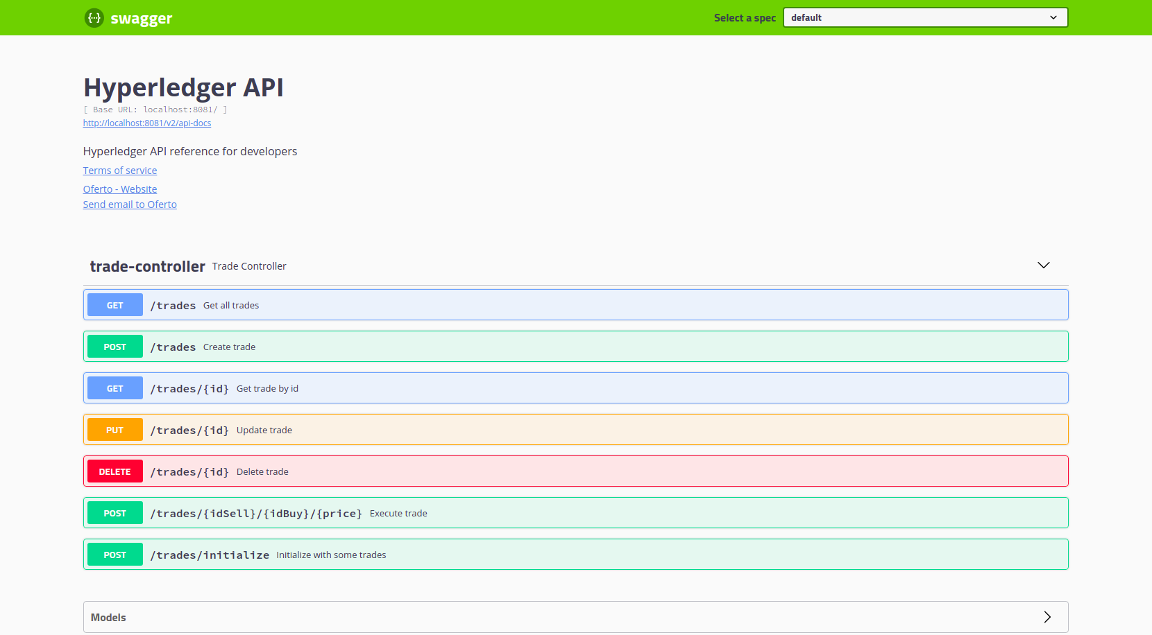
Swagger Hyperledger Backend
Swagger API Explorer for Hyperledger Energy Codechain installed

Slide 28
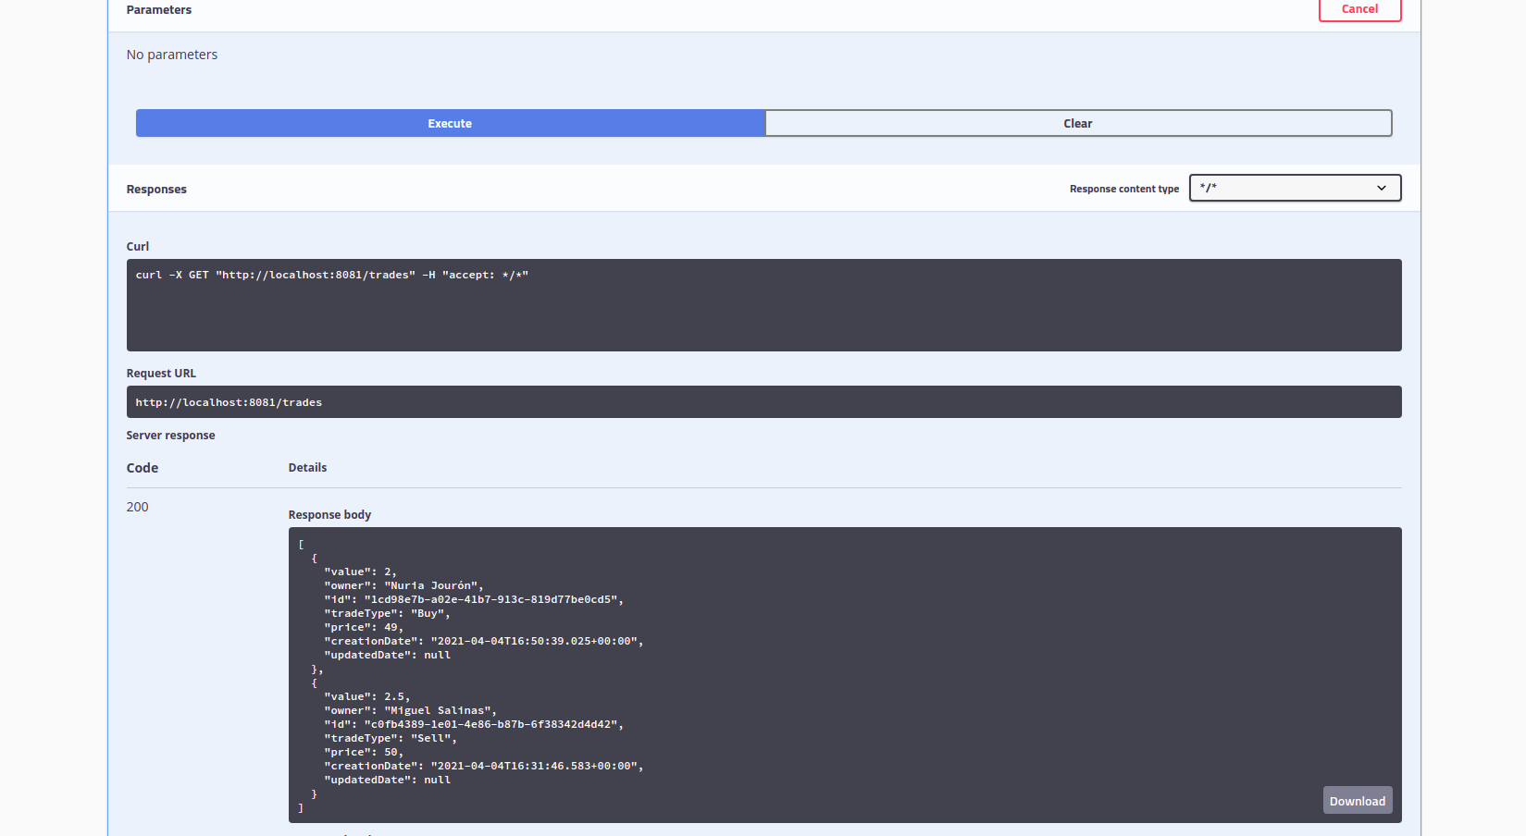
Swagger Hyperledger Backend
Example 1: Get all trades from blockchain

Slide 29
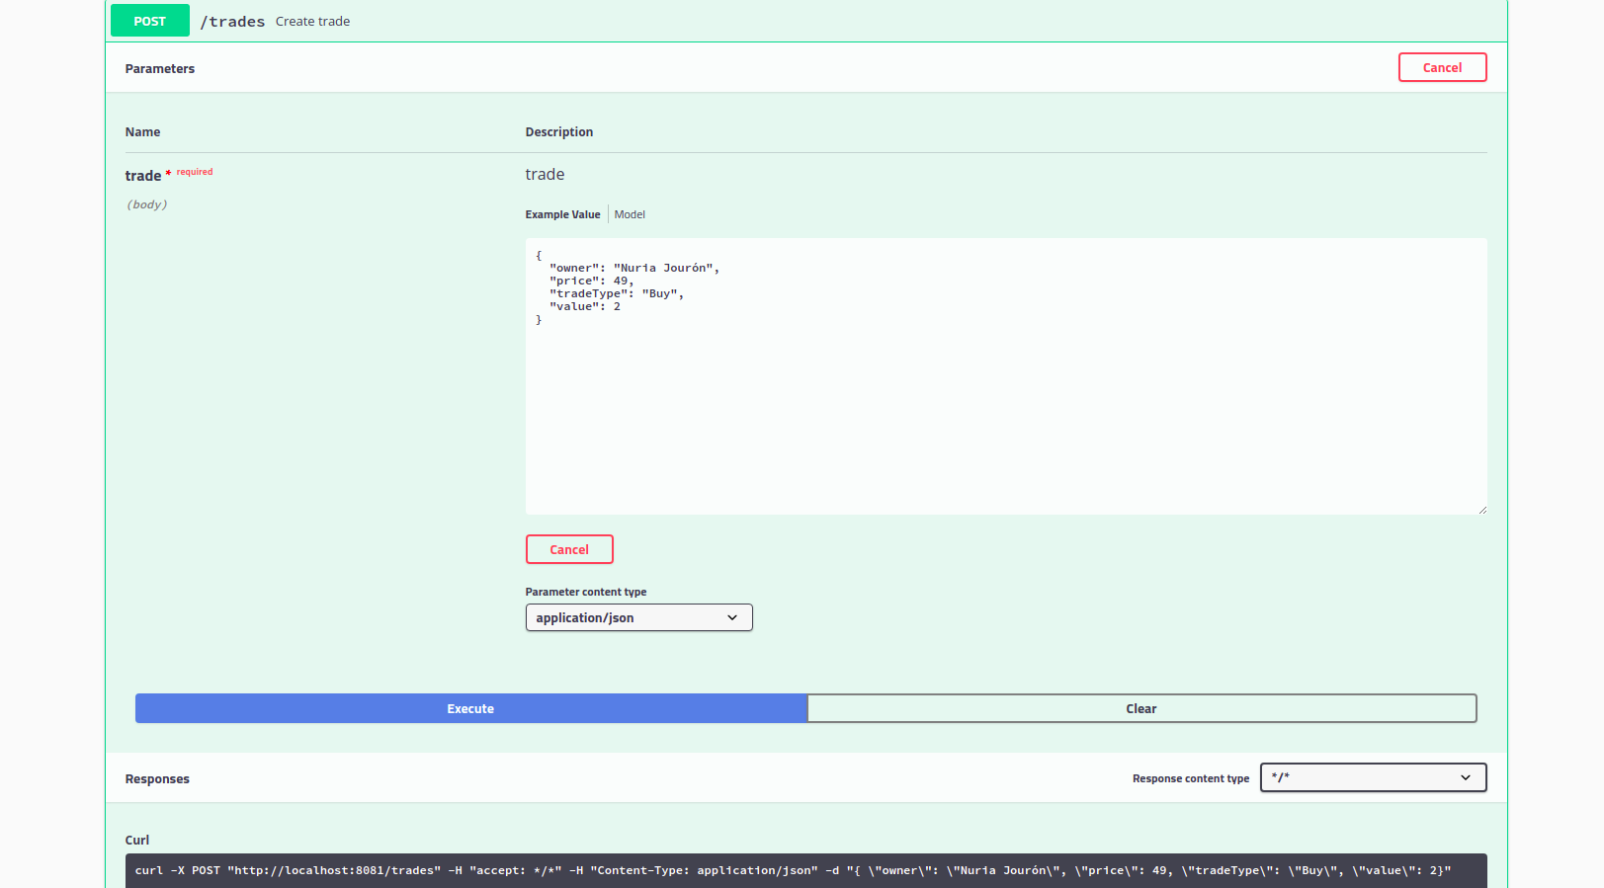
Swagger Hyperledger Backend
Example 2: Create a new Buy Trade

Slide 30
Install Hyperledger Frontend
We are deploying the Hyperledger UI Frontend from Angular CLI
Clone the project
git clone https://github.com/masalinas/poc-hyperledger-ui.git
Install dependencies
npm install
Start frontend
npm run start

Slide 31
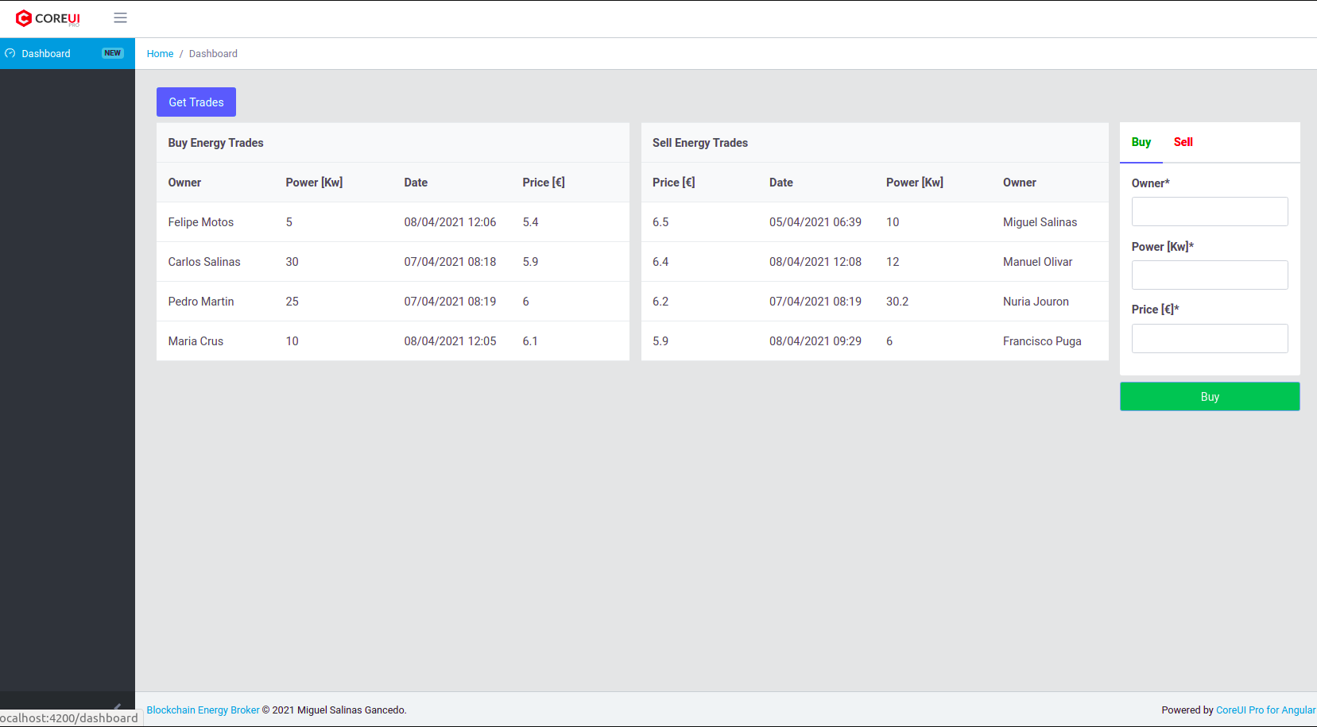
Install Hyperledger Frontend
Hyperledger UI Frontend interface

Slide 32
Install Hyperledger minifabric
Before install Hyperledger minifabric we must install some dependencies
Install nodeJs
sudo apt-get update
sudo apt-get install nodejs
node --version
npm --version
Install jdk
sudo apt install default-jdk
java --version
Install go
cd ~/temp
curl -O https://dl.google.com/go/go1.10.3.linux-amd64.tar.gz
tar xvf go1.10.3.linux-amd64.tar.gz
sudo chown -R root:root ./go
sudo mv go /usr/local
go --version

Slide 33
Install Hyperledger minifabric
Configure Go routes
sudo nano ~/.profile
export GOPATH=$HOME/work
export PATH=$PATH:/usr/local/go/bin:$GOPATH/bin
execute this command:
source ~/.profile

Slide 34
Install Hyperledger minifabric
Install docker
sudo apt install apt-transport-https ca-certificates curl software-properties-common
curl -fsSL https://download.docker.com/linux/ubuntu/gpg | sudo apt-key add -
sudo add-apt-repository "deb [arch=amd64] https://download.docker.com/linux/ubuntu focal stable"
sudo apt update
sudo apt install docker-ce
docker --version
Add groups to execute docker without sudo priviledges
sudo groupadd docker
sudo usermod -aG docker $USER

Slide 35
Install Hyperledger minifabric
Install docker-compose
sudo curl -L "https://github.com/docker/compose/releases/download/1.26.0/docker-compose-$(uname -s)-$(uname -m)" -o /usr/local/bin/docker-compose
sudo chmod +x /usr/local/bin/docker-compose
docker-compose --version

Slide 36
Install Hyperledger minifabric
Create minifab working folder:
mkdir ~/minifab && cd ~/minifab
Install minifab:
curl -o minifab -sL https://tinyurl.com/yxa2q6yr
chmod +x minifab
sudo mv minifab usrlocal/bin
Create the netwotk hyperledger from spec.yaml

Slide 37
Install Hyperledger minifabric
fabric:
cas:
- "ca.broker.oferto.io"
- "ca.edp.oferto.io"
peers:
- "peer.broker.oferto.io"
- "peer.edp.oferto.io"
orderers:
- "orderer.oferto.io"
settings:
ca:
FABRIC_LOGGING_SPEC: DEBUG
peer:
FABRIC_LOGGING_SPEC: DEBUG
orderer:
FABRIC_LOGGING_SPEC: DEBUG
### set the docker network name to override the automatically generated name.
netname: "oferto"

Slide 38
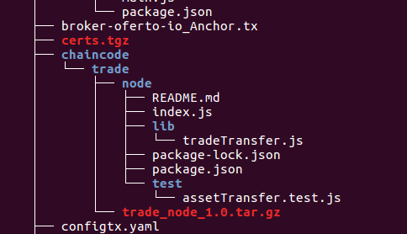
Install Hyperledger minifabric
Clone chaincode repo from git inside minifab working folder:
mkdir ~/minifab/vars/chaincode
git clone https://github.com/masalinas/poc-hyperledger-cc.git
rename folder to trade
mv poc-hyperledger-cc trade
cd trade
mkdir node
move all chaincode files to node folder

Slide 39
Install Hyperledger minifabric
Create the hyperledger
minifab up -o broker.oferto.io -c oferto -n trade -v 1.0 -l node -p '' -d false
Execute some command in the new chaincode installed
Initialize the blockchain with some assets
minifab invoke -n trade -p '"InitLedger"'
Select all assets
minifab invoke -n trade -p '"GetAllTrades"'

Slide 40
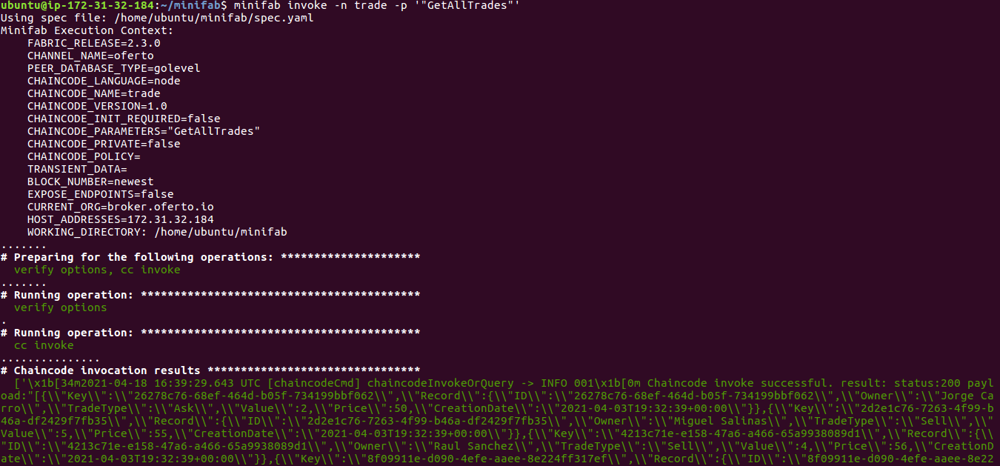
Install Hyperledger minifabric

Slide 41
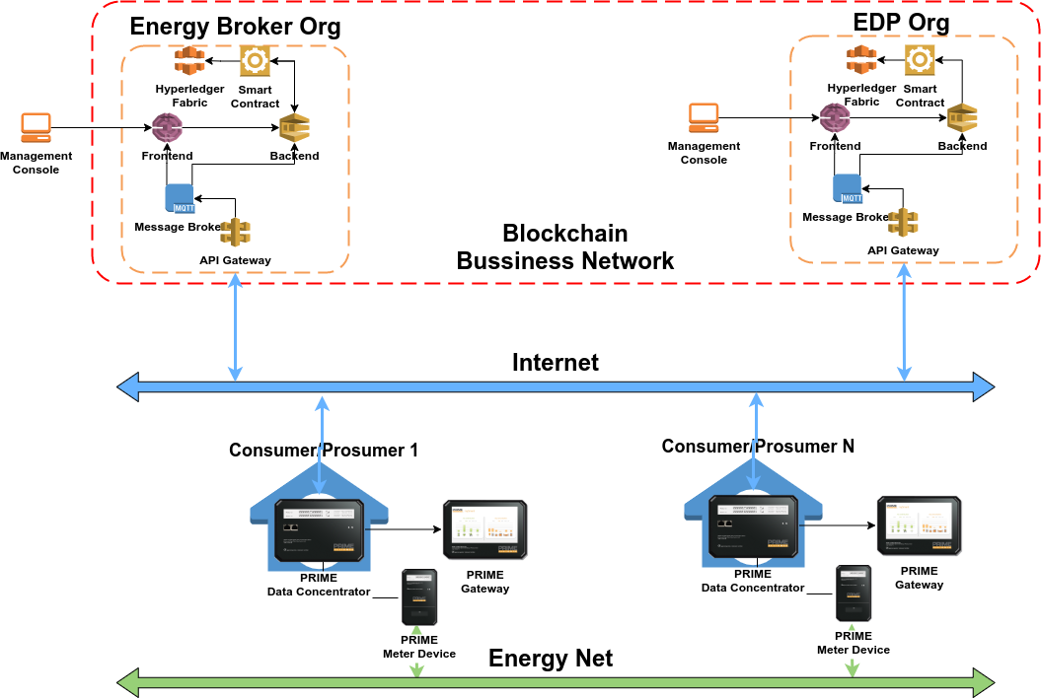
Energy Transactive Blockchain Architecture
This diagram represent the Energy Transactive Blockchain Architecture

Slide 42
Hyperledger Link
Welcome Hyperledger Fabric 2.0: Enterprise DLT for Production
https://www.hyperledger.org/blog/2020/01/30/welcome-hyperledger-fabric-2-0-enterprise-dlt-for-production
Blockchain 50: Billion Dollar Babies
https://www.forbes.com/sites/michaeldelcastillo/2019/04/16/blockchain-50-billion-dollar-babies/?sh=7b77889b57cc
Hyperledger Fabric last documentation: last official hyperledger documentation
https://hyperledger-fabric.readthedocs.io/en/latest/
Minifabric: If you would like to learn Hyperledger Fabric or develop your smart contract, or just want to get a feel of Hyperledger Fabric
https://github.com/litong01/minifabric
https://github.com/hyperledger-labs/minifabric/blob/main/docs/README.md
https://www.hyperledger.org/blog/2020/04/29/minifabric-a-hyperledger-fabric-quick-start-tool-with-video-guides

Slide 43
Hyperledger Link
Hyperledger Explorer: Hyperledger Explorer is a user-friendly Web application tool used to view, invoke, deploy or query blocks, transactions and associated data, network information (name, status, list of nodes), chain codes and transaction families, as well as any other relevant information stored in the ledger.
https://www.hyperledger.org/use/explorer
Hyperledger Fabric Gateway SDK for Java: The Fabric Gateway SDK allows applications to interact with a Fabric blockchain network
https://hyperledger.github.io/fabric-gateway-java
Hyperledger Fabric SDK for Node.js: The Hyperledger Fabric SDK allows applications to interact with a Fabric blockchain network
https://hyperledger.github.io/fabric-sdk-node/
Blockchain Automation Framework: An automation framework for rapidly and consistently deploying production-ready DLT platforms.
https://github.com/hyperledger-labs/blockchain-automation-framework

