Slide 1

zendesk_to_db.py
Daniel Tranfaglia

Slide 2
Purpose
Scrape Zendesk for data relating to tickets, ticket comments, and users. Then organize that data and insert into the HelpCenter database on the .95 into tables labelled ‘ticket’, ‘user’, and ‘response’.
Script will run everyday in the early morning hours.

Slide 3
Essentials
starting_ticket.txt
Stores and keeps track of the next ticket ID to scrape from. This file is read at the beginning of the script, and updated after every ticket is completely scraped.
The first ticket that was scraped has ticket ID 17093. This was the first ticket recorded on Zendesk on July 1st, 2016.

Slide 4
Module Imports
pyodbc -- Handles database connections, creates the table cursor, and executes SQL queries through the script.
requests -- Allows web scraping to collect data from Zendesk.
string -- Helps handle any necessary string operations.
datetime -- Was imported to run script at a specified time. No longer needed since the .95 automatically runs the script.

Slide 5
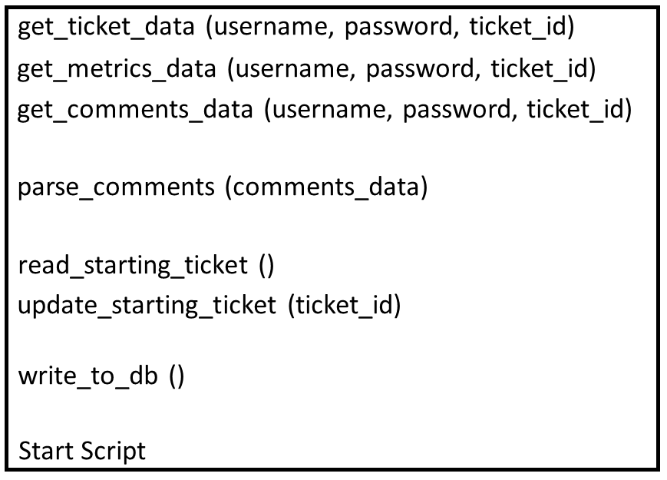
Structure

Slide 6
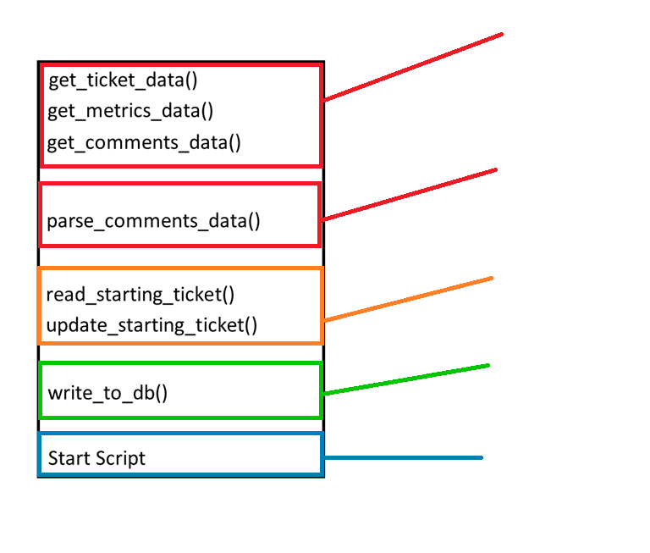
Takes the Zendesk credentials (username, password), and a ticket ID, and uses the requests module to return ticket data, ticket metrics data, and ticket comments data, in JSON format.
Uses the collected ticket comments data for a ticket to parse out user data such as city, email, mobile provider, OS, and type of phone.
Reads starting_ticket.txt to find the next ticket to scrape, then updates that file after every ticket is complete and written into the DB.
Calls the helper functions above to collect Zendesk data and write it into the tables in the HelpCenter DB.
Runs the script. Calls write_to_db().

Slide 7
Breakdown of Steps

Slide 8
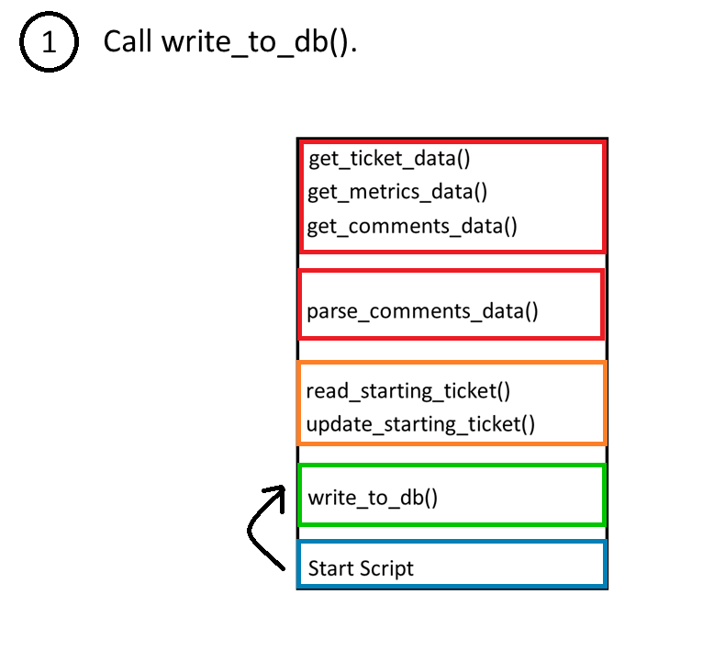
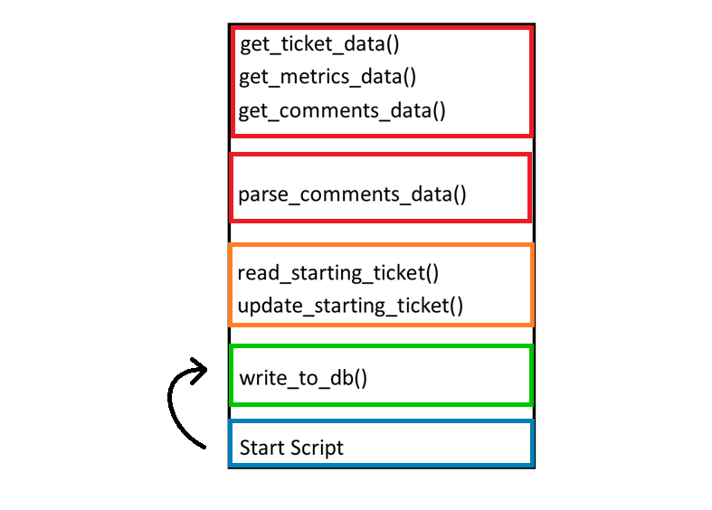

Slide 9
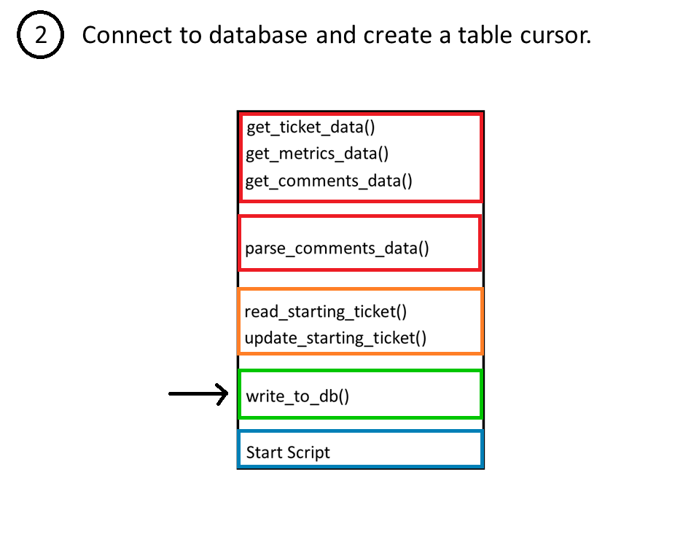

Slide 10
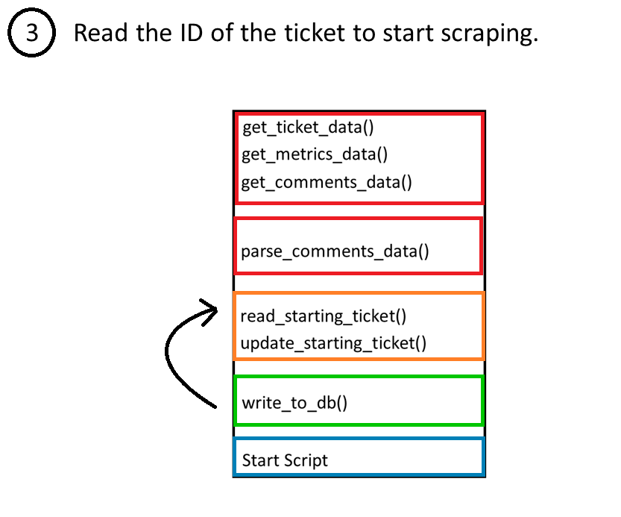

Slide 11
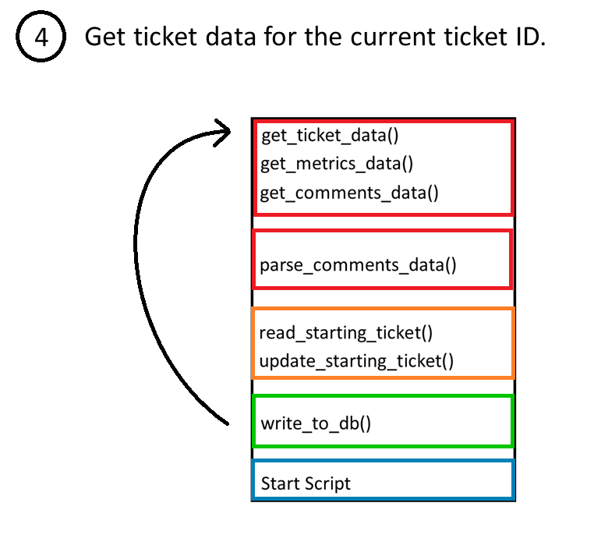

Slide 12
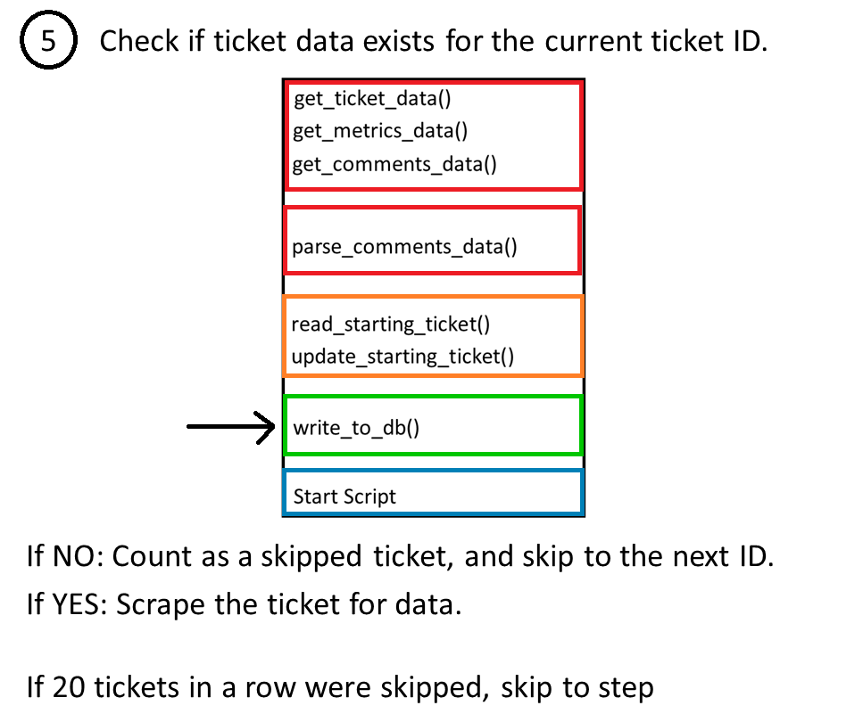


Slide 13
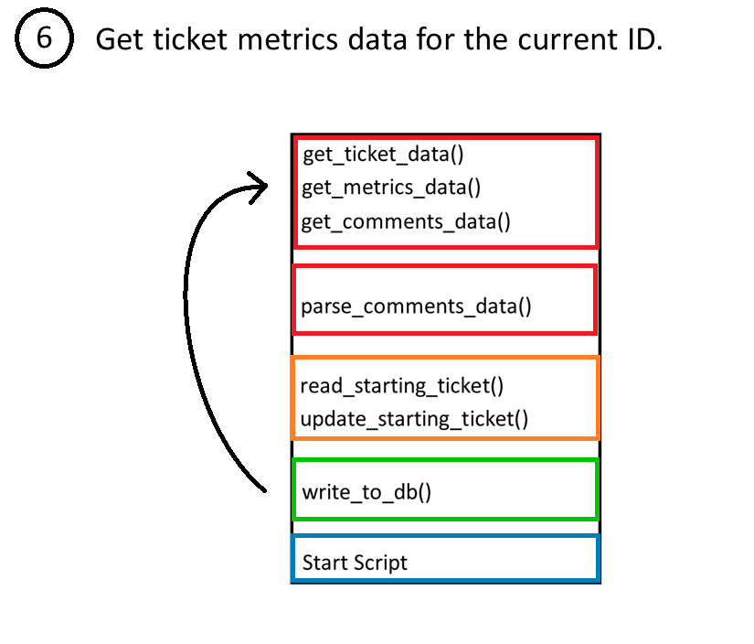

Slide 14
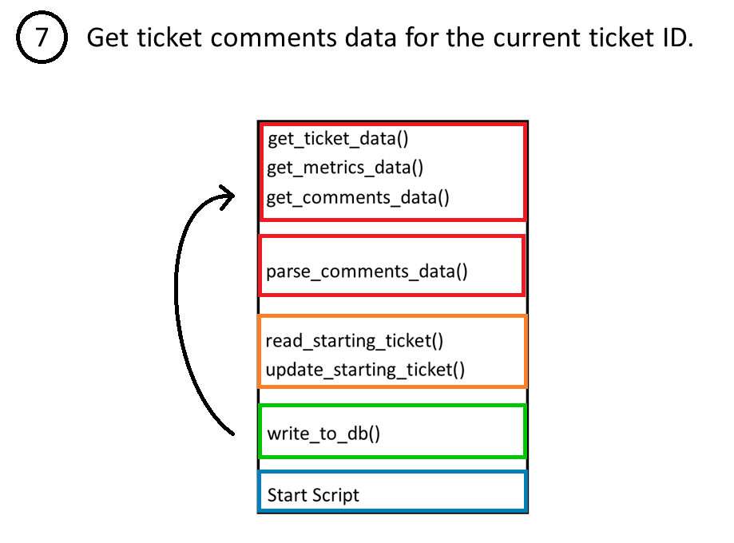

Slide 15
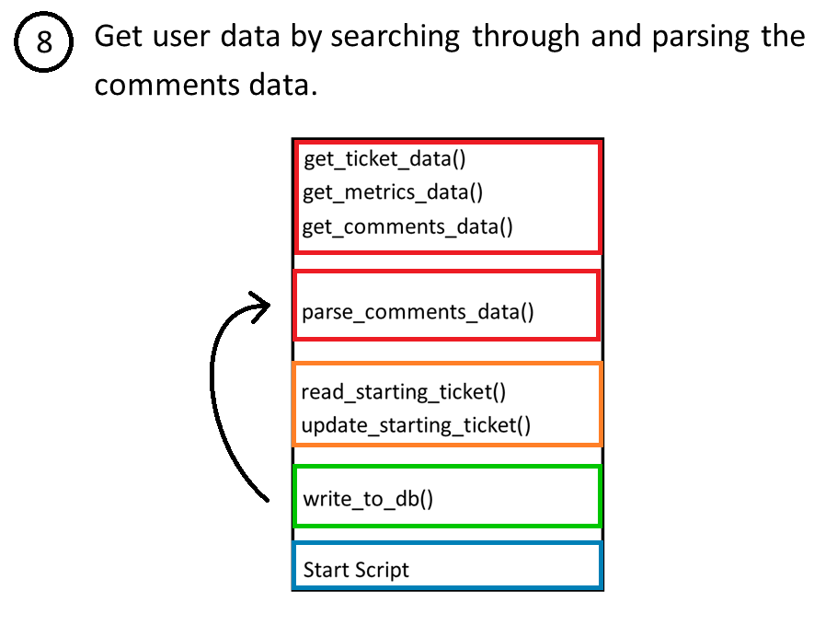

Slide 16
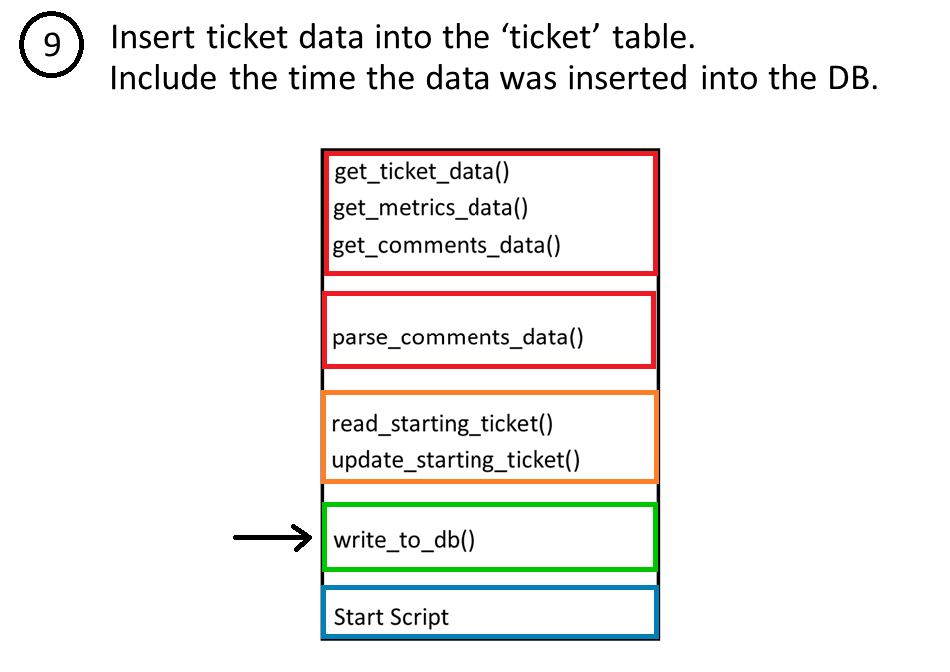

Slide 17
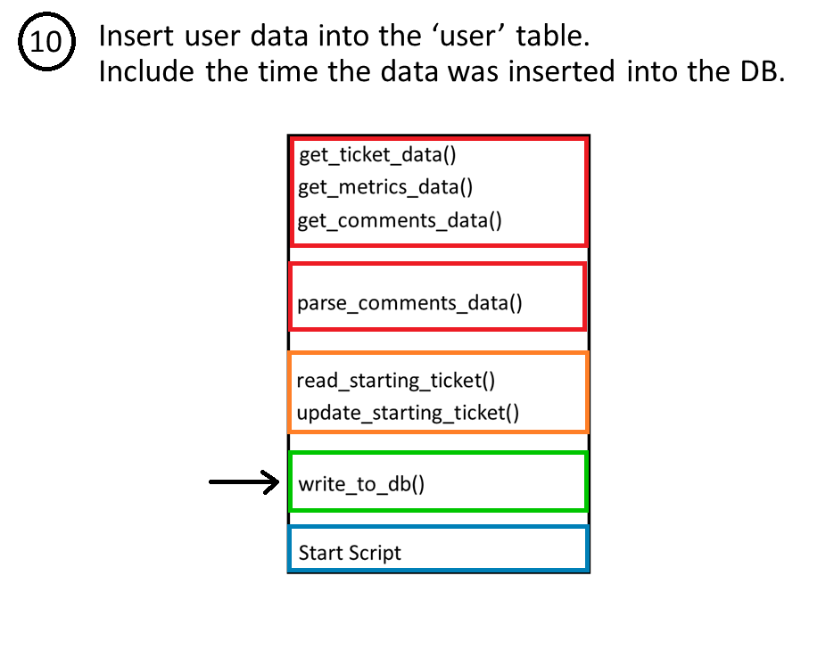

Slide 18
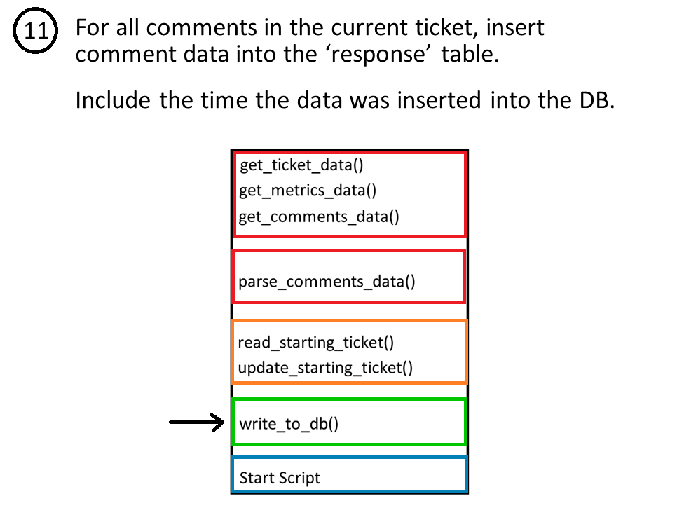

Slide 19
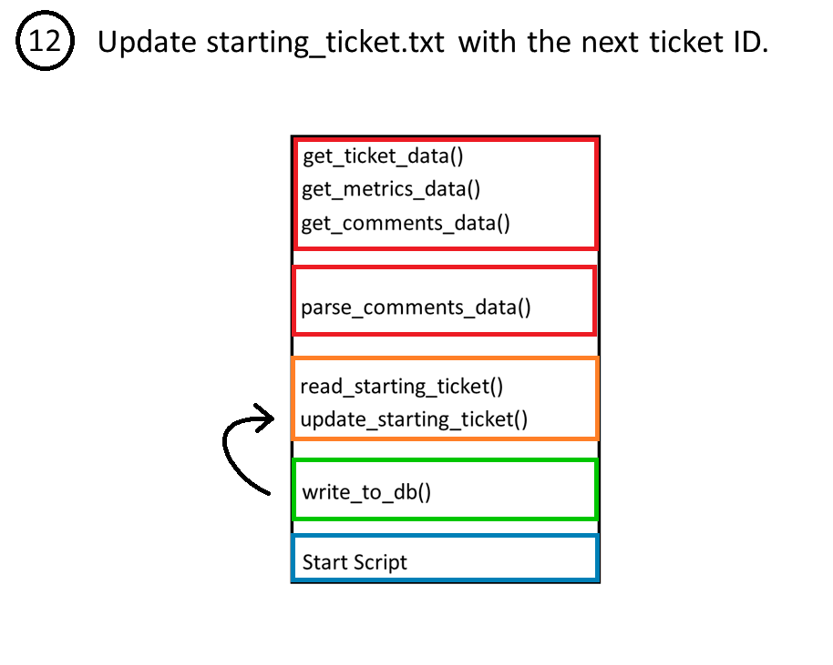

Slide 20
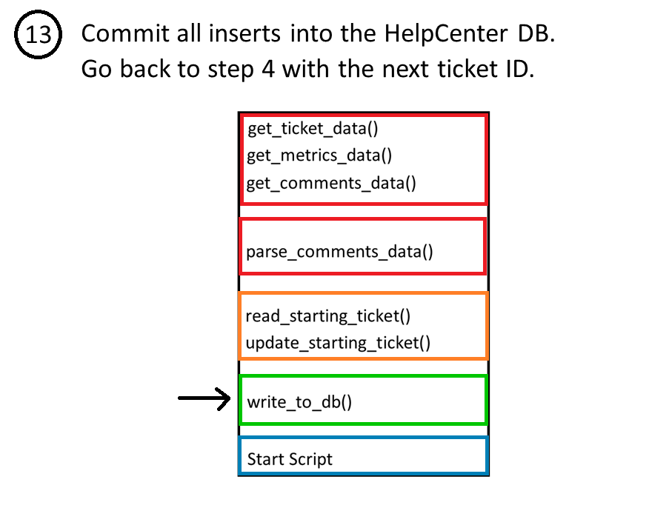

Slide 21
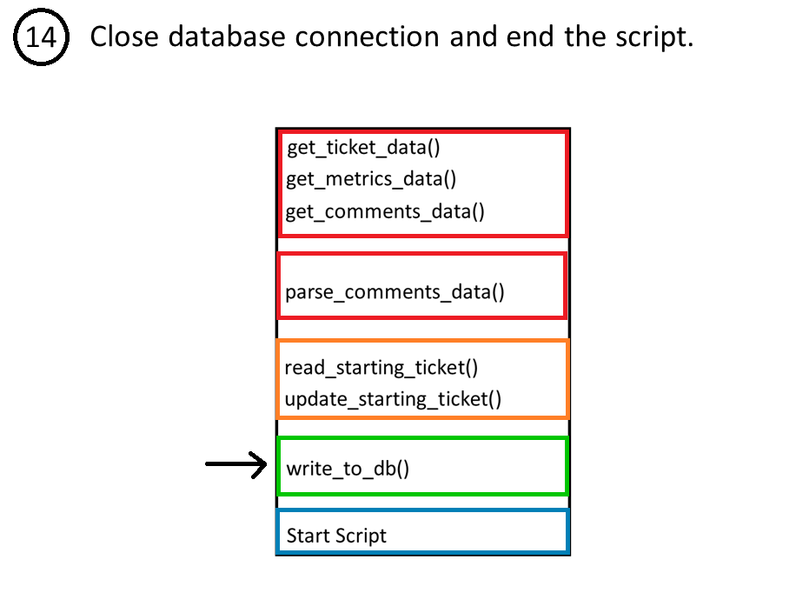

Slide 22
Current Flaws
There is no way of updating tickets that are already in the database.
Unnecessary import (datetime).
Text file reading for next ticket could cause issues going forward. What if the text file is lost?

