Slide 1
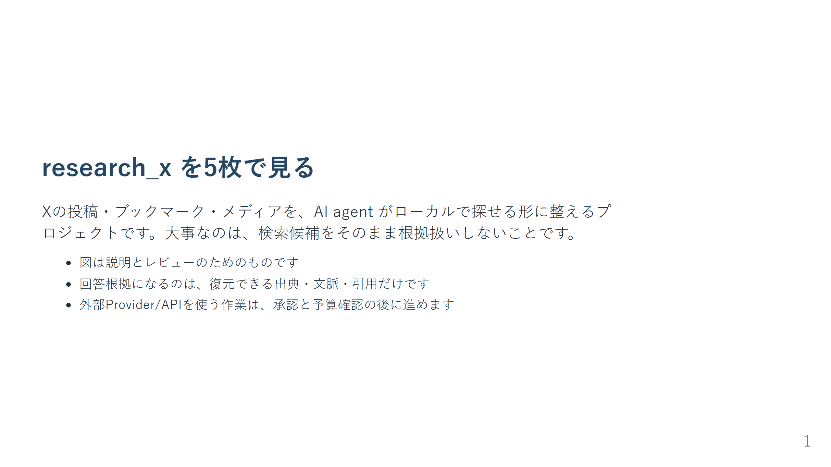
Notes:
claim: claim-project-purpose claim: claim-sier-context

Slide 2
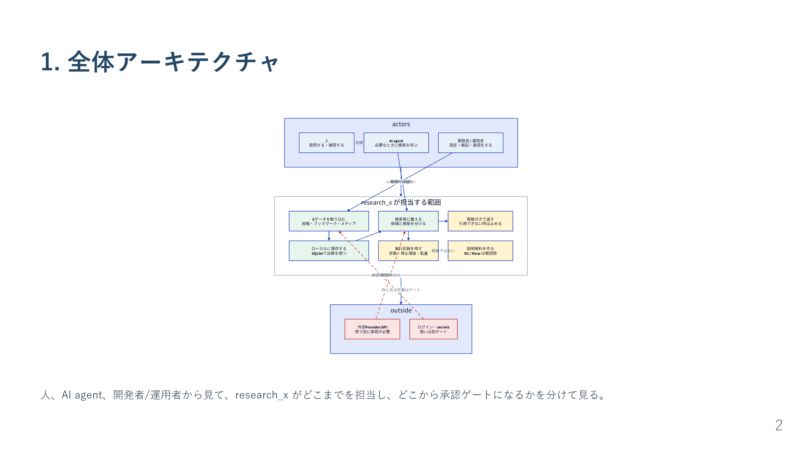
Notes:
claim: claim-runtime-architecture claim: claim-c4-container-boundary claim: claim-acquisition-chain claim: claim-bookmark-store

Slide 3
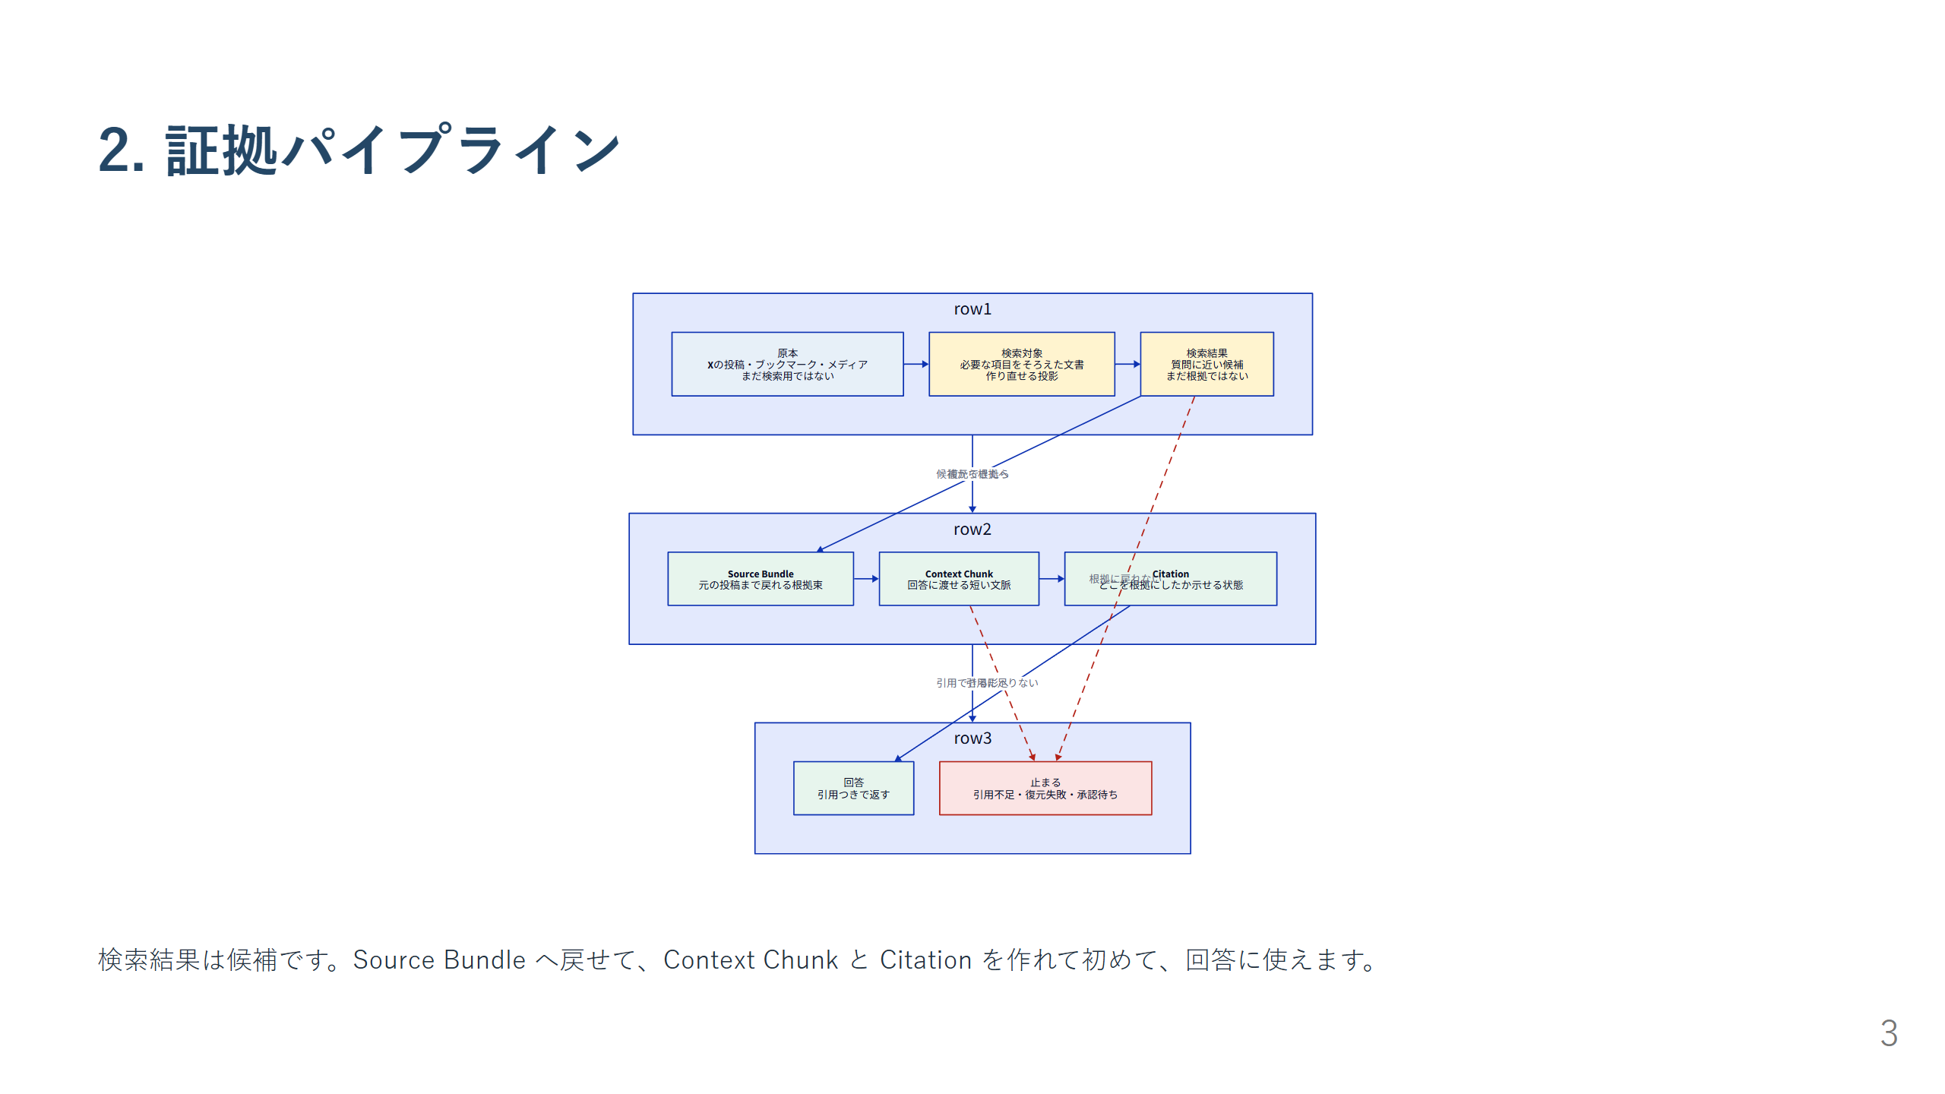
Notes:
claim: claim-evidence-invariant claim: claim-memory-schema

Slide 4
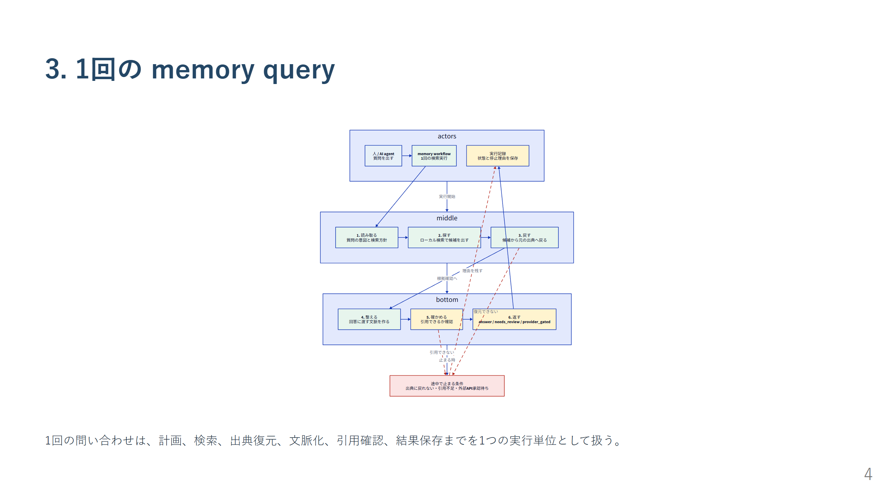
Notes:
claim: claim-workflow-execution

Slide 5
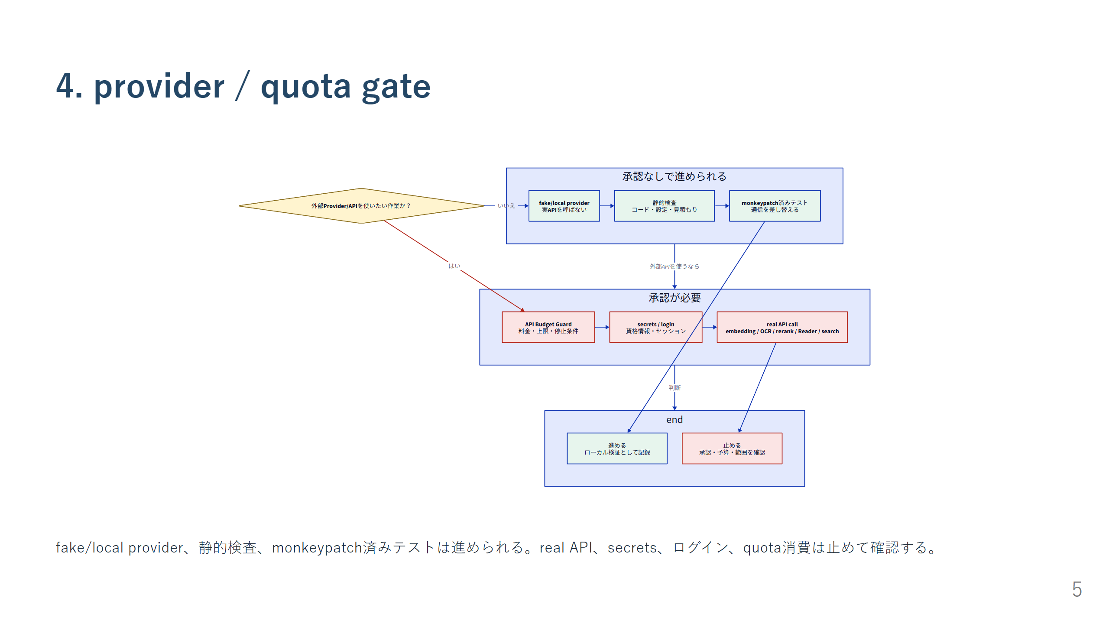
Notes:
claim: claim-provider-gate claim: claim-sier-boundary

Slide 6
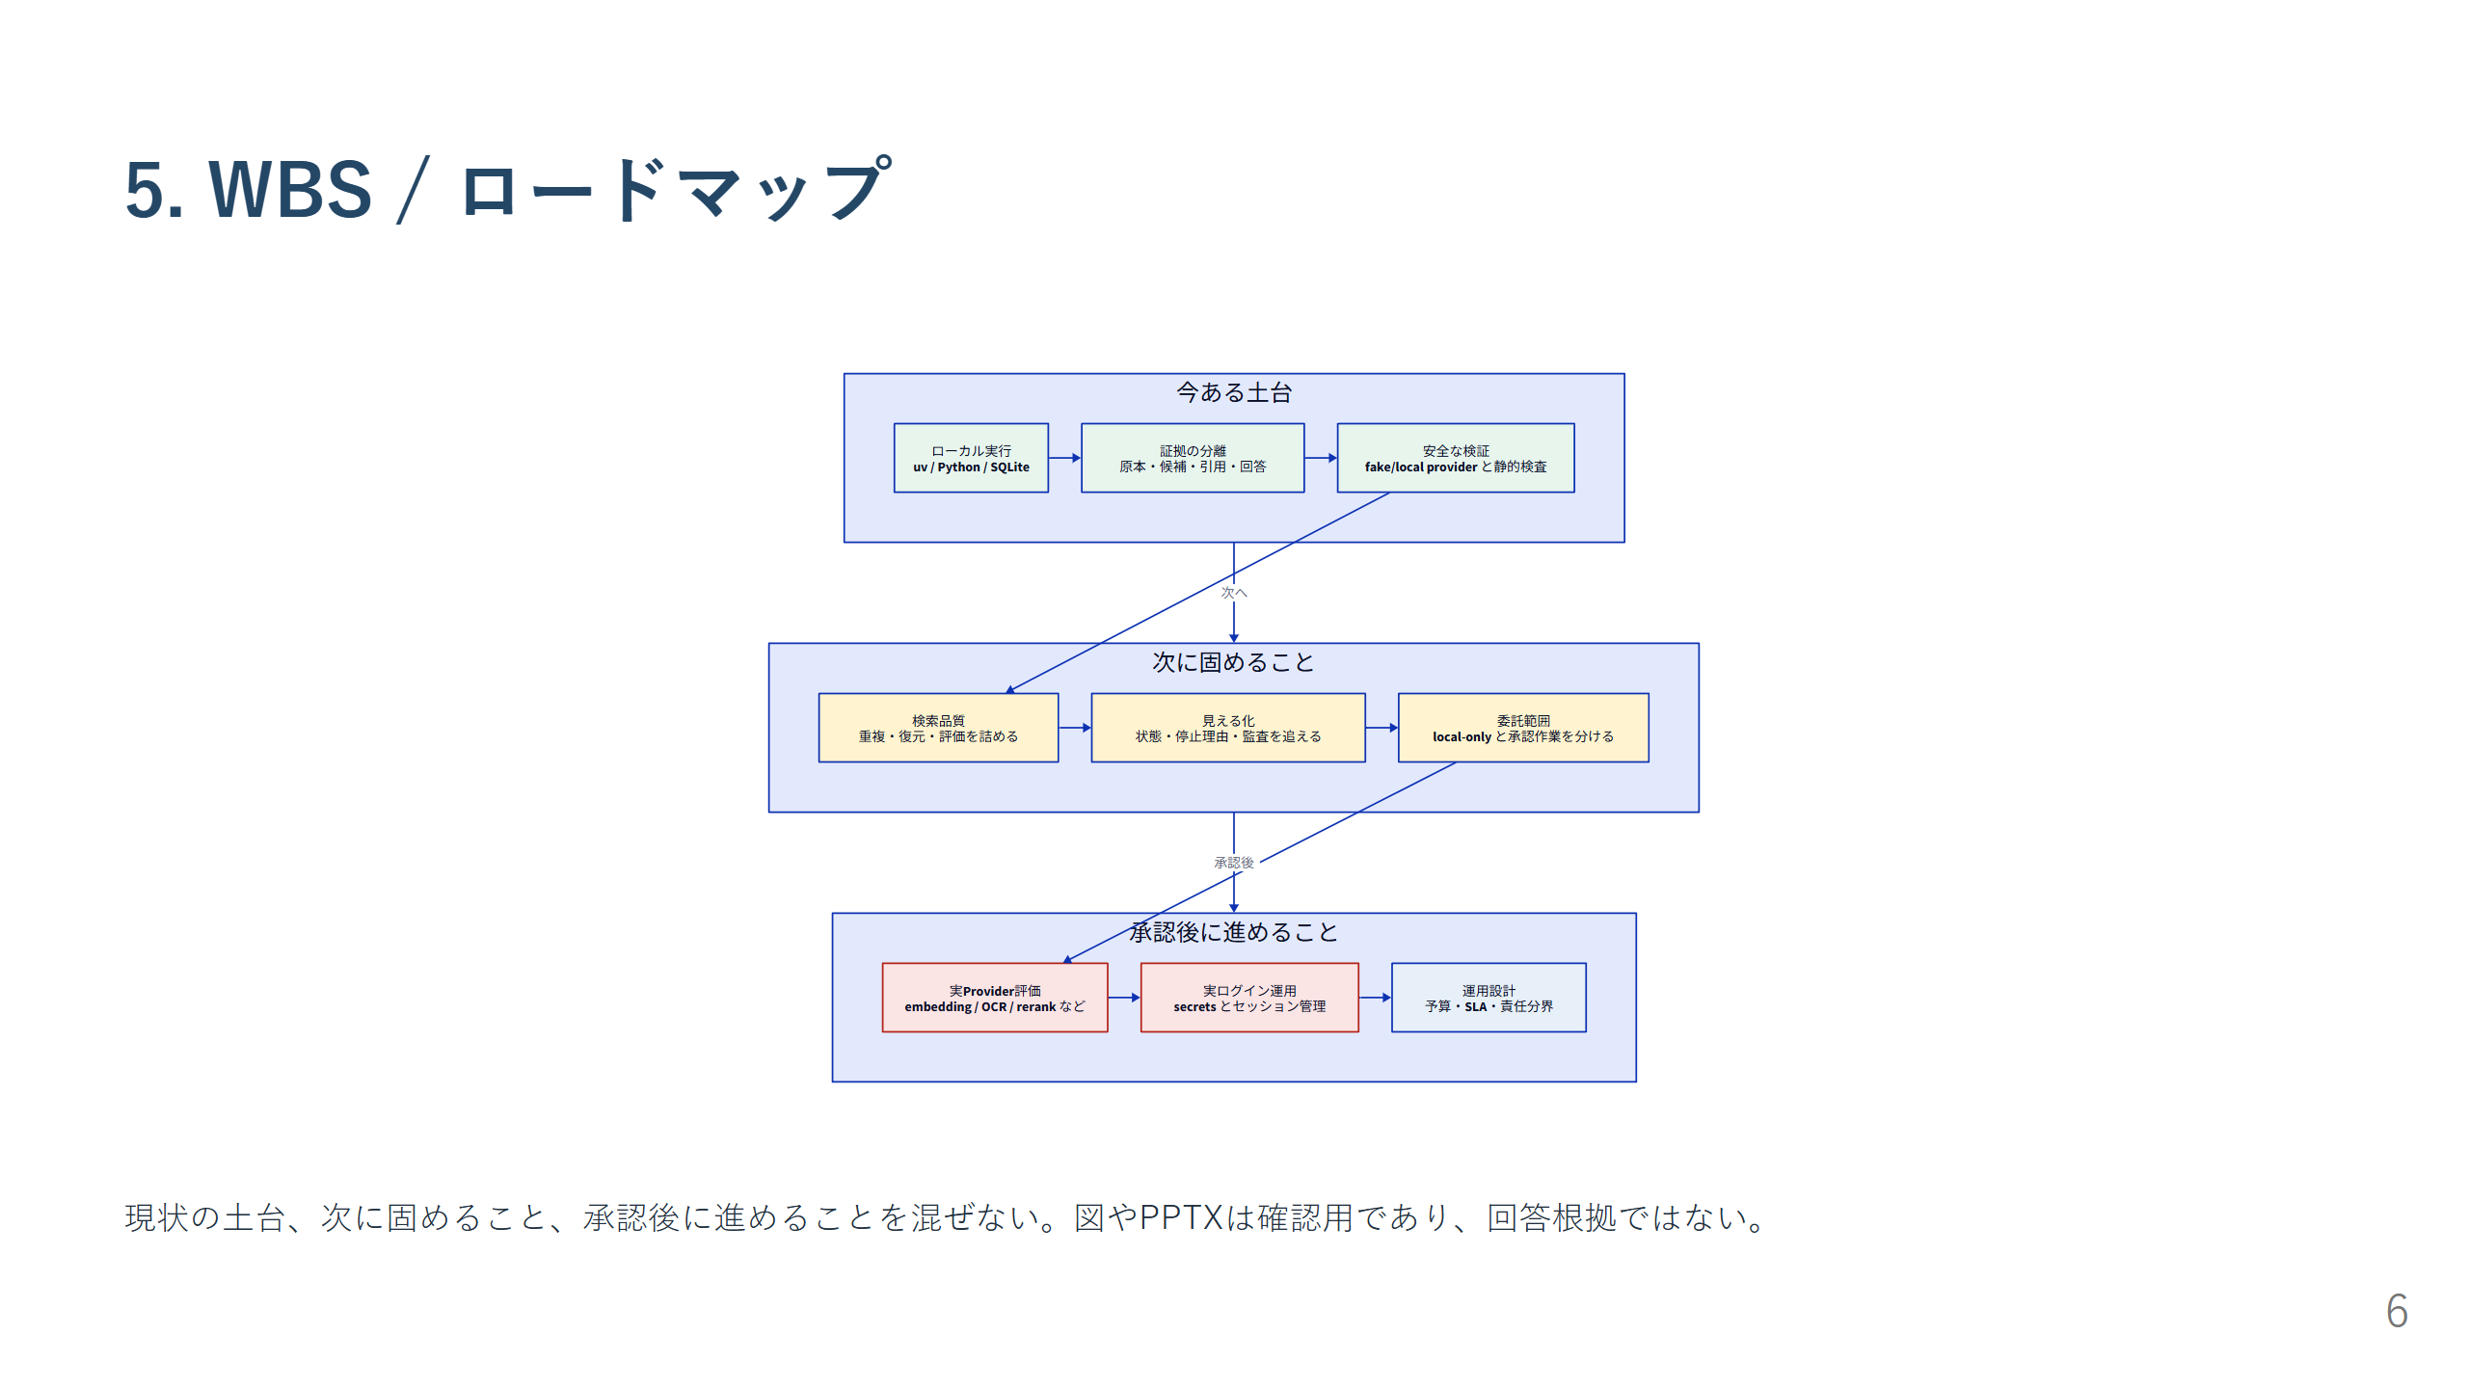
Notes:
claim: claim-current-open-items claim: claim-control-artifacts

Slide 7
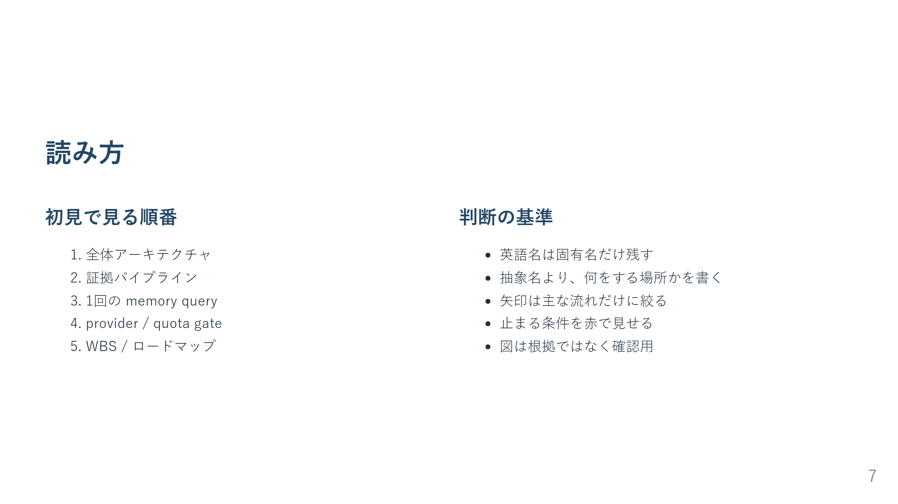
Notes:
claim: claim-dev-entrypoints

