Slide 1
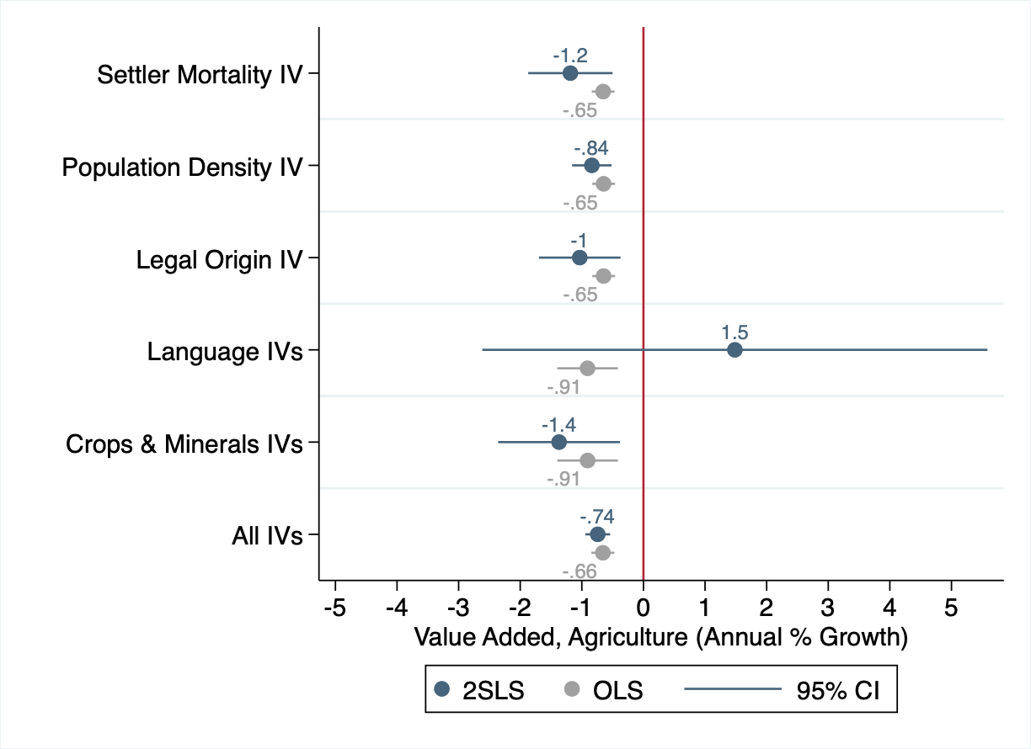
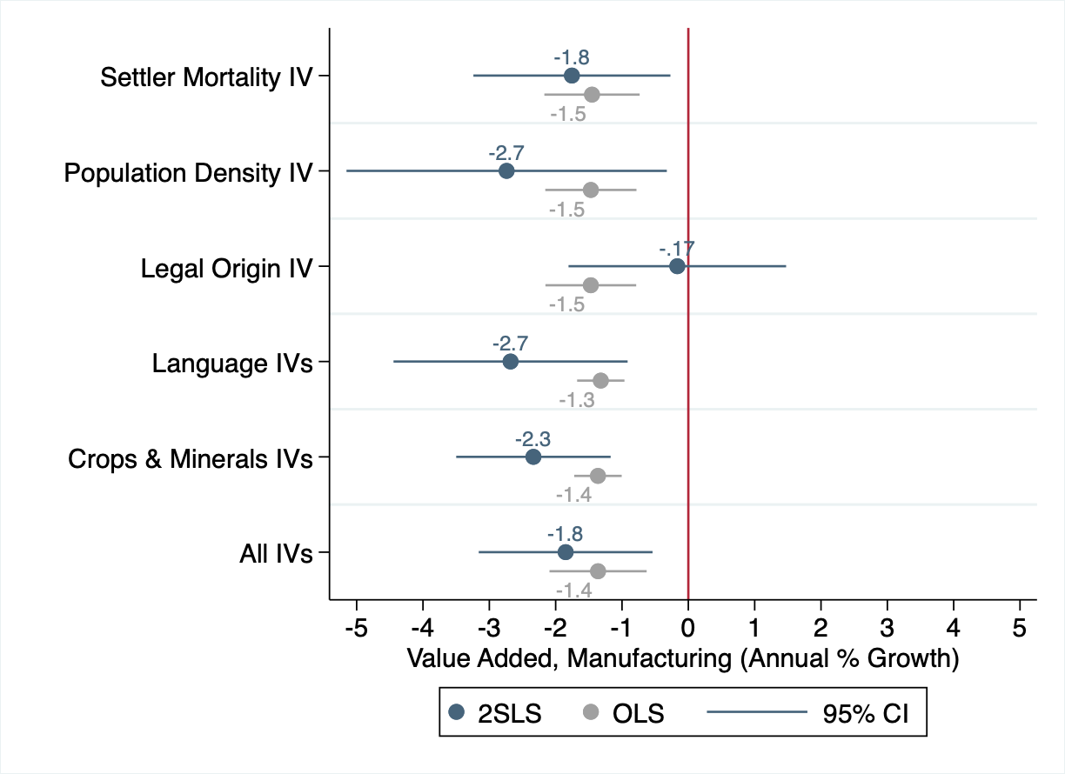
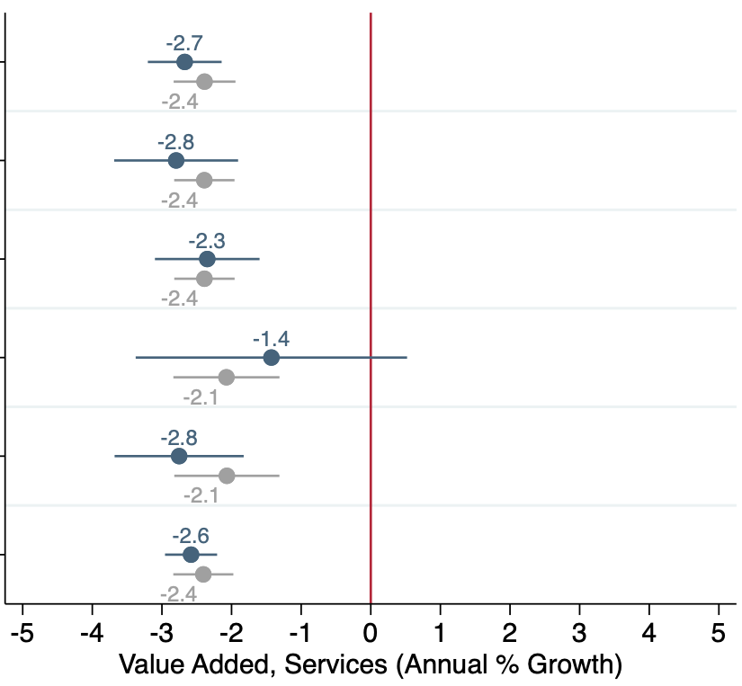
Settler
mortality IV
Pop.
density IV
Legal
Origin IV
Language
IV
Crops &
Minerals IV
All IVs

Slide 2
Settler
mortality IV
Pop.
density IV
Legal
Origin IV
Language
IV
Crops &
Minerals IV
All IVs

Slide 3
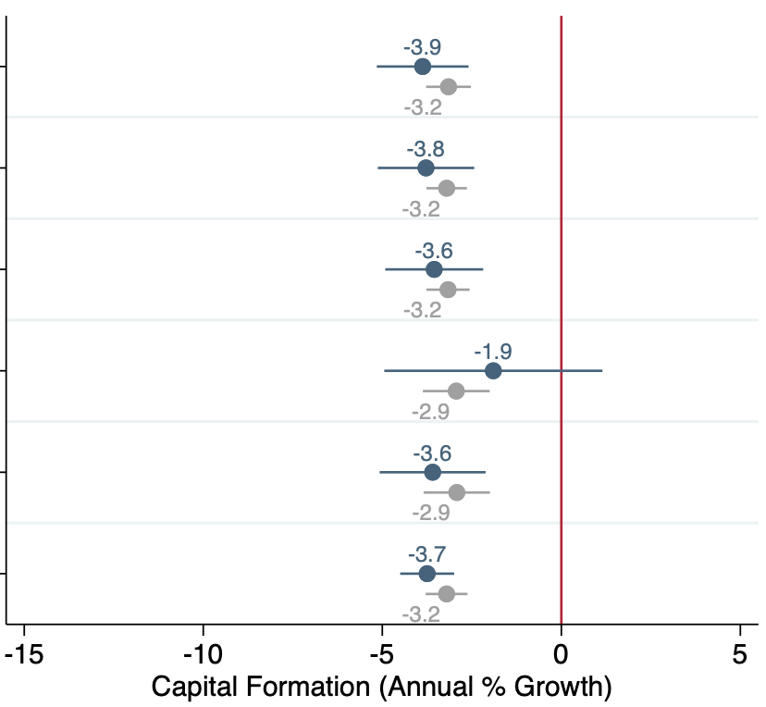
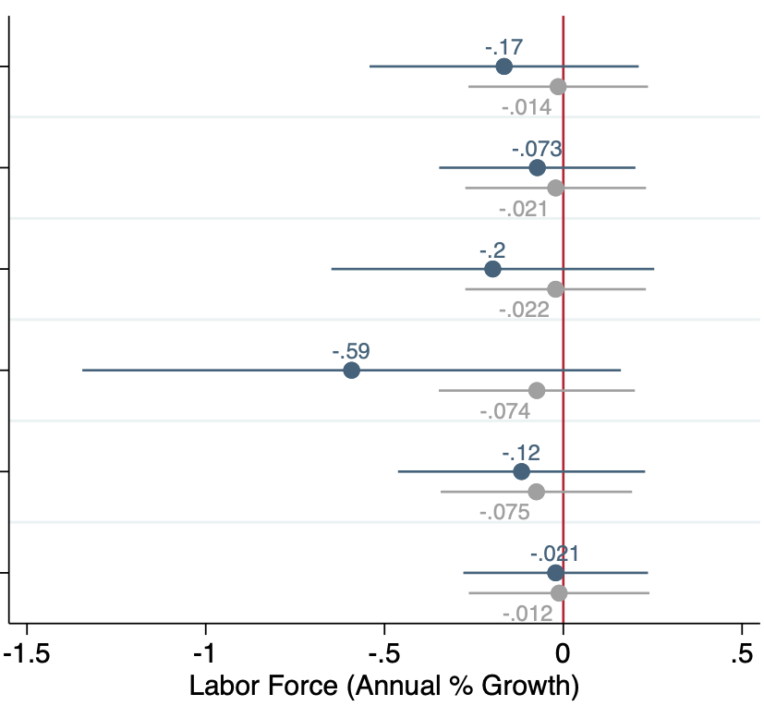
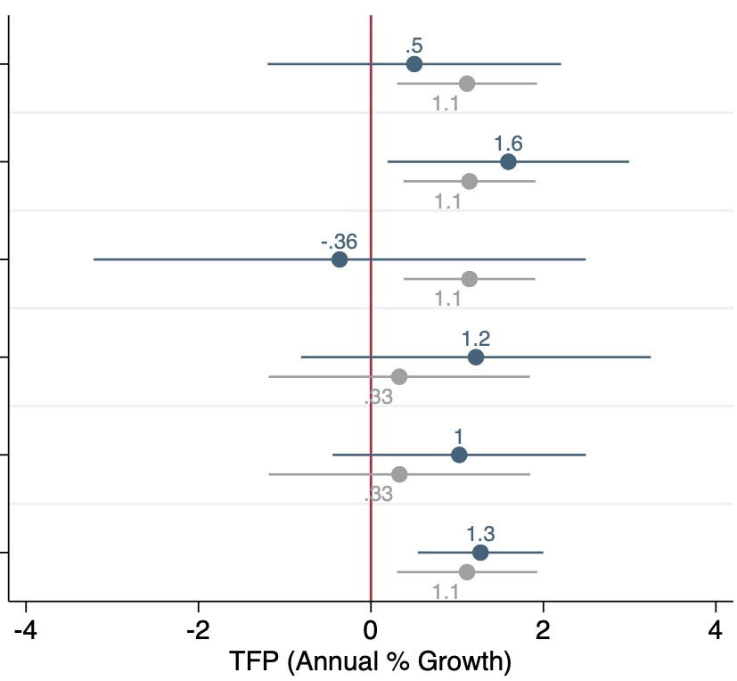
Settler
mortality IV
Pop.
density IV
Legal
Origin IV
Language
IV
Crops &
Minerals IV
All IVs

Slide 4
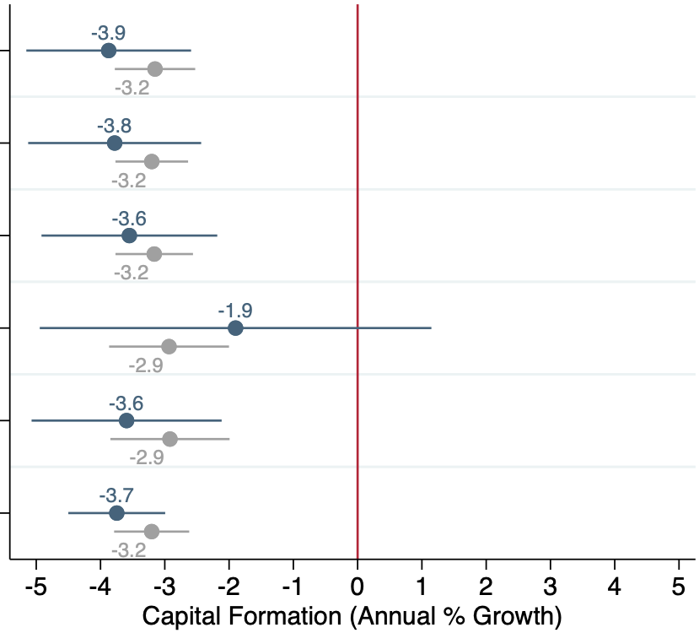
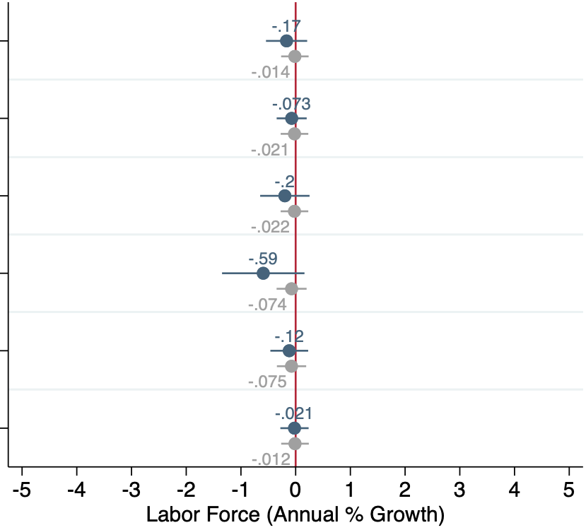
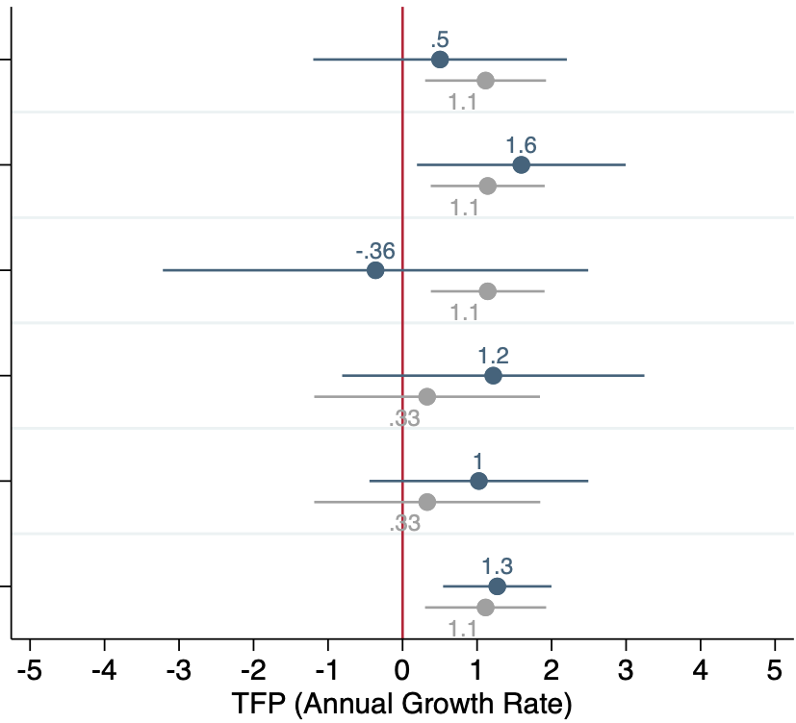
Settler
mortality IV
Pop.
density IV
Legal
Origin IV
Language
IV
Crops &
Minerals IV
All IVs

