Slide 1
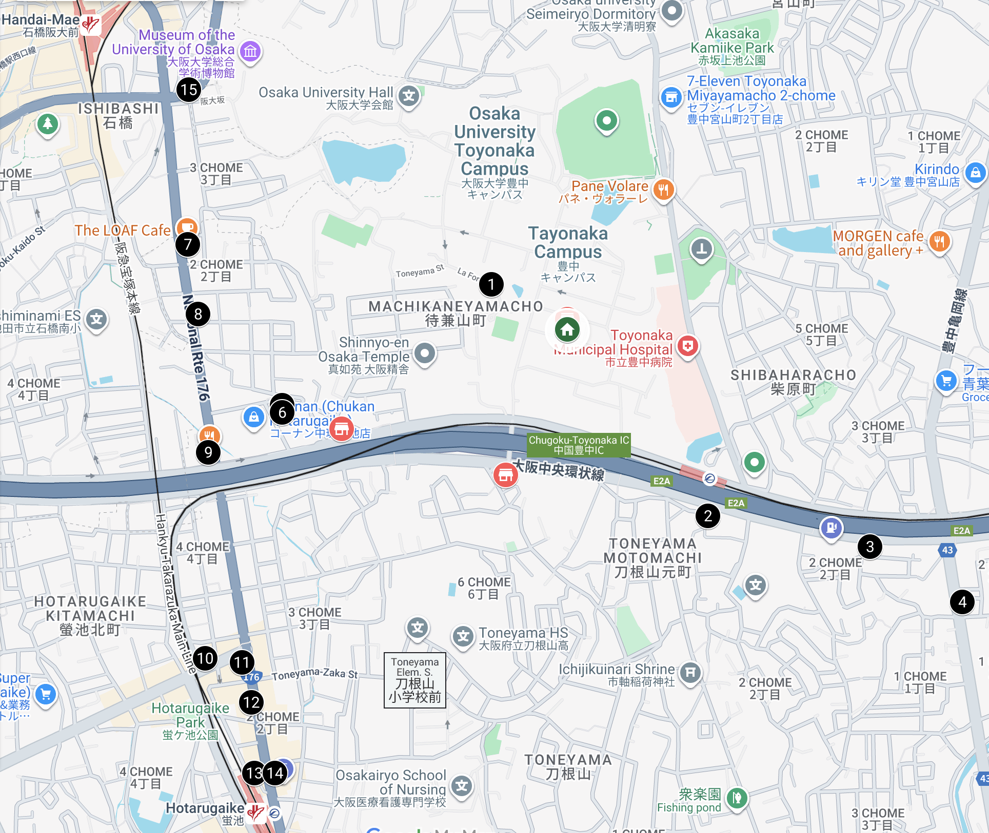


Lunch Map
 | Name (EN/JP) | Cuisine | Distance | Closed
1 | La Foret/らふぉれ | campus cafeteria | 5 min
2 | Steak no Don / ステーキのどん | Steakhouse | 10 min
3 | Dip Rasna / ディップラスナ | Indian cuisine | 15 min
4 | Aika / 藍花 | Kushikatsu | 15-20 min | Tue, Wed
5 | Sobafuji/ 蕎麦藤 | Soba | 10 min | Wed
6 | Akichan / あきちゃん | Okonomiyaki | 10 min | Mon, Tue
7 | The LOAF Cafe | French & Italian cuisine | 15-20 min
8 | Wafu Chuka Torin / 和風中華 東林 | Japanese Chinese cuisine | 10-15-min | Sun
9 | Mahorobatei / まほろば亭 | Japanese Chinese cuisine | 10-15 min | Wed
10 | Men-ya Hoi / 麺屋ほぃ | Ramen | 15-20 min | Wed
11 | Kathmandu / カトマンドゥ | Nepalese cuisine | 15-20 min
12 | Yoshioka Maguro-bushi Center /吉岡マグロ節センター | Ramen | 15-20 min
13 | Maruyoshi Seimenjo /マルヨシ製麺所 | Udon | 20-min
14 | Maruju / 丸十 | Udon | 20-min | Sun
15 | Mendo Shuhari / 麺道 しゅはり | Ramen | 15-20 min
Remark:
No. 5 is located behind No. 6.
means convenience stores.
means Nambu Yoichiro Hall.
In the top-left corner of the map, there are many restaurants near Ishibashi-Handai-mae Station (石橋阪大前駅) . But it takes about 25–30 minutes on foot to get there.

Slide 2
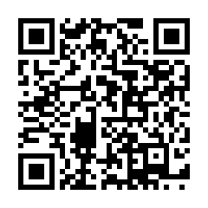
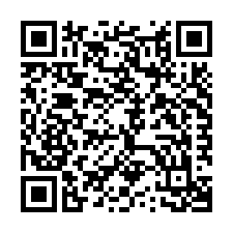
Lunch Map PDF
URL
https://masataka123.github.io/blog3/pdf/20251005_access/lunch_map.pdf
QR code
Google mymap
URL
https://www.google.com/maps/d/edit?mid=1B7egM_vT4mLeZgtXCt88ys5hColf05I&usp=sharing
QR code
Created by Masataka Iwai in 2025.

