Slide 1
Task Summary
Mathias Saver, PhD
27.08.2025

Slide 2
The CPTAC data
To better understand cancer biology, the Clinical Proteomic Tumor Analysis Consortium (CPTAC) integrates Proteomics and genomics/transcriptomics data
Some of the main use cases include:
biomarker and target discovery
studies in drug mechanisms
Cancer subtype classification or stratification
CPTAC has released proteogenomic data for multiple tumor types, including:
Breast cancer
Ovarian cancer
Colorectal cancer
Lung adenocarcinoma and squamous cell carcinoma
Clear cell renal cell carcinoma
Endometrial carcinoma
Pediatric brain tumors (more recent expansions)

Slide 3
Main Goal
The present Task made use of a subset of the proteomics data ( proteinGroups ) data, representing cases of Endometrial carcinoma
The principal goal of this task was to carry out basic data wrangling, exploratory data analysis

Slide 4
Pre-processing summary
7377 entries/rows in the proteinGroups.txt table were removed since they represent proteins not detected in any sample
The resulting expression data was median normalized, and then log transformed.
column metadata table was created including the following clinical attributes: tumor_stage_pathological, histologic_type & age. The age column was also use to create a age_cat column, which divided the cases into ‘high’ or ‘low’ based on the median

Slide 5
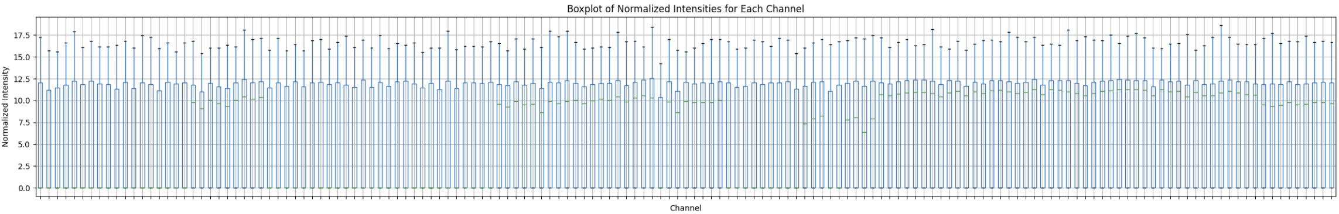
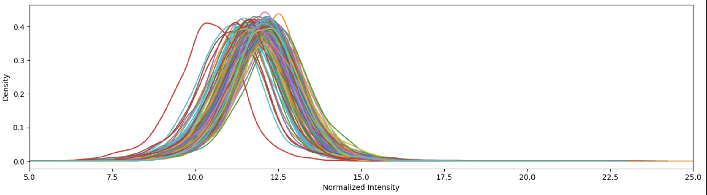
Quality control
The idea here, is to verify that after normalization there is comparable variability across samples

Slide 6
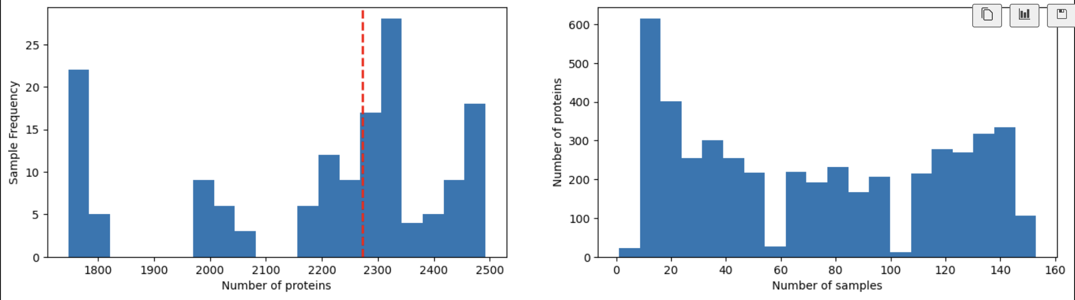
Protein Coverage across samples

Slide 7
QC Summary
There's similar variability across samples in the normalized data
The median number of protein detected per sample is ca. 2300

Slide 8
Exploratory Data Analysis

Slide 9
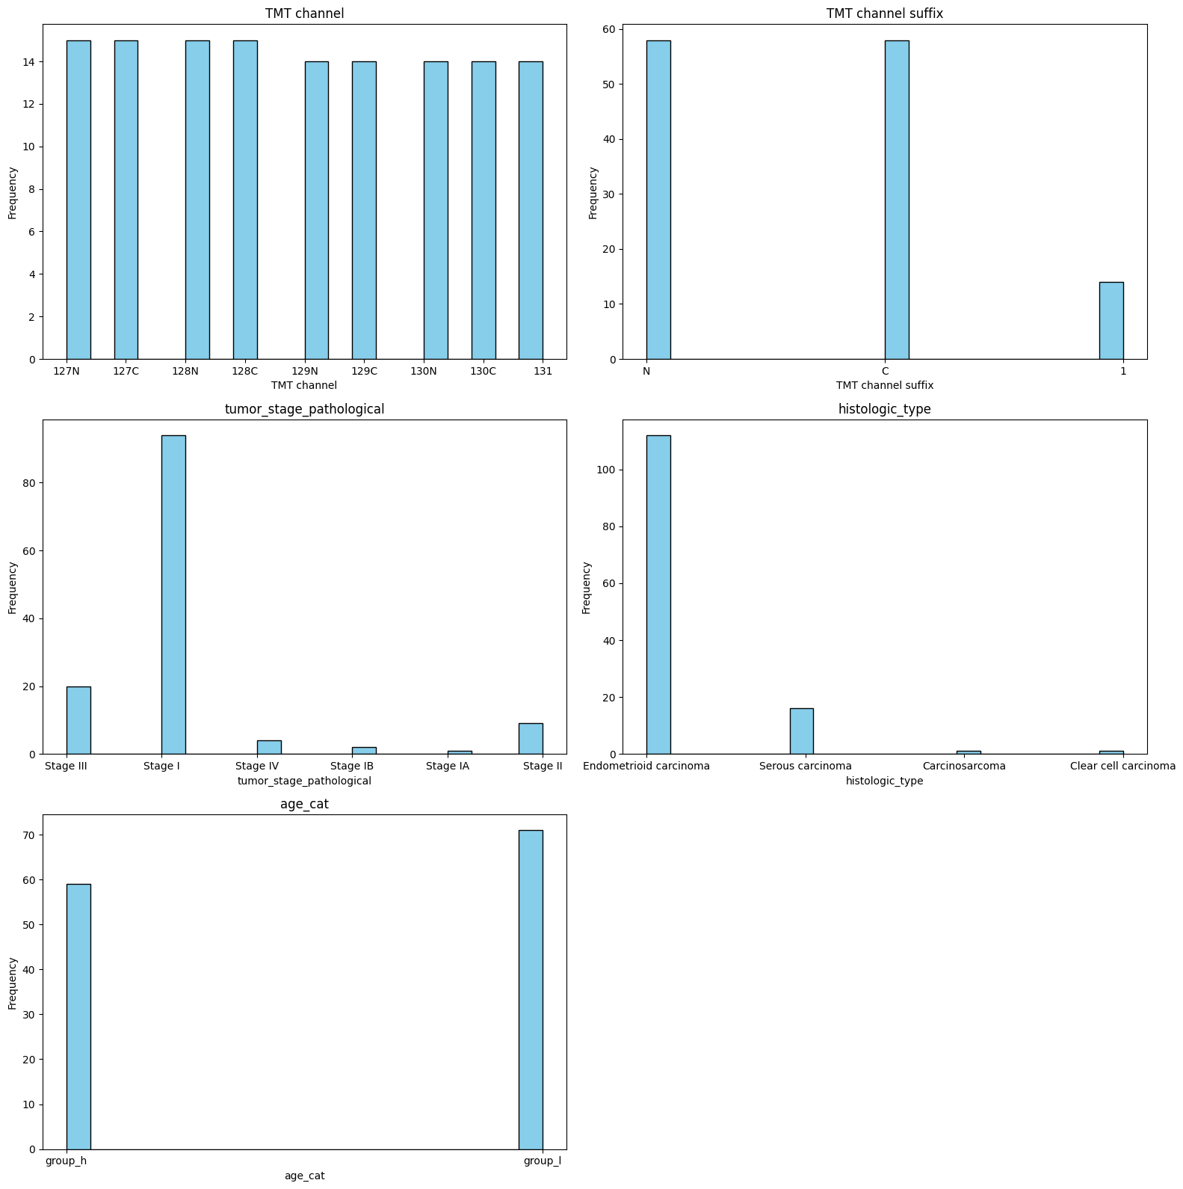
Distribution of categorical factors

Slide 10
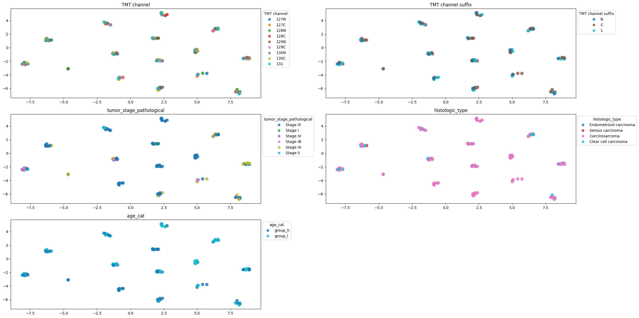
tSNE applied to normalized data

Slide 11
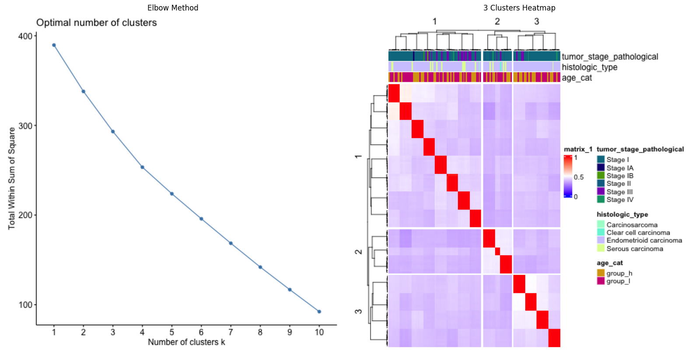
Hierarchical Clustering

Slide 12
Differential Protein Abundance

Slide 13
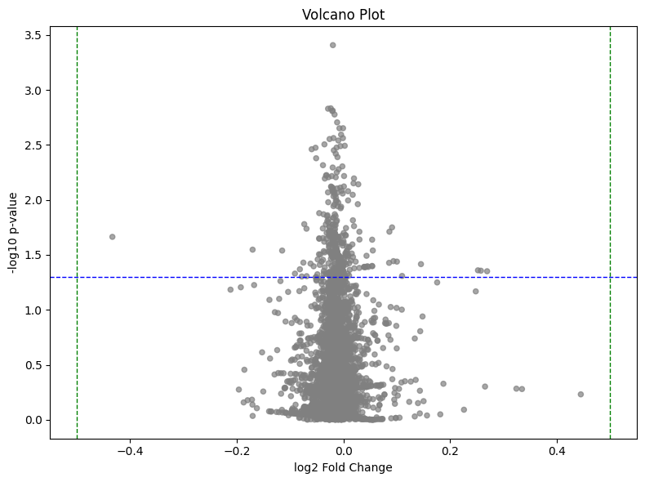
Effect of Age group on protein abundance
Groups were compared using a t-test, with the ‘low group’ as reference
When comparing the High vs Low age categorical groups, a few proteins are found with a pvalue < 0.05 . However, all of their log2Fc are very small. Thus indicating that the 'biology' of the cancer in between these two groups is similar

Slide 14
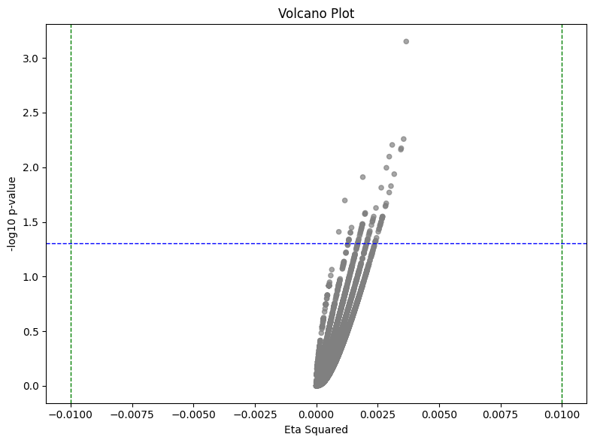
Effect of Tumor stage on protein abundance
Groups were compared using a Kruskal-Wallis test
Effect size is quantified with ‘Eta-squared’: similar to R2, it measures how much of the variability is explained by the groups
a few proteins are found with a pvalue < 0.05 . However, all of their log2Fc are very small. Thus indicating that the 'biology' of the cancer in between the tumor stage groups is similar

Slide 15
Conclusions
The abundance data was normalized to equal variances across samples
Samples have a median of ca. 2300 proteins detected
tSNE & hierarchical clustering didn’t reveal any clear subgroups of cases
Minimal difference were observed in protein abundance when analyzing the effect of “age categorical group” or ”tumor_stage”
NOTES:
The pvalues showed in the volcano plots are un-adjusted. So after correcting for multiple hypothesis testing, most of these differences might vanish
To show a potentially stronger proteomic separation it would be important to do a more extended analysis of the metadata (e.g: looking at MSI status)
It might be possible to increase statistical power by collapsing groups (e.g: early [I/II] vs late [III/IV])
Tumor stage progression might depend on other factors (e.g: Interactions with Tumor Microenvironment).

