Slide 1
Pipecat Voice Bot
Detailed Architecture Documentation

Slide 2
Project Overview
🎯 Goal: Real-time voice dialogue bot using local LLM and Japanese TTS
🌐 Input/Output: Browser video session / Phone (PSTN/Vonage Voice API)
🔧 Key Technologies:
  Pipecat: Pipeline orchestration
  Vonage API: Audio/video gateway
  LM Studio: Local LLM runtime
  Whisper MLX: Fast speech recognition (Japanese-ready)
  pyopenjtalk: Japanese text-to-speech
📊 Features: Privacy-focused (all local), low-latency, multi-session

Slide 3
System Architecture
Four main layers:
  Client Layer: Browser UI + OpenTok SDK
  Cloud Layer: Vonage Video/Voice API + Audio Connector
  Server Layer: FastAPI + WebSocket + Session Management
  Processing Layer: Pipecat Pipeline (STT→LLM→TTS)
Data Flow:
  Client → Vonage Cloud → Server
  Server → Pipecat Pipeline → LM Studio/pyopenjtalk
  Results → Vonage Cloud → Client

Slide 4
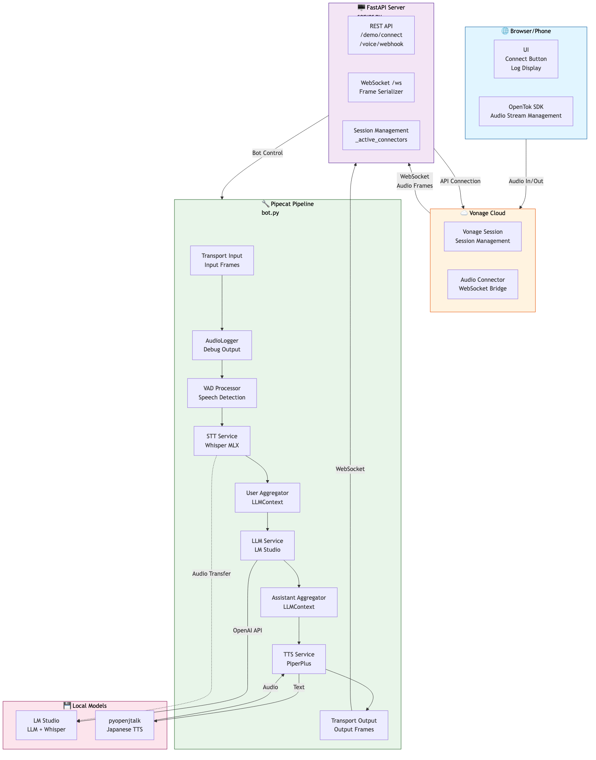
Diagram: Full System Architecture

Slide 5
server.py: FastAPI Server
Responsibility: HTTP/WebSocket interface, Vonage integration
Main Endpoints:
  GET/POST /voice/webhook: Receive incoming calls (return NCCO)
  POST /demo/connect: Create video session
  POST /connect: General connection (Video API)
  GET /: Serve static HTML
  WebSocket /ws: Bidirectional audio streaming
Session Management: _active_connectors dict tracks multiple connections

Slide 6
bot.py: Pipecat Pipeline
Responsibility: Audio processing, STT/LLM/TTS integration, conversation management
Initialization (preload_models):
  OpenAILLMService (LM Studio)
  WhisperSTTServiceMLX (Whisper)
  PiperPlusTTSService (Japanese TTS)
  SileroVADAnalyzer (Voice activity detection)
  LocalSmartTurnAnalyzerV3 (Conversation turn detection)
Critical Fix: Monkey-Patch LLMAssistantAggregator to forward TextFrame downstream

Slide 7
Pipecat Pipeline Flow
1. Transport Input → AudioFrameLogger (debugging)
2. VADProcessor (SileroVAD) → Detect speech/silence
3. WhisperSTTServiceMLX → Audio → Text
4. LLMUserAggregator → Add utterance to LLMContext
5. OpenAILLMService (LM Studio) → Text → Text
6. LLMAssistantAggregator → Send response to LLMContext + TTS
7. PiperPlusTTSService → Text → Audio frames
8. Transport Output → Send to client

Slide 8
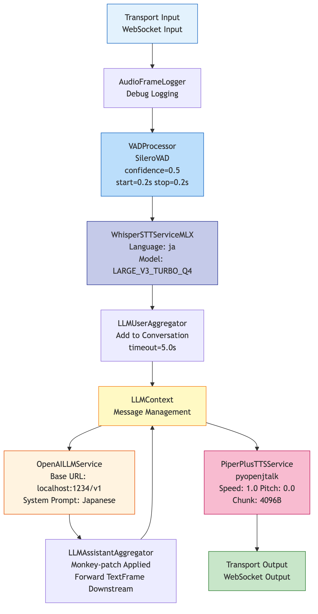
Diagram: Pipecat Pipeline Detail

Slide 9
tts_piper_plus.py: Japanese TTS
Purpose: Wrap pyopenjtalk (Japanese HTS synthesis) in Pipecat interface
Features:
  Async execution: Use thread pool to avoid blocking TTS
  Audio normalization: Convert float64 → int16 with clipping
  Chunking: Generate TTSAudioRawFrame in 4096B units
  Parameters: Speed=1.0, Pitch=0.0 (adjustable)
Advantages: No model download needed, lightweight, fast

Slide 10
static/index.html: Browser UI
Technology: Vonage OpenTok SDK (vanilla JavaScript)
Features:
  Connect Button: POST /demo/connect → Create Vonage session
  Status Display: Update connection state in real-time
  Log Panel: Record events/errors with timestamp
  Audio Stream: Subscribe to bot's microphone (audioOnly=true)
Session Flow: OT.initSession() → Connect with token → Subscribe()

Slide 11
Data Flow: Video Session
1. User clicks 'Connect' button
2. Browser calls POST /demo/connect
3. Server creates Vonage Session → Launches Audio Connector
4. Browser calls OT.initSession() → Join with token
5. Vonage Audio Connector connects to WebSocket
6. Bot sends greeting (Text → TTS → Audio)
7. Bidirectional: User speech ↔ Vonage ↔ Pipecat ↔ Response audio

Slide 12
Data Flow: Phone (PSTN)
1. User calls Vonage phone number
2. Vonage sends GET /voice/webhook request
3. Server returns NCCO (specify WebSocket endpoint)
4. Vonage automatically connects call to WebSocket /ws
5. Bot starts Pipecat Pipeline
6. Bidirectional: Phone audio ↔ Vonage ↔ Pipecat ↔ Response audio
Advantage: No browser needed, works with regular phone

Slide 13
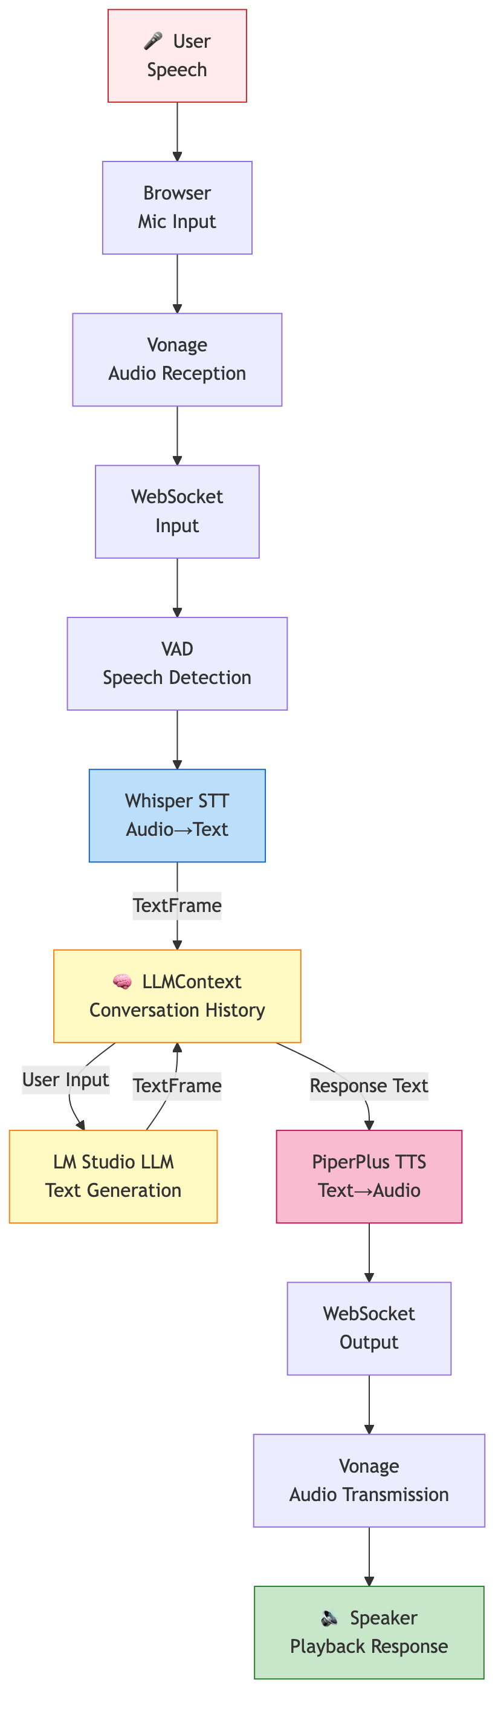
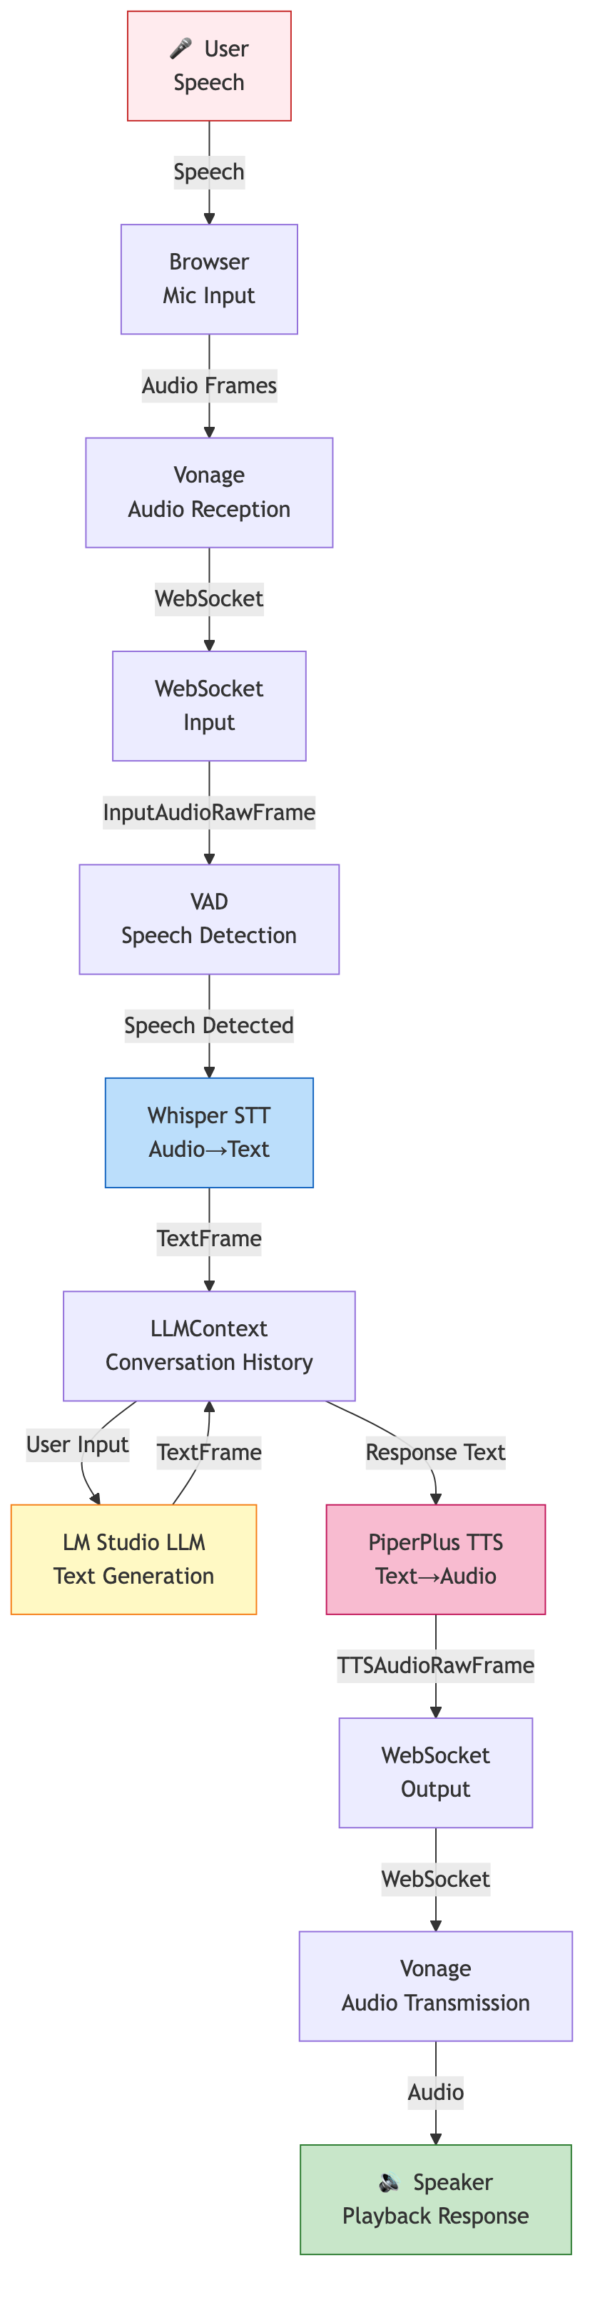
Diagram: Data Flow

Slide 14
Dependencies & Local Models
Python Packages:
  pipecat-ai: Pipeline, STT/TTS/LLM integration
  vonage: Vonage Video/Voice API
  uvicorn: ASGI server
  fastapi: Web framework
Local Models (LM Studio required):
  LLM: Gemma/Llama etc (user-selectable)
  STT: Whisper (LARGE_V3_TURBO_Q4 recommended)
  TTS: pyopenjtalk (HTS-based)

Slide 15
Environment Variables (.env)
LM Studio:
  LM_STUDIO_BASE_URL=http://localhost:1234/v1
  LM_MODEL=gemma-4-26B-A4B-it-MLX-8bit
  STT_LANGUAGE=ja
Vonage:
  VONAGE_APPLICATION_ID=<your-app-id>
  VONAGE_PRIVATE_KEY=<path-or-raw-key>
  VONAGE_AUDIO_RATE=16000
  WS_URI=wss://<tunnel-url>/ws (optional)

Slide 16
Startup Steps
1. Start LM Studio on localhost:1234
  Load a model (Gemma/Llama etc)
2. Configure repository with .env file
3. Expose with Cloudflare Tunnel
  cloudflared tunnel run pipecat
4. Start FastAPI server
  python server.py
5. Open Tunnel URL in browser
6. Click 'Connect' button → Voice conversation starts

Slide 17
Pipeline Configuration Details
VAD (Voice Activity Detection):
  Confidence: 0.5
  Speech Start: 0.2 sec
  Silence Detection: 0.2 sec
  Idle: 1.0 sec
STT:
  Language: Japanese (ja)
  no_speech_prob: 0.3 (adjust silence threshold)
LLM:
  System Prompt: Japanese, concise, TTS-compatible

Slide 18
Important Technical Approaches
1. State Reset (_reset_service):
  Clear LLM/STT/TTS internal state per connection
  Prevent cross-connection interference
2. Monkey-Patch (LLMAssistantAggregator):
  Forward TextFrame downstream
  Enable TTS to receive responses
3. Audio Connector Management:
  Stop all old connectors on new connection
  Prevent memory leaks

Slide 19
Error Handling
Server Side:
  WebSocket disconnect → cleanup in finally block
  Model load failure → log and continue (runtime error)
  Connector stop failure → warning log only
Pipeline Side:
  STT timeout → cancel _ttfb_timeout_task
  LLM error → exception log → end session
Browser Side:
  Connection failure → show status
  Stream receive failure → log only (continue UI)

Slide 20
Performance & Optimization
Model Pre-loading:
  preload_models() on startup loads all models to memory
  Eliminates first-connection delay
Whisper MLX:
  LARGE_V3_TURBO_Q4: Fast, high-accuracy (recommended)
Async Processing:
  asyncio avoids I/O blocking
  Parallel processing achieves low-latency
Greeting Strategy:
  Immediate + Delayed to handle network latency

Slide 21
Security Considerations
Privacy:
  All processing runs locally → no data sent externally
  LLM/STT/TTS run in LM Studio
Authentication & Authorization:
  Vonage API secured by SDK (private key management)
  Secrets managed in environment variables (.env)
Communication:
  Tunnel URL encrypted with HTTPS/WSS
  WebSocket uses binary protocol for efficiency

Slide 22
Troubleshooting
Cannot Connect:
  Verify LM Studio is running
  Check Tunnel URL is correct (WS_URI)
  Verify Vonage credentials are correct
Audio Cuts Out:
  Check network latency
  Verify LLM response time isn't too long
  Adjust Whisper no_speech_prob
No Response:
  Verify LLM model is loaded correctly
  Verify Monkey-Patch is applied

Slide 23
Summary
✓ Modular design with independent components
✓ Local execution prioritizes privacy
✓ Vonage integration enables diverse input/output
✓ Pipecat simplifies complex audio processing
✓ Japanese optimization enables natural dialogue
✓ Multi-session support handles multiple users
Future Enhancements:
  Emotion analysis & multi-language support
  Multiple LLM model support
  Conversation logging & analytics

