Slide 1
CODE-DERIVED ARCHITECTURE ANALYSIS
Vonage Voice Verify — Detailed Architecture
Verify V2 authentication × InApp Voice × PSTN fallback — a code-read deep dive of backend (Vonage Cloud Runtime / TypeScript) and android-app (Kotlin / MVVM).
Code-first analysis
All diagrams reflect actual reads of index.ts, config.ts, db.ts, models, routes/auth.ts, routes/voice.ts, routes/voiceAuth.ts, webhooks.ts and every Activity / ViewModel / Service.
Mermaid source + PNG
doc/*.mmd rendered with mmdc scale=3 (white background) into PNG, embedded in this deck with an aspect-ratio lock — resizing never distorts or crops.
13 slides, no overflow
System → Backend → Auth → Voice → Android → Data → Security → Deployment → Recommendations. Every diagram is contain-fitted so nothing spills off the slide.
Target: verify-inapp-mobilevoice-app · Environment: Node 20 / JDK 17 / VCR (APAC) / MongoDB Atlas

Slide 2
01 | OVERVIEW
System Overview & Technology Stack
SMS OTP login → dial pad → InApp/PSTN calls. Phone numbers and call state are persisted in MongoDB.
Layer | Technology / key files | Role
Android | Kotlin / AGP 8.7 / SDK 34 / ViewBinding / client-sdk-voice 2.6.0 / firebase-bom 32.7 | 5-screen flow, MVVM, Foreground service, FCM push
Backend | Node 20 / TS / VCR handler index.ts / @vonage/server-sdk 3.13 / @vonage/jwt 1.14 / mongodb 6.12 | OTP, NCCO, JWT issuance, webhooks, rate limit, HMAC signature
Vonage | Verify V2 / Voice API / Users API (AP) / push (FCM) | SMS 6-digit OTP, PSTN calls, InApp (WebRTC), call-invite push
Data | MongoDB 5.0+ (Atlas) / mongodb driver used directly (no ODM) | phone_users / call_events / user_tokens / push_tokens
Key facts (from code)
• Single entry point: handler(event) branches health → CORS → webhook signature → rate limit → public routes → JWT → protected routes → 404 (src/index.ts).
• Public: send-otp / verify-otp / users list / ncco. Protected: voice/call, token, register, push-token, reconnect.
• No web framework / ODM: node:http + VCR handler, JWT verified with node:crypto (RSA-SHA256), MongoClient.singleton (maxPoolSize=1).
App facts
• Flow: PhoneInput (LAUNCHER) → VerifyCode → DialPad → Call; incoming → IncomingCall → Call.
• Outbound calls call voiceClient.serverCall directly; /api/voice/call backs the PSTN fallback path.
• BACKEND_URL resolution: .env > -P flag > gradle.properties > env var > localhost:3000.
verify-inapp-mobilevoice-app | backend (VCR / Node 20 / TS) + android-app (Kotlin) | Mermaid PNG embedded with aspect-ratio lock

Slide 3
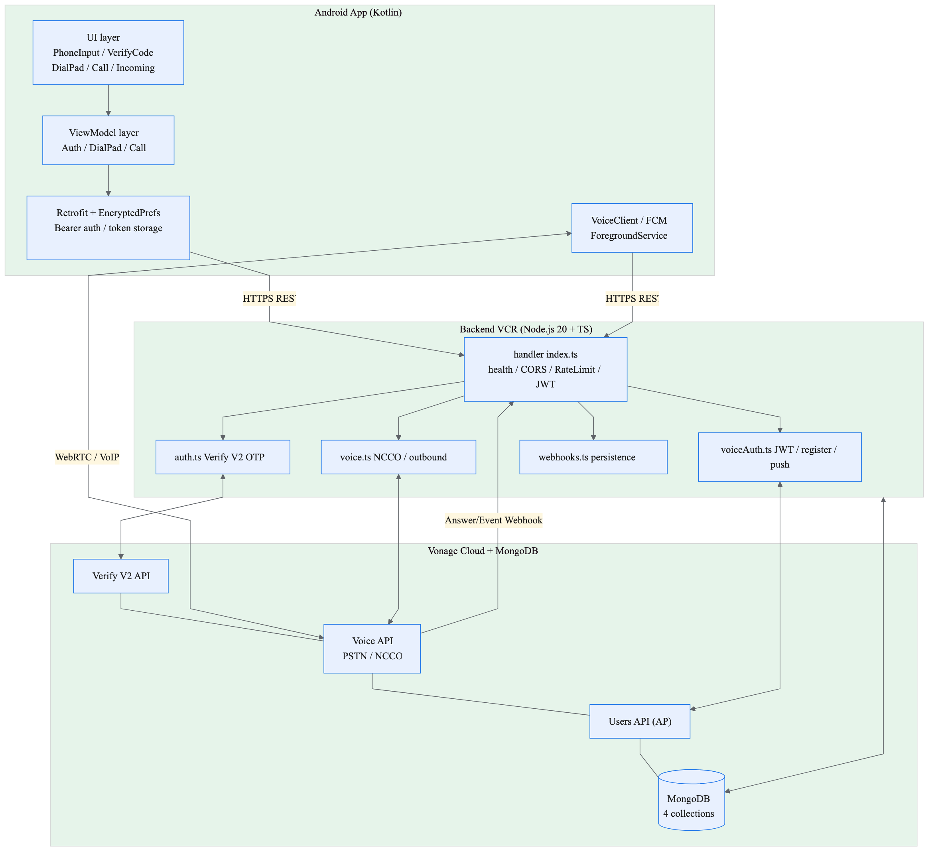
02 | SYSTEM
End-to-End System Topology
Android ↔ VCR backend ↔ Vonage Cloud ↔ MongoDB responsibilities at a glance.
Mermaid: doc/01_system_overview_en.mmd → 01_system_overview_en.png (mmdc scale=3)
• UI→VM→Retrofit talk to the single handler over HTTPS REST; the SDK adds a WebRTC/VoIP media path.
• Backend splits into auth (Verify), voice (NCCO/call), voiceAuth (JWT/register) and webhooks (persistence).
• Verify V2, Voice API and Users API (AP region) are consumed only by their owning modules.
• All four Mongo collections are reachable from the backend; presence flags drive call routing.
verify-inapp-mobilevoice-app | backend (VCR / Node 20 / TS) + android-app (Kotlin) | Mermaid PNG embedded with aspect-ratio lock

Slide 4
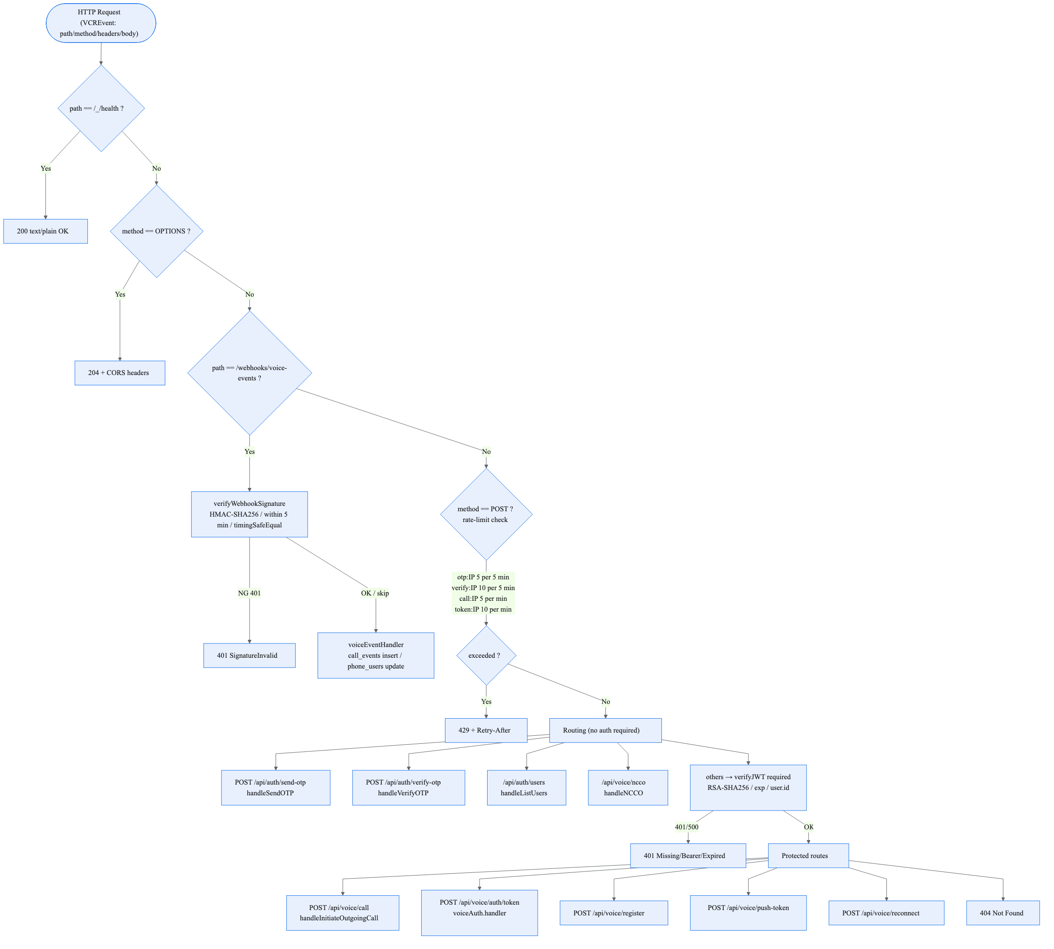
03 | BACKEND
Request Pipeline & Routing (index.ts)
Exact decision order of the handler: middleware and the public/protected route boundary are the core.
Mermaid: doc/02_backend_routing_en.mmd → 02_backend_routing_en.png (mmdc scale=3)
• Per-IP in-memory rate limits (60 s cleanup): otp 5/5 min, verify 10/5 min, call 5/1 min, token 10/1 min → 429 + Retry-After.
• Webhook route validates HMAC-SHA256 signature first (5-min window, timing-safe); skips if secret or VCR callback router is detected.
• JWT gate applies to voice/call, token, register, push-token, reconnect — verified via the private key PEM + exp + user.id.
• ncco and users stay public because they are driven by Vonage answer webhooks rather than client auth.
verify-inapp-mobilevoice-app | backend (VCR / Node 20 / TS) + android-app (Kotlin) | Mermaid PNG embedded with aspect-ratio lock

Slide 5
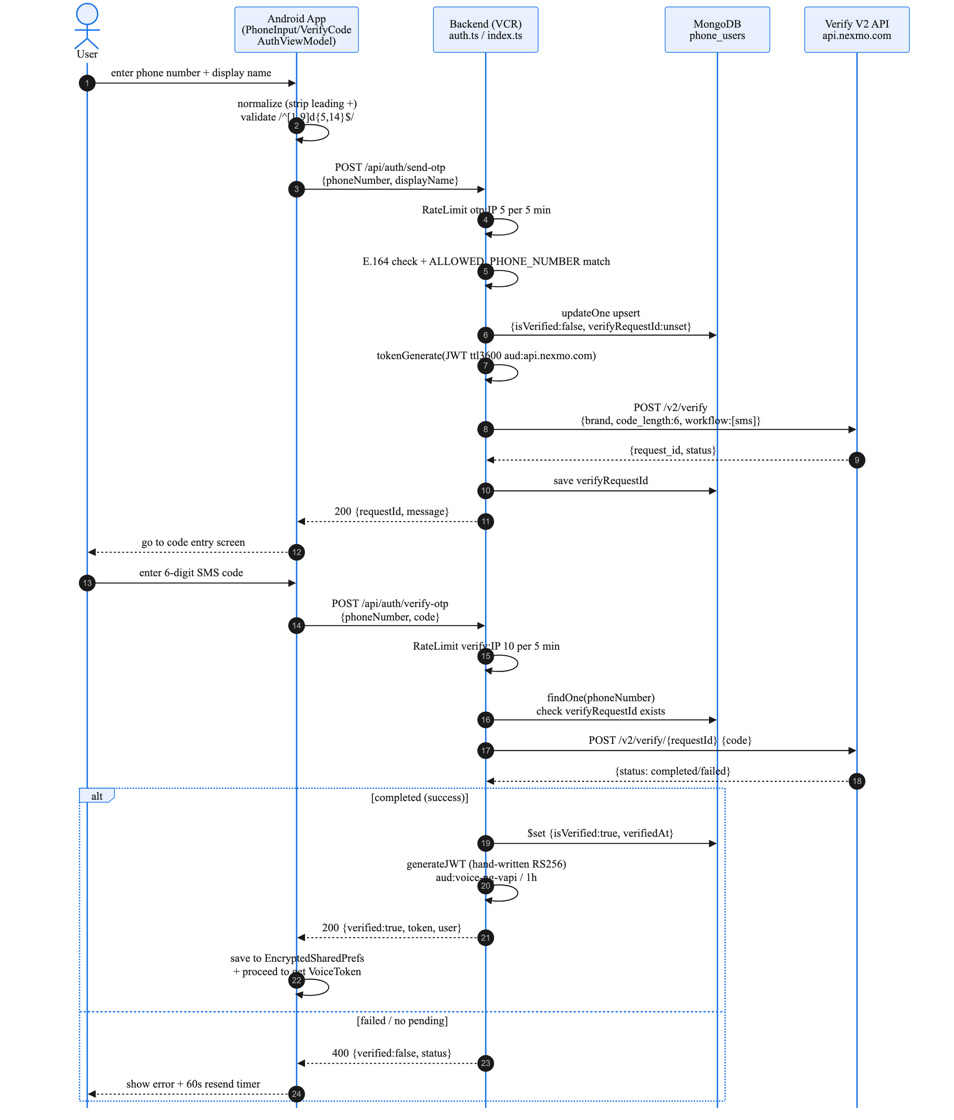
04 | AUTH
Authentication Flow (Verify V2 OTP)
send-otp (upsert) → SMS → verify-otp ('completed') → issuer of a custom RS256 JWT.
Highlights
• Send: strip '+', validate /^[1-9]\d{1,14}$/, gate by ALLOWED_PHONE_NUMBER, upsert phone_users, issue Verify V2 JWT (ttl 3600, aud api.nexmo.com), POST /v2/verify sms workflow.
• Verify: findOne → POST /v2/verify/{requestId} {code}. Only status 'completed' sets isVerified + verifiedAt.
Mermaid: doc/03_auth_otp_sequence_en.mmd → 03_auth_otp_sequence_en.png (mmdc scale=3)
verify-inapp-mobilevoice-app | backend (VCR / Node 20 / TS) + android-app (Kotlin) | Mermaid PNG embedded with aspect-ratio lock

Slide 6
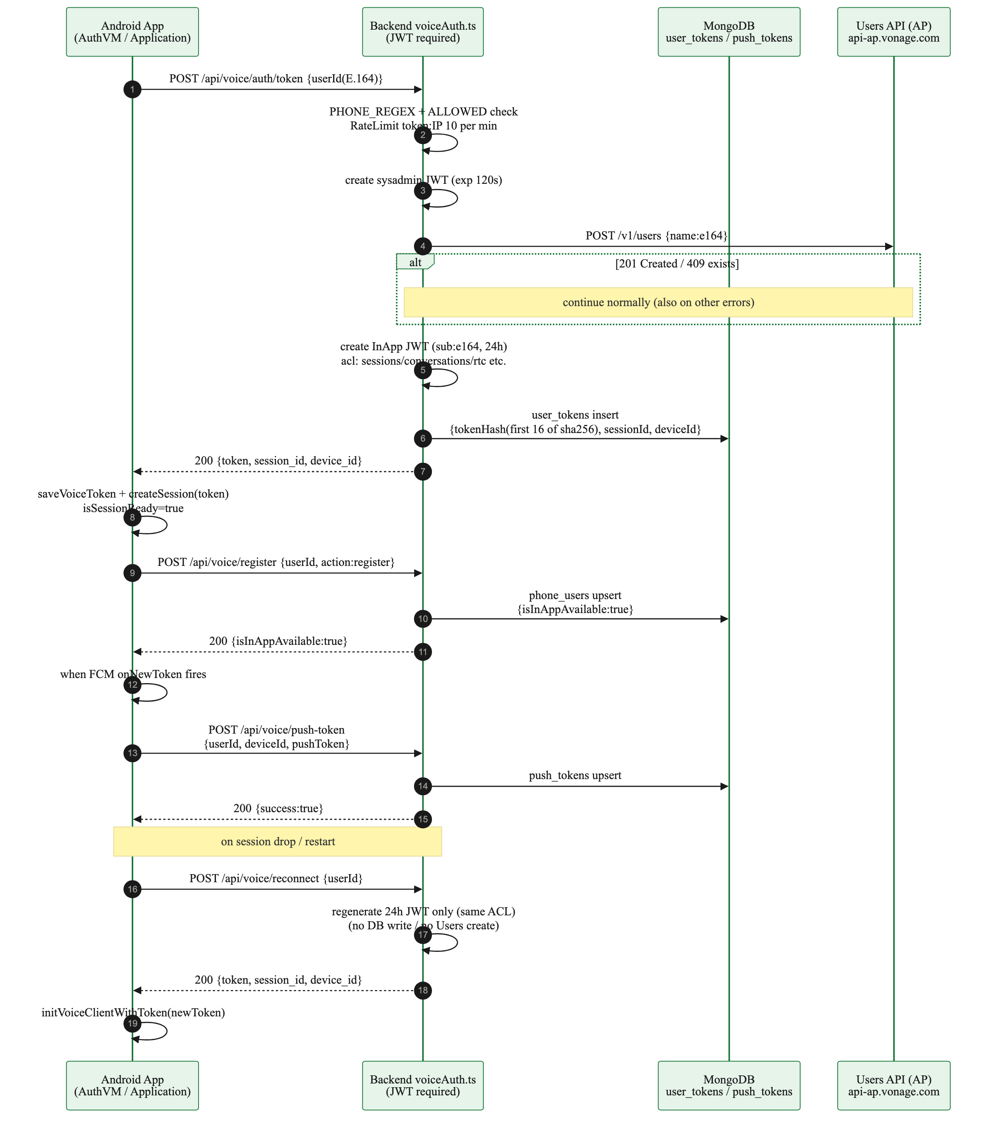
05 | VOICE AUTH
InApp Voice Onboarding (token / register / push)
Users API (AP) enrollment → 24 h JWT → register → FCM token binding → reconnect re-issuance.
Highlights
• token: sysadmin JWT (120 s) → POST /v1/users (409 'already exists' is treated as success) → 24 h sub=e164 JWT with a restricted ACL → store sha256(token)[0:16] in user_tokens.
• register flips isInAppAvailable (upsert of phone_users); push-token binds the FCM device token (remove action deletes it).
Mermaid: doc/04_voice_token_sequence_en.mmd → 04_voice_token_sequence_en.png (mmdc scale=3)
verify-inapp-mobilevoice-app | backend (VCR / Node 20 / TS) + android-app (Kotlin) | Mermaid PNG embedded with aspect-ratio lock

Slide 7
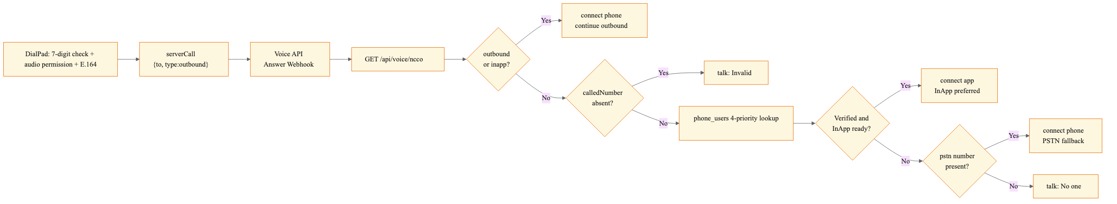
06a | CALL
Call Flow #1 — Outbound & NCCO Branching
serverCall entry. outbound connects directly; verified + present users go InApp; otherwise PSTN; otherwise talk.
Mermaid: doc/05a_call_ncco_en.mmd (split view; combined original: 05_call_ncco_flow_en.mmd)
• DialPad: requires ≥7 digits, RECORD_AUDIO permission, E.164 normalization, then a bounded session-retry loop (≤5 attempts) before serverCall{to, type:'outbound'}.
• voice.ts routing precedence = availability policy: InApp (app) > PSTN (phone) > talk message.
• NCCO answer: GET /api/voice/ncco inspects context; type outbound/inapp → connect phone to the dialed number (from VONAGE_PHONE_NUMBER).
• Otherwise a 4-priority lookup (verified+present → verified → present → any) decides the endpoint; empty states return tts 'talk' prompts.
verify-inapp-mobilevoice-app | backend (VCR / Node 20 / TS) + android-app (Kotlin) | Mermaid PNG embedded with aspect-ratio lock

Slide 8
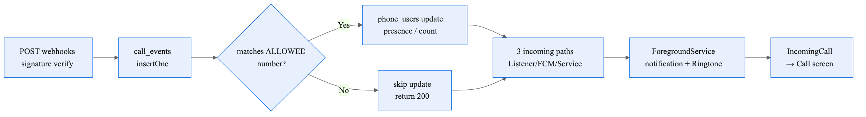
06b | EVENTS & PUSH
Call Flow #2 — Event Persistence & Incoming Push
webhooks.ts persistence plus three inbound paths (listener / FCM / service) into IncomingCallActivity.
Mermaid: doc/05b_events_push_en.mmd (split view; combined original: 05_call_ncco_flow_en.mmd)
• Every event is inserted into call_events. Presence updates only when 'to' matches ALLOWED_PHONE_NUMBER (3 notations: +present, no +): started→true/active, stopped/failed→false (+totalCalls).
• FCM onMessageReceived handles only 'vonage'-typed invites via processPushCallInviteSync; other actions are logged.
• Incoming ringtone is driven by the Foreground service (notification 1001) and FCM notification 1002.
• IncomingCallActivity uses lock-screen flags, answers via voiceClient.answer, and routes to CallActivity on 'connected'.
verify-inapp-mobilevoice-app | backend (VCR / Node 20 / TS) + android-app (Kotlin) | Mermaid PNG embedded with aspect-ratio lock

Slide 9
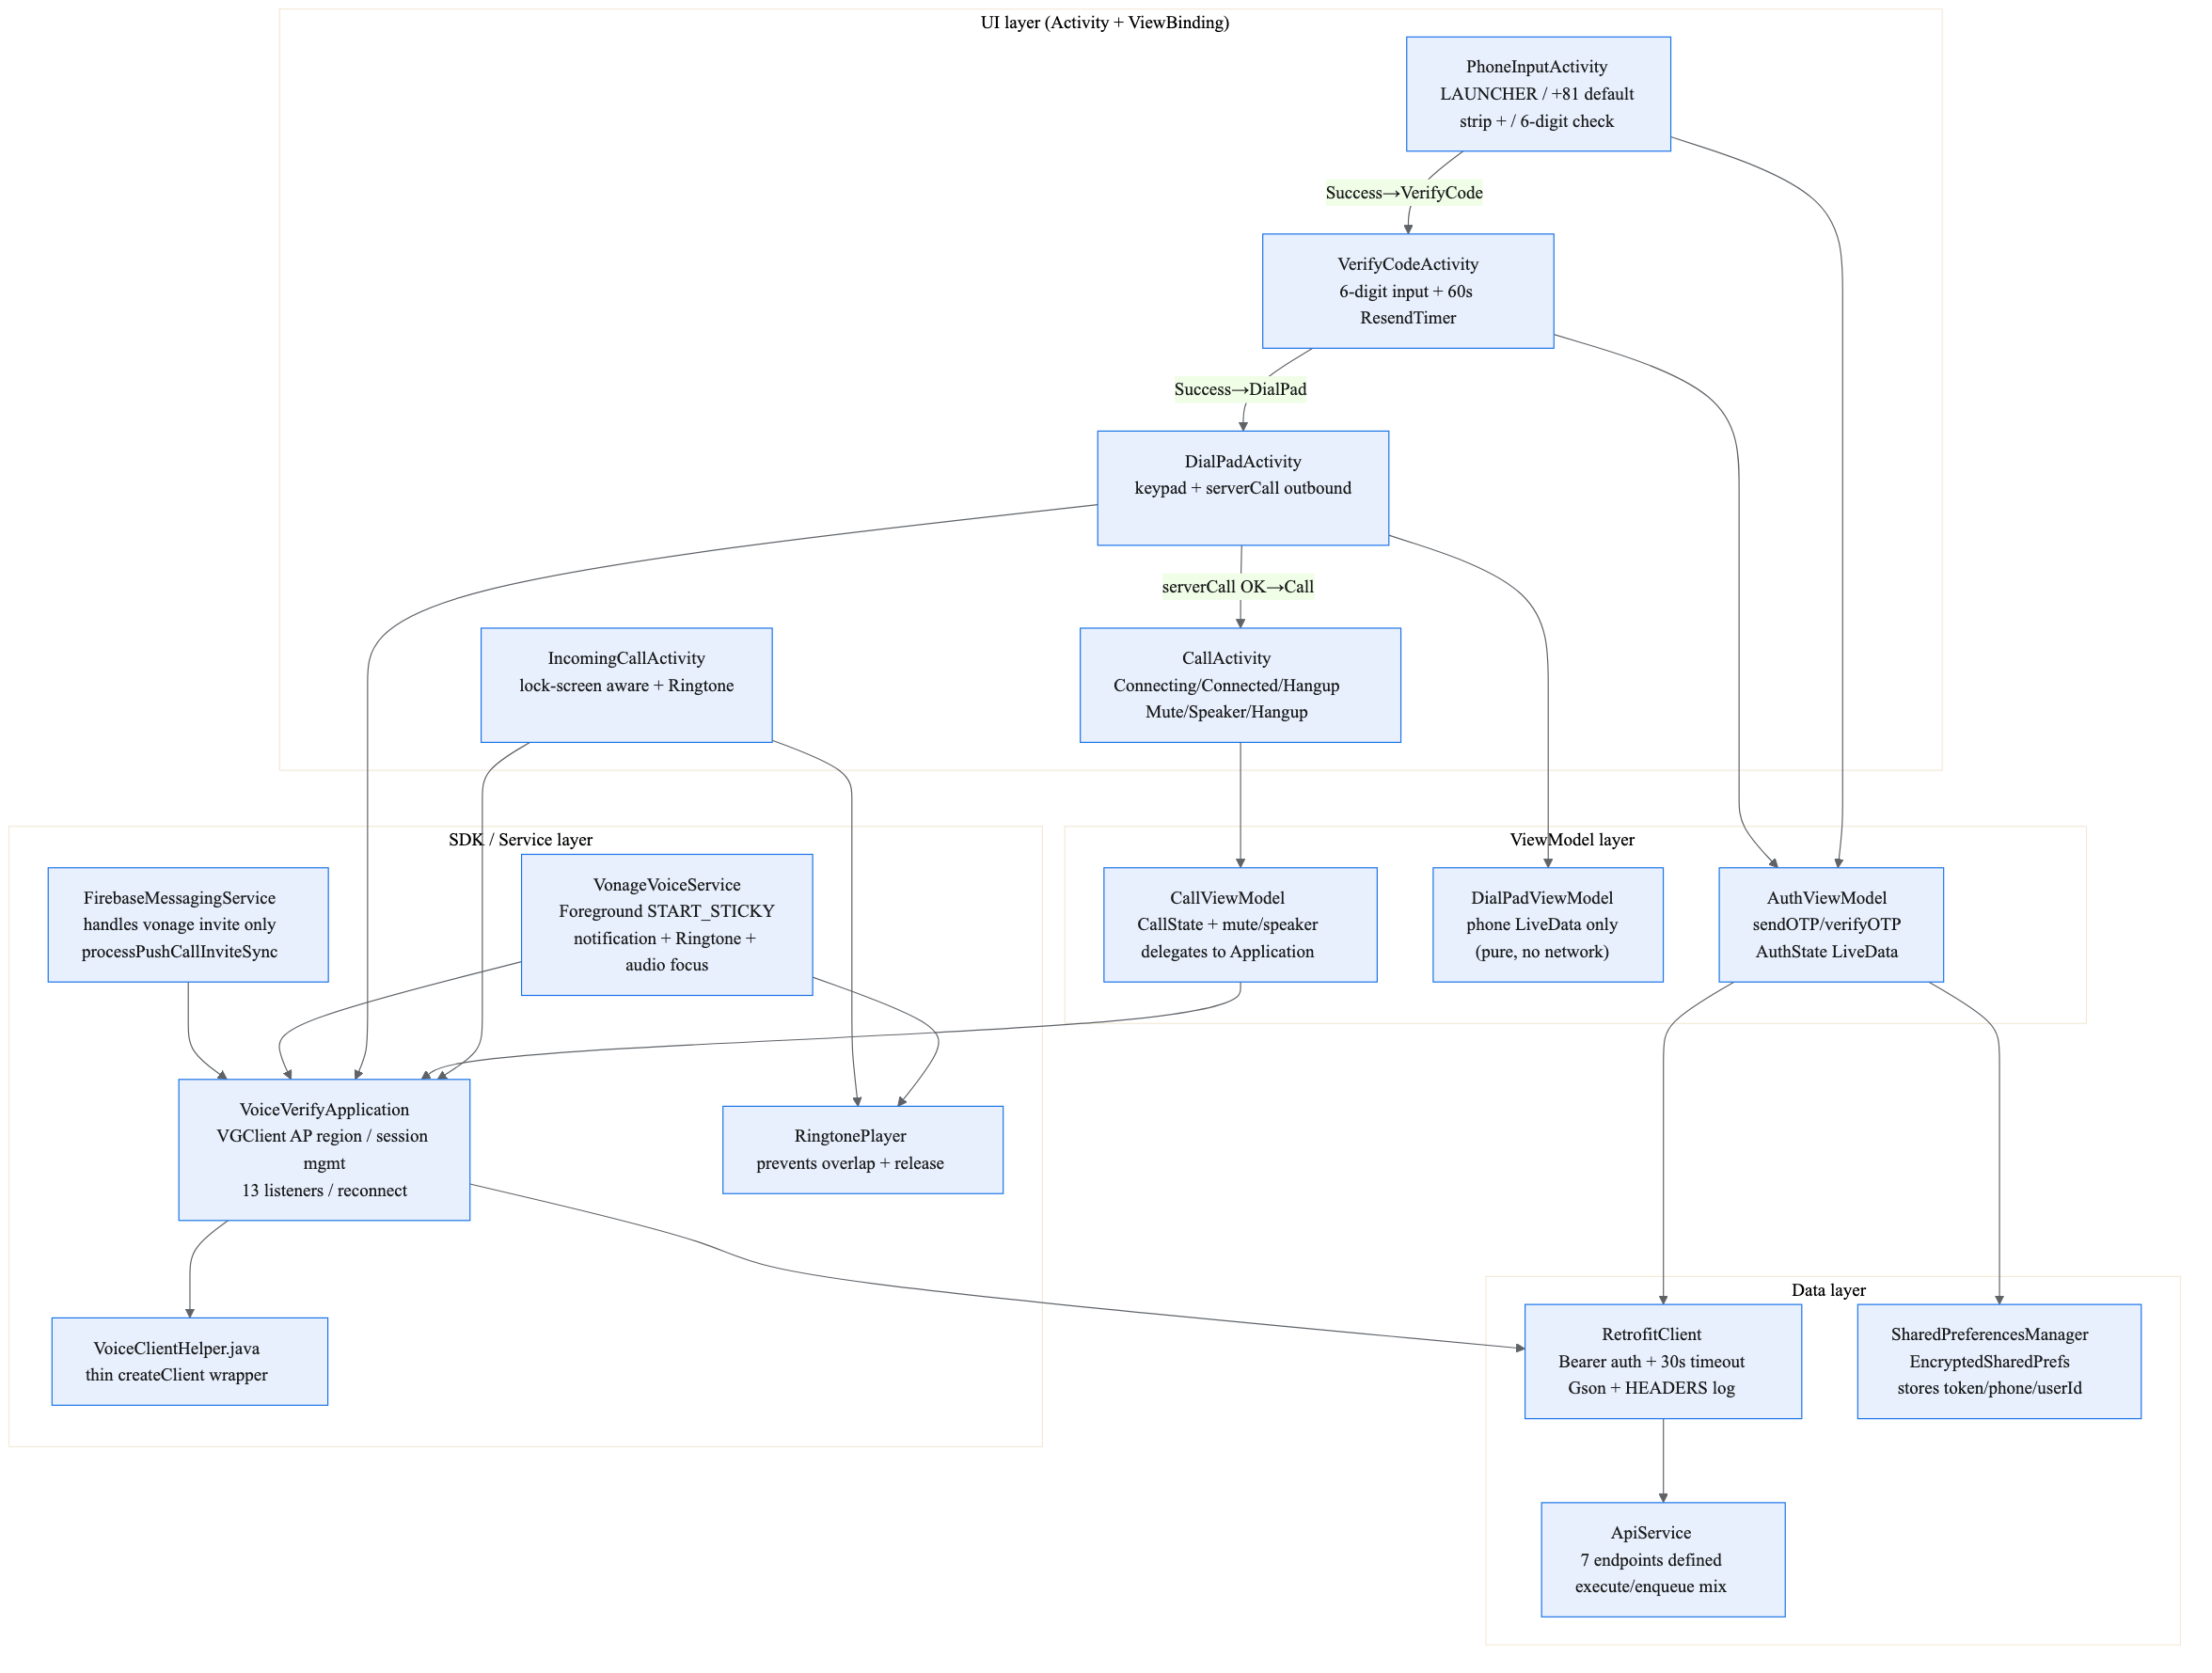
07 | ANDROID
Android App Composition (MVVM + Services)
UI ⇄ ViewModel ⇄ Data ⇄ SDK/Service. Outbound calls go through the Application-owned VoiceClient.
Mermaid: doc/06_android_architecture_en.mmd → 06_android_architecture_en.png (mmdc scale=3)
• AuthViewModel fires Retrofit execute() on Dispatchers.IO (synchronous); the Application uses enqueue(). listUsers / initiateCall are defined but currently unused (SDK serverCall is primary).
• Permission set: INTERNET, RECORD_AUDIO, phoneCall Foreground, POST_NOTIFICATIONS, MODIFY_AUDIO_SETTINGS etc.; AP region is hard-coded; prefs are encrypted.
• VoiceVerifyApplication owns the 13 SDK listeners (call-invite → Foreground service) and session reconnect; clearAllListeners tears them down on re-init.
• Notable dead code: ACTION_MUTE / ACTION_SPEAKER declared but unhandled in onStartCommand; Camera permission is absent.
verify-inapp-mobilevoice-app | backend (VCR / Node 20 / TS) + android-app (Kotlin) | Mermaid PNG embedded with aspect-ratio lock

Slide 10
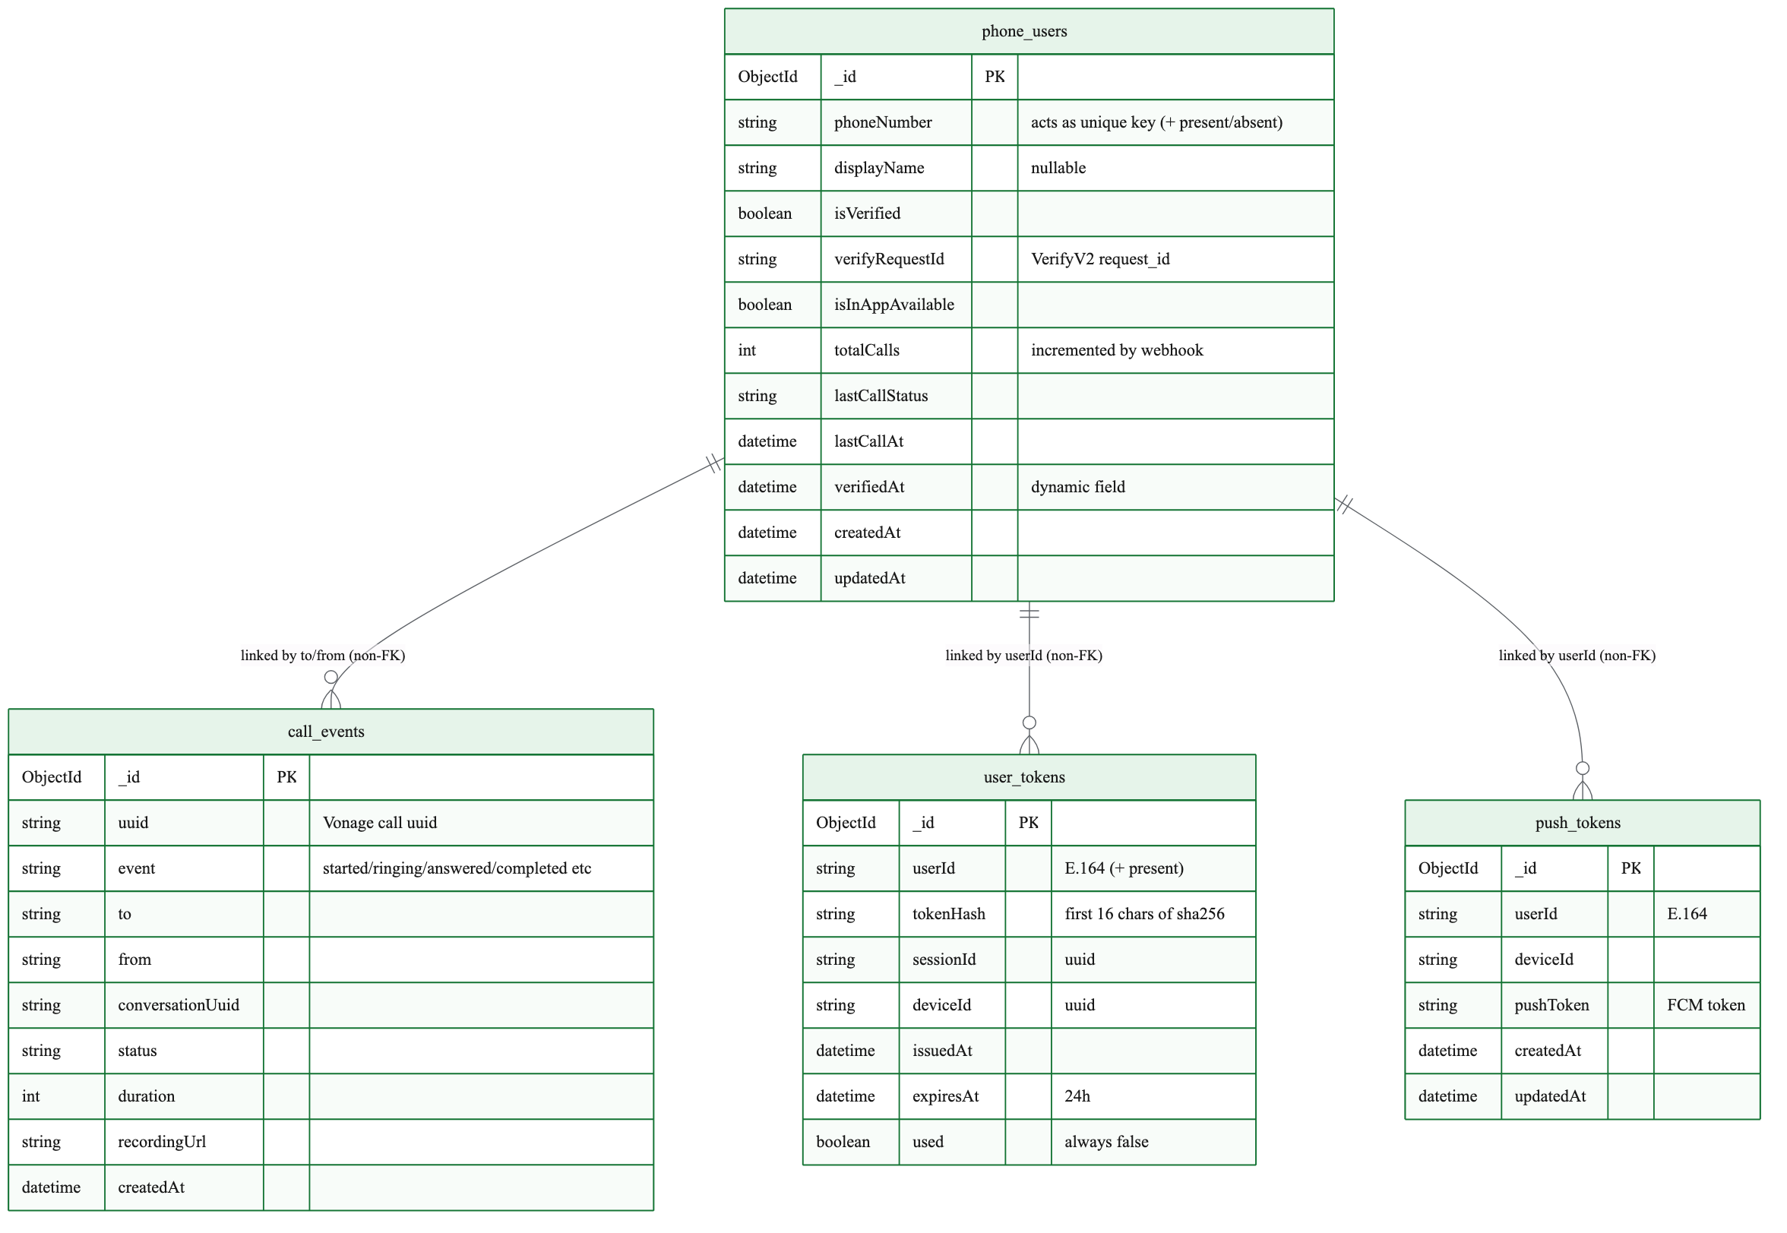
08 | DATA
Data Model (MongoDB — 4 Collections)
No ODM, no index definitions found, and phoneNumber '±'+ inconsistency is a live implementation quirk.
Mermaid: doc/07_data_model_en.mmd → 07_data_model_en.png (mmdc scale=3)
• phone_users is the hub; relations are non-FK, keyed by phone number. Dynamic verifiedAt field; totalCalls starts unset until the first webhook increment.
• user_tokens stores only the token hash and issued/expiry; its 'used' flag is always false today.
• call_events stores every lifecycle event (uuid/event/to/from/conversation/status/duration).
• push_tokens is upsert-or-remove only. Both + and +-less phone numbers exist across collections — see Recommendations.
verify-inapp-mobilevoice-app | backend (VCR / Node 20 / TS) + android-app (Kotlin) | Mermaid PNG embedded with aspect-ratio lock

Slide 11
09 | SECURITY
Security: JWT, Signatures, Rate Limits
Three JWT families + HMAC webhook signing + encrypted prefs. Key handling and number gating are the focus.
Subject | Specification (from code) | TTL / notes
Verify V2 JWT | @vonage/jwt tokenGenerate / aud=api.nexmo.com | 3600 s — Bearer for SMS send & check
InApp Voice JWT | sub=E.164 / ACL-restricted (sessions, conversations, rtc, ...) | 24 h — issued by token & reconnect
Login JWT | Hand-written RS256 (crypto.sign) / aud=voice-ng-vapi / user.id=phone | 1 h — checks private-key PEM + exp
Webhook signature | HMAC-SHA256(secret, timestamp+body), 5-min window, timing-safe | Skipped if no secret / VCR router
Rate limits | In-memory Map keyed by IP (x-forwarded-for / x-real-ip), 60 s sweep | otp / verify / call / token buckets
Operations
• Private key: VONAGE_PRIVATE_KEY (inline) takes priority over VONAGE_PRIVATE_KEY_PATH (file). Neither → throw/500. Losing the key means creating a new Application.
• Number gating: if ALLOWED_PHONE_NUMBER is empty the gate is disabled. '+' normalization is inconsistent between routes (see Recommendations).
Client side
• Device side: EncryptedSharedPreferences (AES-256) and a Retrofit interceptor that attaches 'Authorization: Bearer' automatically.
• Cleartext HTTP is disabled (usesCleartextTraffic=false); local dev relies on Cloudflare/LAN HTTPS and the emulator's 10.0.2.2 alias.
verify-inapp-mobilevoice-app | backend (VCR / Node 20 / TS) + android-app (Kotlin) | Mermaid PNG embedded with aspect-ratio lock

Slide 12
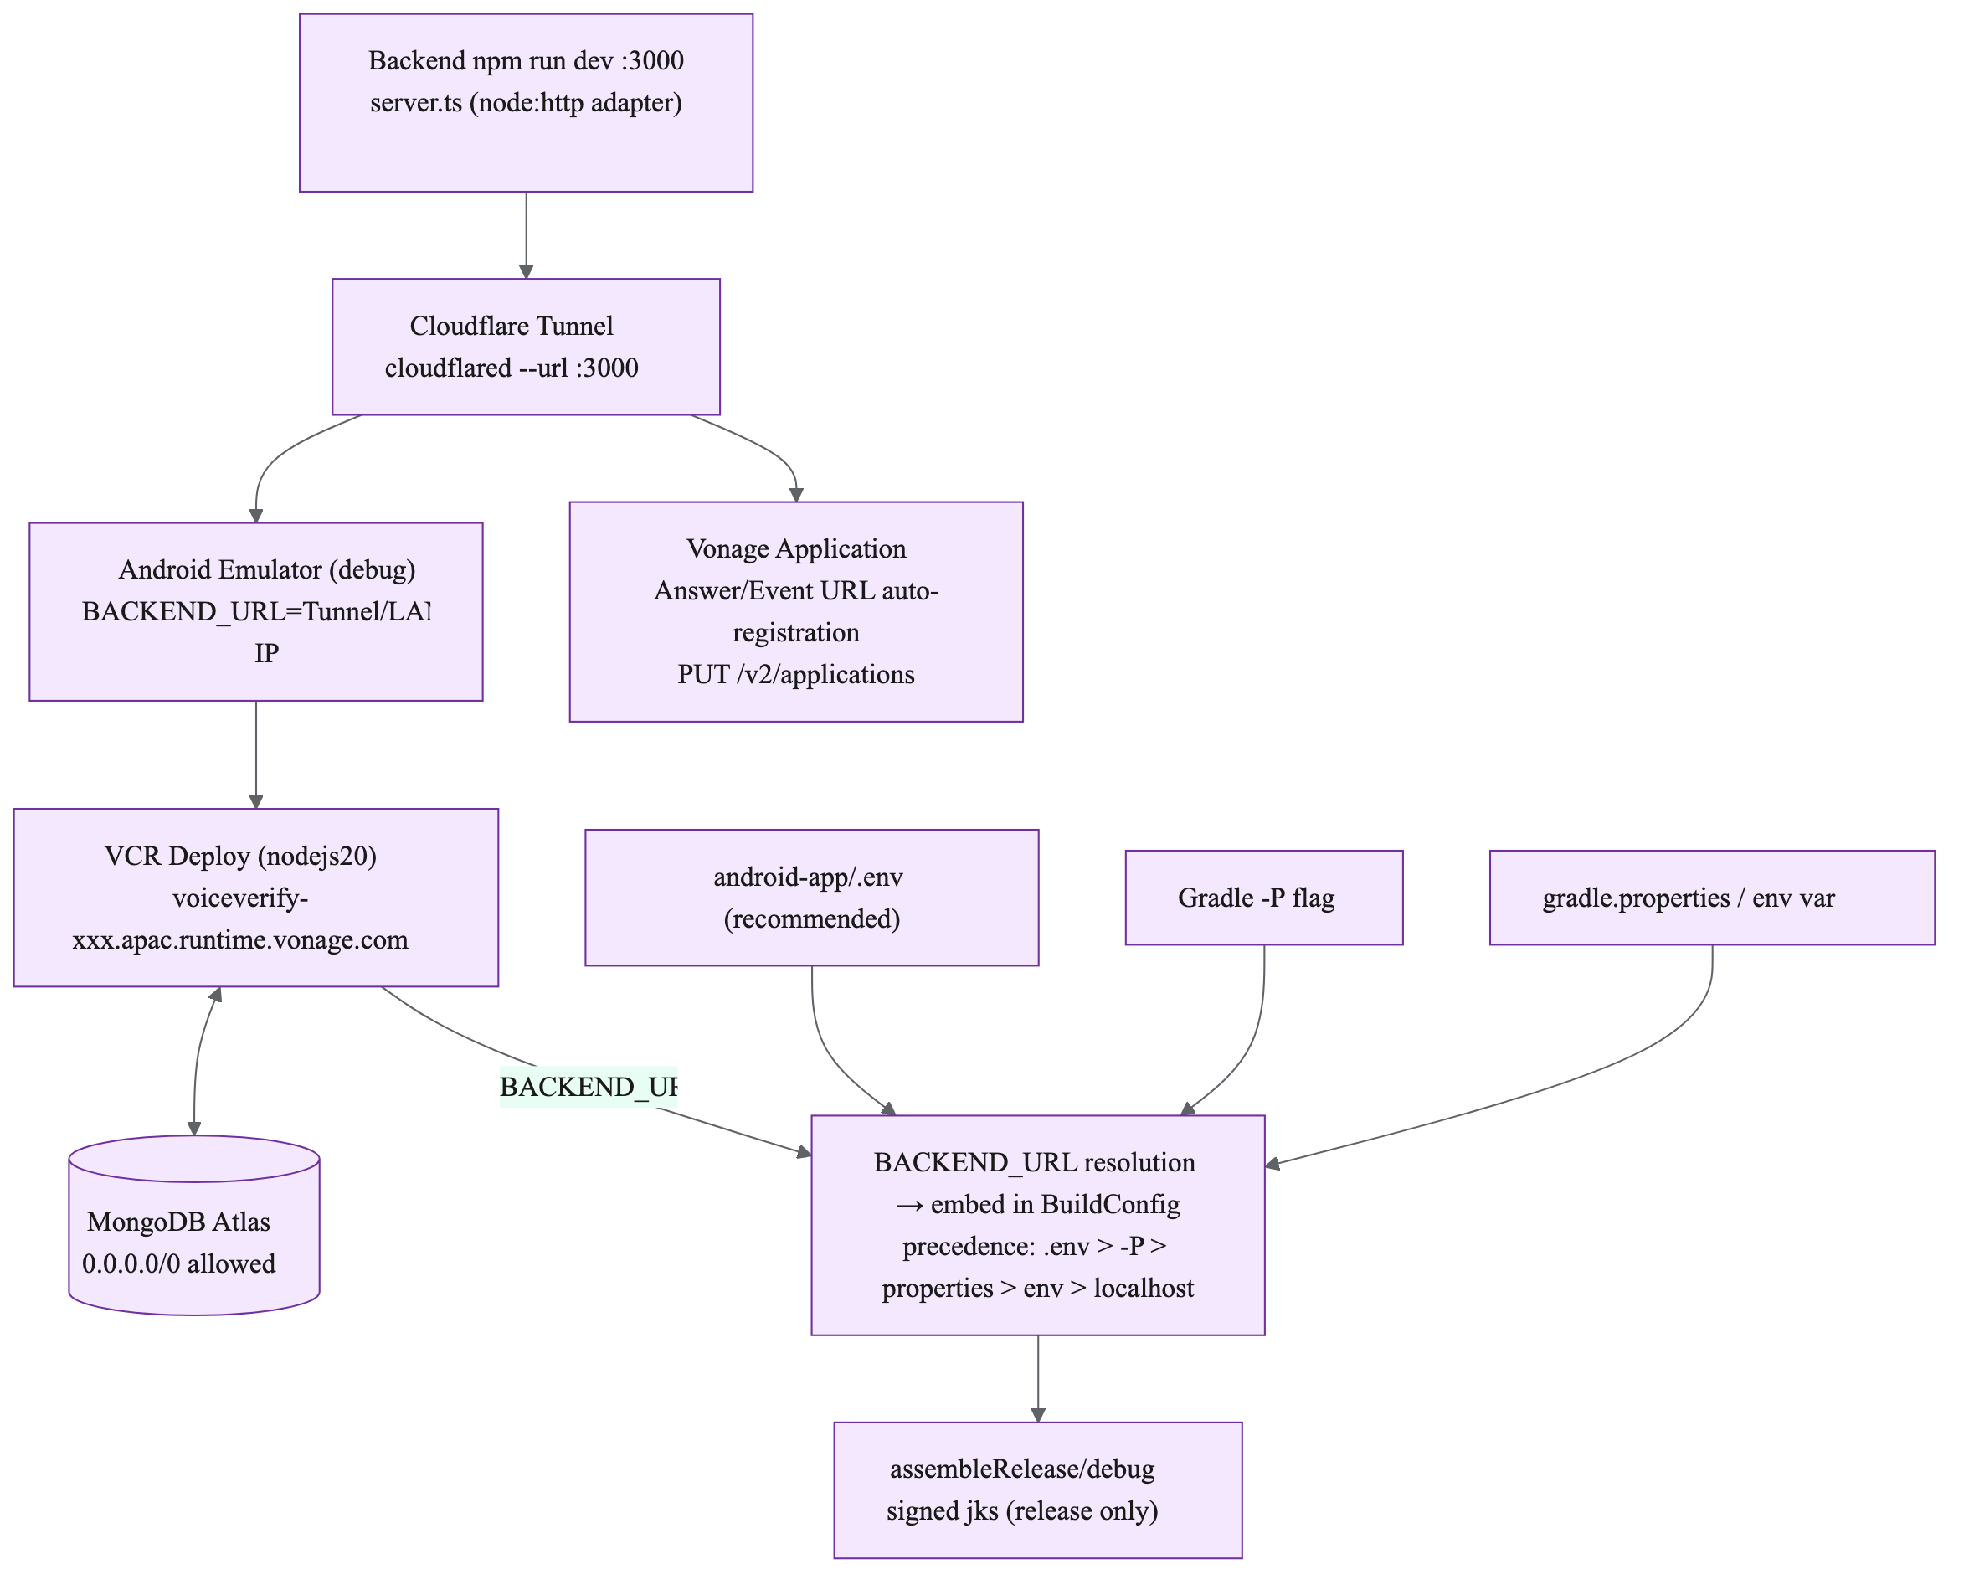
10 | DEPLOY
Deployment & Configuration
VCR (APAC) production + Cloudflare Tunnel verification + 5-stage BACKEND_URL resolution.
Mermaid: doc/08_deployment_en.mmd → 08_deployment_en.png (mmdc scale=3)
• server.ts is a local adapter (node:http) that auto-registers Answer/Event URLs on the Vonage application when APP_DOMAIN is set (Basic auth). It actually listens on VCR_PORT, not PORT.
• Production: npm run build → vcr deploy → register webhooks via `vonage apps:update` or the dashboard.
• BACKEND_URL precedence: .env > -P flag > gradle.properties > environment > localhost:3000; trailing '/' is required.
• Release builds require a keystore; debug builds run unsigned against a tunnel or LAN URL.
verify-inapp-mobilevoice-app | backend (VCR / Node 20 / TS) + android-app (Kotlin) | Mermaid PNG embedded with aspect-ratio lock

Slide 13
11 | WRAP-UP
Conclusions & Recommendations
Solid working design with three load-bearing inconsistencies worth fixing for availability.
Conclusions
• Single handler entry with a clear public/protected boundary; OTP → token → NCCO → webhook responsibilities are cleanly separated (index.ts).
• Two-stage call path (InApp preferred → PSTN fallback) plus presence flags; three inbound paths + Foreground service reduce missed-call risk.
• Stateless VCR handler (pool=1) with upsert-heavy writes; region awareness (AP) throughout.
• Public API summary: send-otp, verify-otp, users, ncco, call, token, register, push-token, reconnect, voice-events + /_/health.
Improvements (priority order)
• 1. (Critical) phoneNumber format: '+' present in token/register flows but absent in send-otp, and verify-otp compares without stripping. Central E.164 helper + unique index on phone_users.
• 2. Clean up server.ts: configureNCCOUrl builds a JWT it never uses, ignores PORT (uses VCR_PORT), and adds GET /api/debug — remove dual-routing drift from index.ts.
• 3. Follow-ups: real unique indexes, persist reconnect tokens, use user_tokens.used, prune unused env vars and the unhandled ACTION_MUTE/SPEAKER.
• 4. Maintenance: doc/*.mmd is the single source of truth — re-render PNGs and re-embed (every image is aspect-locked, so replacement cannot distort).
verify-inapp-mobilevoice-app | backend (VCR / Node 20 / TS) + android-app (Kotlin) | Mermaid PNG embedded with aspect-ratio lock

