Slide 1
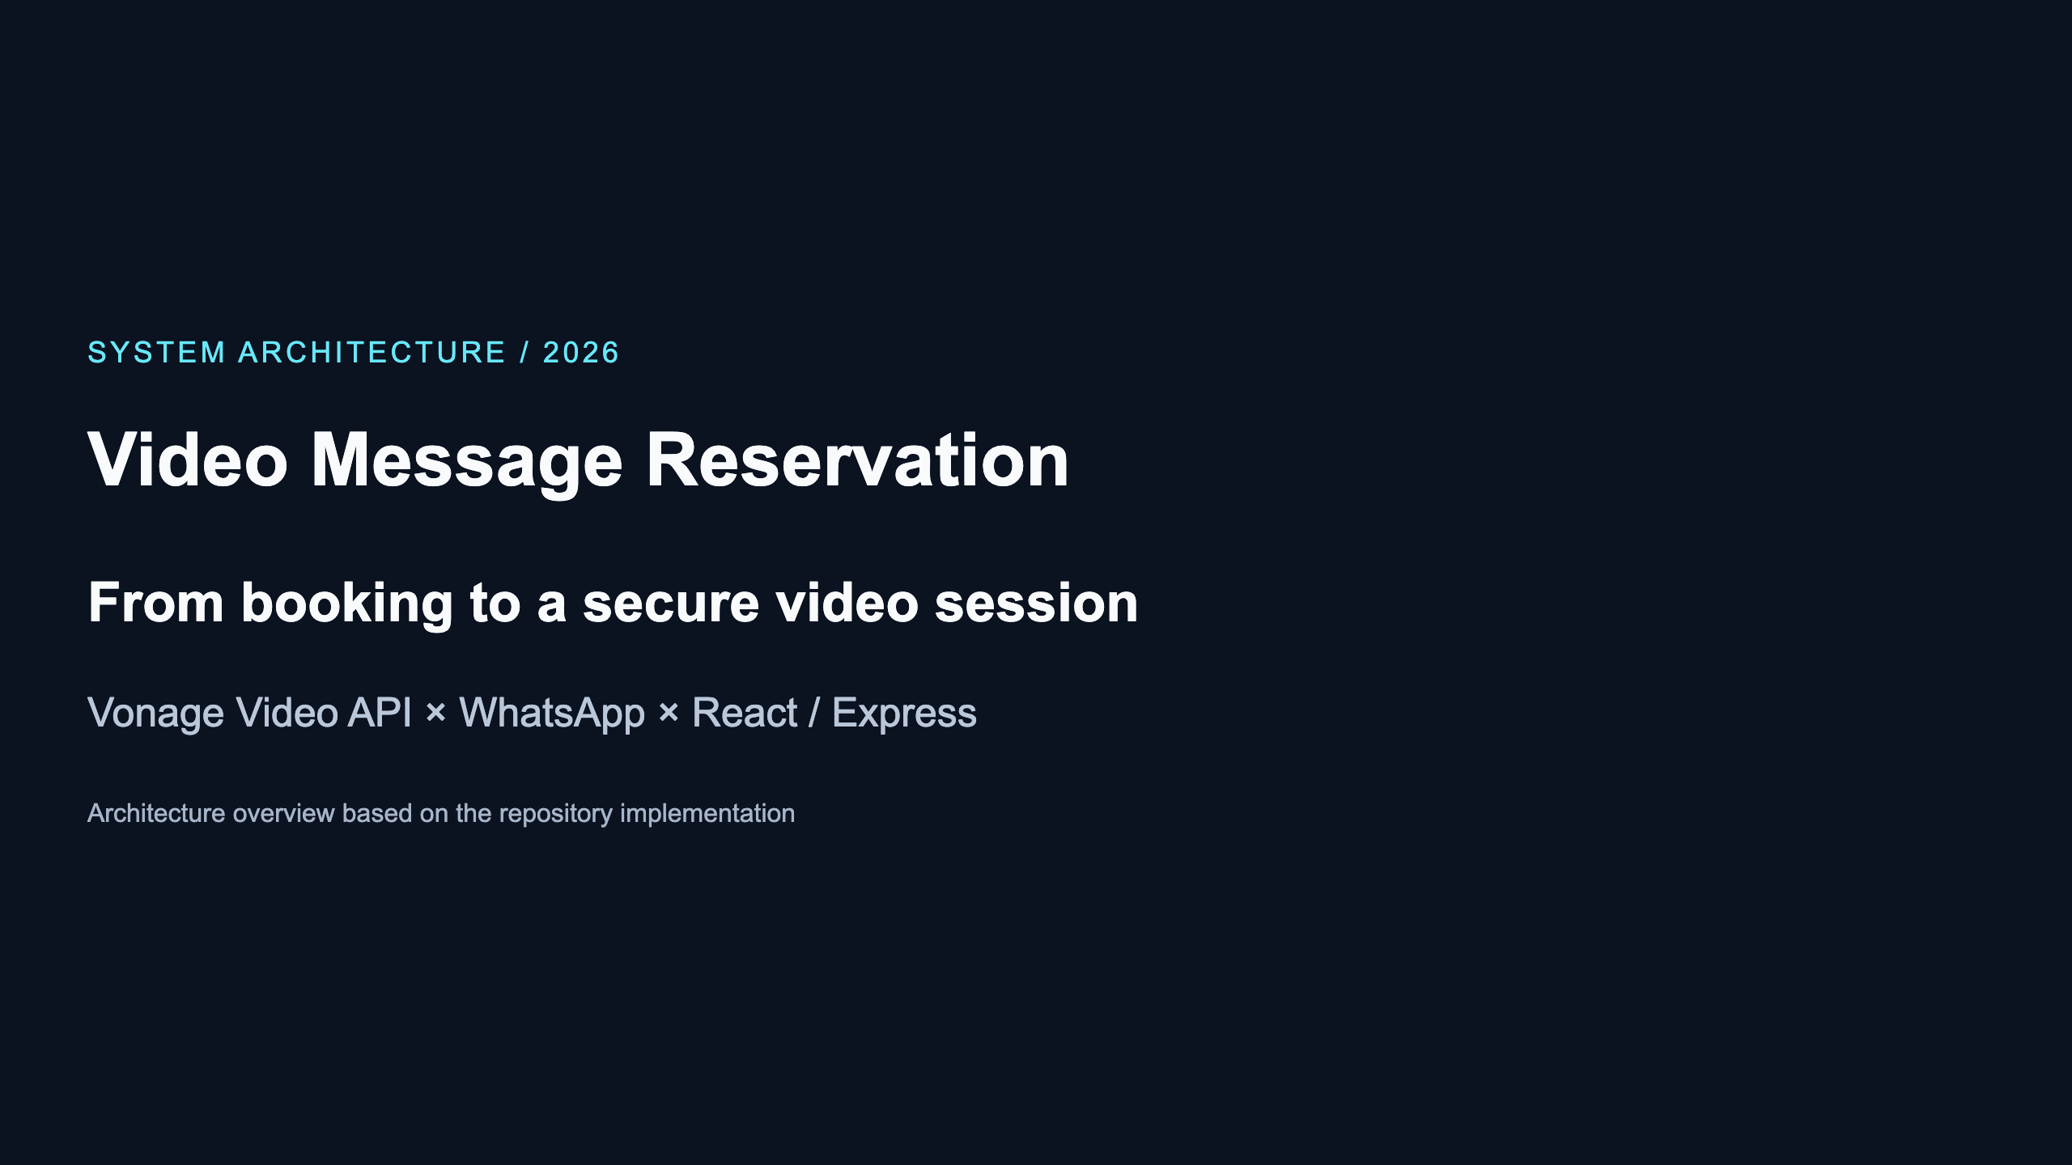

Slide 2
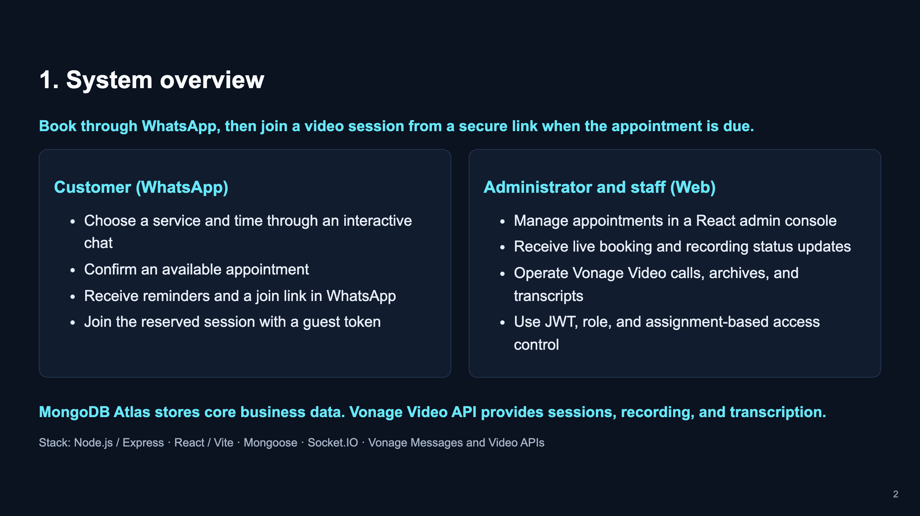

Slide 3
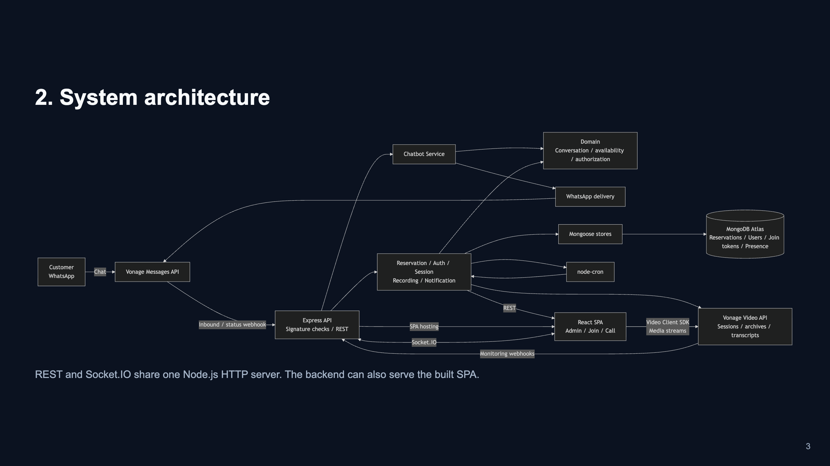
Notes:
Mermaid source: ./slide-assets/architecture.mmd

Slide 4
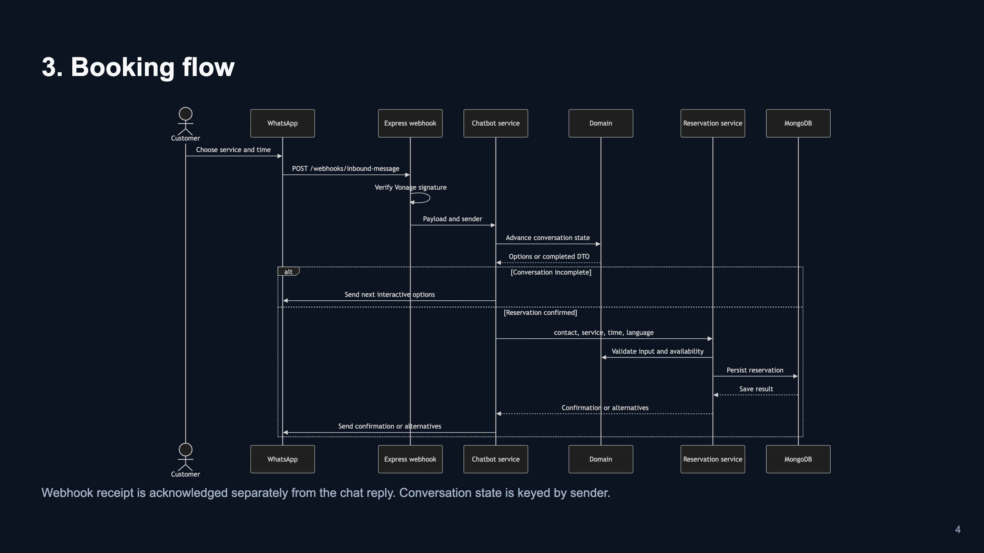
Notes:
Mermaid source: ./slide-assets/reservation-sequence.mmd

Slide 5
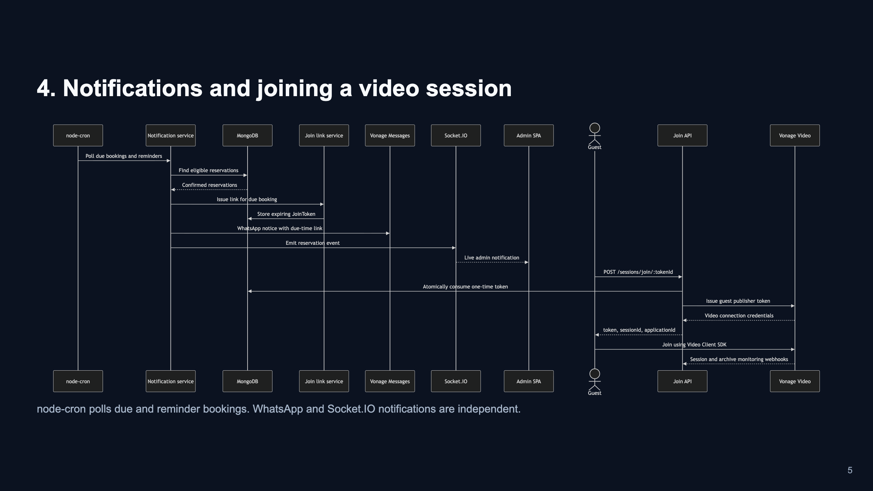
Notes:
Mermaid source: ./slide-assets/notification-session-sequence.mmd

Slide 6
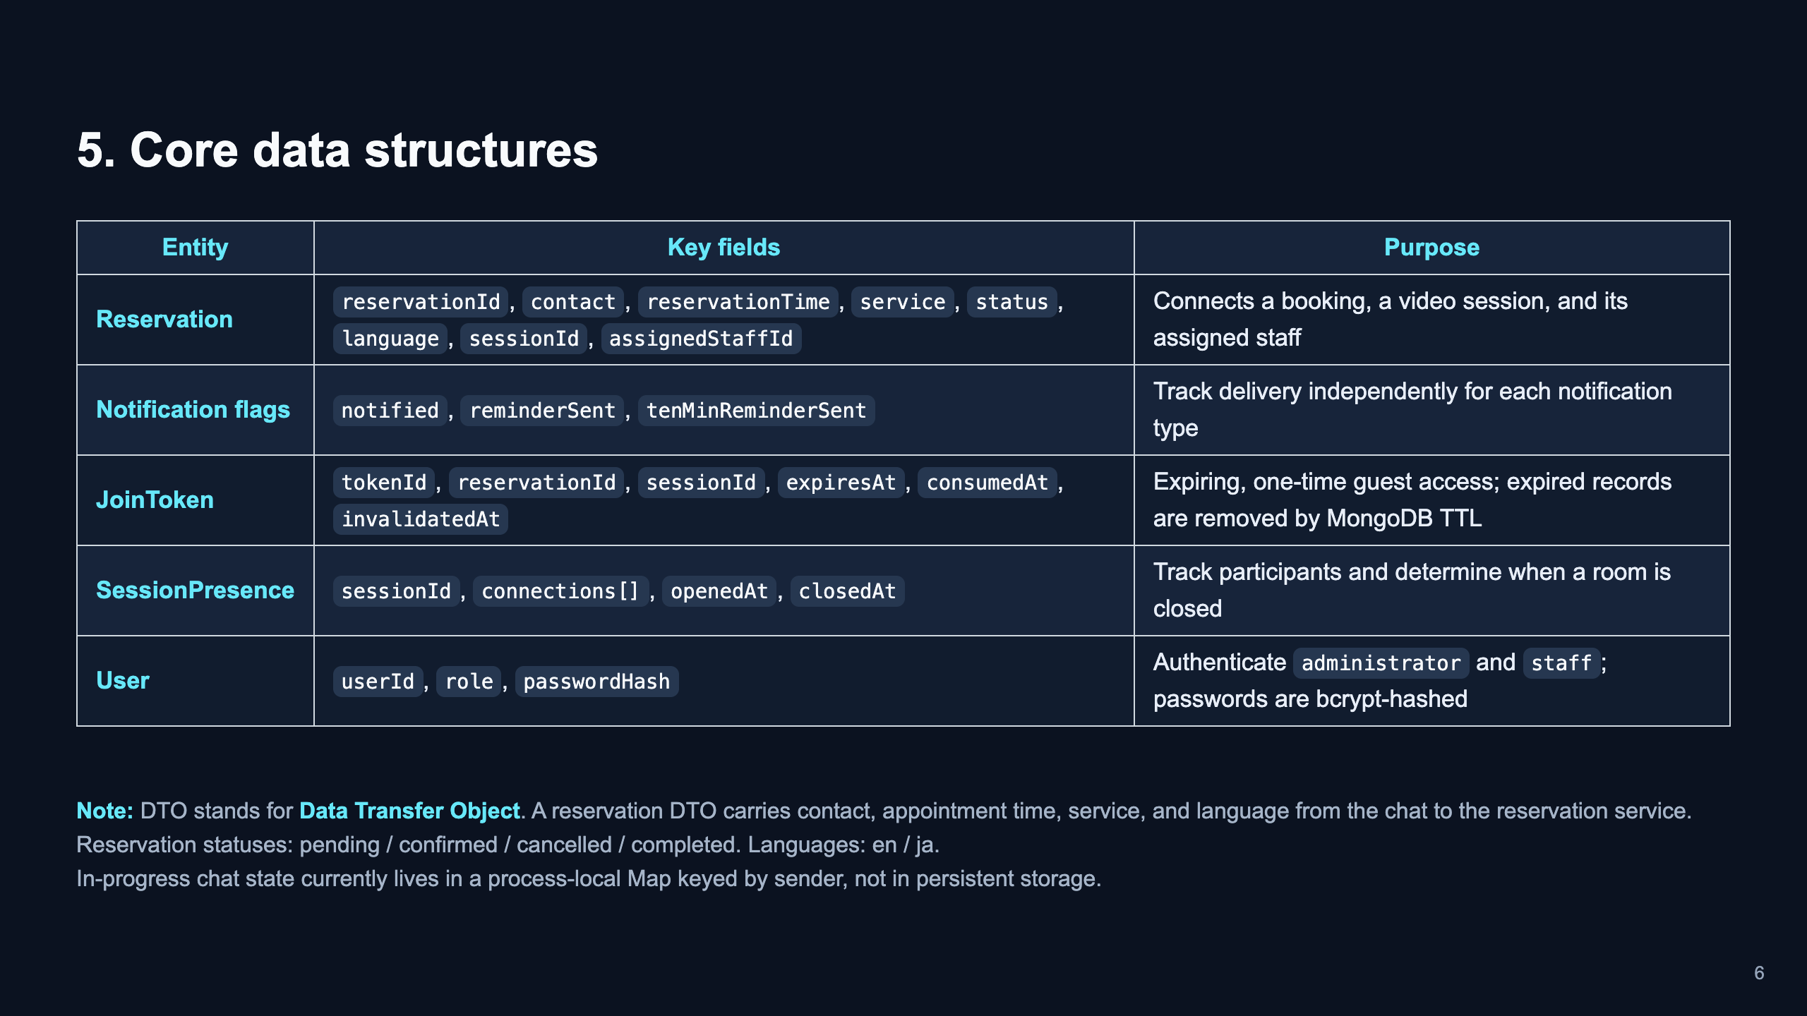

Slide 7
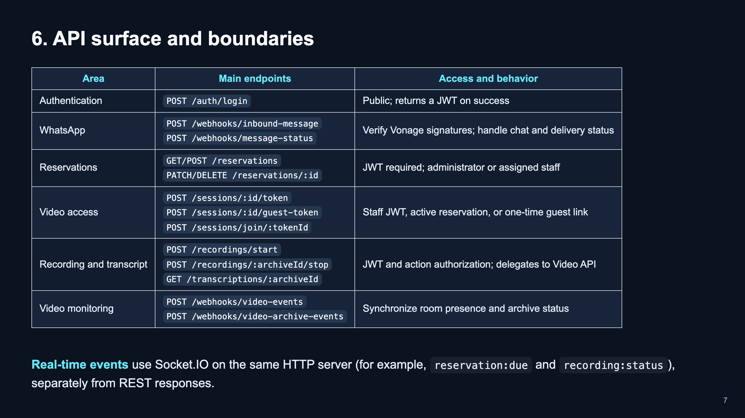

Slide 8
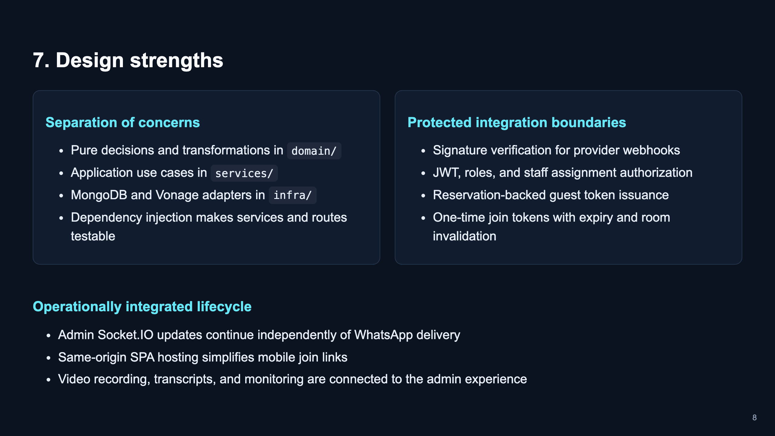

Slide 9
