Slide 1

DTSA5509 Supervised Learning Final Project: Sunglasses Image Classifier Matt Schurmann masc3796@colorado.edu Nov 23 2023
<number>

Slide 2
Data Set and Problem Description (1)
Data Set: Mitchell,Tom. (1999). CMU Face Images. UCI Machine Learning Repository. https://doi.org/10.24432/C5JC79.
Type of Learning: Supervised Learning
Type of Problem: Image Classification
Python Libraries Used:
Scikit-learn matplotlib seaborn pandas numpy
<number>

Slide 3



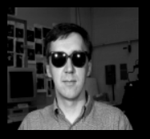
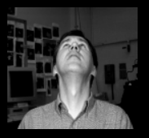
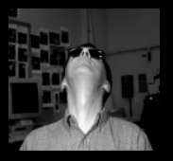
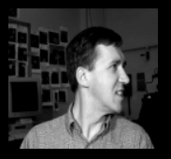
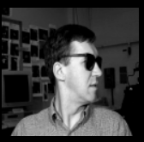
Data Set and Problem Description (2)
Number of Images: 640
File Format: Portable Greyscale Map (.pgm) Color Palette: Greyscale
Dimensions: 3 copies of each image, (120x128), (60x64), (30x32)
Modalities: Unique Faces – 20 different people Direction - Left, Right, Up, Straight Mood - Happy, Sad, Angry, Neutral Sunglasses - On, Off
<number>

Slide 4
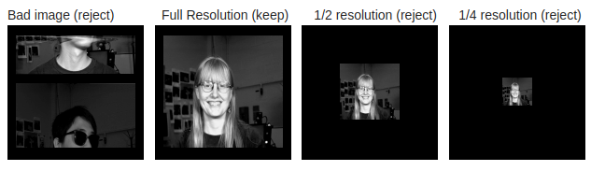
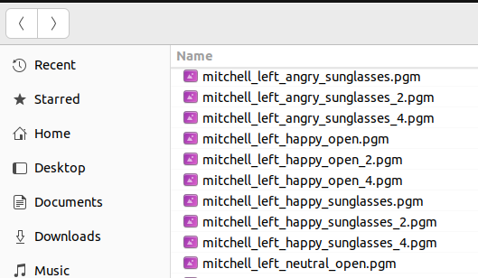
Data Cleaning and Preparation (1)
Training data labels are encoded in the file names of each image and not in any tabular format.
Mis-captured images need to be removed.
Each image is duplicated 3 times in different resolutions. I have selected only the highest resolution versions for this project.
Some label classes are not binary (e.g. more than 2 labels). For example, "mood" can take values (happy, sad, angry, neutral). These will be split into binary labels (mood_happy, mood_sad, mood_angry, mood_neutral) which have values (1 or 0).
<number>

Slide 5
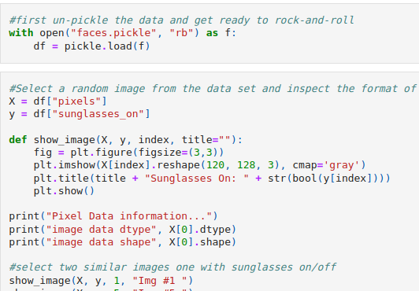
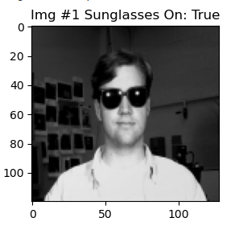
Data Cleaning and Preparation (2)
<number>

Slide 6
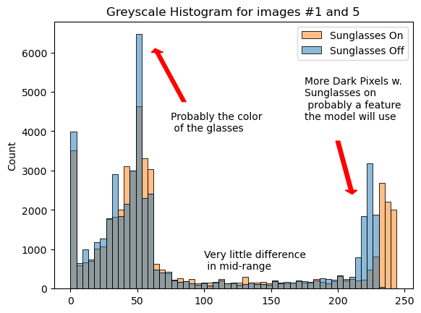
Exploratory Data Analysis (EDA)
Features are not easily separable for image data .
Here we attempt to look for possible differences based on luminosity.
Sunglasses are dark…
<number>

Slide 7
Modeling and Training (1)
Multiple Models Evaluated
K-Nearest Neighbors (KNN)
Support Vector Machine (SVM)
Gaussian Naive Bayes (NB) – not covered in the course
Random Forest Ensemble (RF)
Manual Tuning to determine parameter ranges
Test/train split of 50% to ensure truly unseen data is tested
Automated Tuning using Grid-Search, with K-Folds Cross-Validation
Scoring using Accuracy (data set is balanced)
Confusion Matrix to identify FP and FN rates if asymmetrical
Methods to improve robustness
<number>

Slide 8
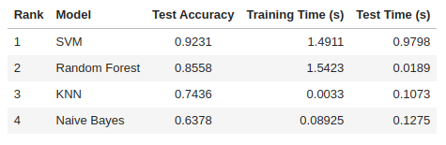
Modeling and Training (2)
<number>

Slide 9
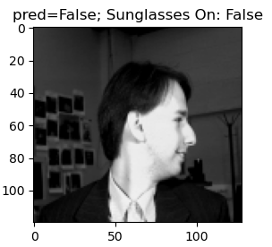
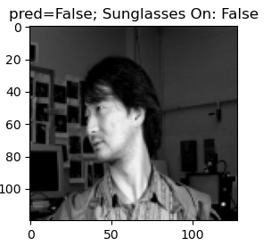
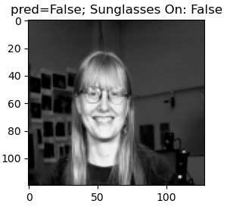
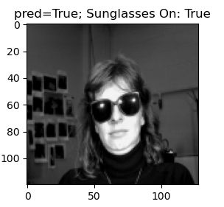
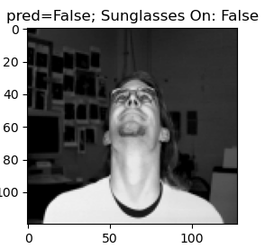
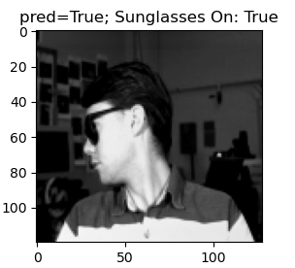
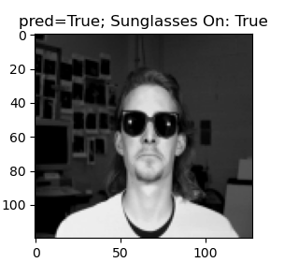
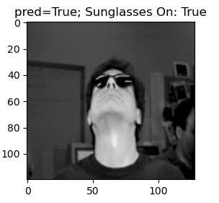
Results of SVM Model (Test Data)
92% Test Accuracy overall
<number>

Slide 10
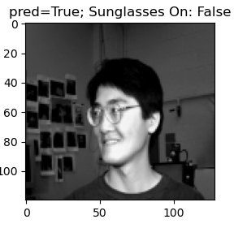
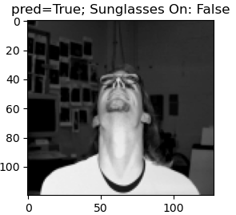
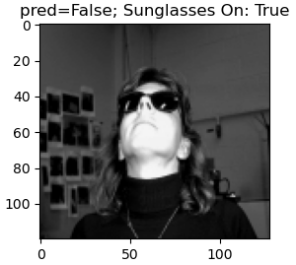
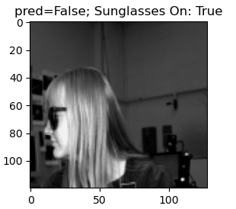
Examining False Positives/Negatives
False Positives
False Negatives
Several examples with reflections in glasses, and non-forward head position
Several false-positives wearing glasses (but not sunglasses)
<number>

Slide 11
Conclusions and Discussion
Learning Outcomes
Hands-on, real-World use of Sklearn classification models
Challenges of image classification (high dimensionality data)
Challenges of data labeling and feature identification
Suggestions for Improvement
More efficient models than SVM, trade-off with accuracy if needed
Use a larger training data set
Investigate lower resolution images to improve speed
Perform a more exhaustive parameter grid-search on a higher performance computer
Include color photographs - presumably color would differentiate the sunglasses more vs. dark spots in grey-scale images.
<number>

Slide 12
Thank You!
<number>

