Slide 1
BOSTON PROPERTY ASSESSMENT
ALY 6040 DATA MINING
GROUP 6 : NEIL, SAGAR, TEJAL
INSTRUCTOR- PROF. JUSTIN GROSZ

Slide 2
INDEX
INTRODUCTION
EXPLORATORY DATA ANALYSIS
FINDINGS
RECOMMENDATION

Slide 3
INTRODUCTION
Residential and commercial properties are assessed in Boston.
According to the Boston Globe, the competitive Boston housing market drives increasing expenses
Long-term pandemic demands larger homes.
Property managers and brokers can only show properties to a limited number of individuals.

Slide 4
OUR KEY FOCUS
To provide easier home options for people.
What features to focus on while determining pricing of the property
What influences the property rate

Slide 5
EDA
Examined the Data structure and shape
Removed the Null values
Removed the Outlier
Checked Variance influence factor
Perform the Label encoding
Conversion of data in appropriate type
We undergone exploration of data and focused on key features.
Our EDA included – cleaning missing values, checking for outliers, checking unique values and finding if there was any correlation within the dataset.

Slide 6
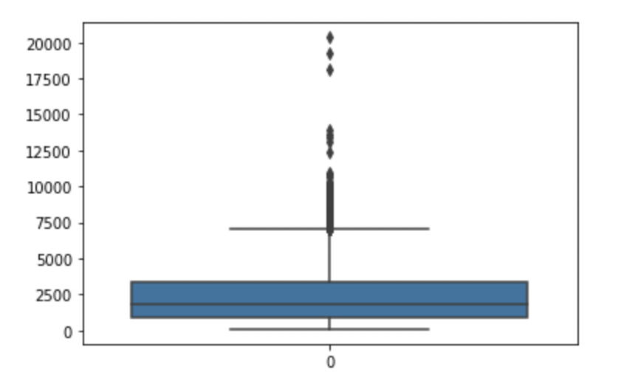
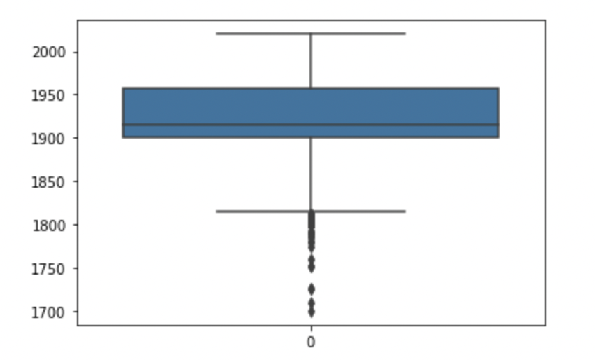
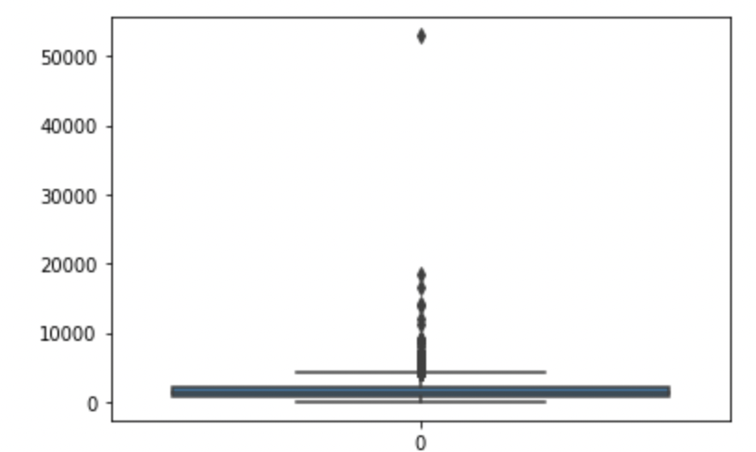
CHECKING FOR OUTLIERS AND ELIMINATING THEM
TOTAL_VALUE
Year Built
Gross Area

Slide 7
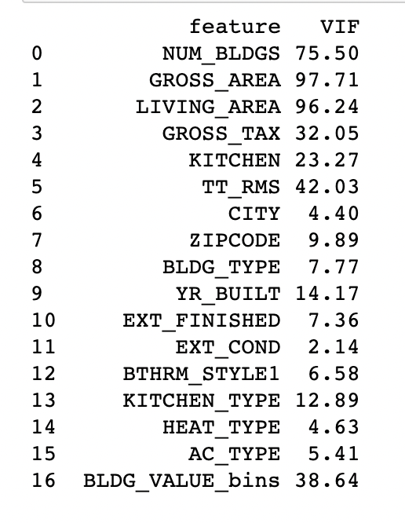
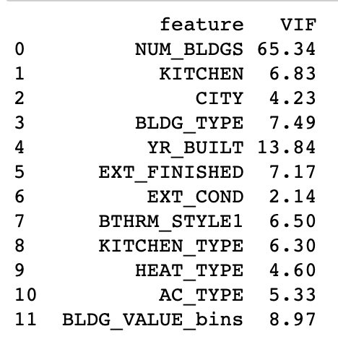
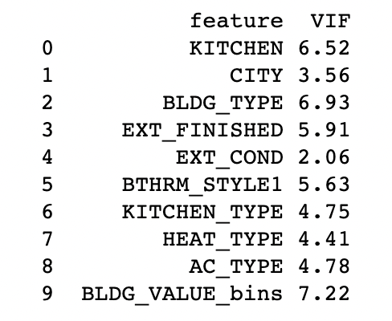
SELECTING IMPORTANT FEATURES BY AVOIDING MULTICOLLINEARITY USING RECERSIVE METHOD VIF

Slide 8
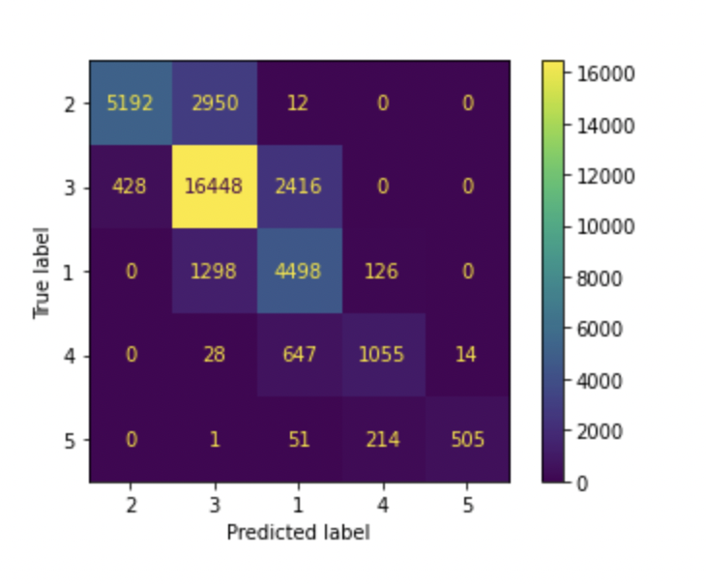
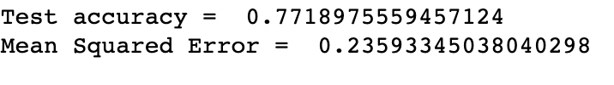
LINEAR REGRESSION MODEL
Essential variable:
KITCHEN_TYPE
AC_TYPE
HEAT_TYPE.
Have the highest co-efficient values

Slide 9
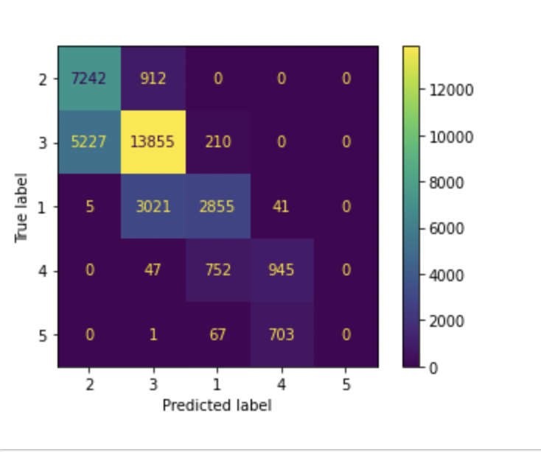
RANDOM FOREST
Test accuracy- 69.23%
Essential features:
BLDG_VALUE_bins,
CITY, YEAR_BUILT,
KITCHEN_TYPE

Slide 10
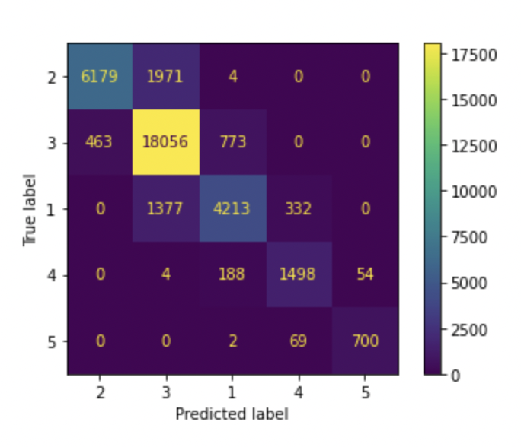
LIGHTGBM REGRESSION
Test accuracy = 86.49%
Mean Squared Error = 0.1467
Essential features:
CITY
KITCHEN TYPE
YEAR BUILT

Slide 11
Model Regularization - Ridge and lasso
Ridge - Time taken to fit the model is 0.70s with accuracy of 78.6%
Lasso – Time taken to fit the model is 0.12s with accuracy of 78.5%
Important features – Kitchen Type, City and Building Value

Slide 12
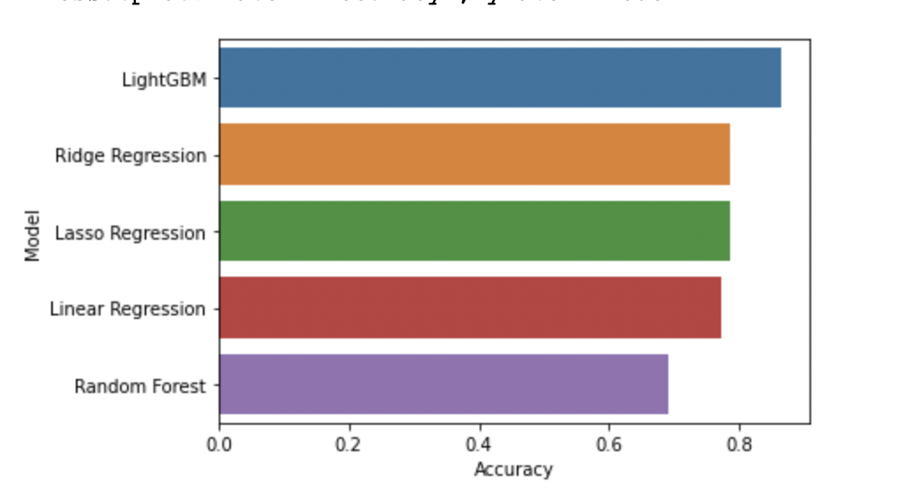
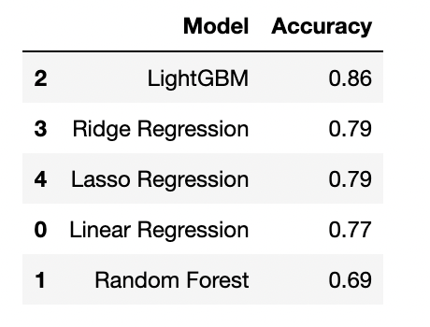
Model comparison
Light Gradient Boost Machine (GBM) performed the best.

Slide 13
WHAT INFLUENCES THE PROPERTY RATES?
The property rates are increased by Kitchen Type, Year Built and City.

Slide 14
Recommendations
Prioritize obtaining the ideal kitchen type. Avoid lavish, large kitchen as they can increase the price significantly.
People with limited budget they should avoid resident property in cities such as Boston, and its neighboring Cities since they are highly priced instead, they can choose for those are remote.

Slide 15
References
40 Techniques Used by Data Scientists. (2020). Data Science Central. https://www.datasciencecentral.com/profiles/blogs/40-techniques-used-by-data-scientists
Bhattacharyya, S. (2020, September 28). Ridge and Lasso Regression: L1 and L2 Regularization. Medium. https://towardsdatascience.com/ridge-and-lasso-regression-a-complete-guide-with-python-scikit-learn-e20e34bcbf0b
Brendel, C. (2021, December 14). Quickly Compare Multiple Models - Towards Data Science. Medium. https://towardsdatascience.com/quickly-test-multiple-models-a98477476f0
Brownlee, J. (2021, April 27). How to Develop a Light Gradient Boosted Machine (LightGBM) Ensemble. Machine Learning Mastery. https://machinelearningmastery.com/light-gradient-boosted-machine-lightgbm-ensemble/

