Slide 1


Data Management
2024/2025
NoSQL Project
ability to compare different technologies
Group:
Masciotta Bruno 1989718
Campanella Edoardo 1984925
Submitted to:
Roberto Maria Delfino

Slide 2
Introduction
About Dataset
Goal of the project

Slide 3

About Dataset
Description
This dataset is designed to help data scientists and machine learning enthusiasts develop fraud detection models. It contains 21 features capturing various aspects of financial transactions.
Use Cases
Fraud detection model training
Anomaly detection in financial transactions
Risk scoring system for banks and fintech companies
Reference
https://www.kaggle.com/fraud-detection-transactions
Notes:
It contains realistic synthetic transaction data, including user information, transaction types, risk scores, and more how we can see…

Slide 4
Dataset Structure
Transaction_ID -- Unique identifier for each transaction (e.g., TXN_33553)
User_ID -- Unique identifier for the user (e.g., USER_1834)
Transaction_Amount -- Amount of money involved in the transaction (e.g., 39.79)
Transaction_Type -- Type of transaction (e.g., POS, Online, ATM)
Timestamp -- Date and time of the transaction (e.g., 2023-08-14 19:30:00)
Account_Balance -- User's account balance before the transaction (e.g., 93213.17)
Device_Type -- Geographical location where the transaction occurred (e.g., Sydney)
Merchant_Category -- Category of the merchant (e.g., Travel, Retail)
IP_Address_Flag -- Whether the IP address was flagged as suspicious (0 or 1)
Previous_Fraudulent_Activity -- Number of past fraudulent activities by the user (e.g., 0)
Daily_Transaction_Count -- Number of transactions made by the user that day (e.g., 7)
Avg_Transaction_Amount_7d -- User's average transaction amount in the past 7 days (e.g., 437.63)
Failed_Transaction_Count_7d -- Count of failed transactions in the past 7 days (e.g., 3)
Card_Type -- Type of payment card used (e.g., Amex, Visa)
Card_Age -- Age of the card in months (e.g., 65)
Transaction_Distance -- Distance between the user's usual location and transaction location(e.g.,83.17 km)
Authentication_Method -- How the user authenticated (e.g., Biometric, PIN)
Risk_Score -- Fraud risk score computed for the transaction (e.g., 0.8494)
Is_Weekend -- Whether the transaction occurred on a weekend (0 = Weekday, 1 = Weekend)
Fraud_Label -- Target variable (0 = Not Fraud, 1 = Fraud)

Slide 5


Goal of the project
Objective
Compare relational and NoSQL database systems to analyze their strengths and weaknesses in handling a dataset.
Key goals
Select tools
  Relational DBMS (MySQL)
  NoSQL tool (Neo4j)
Analyze the dataset
  Perform analysis on both systems
  Focus on efficiency and query performance
Compare results
  Pros and cons of relational DBMS
  Pros and cons of NoSQL

Slide 6
MySQL approach
Normalization and ER schema
Data loading process
Query analysis
Performance metrics

Slide 7


Normalization and ER schema
What is normalization?
Normalization is a database design technique that:
Reduces data duplication
Improves query efficiency
Ensures consistency in the database
Why is it important?
1.1 without normalization 1.2 with normalization
Without normalization repeating «mobile», «NYC» and «Grocery» for every transaction. Instead with normalization we move repeated values into separate tables, and this made it much cleaner, less duplication, faster queries and easier updates.

Slide 8
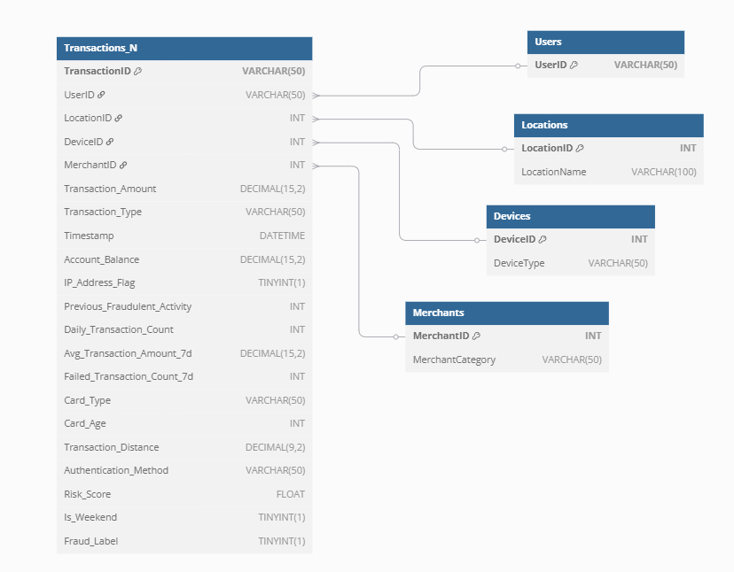
ER Schema

Slide 9
Data loading process
Steps to load data
Step 1: Load raw data
  Use Python and Pandas to read the CSV file
  Insert data into the Transactions table using SQL queries
Step 2: Populate normalized tables
Step 3: Link data
  Populate transactions_N table by linking foreign keys
Code reference
load_data.py
insert_data.sql
Notes:
Importing raw data from external sources into the database.
Goal: prepare the dataset for analysis by organizing it into normalized tables.

Slide 10
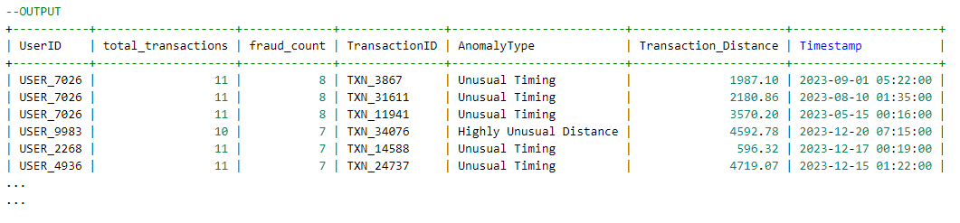
Query analysis
Suspicious users and high-risk transactions
Analyze suspicious users and their high-risk transactions based on:
Unusual timing: transactions occurring between 12 AM and 6 AM
Unusual distance: transactions with distances significantly higher than the user’s average.
Query & Output
https://colab/query-output
1.3 Output query

Slide 11
Query analysis
Key findings
Suspicious users
  Users like USER_7026 and USER_9983 have high fraud_count values (8 and 7) and are involved in multiple flagged transactions.
  These users are highly suspicious and should be prioritized for investigation.
High-risk transaction patterns
  Unusual timing – late night transactions (12 AM – 6 AM) are strong indicators of fraud.
  Unusual distance – geographic anomalies often involve large deviations from the user’s typical behavior

Slide 12
Performance metrics
Query performance optimization: before and after indexing
Analyze the performance of a query to identify the top 10 users with the highest transaction counts.
Compare query execution metrics before and after adding index.
Initial query performance
  Execution time: 175 ms
  Rows scanned: 50 000 rows
  Temporary table usage: high
  Cost: high cost due to full table scanning
Improved query performance
  Execution time: reduced (69% improvement)
  Rows scanned: still 50 000
  Temporary table usage: eliminated
  Cost: significantly reduced due to index usage

Slide 13
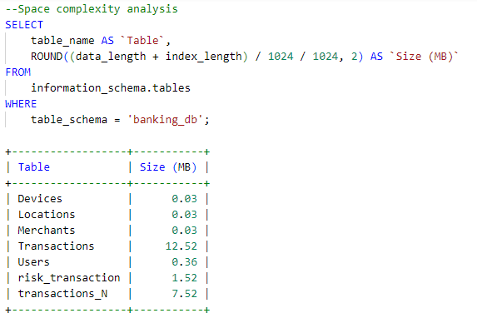
Performance metrics
Resource usage and space complexity
Analyze resource usage and space complexity of the query and database tables.

Slide 14
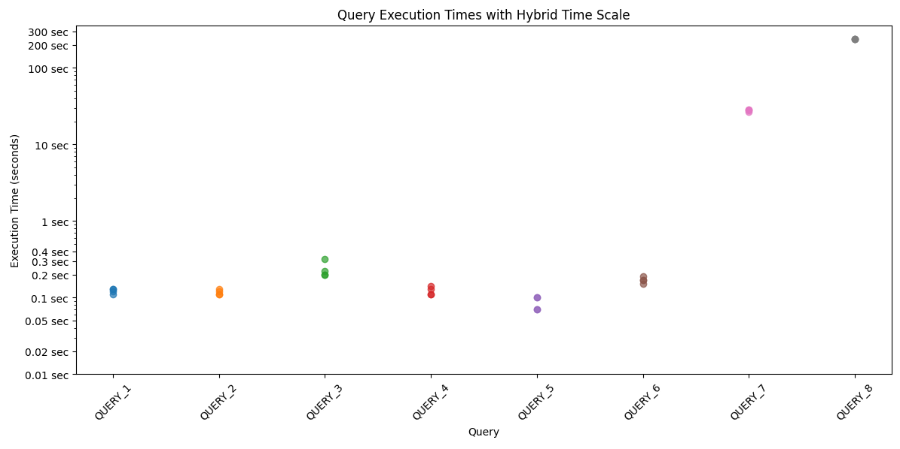
Performance metrics
Time complexity
Analyze time complexity of the query.
Critical aspects of self and multi-join operations
Self join (query 7): likely involves joining a table with itself, which can be computationally expensive.
Multi-join (query 8): involves multiple joins across several tables, which can lead to exponential growth in the number of rows processed.

Slide 15
Neo4j approach
Data loading process
Query analysis
Performance metrics

Slide 16

Data Loading in Neo4j
Place the CSV file in the /import folder
Use this command to read data:
Create nodes and relationships:

Slide 17
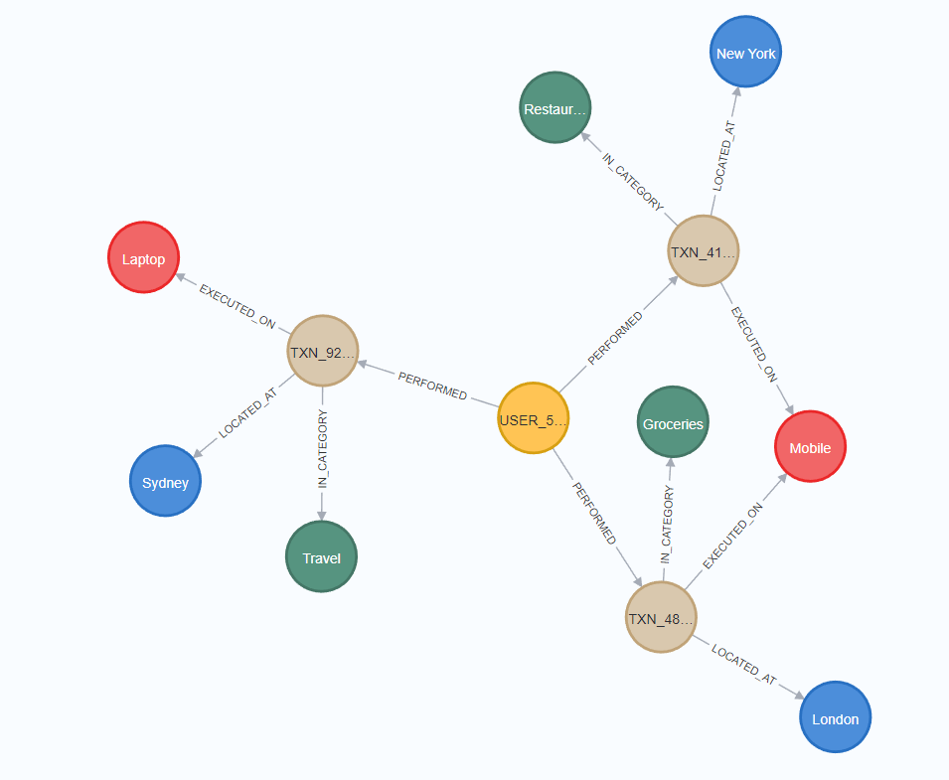
Result Graph

Slide 18
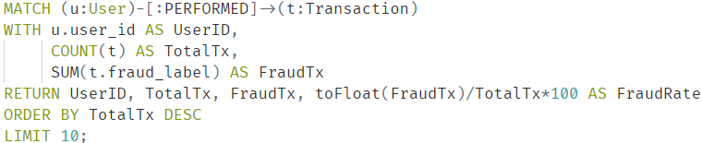
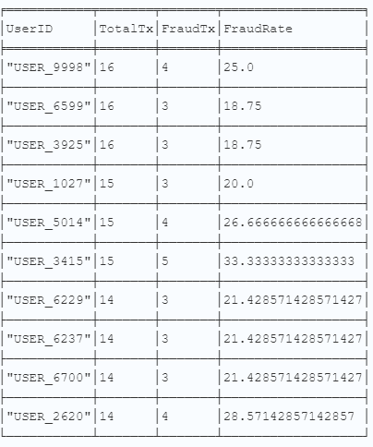
Query analysis
Identifies the top 10 users with the most transactions, showing their fraud transactions and fraud rate.
Compute the average of Fraud_Rate considering all dataset.
Compare result of the query with the average.
Query:
Output:

Slide 19
Query Analysis: Results
Most users in the top 10 have a fraud rate significantly below the average (32.10%), with rates ranging from 18.75% to 33.33%.
The user with the highest fraud rate (USER_3415) has a fraud rate of 33.33%, which is slightly higher than the average.
Conclusions:
High number of transactions NOT Implies high number of frauds
Frauds doesn’t depend only on number of transactions, but for example also on device, merchant category or distance.

Slide 20
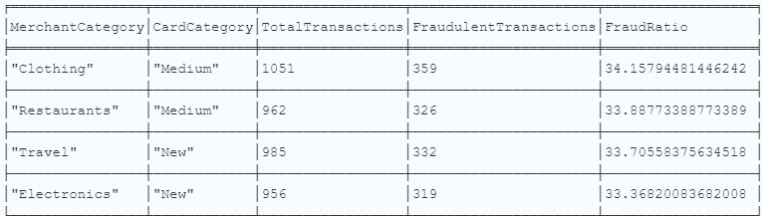
Query Analysis
Combination of 2 queries:
Compute the transaction and frauds for each merchant category
Compute the transaction and frauds for each card_age category: New, Medium, Old
Query:
https://colab/query_analysis
Output (Partial):

Slide 21
Query Analysis: Results
Conclusion:
Highest risk: “Medium” cards (25–48 months) in Clothing (34.2 %) and Restaurants (33.9%).
“Old” cards (4+ years): slightly lower rates (31.5 – 32.7 %) despite high volumes.
High-volume categories: Restaurants “Old” (7 990 TNX) & Travel “Old” (8 041 TNX) at ~32 % fraud.
Volume vs. risk disconnect: High transaction volume (like Restaurants “Old”) does not always imply higher fraud rates than lower-volume segments.

Slide 22
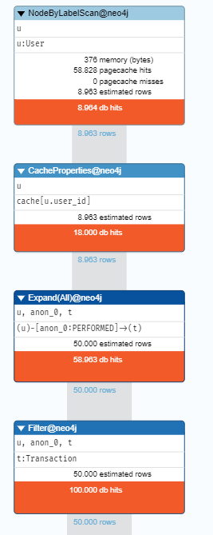
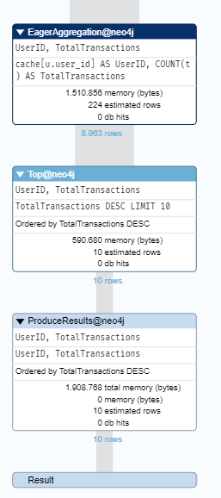
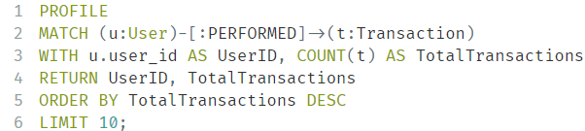
Performance Metrics
The operator PROFILE allow to analyze the metrics of a query such as:
  Memory
  Db Hits
  Page cache Hits/misses
  Estimated Rows
Query:

Slide 23
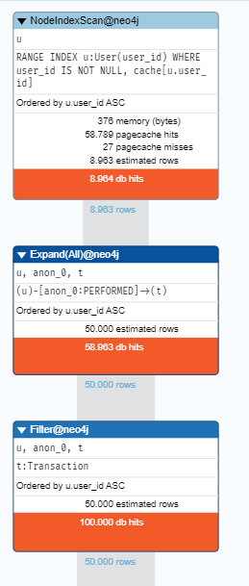
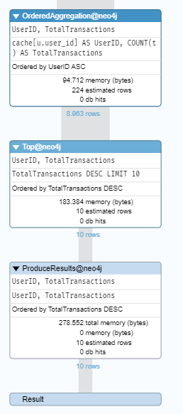

Performance Metrics: Possible Improvement!
To improve the metrics, we use the concept of Indexes and Constraints:
Transaction:
User:
Improvement about memory during the phase of aggregation, top and produceresults.

Slide 24
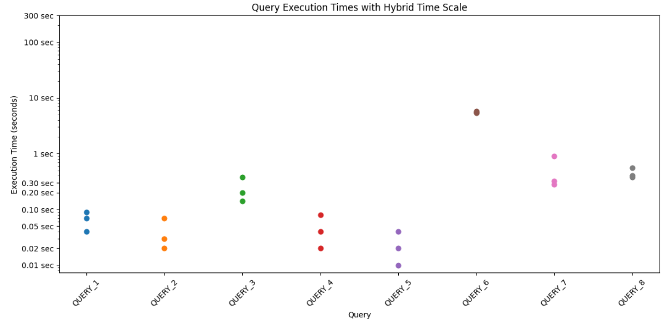
Performance Metrics: Time Complexity
The following graph show Time Complexity of the queries:
Critical Aspect: Traverse of the whole graph during a query composed by complex JOIN in the case of a big dataset.

Slide 25
Conclusion
Summary of key points
References

Slide 26
Summary of key points
MySQL (Relational Database):
Best suited for structured data with predictable relationships.
Multi – join can be computationally expensive.
Use MySQL when:
Data is structured
Queries are simple
Transactions are independent
Neo4j (Graph Database):
Optimized for analyzing interconnected data.
Suitable for real-time analysis of highly connected data.
Use Neo4j when:
Real-time analysis is critical
Patterns are complex
Schema flexibility is important

Slide 27
References
GitHub repo
https://github.com/masciotta02/NoSQL_Project
Other resources
Tutor presentation (Neo4j)

Slide 28
THANK YOU FOR YOUR ATTENTION!

