Slide 1
Wombat
Romero Andrade Cristian
Compilador

Slide 2
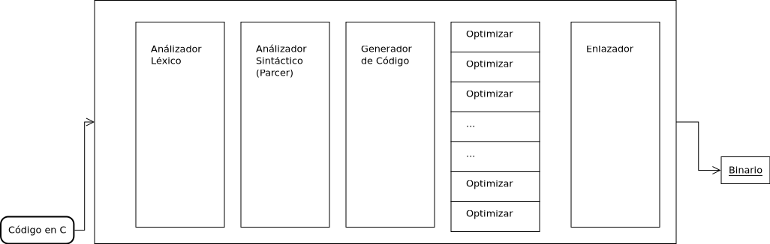
Diseño

Slide 3
Código a alcanzar
int main () {
  return 2;
}

Slide 4

Elixir
No es más otro lenguaje funcional para esta década.
Algunas funcionalidades lo simplifica.
Unas desventajas del paradigma lo hacen un poco molesto.

Slide 5

Mix es un make
$ mix new kv --module KV
$ mix test
$ mix escript.build
$ iex –S mix

Slide 6
Un make para compilar y limpiar
make:
mix escript.build
clean:
rm -f compiladorwombat ejemplo/*.out \
test/stage_1/invalid/*.out \
test/stage_1/valid/*.out

Slide 7
Compilación y Ejecución
Make en la raiz del proyecto
$ make
comandos
$ ./compiladorwombat ruta/archivo.c
$ make
mix escript.build
Compiling 1 file (.ex)
Generated escript compiladorwombat with MIX_ENV=dev
$ ls
_build compiladorwombat config deps doc ejemplo lib Makefile miscelanea mix.exs mix.lock README.md test

Slide 8
Ejecución "Devuelve" 0
Salida parser: : %Arbol{
lleaf: %Arbol{
lleaf: %Arbol{
lleaf: %Arbol{lleaf: nil, node: :const, rleaf: nil, val: 2},
node: :kreturn,
rleaf: nil,
val: nil
},
node: :function,
rleaf: nil,
val: :main
},
node: :program,
rleaf: nil,
val: nil
}
Code Generator output:
.text
.p2align 4
.globl main
.type main, @function
main:
movl $2, %eax
ret
$
$ ./compiladorwombat ejemplo/return_2.c
Compilado: ejemplo/return_2.c
Salida del desinfectante: : ["int", "main", "()", "{", "return", "2;}"]
["int", "main", "()", "{", "return", "2;}"]
{:kint, ""}
{:kmain, ""}
{:open_paren, ")"}
{:close_paren, ""}
{:open_brace, ""}
{:kreturn, ""}
{{:const, 2}, ";}"}
{:semicolon, "}"}
{:close_brace, ""}
Salida Lexer: : [
:kint,
:kmain,
:open_paren,
:close_paren,
:open_brace,
:kreturn,
{:const, 2},
:semicolon,
:close_brace
]
int main () {
  return 2;
}

Slide 9
Ejecución con error "devuelve" 1
int main() {
return0;
}
$ ./compiladorwombat test/stage_1/invalid/no_space.c
.Compilado: test/stage_1/invalid/no_space.c
Salida del desinfectante: : ["int", "main()", "{", "return0;", "}"]
["int", "main()", "{", "return0;", "}"]
{:kint, ""}
{:kmain, "()"}
{:open_paren, ")"}
{:close_paren, ""}
{:open_brace, ""}
{:error, "misspeled in 'return'"}
{:close_brace, ""}
Salida Lexer: : {:error, "misspeled in 'return'"}
{:error, "misspeled in 'return'"}

Slide 10
Otro Ejemplo - RETURN
./compiladorwombat test/stage_1/invalid/wrong_case.c
Compilado: test/stage_1/invalid/wrong_case.c
Salida del desinfectante: : ["int", "main()", "{", "RETURN", "0;", "}"]
["int", "main()", "{", "RETURN", "0;", "}"]
{:kint, ""}
{:kmain, "()"}
{:open_paren, ")"}
{:close_paren, ""}
{:open_brace, ""}
{:error, "constan error"}
{{:const, 0}, ";"}
{:semicolon, ""}
{:close_brace, ""}
int main() {
RETURN 0;
}
Salida Lexer: : [
:kint,
:kmain,
:open_paren,
:close_paren,
:open_brace,
{:error, "constan error"},
{:const, 0},
:semicolon,
:close_brace
]
Salida parser: : {:error, "return?"}
{:error, "return?"}

