Slide 1
Programming TYT Handhelds
MD-380/390 and MD-UV380/390
Presented by KF7HVM - Masen
https://www.kf7hvm.com/info/tyt/
Updated 2021/01/01

Slide 2
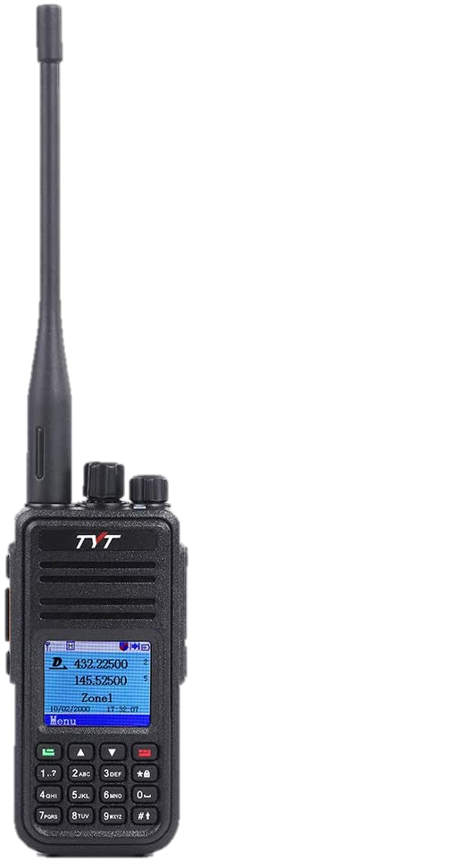
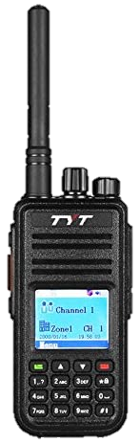
Models and Limits
MD-380 / 390
Monoband, either UHF or VHF
1000 Channels
10,000 Contacts
250 Scan lists (of 32 channels each)
250 Zones (of 16 channels each)
Has custom firmware
MD-UV380 / 390
Dual band + commercial
3000 Channels
10,000 / 120K Contacts
250 Scan lists (of 64 channels each)
250 Zones (of 64 channels each)
390 variants include GPS*

Slide 3


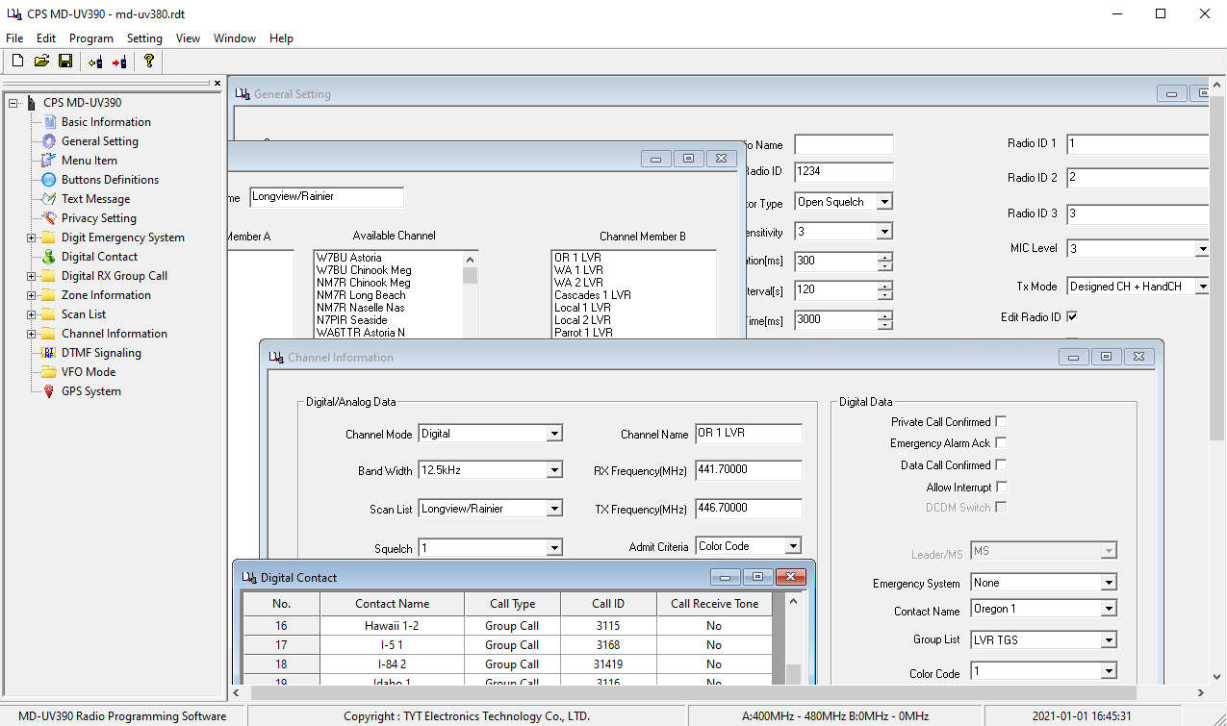
Stock Software
Similar to other Chinese manufacturers
Very limited functionality for managing large, complex code plugs
Cannot reorder zones
Cannot import/export zones, scanlists, grouplists
Requires licensed Microsoft Excel for full import/export function
Windows-only; Different version per model
Annoyances and bugs – tab index, no indication of invalid data

Slide 4
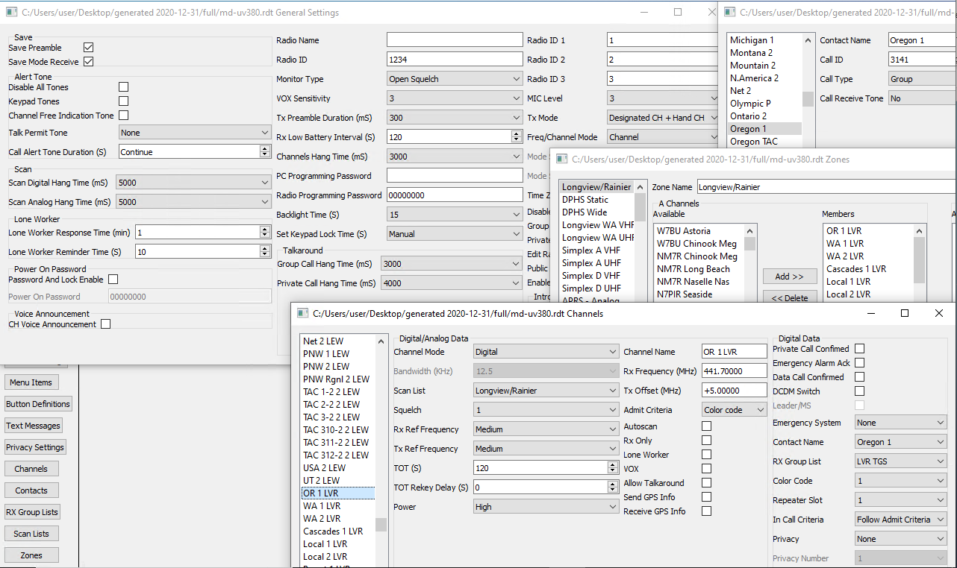
Third Party Software: EditCP
Drag / Drop; Copy between codeplugs
Support multiple radio models
JSON import/export
Data validation
Upload Codeplug, Firmwares and contact list
Windows or Linux
Identical field names and placement, easy for those familiar with stock CPS
https://www.farnsworth.org/dale/codeplug/editcp/

Slide 5
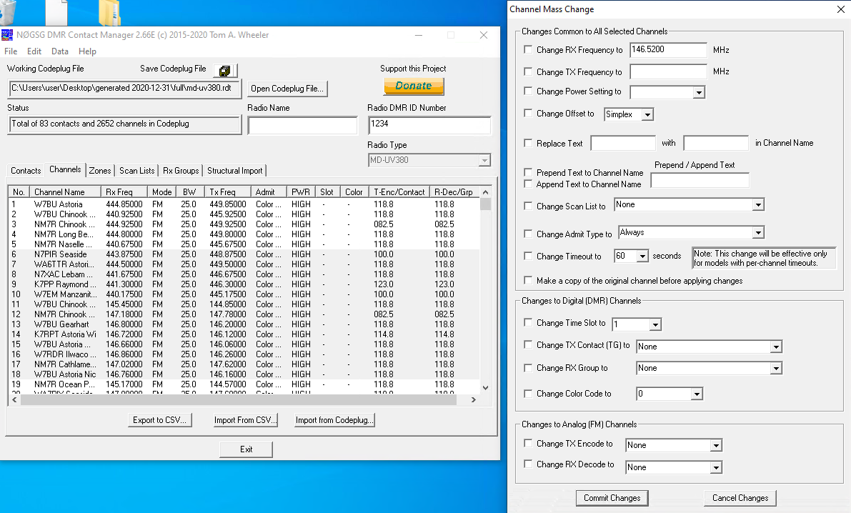
Third Party Software: N0GSG Contact Manager
Supports multiple radio types, including Anytone
Structural import/export allows for sharing across radio types
Channel Mass Change
Zone Wizard
Download, filter, and export DMR ID Database
Windows only, but runs in Wine
http://n0gsg.com/contact-manager/

Slide 6
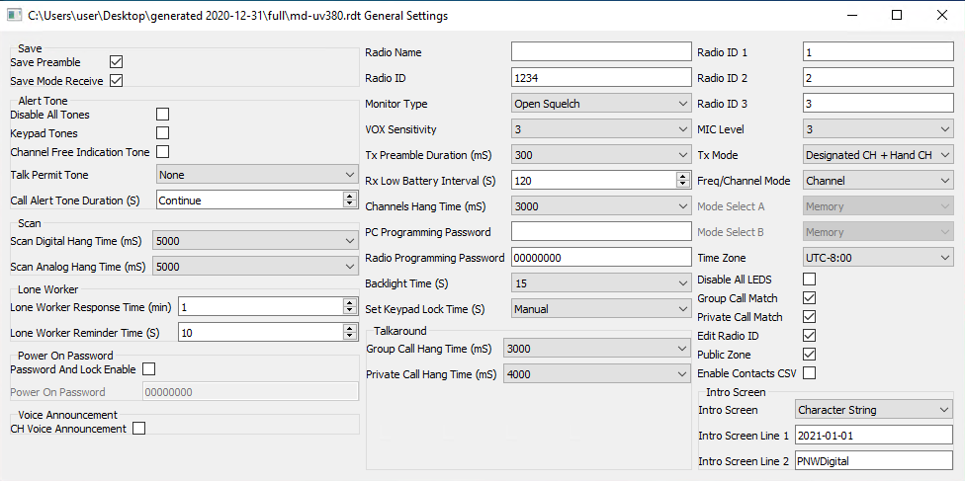
General Settings
Radio Name: callsign
Radio ID: DMR ID
Scan Digital / Analog Hang Time
Talk Permit Tone
Enable Contacts CSV: UV380/390 with ContactCSV firmware only!

Slide 7
Manual Programming
“Give a man a codeplug and he operates for a day;
Teach a man to Codeplug and He Operates for a Lifetime”

Slide 8
DMR Objects
“Contact”, “Digital Contact”, “Talkgroup”
Correlate a DMR ID to a name
“Group List”, “RX List”, “TG List”
A list of contacts that will be heard on a channel
“Channel”
Frequency, offset, color code, TX Contact, RX List
“Scan List”
A list of up to 32 (64 for UV) channels to scan as a group
“Zone”
A list of up to 16 channels (MD-380)
2 lists of up to 64 channels (MD-UV380)

Slide 9
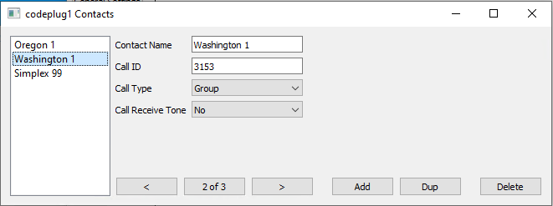
Contacts
Private calls are not typically used in Amateur deployments, except to map Callsigns to DMR ID*

Slide 10
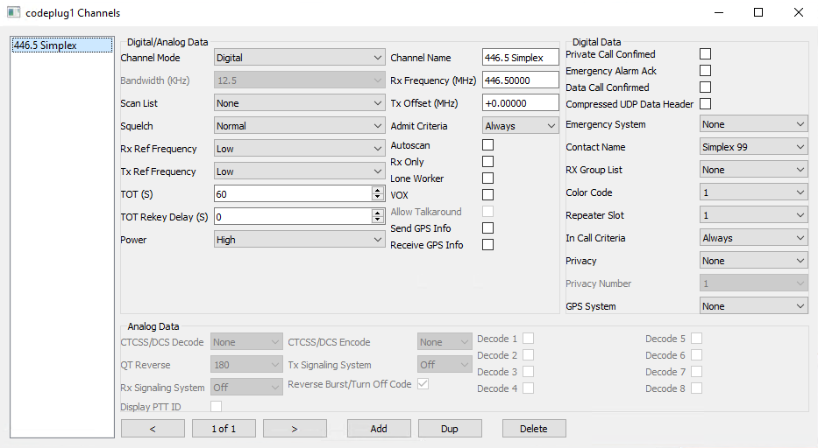
Digital Simplex
Hotspot or P2P simplex
Favor TS 1, TG 99
Admit Criteria: Always
Tx Offset: 0

Slide 11
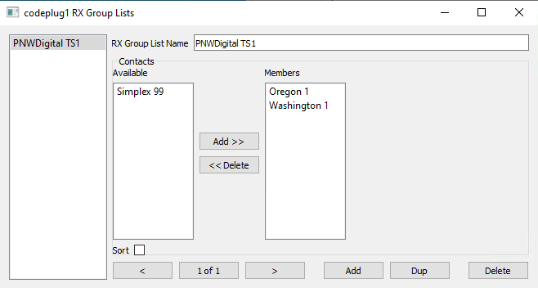
Group List
Allows a single channel to monitor multiple talkgroups
Helps avoid “stealing” the timeslot away from an ongoing QSO
Place all TS 1 talkgroups into a list and all TS 2 talkgroups into another list.
Each channel with a TX Contact on a given timeslot should include the corresponding group list.

Slide 12
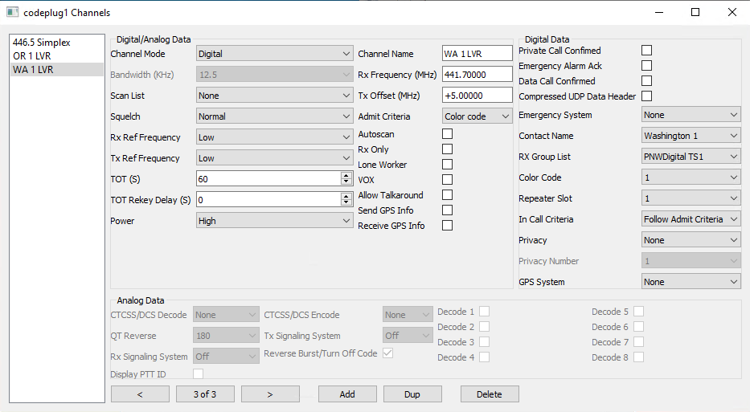
Digital Repeater
1 Channel per TX Talkgroup!
Admit Criteria: Color Code
Contact Name: Washington 1
RX Group List: PNWDigital TS 1
Color Code: 1
Repeater Slot: 1
In Call Criteria:
Follow Admit Criteria

Slide 13
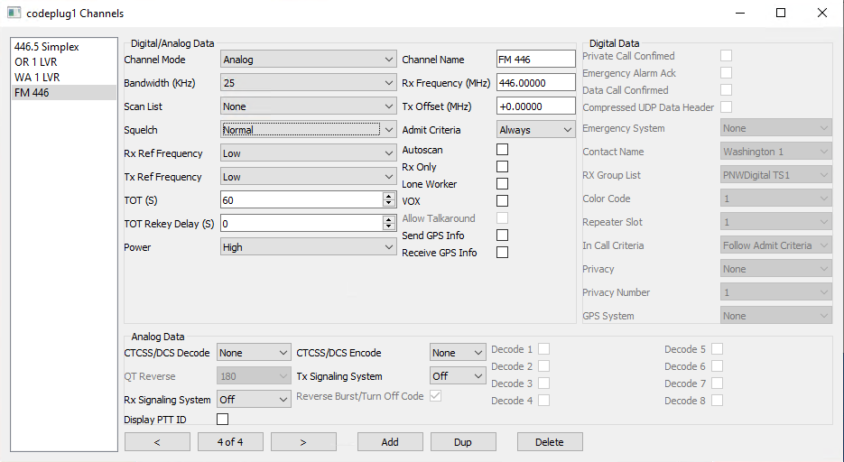
Analog Simplex
Simple
Bandwidth: 25
Admit Criteria: Always

Slide 14
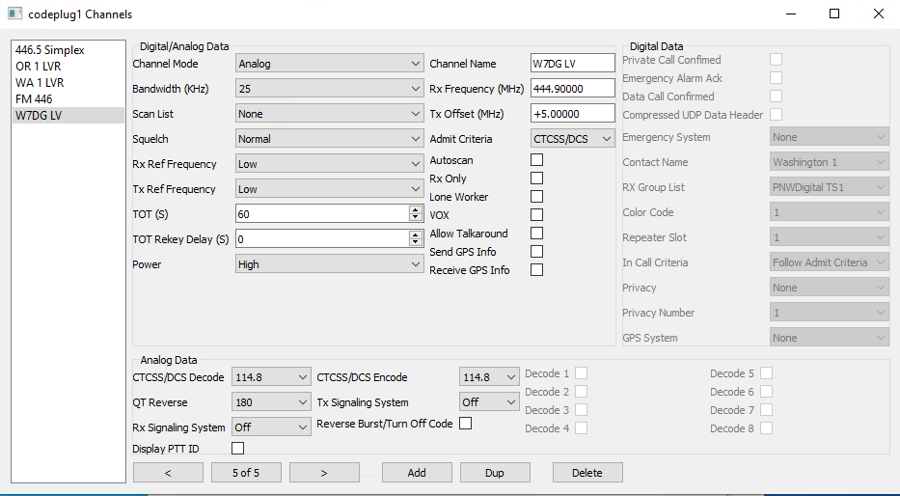
Analog Repeater
Tx Offset: +5
Admit Criteria: CTCSS/DCS
CTCSS/DCS Decode, Encode
Leave signaling options OFF!

Slide 15
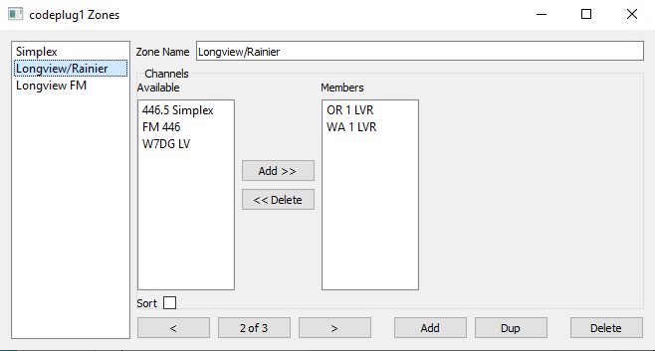
Zones
Channels MUST be in a zone to be accessible on the radio
MD-380 Zones are 16 channels
MD-UV380 Zones are 2x 64 channels

Slide 16
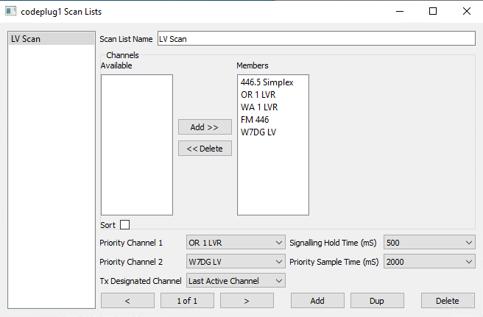
ScanList
Channels to scan as a group
Required for scan functionality. Zones cannot be scanned as-is.
Priority Channel: These channels will be checked 50% of the time
Tx Designated: Which channel transmits during a scan
Priority Sample Time: How often to check the priority channels while receiving another signal.
Hold Times are global: see General Settings

Slide 17
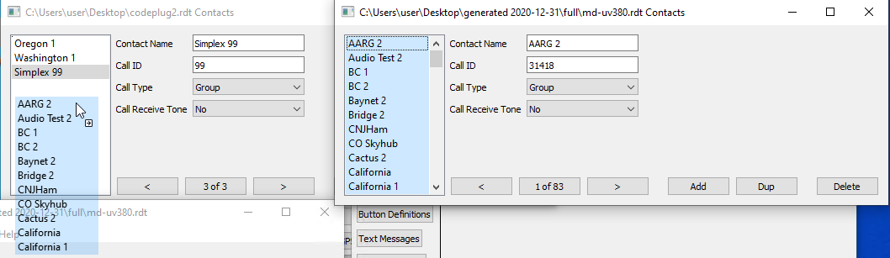
Starting from Existing Codeplug
EditCp allows multiple codeplugs to be open at the same time
Drag / Drop or Copy / Paste between open codeplugs
Automatically copies dependent objects
N0GSG Contact Manager allows direct import of contacts and channels from existing codeplugs

Slide 18
Contacts Database
MD-380: only really supported with 380toolz custom firmware
MD-UV380: Firmware versions beginning with “V” support “ContactsCSV” (up to 120K entries)
With 160K+ IDs and growing, trimming the list is necessary
RadioID.net has a custom db generator (9.99/yr): https://contacts.radioid.net/generator
N0GSG Contact Manager can download and filter the list for free!

Slide 19
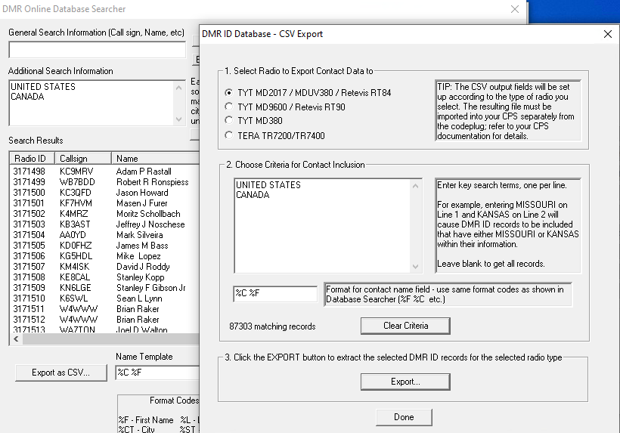
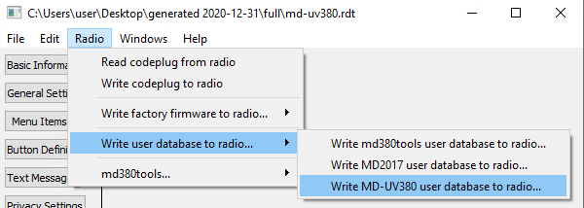
N0GsG Contact Manager
Search by country, name, call, etc
Format the records as desired
Use EditCp to upload the database to MD380 or MD-UV380

Slide 20
Codeplug Generators
K7ABD - https://www.k7abd.net/anytone-config-builder/
cps-import-builder - https://github.com/n7ekb/cps-import-builder
dzcb - https://github.com/masenf/dzcb

