Slide 1
Visual illusions and interactions in biologically inspired neural networks. Analyzing perception of tilt
Martin Asenov
Supervised by Prof. Mark van Rossum and Sander Keemink

Slide 2
Outline
Motivation
V1 Visual cortex
Receptive fields
Turing curves
All together
Timeline
Types of orientation tuned neurons
Neuron spikes
References

Slide 3
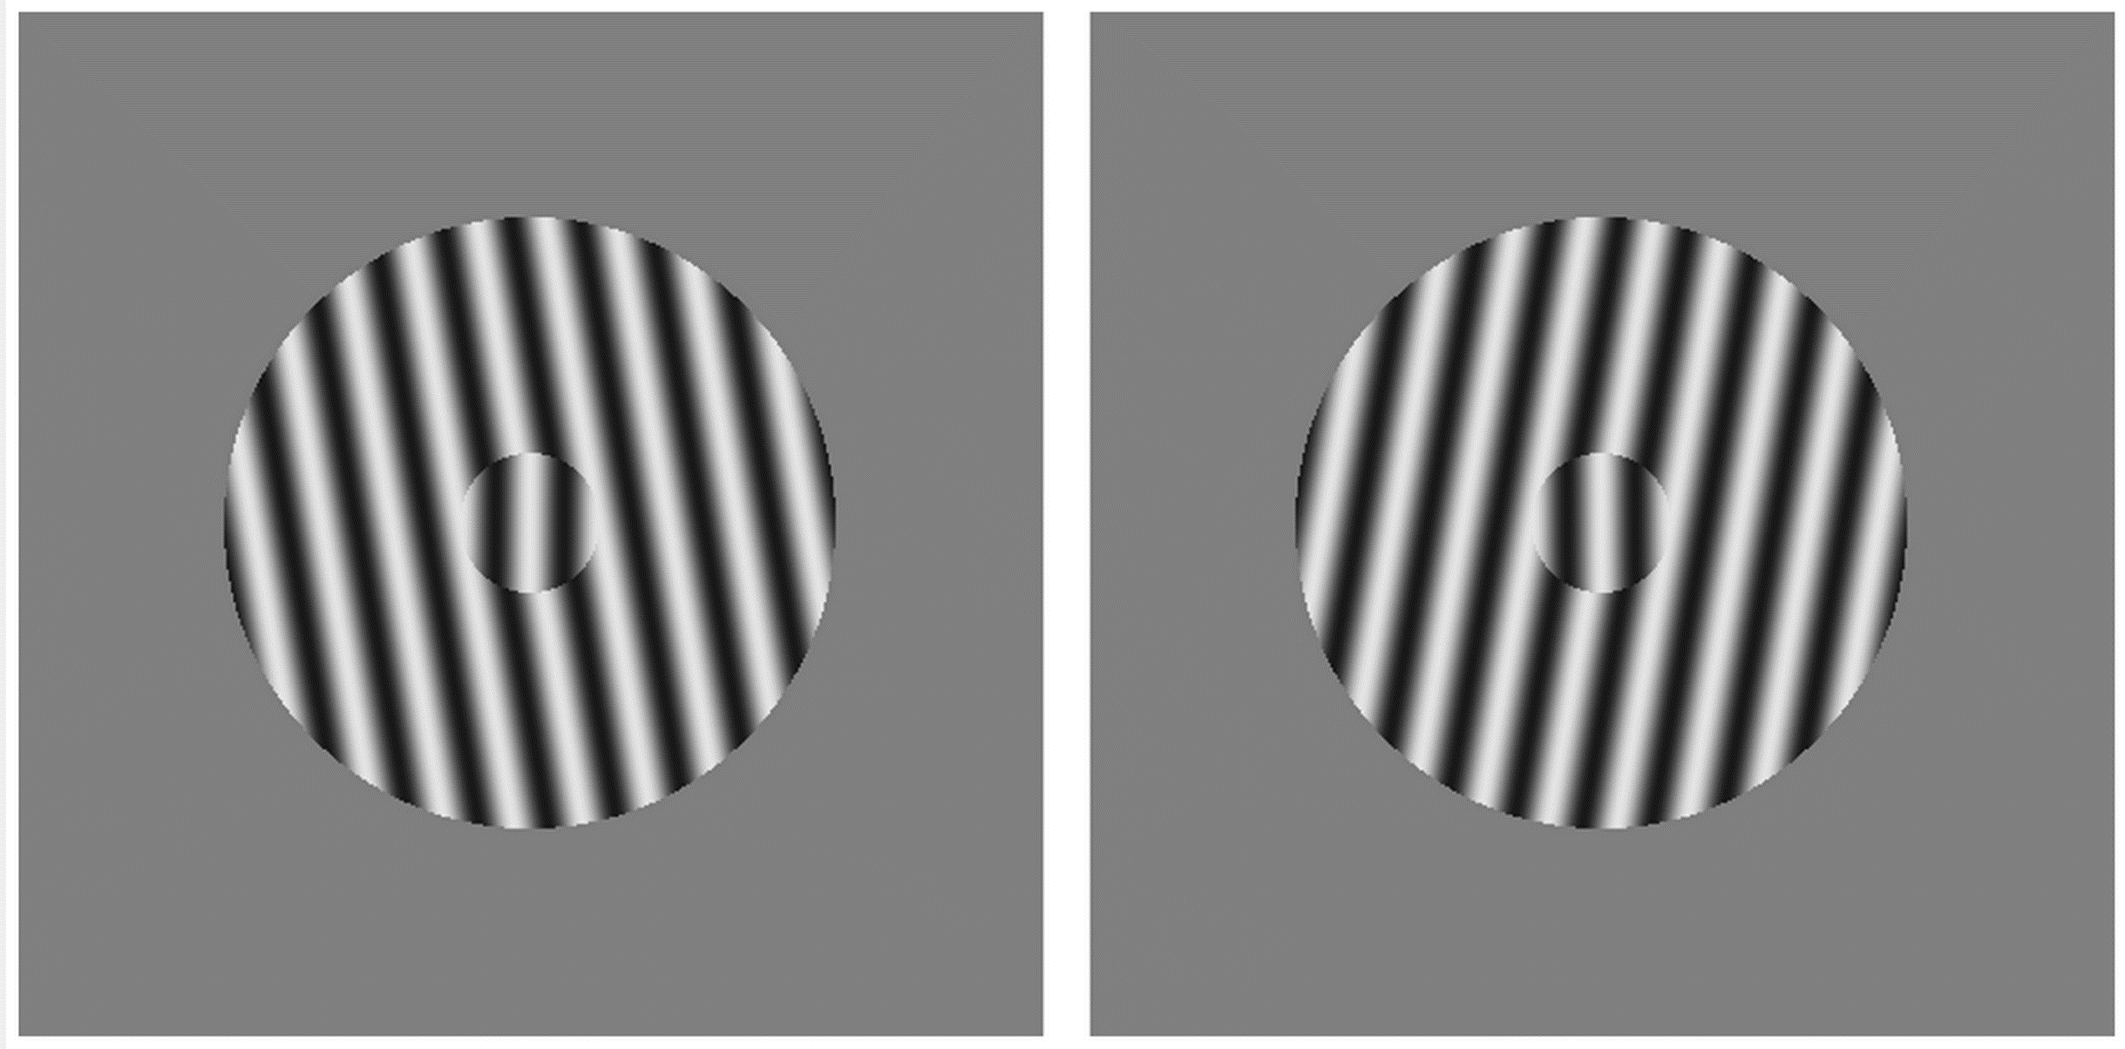
Motivation

Slide 4
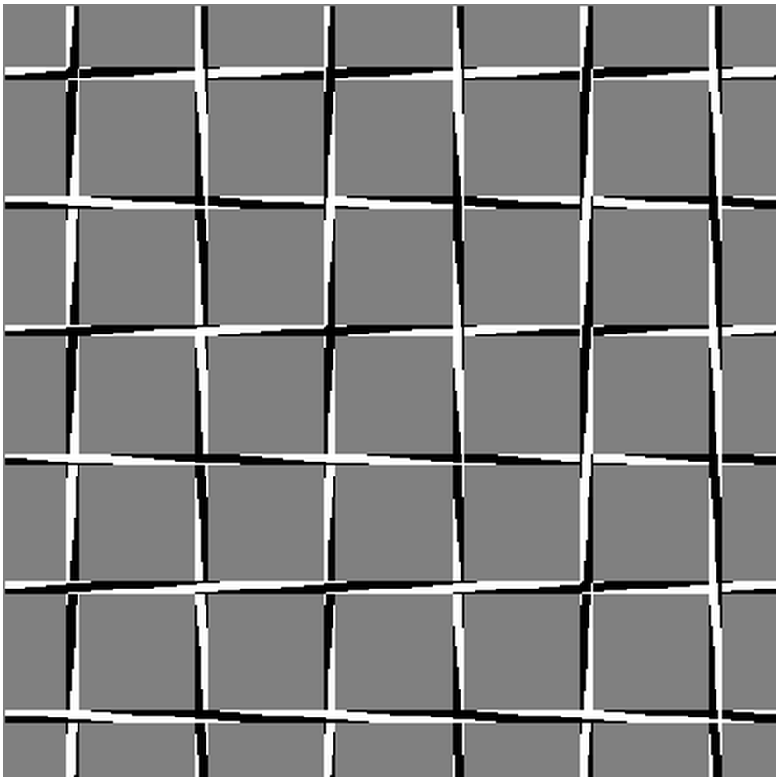
Motivation 2

Slide 5
V1 Visual cortex
Part of the cerebral cortex responsible for processing visual information
V1 - visual orientations, spatial frequencies and colors
V2, V3, V4, V5, V6
We are going to focus on the orientation selective neurons in V1

Slide 6
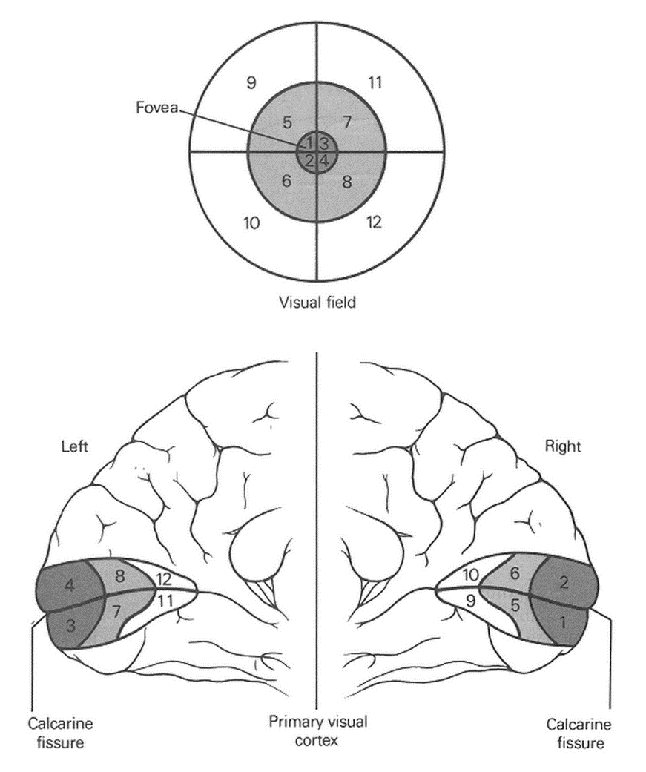
Receptive fields

Slide 7
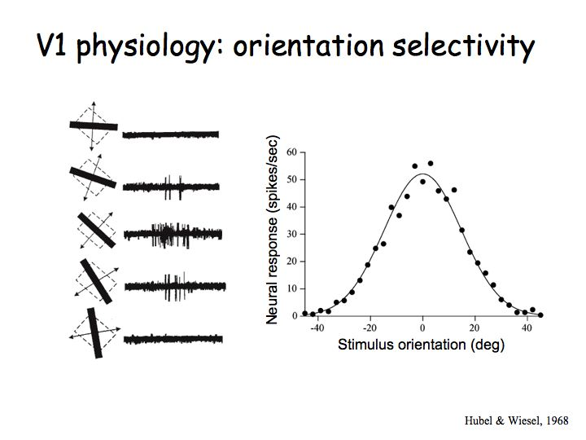
Tuning curves

Slide 8
All together
(On the white board)

Slide 9
Timeline
Implement basic model – week 6
Understanding of orientation representation in the model – week 8
Additional biological realism: noise, different orientation neurons, different purpose neurons, testing on real images, etc. – week 10 & winter break
Initial report & experiments – sem 2, week 3
Based on results – more testing or more complexity – sem2, week 7
Finishing up – sem2, end

Slide 10
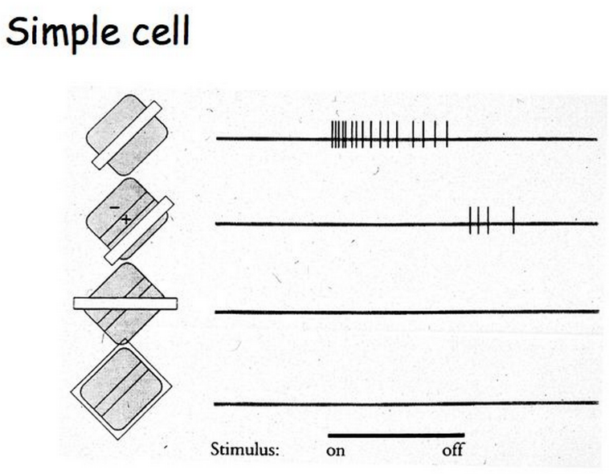
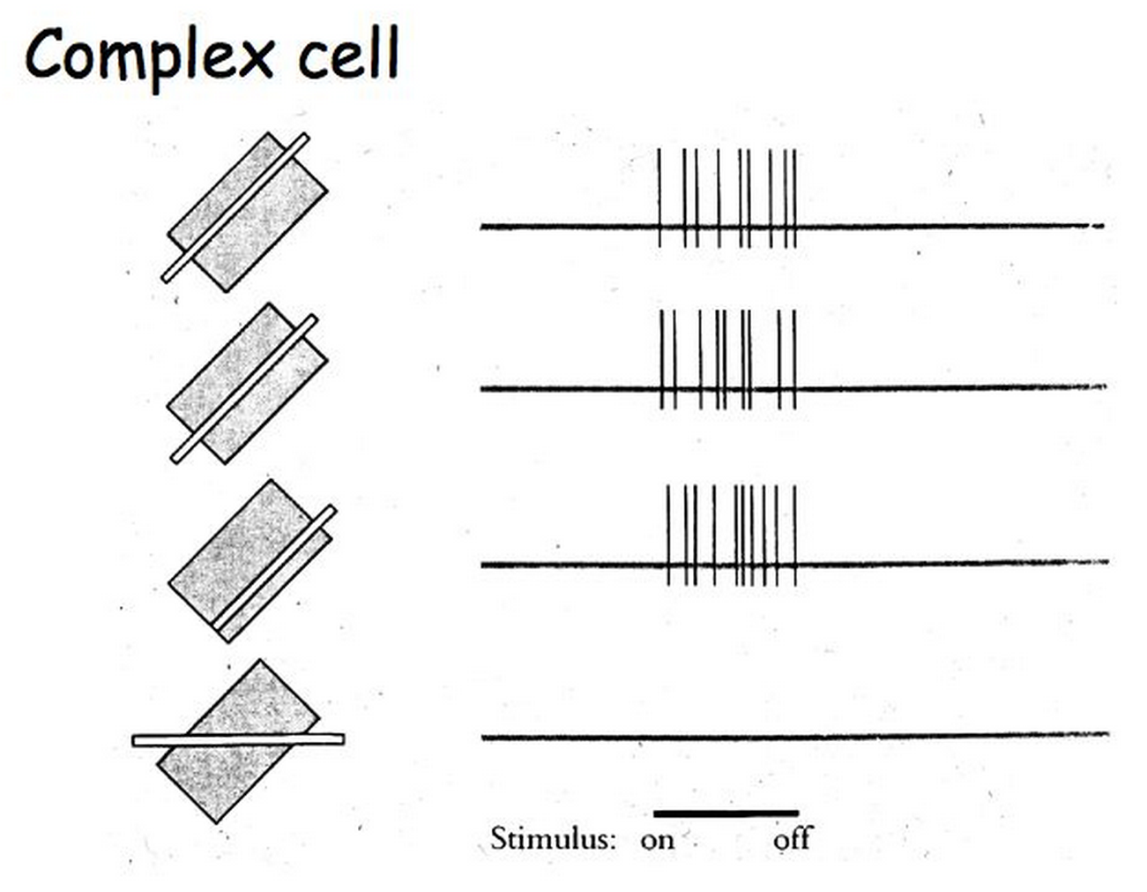
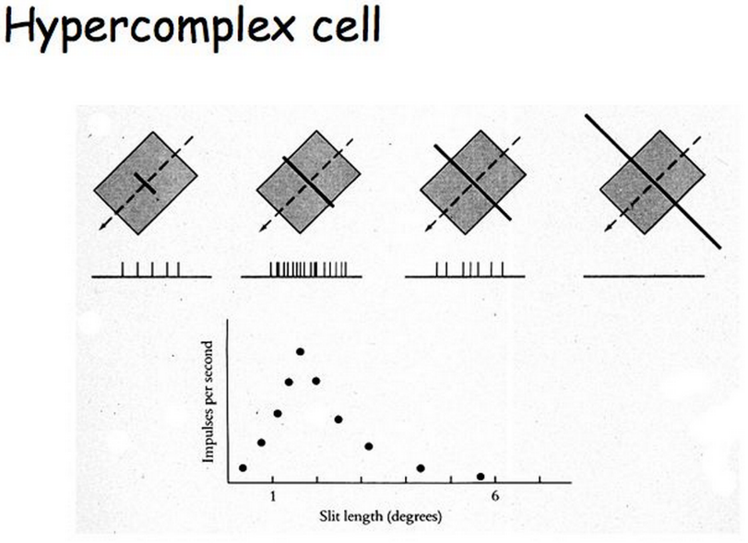
Types of orientation selective neurons
Neurons that like particular orientation
Simple, Complex, Hypercomplex cells

Slide 11
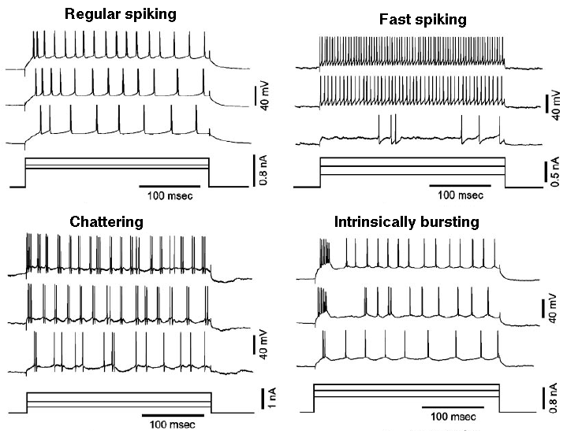
Neuron spikes
Excitement of a neuron, when stimulated
Noise and after effect
Variation over time
Connectivity with other neurons

Slide 12
References
http://www.genesis-sim.org/GENESIS/Tutorials/genesis-intro/tutfigs/cortical_spikes2.gif
http://fourier.eng.hmc.edu/e180/lectures/v1/node1.html
http://journals.plos.org/plosone/article?id=10.1371/journal.pone.0014074

