Slide 1
Visual illusions and interactions in biologically inspired neural networks. Analyzing perception of tilt
Martin Asenov
Supervised by Prof. Mark van Rossum and Sander Keemink

Slide 2
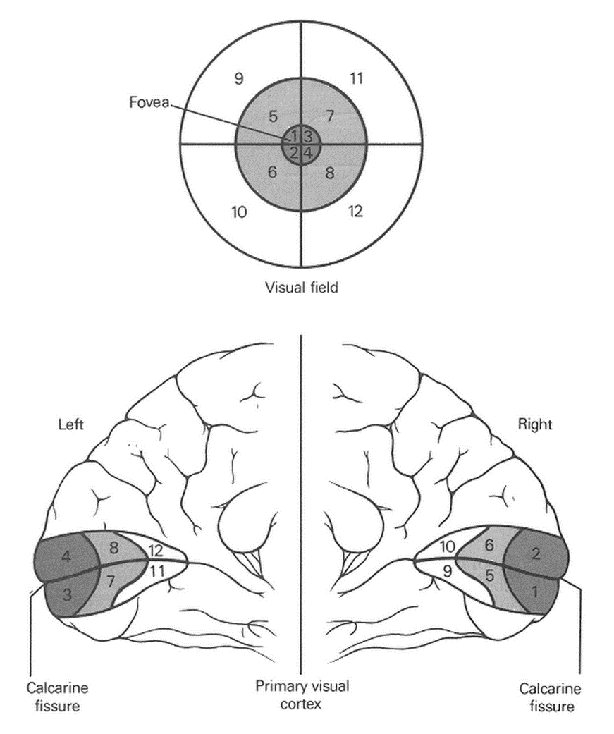
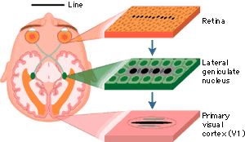
Receptive fields

Slide 3
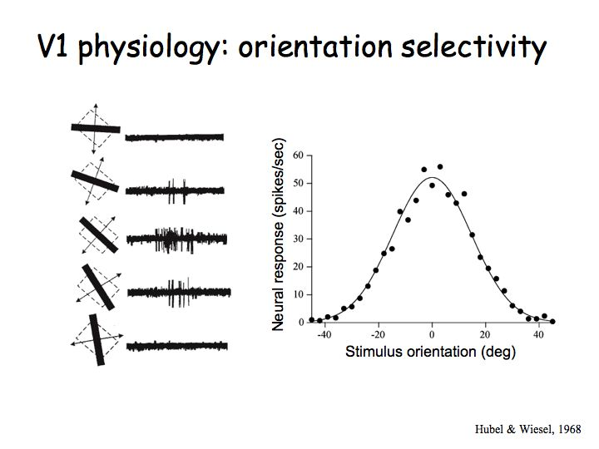
Tuning curves

Slide 4
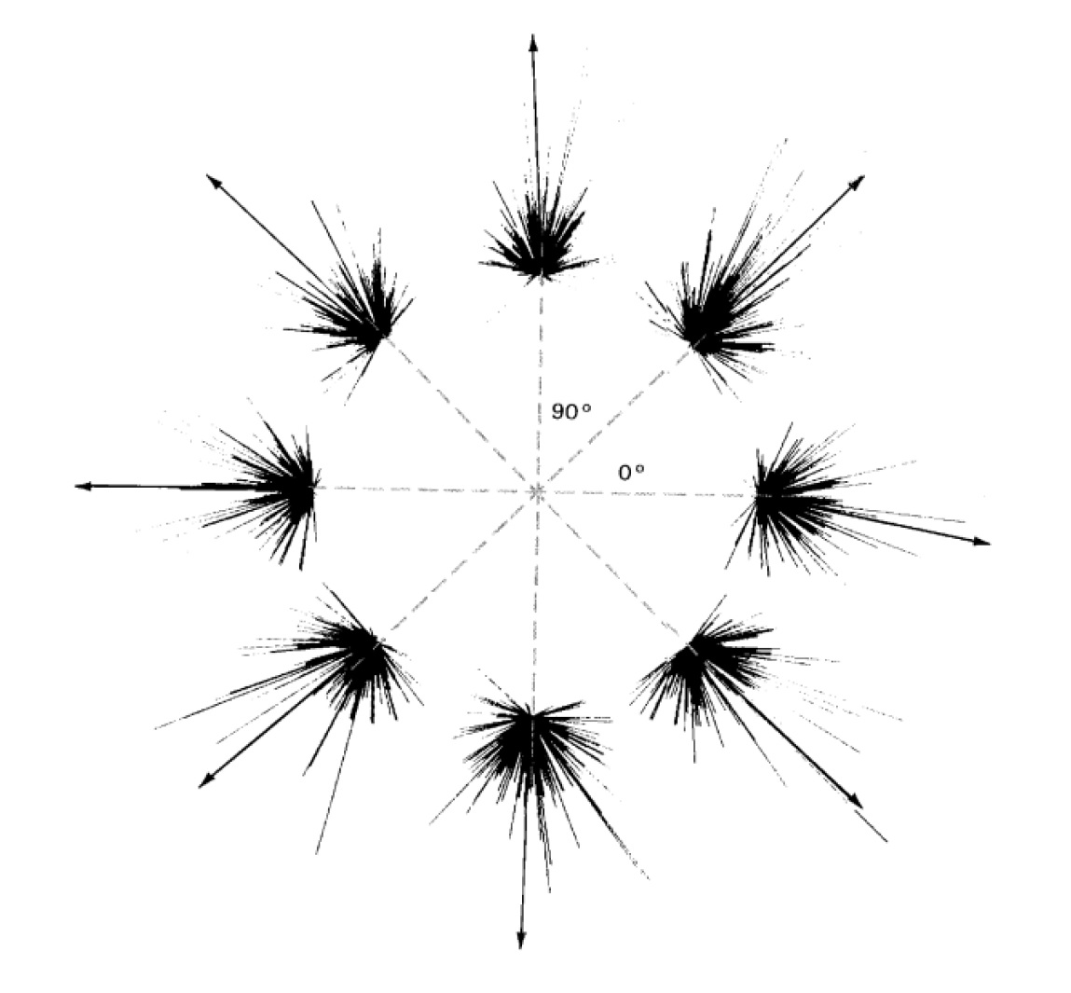
Population coding

Slide 5
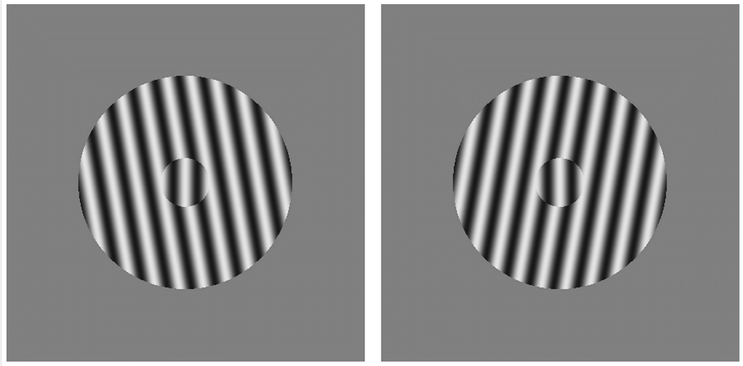
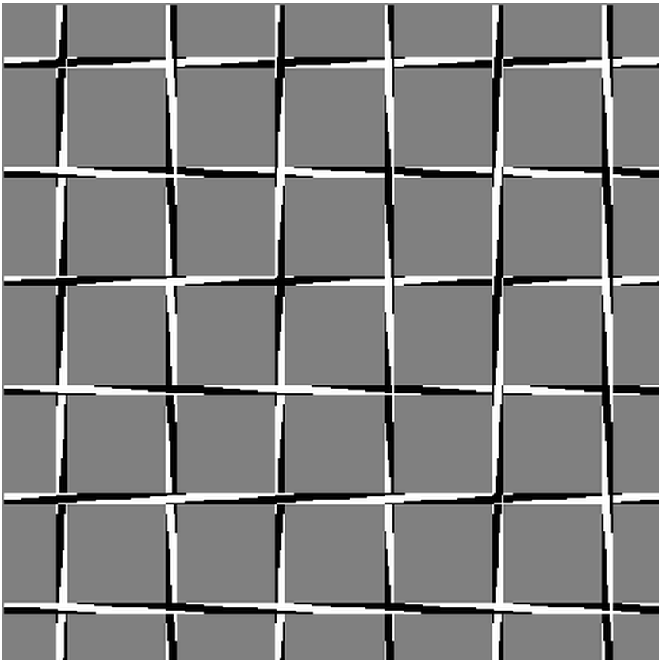
Motivation

Slide 6
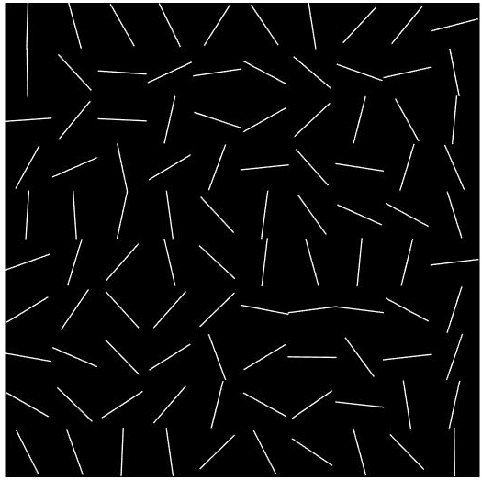
My model
Input

Slide 7
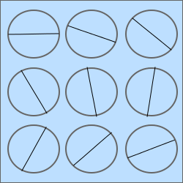
My model (v1)
Single receptive field with orientation selective neurons

Slide 8
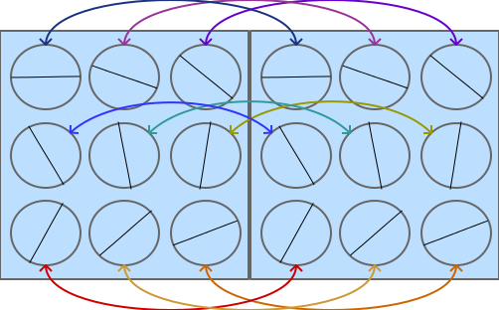
My model (v2)
Two receptive fields with limited connectivity

Slide 9
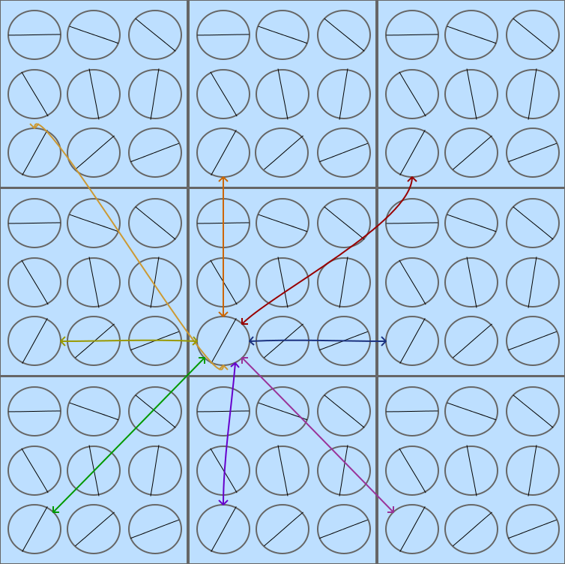
My model (v3)
Any number of receptive fields with limited connectivity
*Connections only for one neuron shown

Slide 10
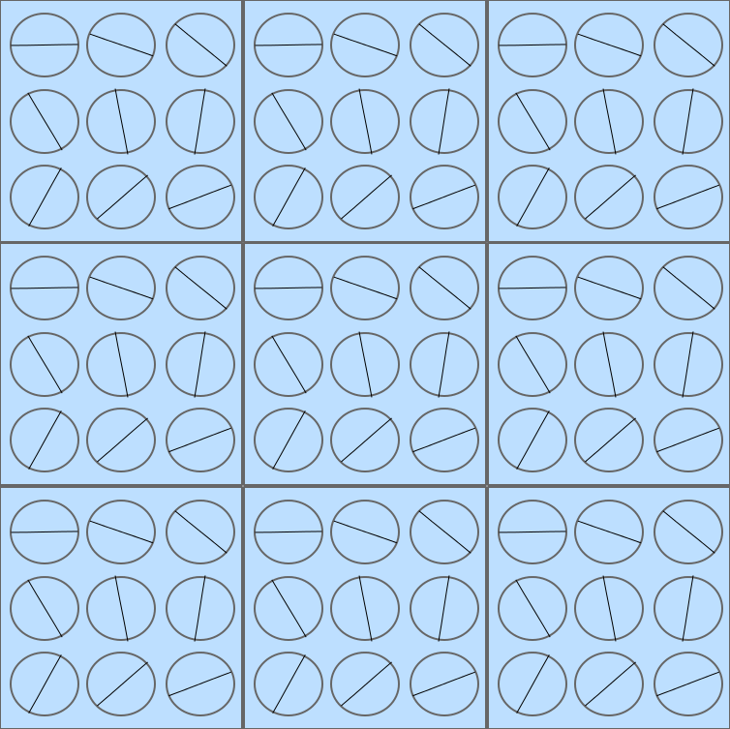
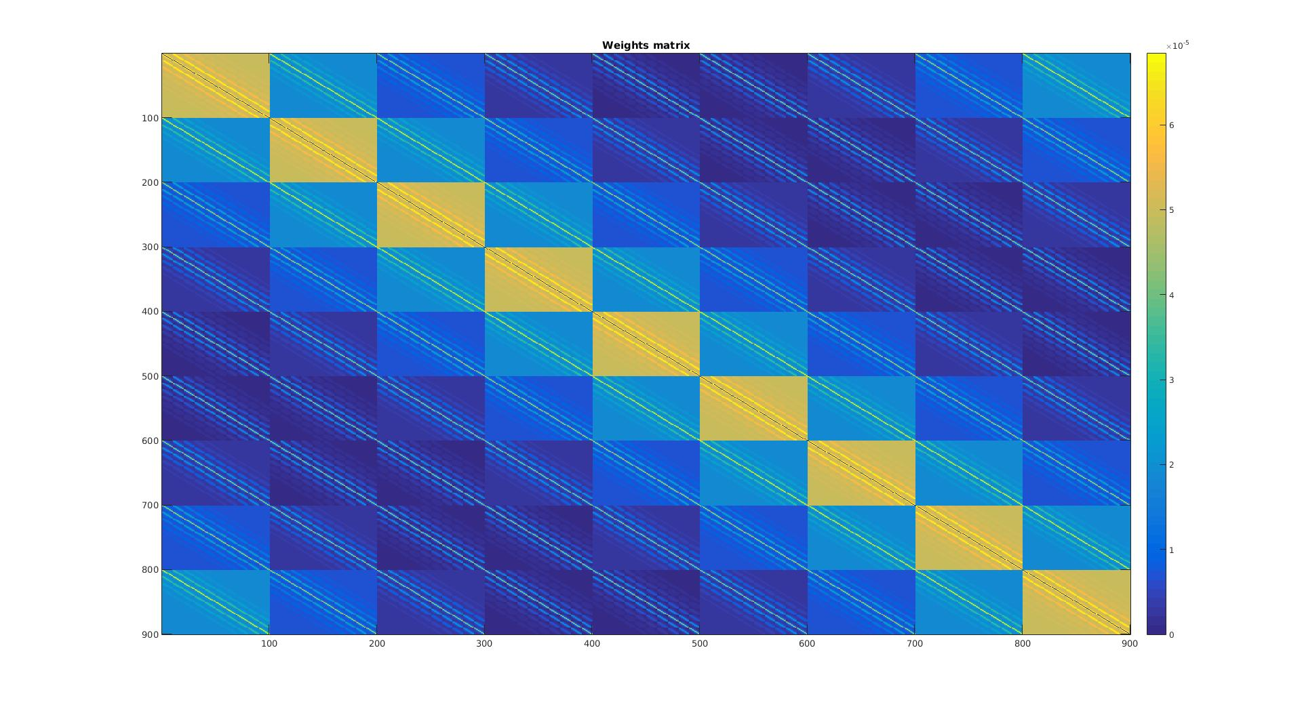
My model (v4)
Any number of receptive fields with full connectivity
*
h*w*n matrix -> Single vector with length S
Weight matrix SxS

Slide 11
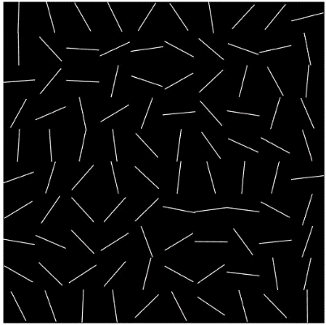
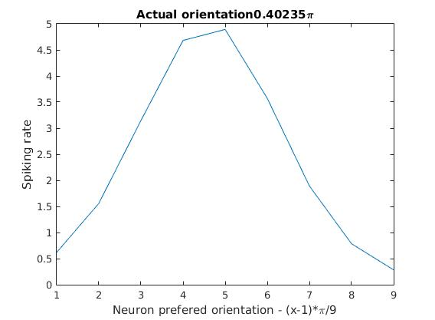
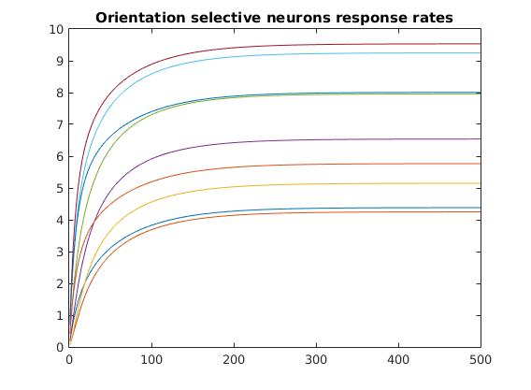
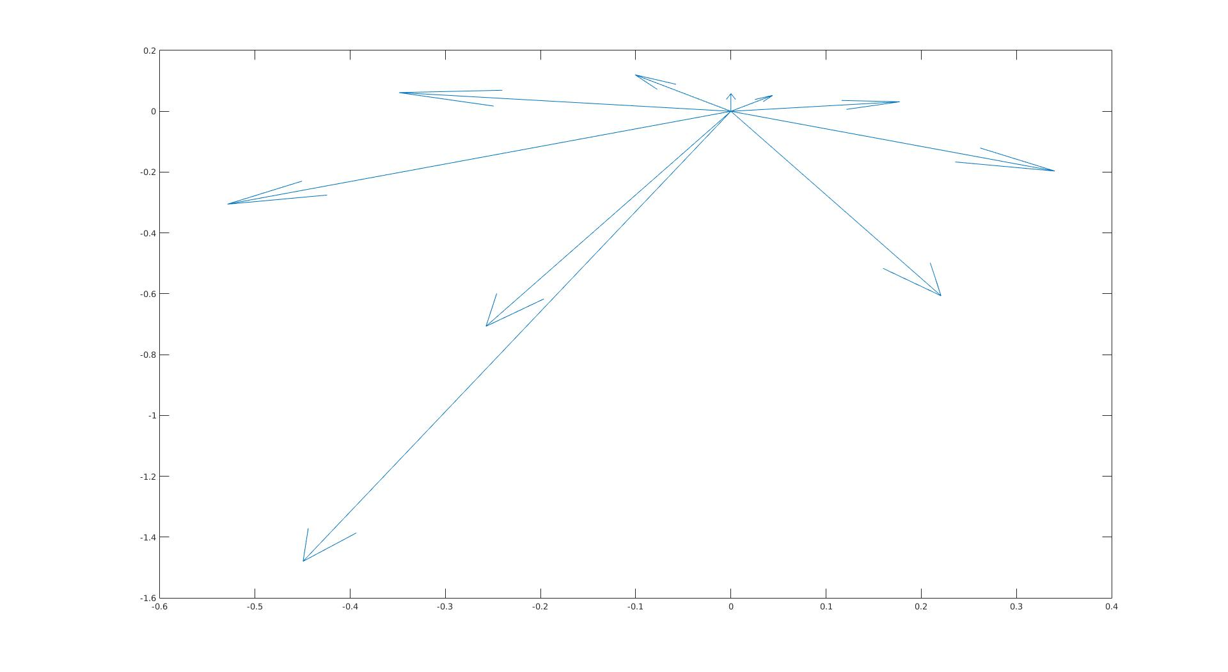

My model
All together
Actual
orientations
One receptive field
(fixed time)
One receptive field
(over time)
Predicted
orientations
Population coding

Slide 12
References
http://www.genesis-sim.org/GENESIS/Tutorials/genesis-intro/tutfigs/cortical_spikes2.gif
http://fourier.eng.hmc.edu/e180/lectures/v1/node1.html
http://journals.plos.org/plosone/article?id=10.1371/journal.pone.0014074
http://brainconnection.brainhq.com/2004/03/06/overview-of-receptive-fields/

