Slide 1

Order Management System with Microservices
Training – Morogoro
Notes:
Introduce the training project: an order management system built as microservices.

Slide 2



What We Built
A simple order management system split into small services. Each service runs on its own and has its own database.
Products
Inventory
Orders
Add, update and view products
Add and deduct stock, with opening and closing quantity
Place and cancel orders, and save order items

Slide 3



Why We Chose This
Why split it into services?
Learning
Why an order management system?
Each service teaches one idea: JPA, Feign, Eureka, Gateway, Resilience4j, Zipkin
Everyone understands it: products, stock and orders
An order needs the price and the stock, so services must work together
It is close to the real systems our institution uses
Reliability
If one service fails, the others keep running, and fallbacks give a clear message
Optimization
A busy service, like orders, can be scaled alone without scaling the whole system

Slide 4







Technologies We Used
Spring Boot
JPA + MySQL
REST API
OpenFeign
Builds each service
Saves the data
Postman and services call each service
Services talk to each other
Eureka
API Gateway
Resilience4j
Zipkin
Services find each other by name
One entry point for all requests
Protects the system when something fails
Traces each request across services

Slide 5
Our Services
Service | Port | What it does
Eureka Server | 8761 | Keeps a list of all running services
API Gateway | 8080 | Receives all requests and sends them to the right service
AddUpdateProduct | 7002 | Adds and updates products
FetchAllProduct | 7009, 7010 | Lists products, and finds them by id or name
ProductInventory | 7004 | Records stock ADD/DEDUCT with opening and closing quantity
OrderService | 8089, 8090 | Places and cancels orders, and saves order items

Slide 6
Architecture
Postman / Client
API Gateway :8080
routing + logging
Eureka Server :8761
All services register here and find each other by name
AddUpdateProduct
:7002
FetchAllProduct
:7009, :7010
Feign
OrderService
:8089, :8090
Feign
ProductInventory
:7004
Zipkin :9411
training_products
order_db
inventory_db
All services send traces here, one trace per request
ProductInventory also calls FetchAllProduct with Feign to show product names.

Slide 7
Patterns We Used
Design
Communication
Reliability
Observability
Service per business area
Database per service
Separate read and write product services
API Gateway
Service discovery (Eureka)
REST with Feign
Load balancing
Multiple instances
Circuit breaker + fallback
Retry
Rate limiter
Bulkhead
Time limiter
Tracing (Zipkin)
Request logging to a file
Health checks (Actuator)

Slide 8




Placing an Order
1
2
3
4
5
Customer sends product and quantity
Get product price from product service
Check stock in inventory service
Deduct stock if there is enough
Save the order and order items
Cancelling an order returns the quantity back to inventory and sets the status to CANCELLED.

Slide 9
Inventory Tracking
Every stock movement is recorded as one row.
Product | Opening | Quantity | Closing | Action
Laptop | 0 | 50 | 50 | ADD
Laptop | 50 | 2 | 48 | DEDUCT
48
units left after the order
The closing quantity becomes the next opening quantity.

Slide 10
API Gateway and Logging
One address for everything
All requests go to localhost:8080
Gateway log
Incoming: POST /order-service/orders
Outgoing: /order-service/orders
status=201 CREATED time=184 ms
Finds services through Eureka
/order-service/orders goes to order-service
Logs every request
What came in, the status, and how long it took
Saved in logs/api-gateway.log
Saved to a log file
logs/api-gateway.log, new file every 10 MB, kept 7 days

Slide 11



Protecting the System (Resilience)
Circuit Breaker
Stop calling a service that keeps failing, then try again later
Retry
Try again if a call fails
Rate Limiter
Allow only 5 orders per second
Bulkhead
Allow only 3 orders processing at the same time
Time Limiter
Stop waiting if a call takes too long
When protection is triggered, the user gets a clear message instead of a crash.

Slide 12
Multiple Instances
FetchAllProduct and OrderService get the most traffic, so we run two copies of each.
fetch-product-service
:7009
Same name in Eureka
Each copy registers with its own id
fetch-product-service
:7010
API Gateway :8080
lb() through Eureka
Requests are shared
The gateway and Feign send requests to both copies
order-service
:8089
Keeps running
order-service
:8090
If one copy stops, the other keeps serving requests

Slide 13
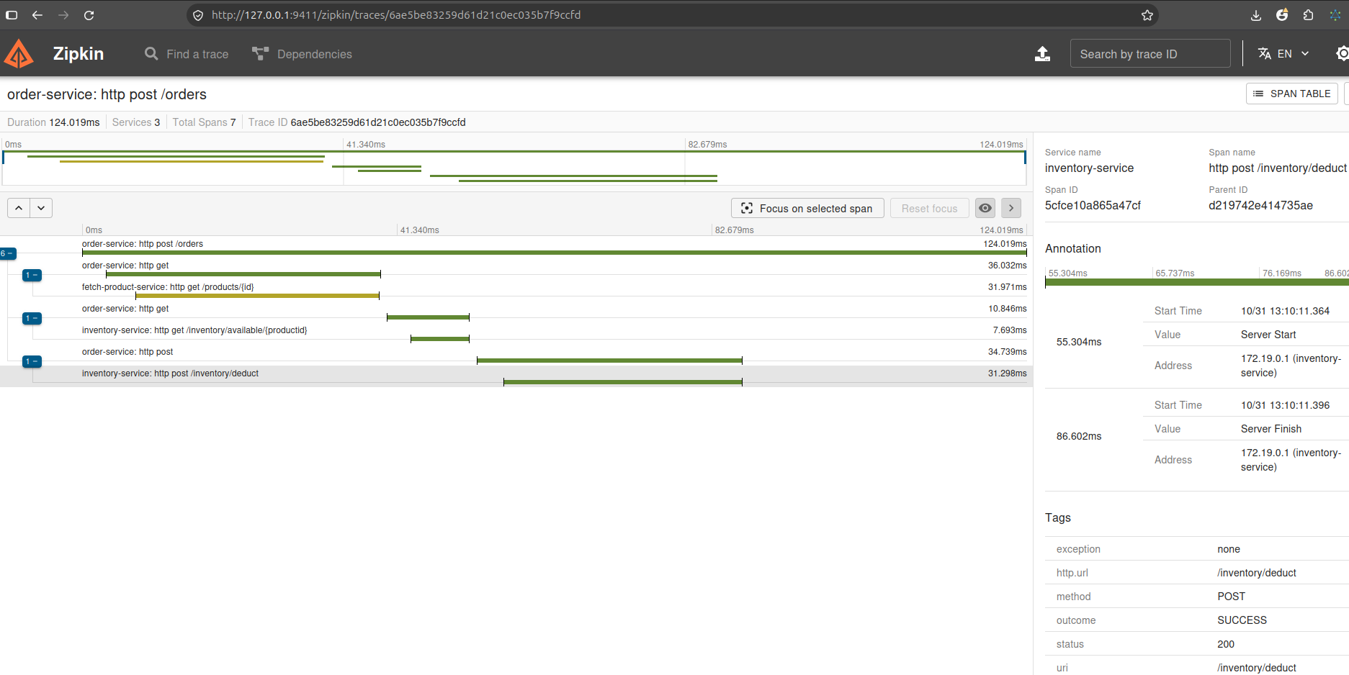
Tracing with Zipkin
Every request gets a Trace ID, and each step through a service is recorded as a span.
Step | Time
Place order (total) | 124 ms
Get product price | 32 ms
Check stock | 8 ms
Deduct stock | 31 ms
See the full path of a request
Find which service is slow
Find where an error happened
POST /orders: 3 services, 7 spans, 124 ms

Slide 14
Lessons Learnt
1
2
3
Small services are easier to build, test and change.
Eureka and the gateway remove fixed addresses, so services can move or scale easily.
Resilience patterns and Zipkin tracing keep the system running and show quickly where problems are.

Slide 15

How This Helps
Separate systems
Stock, procurement and service requests can be built as separate services.
Easier monitoring
One gateway with logging, plus Zipkin tracing, makes troubleshooting easier.
Always available
Services stay available during high traffic or partial failures.

Slide 16
Thank You
Questions?

