Slide 1

-접속 URL: https://maseratihrtg-qz.github.io/pad

Slide 2
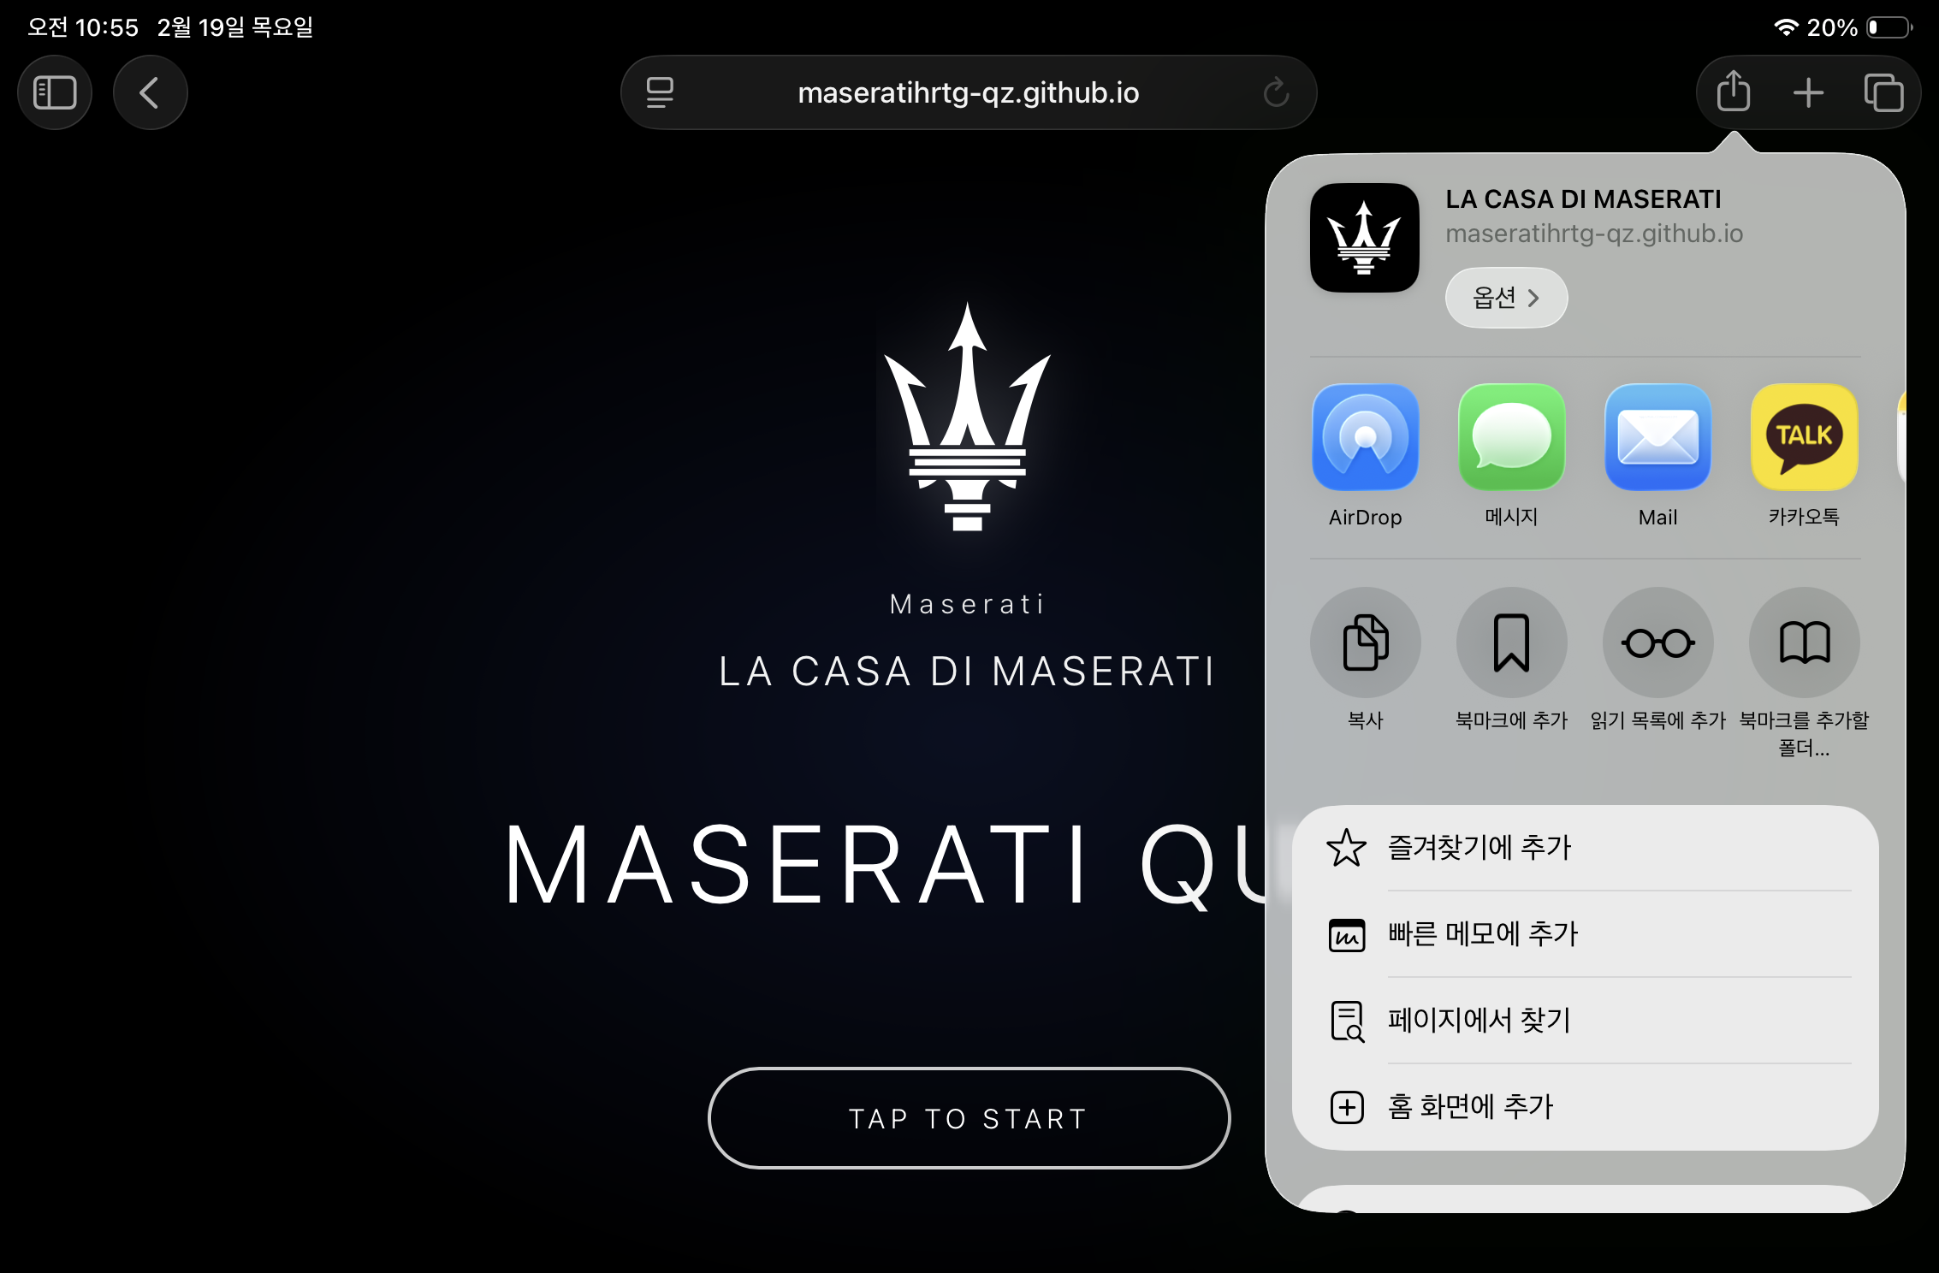

Slide 3
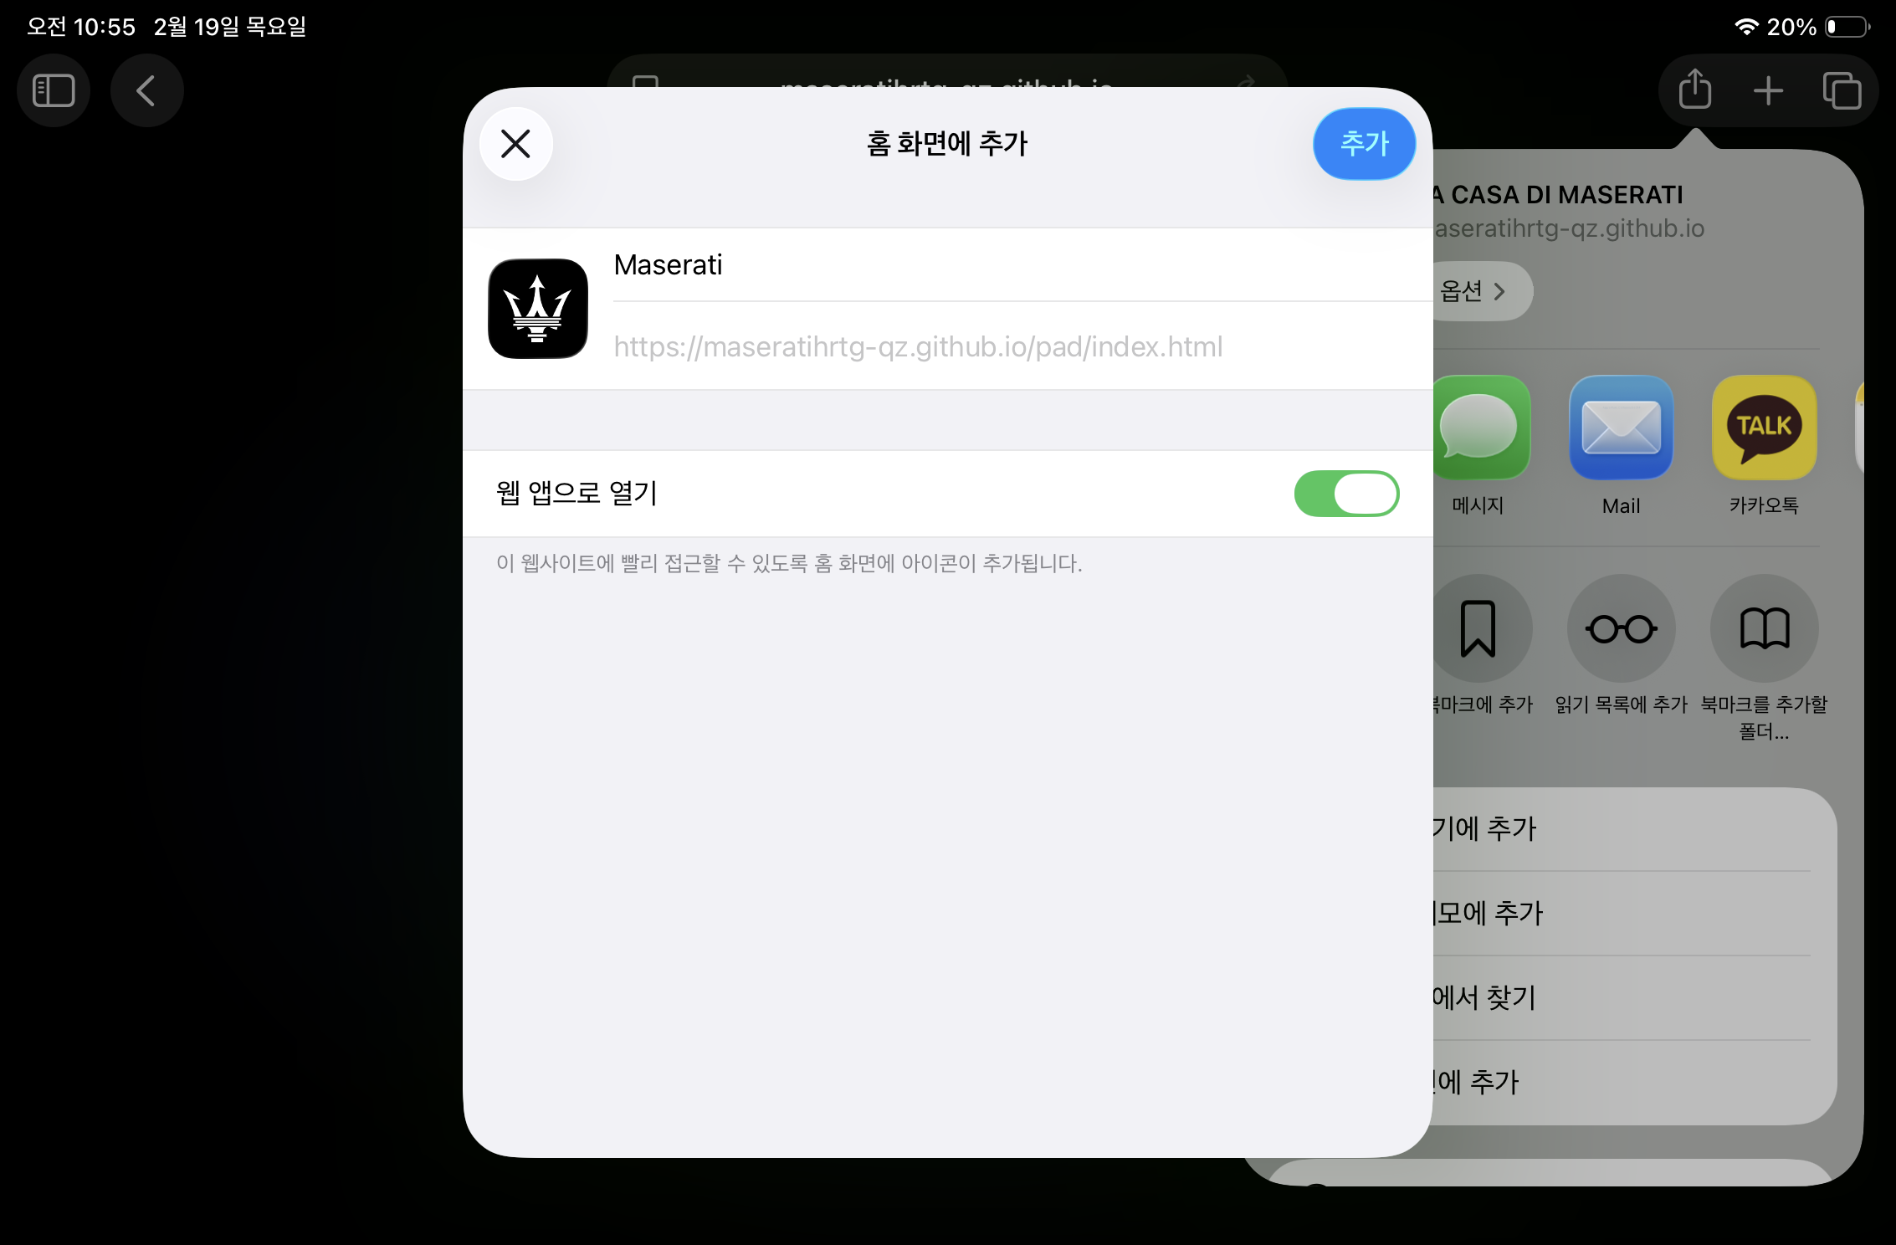

Slide 4
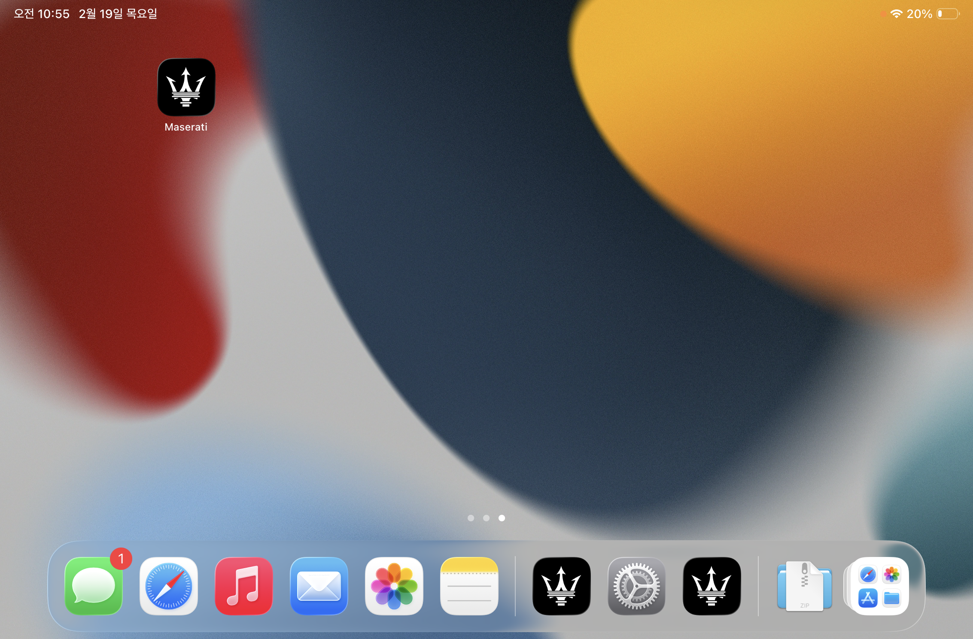

Slide 5


Slide 6
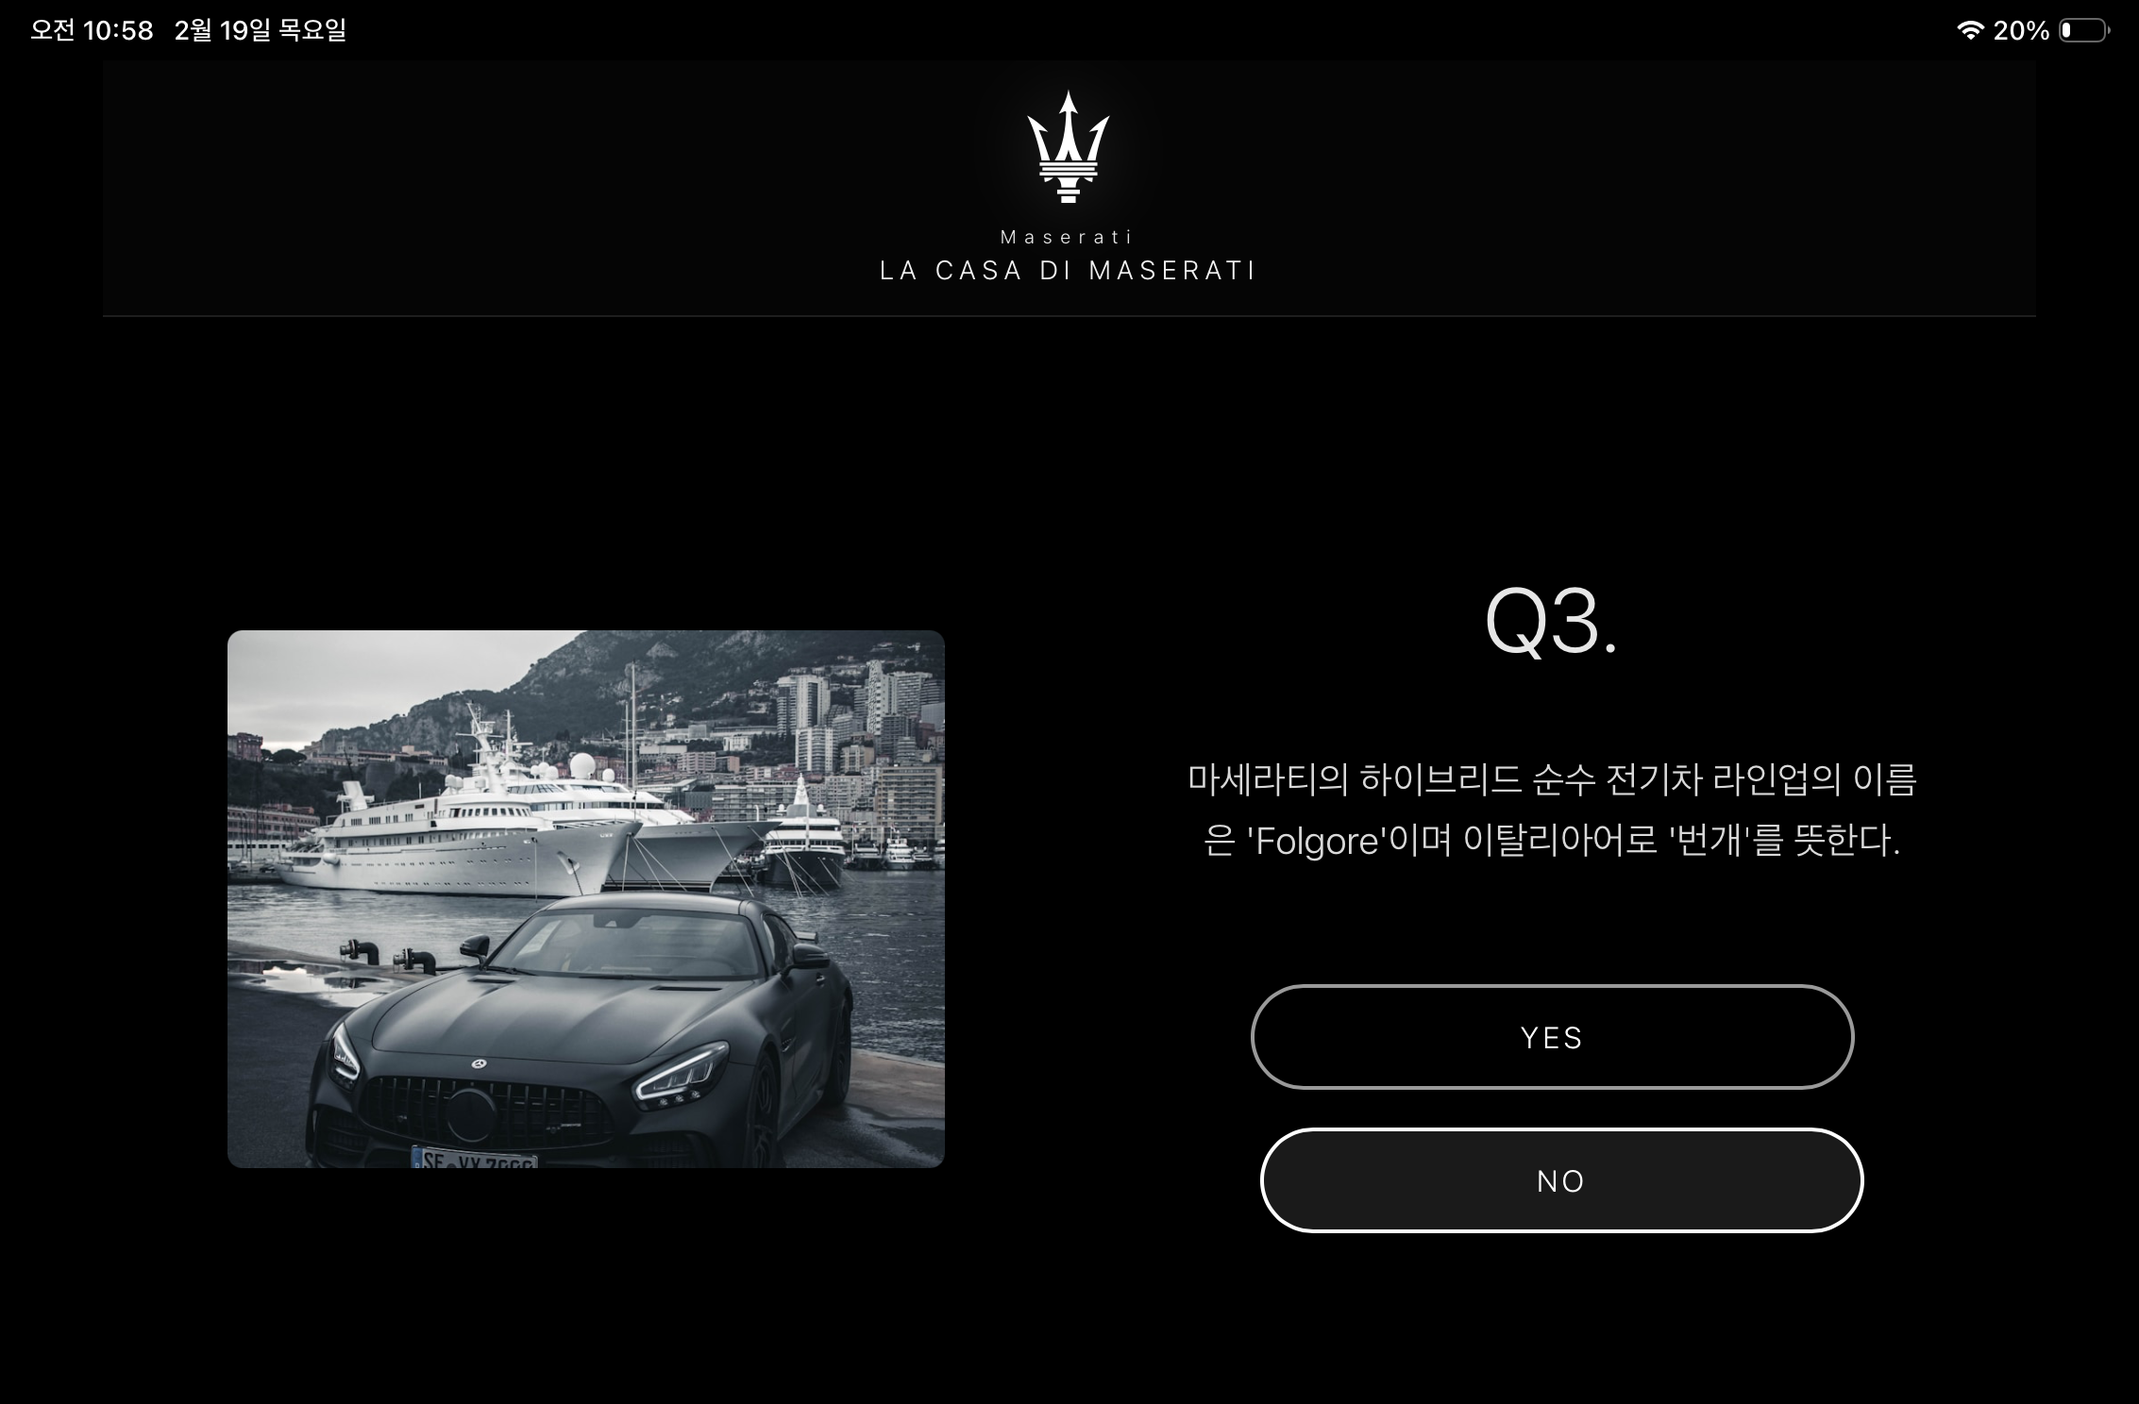

Slide 7


