Slide 1
CodersTrust
Business Skill Course for the Freelancer
DA1 - Grp 2 - Marco Lai Hao Jin, Mathias Hyttel Jørgensen, Mathias Vedsø Vestergaard, Muslim Zaurbekov & Oliver Williams

Slide 2
Business course - Skills
Requirements:
Basic excel skills
Basic Danish comprehension
What to expect to learn:
Make a budget
To price services
zero-based budgeting
Negotiations strategies
Project management theories

Slide 3
Project Management
Team Development
Make use of loyal team members
Constructive discussions within the team
Project Planning
Day-to-day goals
Adjustments along the way
Resources and Budgeting
Make use of the resources and budget made available
Satisfied stakeholders can result in a bigger budget
Negotiation
Harvard University - Four negotiation strategies
Make advantage of the negotiation dynamic

Slide 4
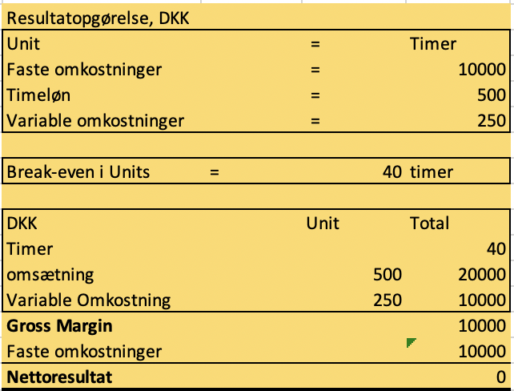
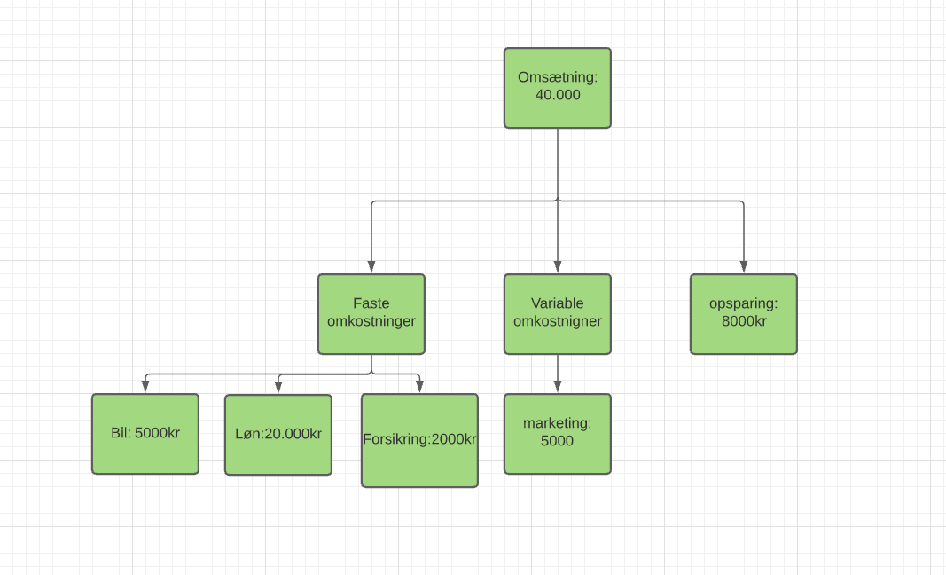
Budgeting
Revenue
Profit margin
Cost
Fixed Cost
Variable Cost
Break-even
Contribution margin → calculation of service Break-even
Pricing of service
Account for revenue, cost and break-even
Zero-based budgeting
Flexible Budgeting
Easy for freelancers

