Slide 1




Room Occupancy Estimation
A data-driven approach using Environmental Sensor Data

Slide 2
Introduction:
Occupancy estimation in smart buildings is a growing field within data science, combining sustainability goals with advancements in sensor-based data analytics to optimize resource use dynamically. This project applies machine learning to predict occupancy based on ambient sensor data, demonstrating both the technological potential and environmental benefits.
Problem Statement:
Efficient building management requires real-time occupancy estimation to reduce energy waste and ensure occupant comfort.
Traditional systems lack adaptability and often rely on simplistic motion-based detections, which can lead to inefficiencies.

Slide 3
PROJECT OBJECTIVES
This study not only tackles a practical issue in smart building technology but also contributes to sustainable practices by minimizing unnecessary energy usage.
To develop a machine learning model that accurately predicts room occupancy using sensor data, allowing buildings to adjust resources dynamically.
Collect and preprocess environmental sensor data linked to occupancy.
Train and evaluate several machine learning models.
Identify the most accurate model for potential real-world application.

Slide 4
Key Features
Features | Description
Temperature Sensors (S1_Temp, S2_Temp, S3_Temp, S4_Temp) | Four temperature sensors capture indoor thermal conditions.
Light Sensors (S1_Light, S2_Light, S3_Light, S4_Light) | Light sensors measure the intensity of light in the room, which can change due to human activity or natural light fluctuations.
Sound Sensors (S1_Sound, S2_Sound, S3_Sound, S4_Sound) | Sound sensors capture audio levels, which can be indicative of occupancy since higher sound levels often correspond to active human presence.
CO2 Levels (S5_CO2, S5_CO2_Slope) | The CO2 concentration and its slope indicate changes in air quality.
Motion Detection (S6_PIR, S7_PIR) | Passive Infrared (PIR) sensors detect motion within the room.
Room Occupancy Count (Target Variable) | The target variable, represents the number of occupants in the room, with values ranging from to a maximum observed count.
Dataset Description
Data Source and Overview:
Sourced from a controlled environment with multiple environmental sensors capturing temperature, light intensity, sound, and CO₂ levels, as well as PIR motion sensors.
Size and Composition:
Contains 10,129 observations with a broad range of environmental factors collected at regular intervals.
02 - WEBSITE
03 - SOCIAL MEDIA

Slide 5
DATA PREPROCESSING
A meticulous preprocessing pipeline is critical to ensuring that the dataset is not only clean but also meaningful for modeling. Class balancing and feature engineering steps add layers of contextual relevance, ultimately boosting model accuracy.
Missing Values
Feature Engineering
Merged separate date and time fields to create a continuous timestamp, which enables more granular temporal analysis.
Extracted hour and day-of-week, enabling the model to learn daily and weekly occupancy patterns.
Removed incomplete entries, ensuring that model performance is not compromised by null values.
OCT
MV
FE
JAN
CB
Class Balancing
(SMOTE) was used to balance the occupancy classes, which helps prevent the model from overfitting to the majority class (unoccupied state). This step was crucial to give all occupancy levels a fair representation, enhancing the model's sensitivity to occupied states

Slide 6
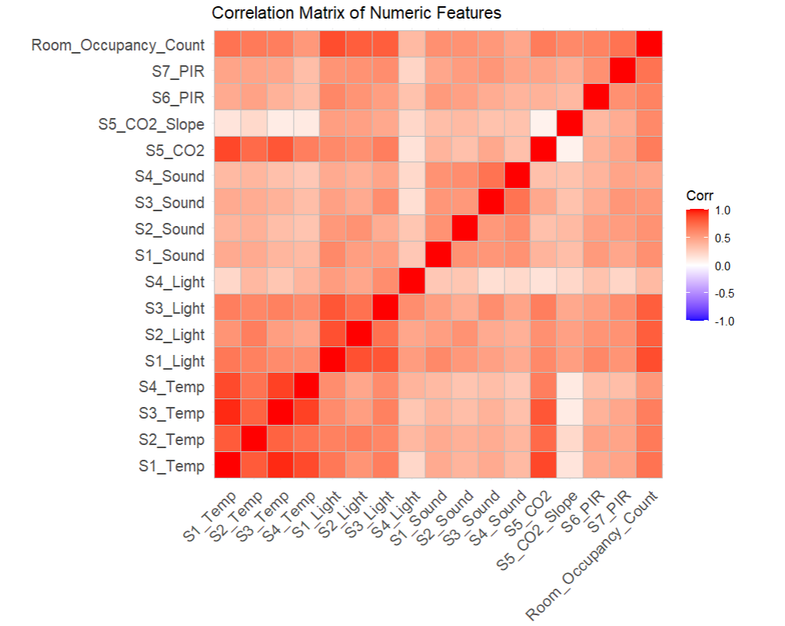
Exploratory Data Analysis
The EDA results validate the dataset’s suitability for occupancy prediction, confirming the relevance of each selected feature. Insights gained here guided subsequent modeling choices, such as focusing on features with strong correlations and daily/weekly patterns.
Correlation Analysis
It Illustrates relationships between variables, highlighting strong correlations with occupancy. Strong positive correlations between occupancy and certain features, such as CO₂ levels and light intensity, provided insights into which factors are more influential.
This correlation analysis informed feature selection, reinforcing the role of specific sensors in occupancy prediction.

Slide 7
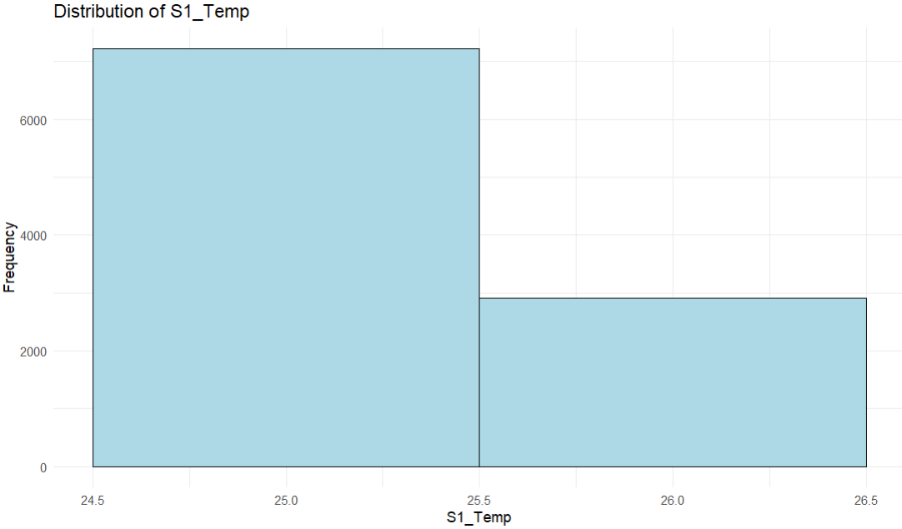
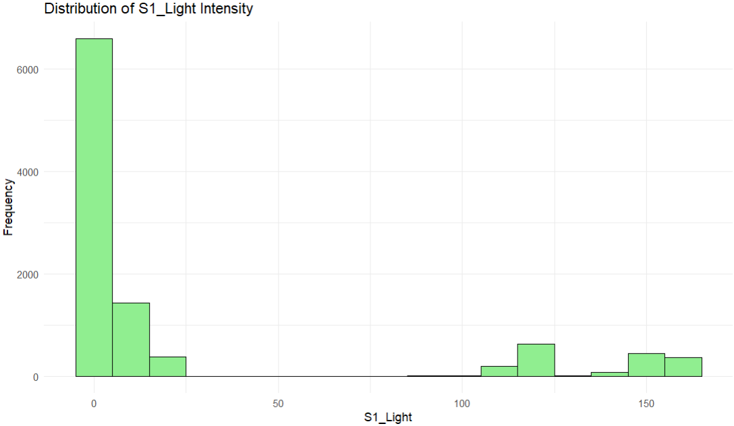
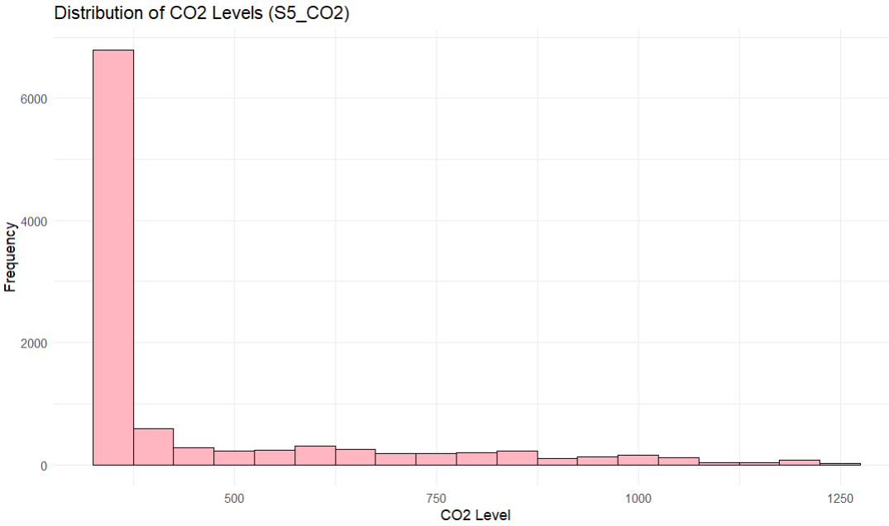
Exploratory Data Analysis
Key Features Trends
Histograms and density plots were visualized for temperature, light, and CO₂ levels, showing distinct distributions based on occupancy.
Occupancy peaks during standard working hours, aligning with business day activity patterns.
Weekends generally show lower occupancy, justifying the use of weekday indicators in feature engineering.

Slide 8
Feature Engineering and Selection
Engineered Features:
Hour of Day: Essential for detecting occupancy trends within a 24-hour cycle, capturing predictable variations in room use.
Light Intensity Levels: Binned into low, medium, and high categories to simplify modeling and reflect typical lighting states.
Weekend Indicator: Identifies weekend occupancy, allowing the model to differentiate between weekday and weekend patterns.
Feature Selection:
Retained only those features with high relevance and correlation to occupancy after EDA, including temperature, light, and CO₂ levels. The outcome is a refined dataset that captures occupancy patterns effectively, with engineered features enhancing the model’s contextual understanding.
The transformed features allow the model to benefit from contextual temporal information and sensor-level distinctions, leading to better classification performance and generalizability.

Slide 9
MODELS SELECTION
Poisson Regression:
Chosen as a linear baseline model, providing insights into the linearity of occupancy patterns.
Decision Tree:
Selected for its interpretability; it creates a clear structure for understanding feature importance.
The selection of models reflects a balance between interpretability, accuracy, and robustness, giving a comprehensive view of how different algorithmic approaches handle occupancy data.
Random Forest:
Ensemble of decision trees that captures complex feature interactions, making it resilient to noise and variance
Gradient Boosting Machine (GBM): Builds on weak models by sequentially correcting errors, providing a refined approach to multi-class classification.
Support Vector Machine (SVM):
Utilizes kernel functions to separate complex, non-linear patterns, potentially beneficial for high-dimensional data like occupancy prediction

Slide 10
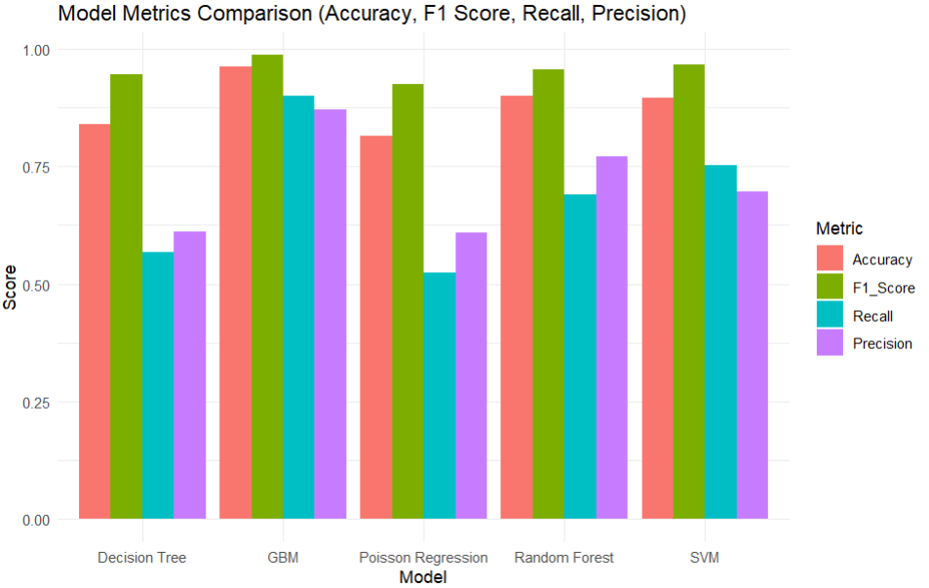
MODELS EVALUATION
Evaluation Metrics:
Accuracy: Measures overall correctness in predictions.
Precision: Important to avoid false positive occupancy predictions, conserving energy resources.
Recall: Measures the model’s ability to correctly identify all occupied states, crucial for comfort and energy efficiency.
F1-Score: Combines precision and recall, providing a balanced measure of each model’s reliability.
RF
RANDOM FOREST
GBM
GRADIENT BOOSTING MACHINE
High accuracy (90.01%) but limited in distinguishing high-occupancy cases.
Achieved the highest accuracy at 96.19%, with well-balanced recall and precision. The model evaluation confirms that GBM provides the best balance of high accuracy and recall, making it the most suitable for dynamic occupancy estimation in real-world settings.

Slide 11
MODELS PERFORMANCE COMPARISON
Gradient Boosting Machine
SVM and DECISION TREES
Model | Accuracy | F1 Score | Recall | Precision
Poisson Regression | 0.816 | 0.926 | 0.523 | 0.609
Decision Tree | 0.839 | 0.947 | 0.568 | 0.612
Random Forest | 0.900 | 0.957 | 0.691 | 0.772
GBM | 0.962 | 0.987 | 0.901 | 0.872
SVM | 0.896 | 0.967 | 0.753 | 0.697
Top-performing model, demonstrating robustness across all metrics and excelling in recall and precision.
Moderate accuracy, though lacking in recall and precision compared to GBM and Random Forest.
RANDOM FOREST
POISSON REGRESSION
Strong alternative with high accuracy but less precise than GBM in multi-class discrimination.
Effective baseline but insufficient for nuanced occupancy distinctions.
GBM’s high precision and recall across occupancy levels indicate its practical applicability for smart building systems, while Random Forest remains a reliable choice when computational resources are limited.

Slide 12
KEY FINDINGS
Top-Performing Model:
GBM with 96.19% accuracy, showing resilience in predicting occupancy accurately across all states.
Strengths of GBM:
Robust handling of complex interactions between features.
High precision across all occupancy classes, minimizing false positives.
Comparative Insights:
Random Forest offers strong performance but falls short of GBM’s consistency in recall.
SVM and Decision Tree offer simpler alternatives but struggle with multi-class prediction accuracy.
GBM’s balanced accuracy, precision, and recall make it highly applicable for smart building systems where resource optimization is critical.

Slide 13
CONCLUSION
Summary of Findings:
The study demonstrates the potential of data-driven models to transform smart building management, highlighting how occupancy estimation supports both environmental goals and enhanced user experiences. Machine learning models, particularly GBM, can effectively predict occupancy using environmental sensor data. The inclusion of temporal features and occupancy indicators enhances prediction accuracy.
Practical Implications:
This model can help dynamically adjust building resources based on occupancy, such as HVAC and lighting, to improve sustainability and comfort.
Future Work:
Incorporate additional environmental factors (e.g., humidity) for even greater accuracy.
Test in a live smart building environment to validate model efficiency and adaptability.
.

Slide 14
REFERENCES
Candanedo, L. M., Feldheim, V., & Deramaix, D. (2017). "Data driven prediction models of energy use of appliances in a low-energy house," Energy and Buildings, vol. 140, pp. 81-97.
Ianniciello, M., Mourad-Chehade, F., & Stolf, P. (2021). "Occupancy detection of buildings and rooms: A comparative survey of machine learning-based methods," Journal of Building Performance, vol. 12, pp. 130-150.
Chatterjee, S., Sen, S., & Ghosh, D. (2019). "Smart occupancy detection systems and their applications: A review," IEEE Sensors Journal, vol. 19, no. 14, pp. 5151-5162.
Breiman, L. (2001). "Random forests," Machine Learning, vol. 45, no. 1, pp. 5-32.
Friedman, J. H. (2002). "Stochastic gradient boosting," Computational Statistics & Data Analysis, vol. 38, no. 4, pp. 367-378.

Slide 15
THANK YOU!

